Slide 1
Spring & Spring Boot

Slide 2
What is Spring?
Spring is a lightweight and comprehensive framework for building java enterprise-level applications.
Spring was created by Rod Johnson in 2002 as an alternative to the heavyweight XML-centric J2EE
The core components of the Spring Framework include the IoC container, dependency injection, aspect-oriented programming (AOP), data access, transaction management etc.
It’s a flexibile framework, being suitable for a large range of applications, from small microservices to large-scale enterprise systems

Slide 3
Spring – Key Features
Inversion of Control (IOC) Container
Dependency Injection (DI)
Aspect-Oriented Programming (AOP)
Spring MVC (web dev)
Transaction Management (data layer)
Spring Security (authentication and authorization)
Spring Boot (rapid application development)
Testing Support

Slide 4
Inversion of Control (IoC)
Design principle where the control of object creation and lifecycle is inverted or delegated to an external container or framework
In traditional programming, the application code is responsible for creating and managing objects, resulting in tight coupling and decreased flexibility
IoC shifts the responsibility of object creation and management to a container or framework, promoting loose coupling and modular design
Removes dependency on concrete implementations and allows dependencies to be injected at runtime
IoC facilitates modular design by separating the creation and configuration of objects, making it easier to replace or extend individual components

Slide 5
Dependency injection (DI)
Is a design pattern and key component of the IoC principle
DI involves injecting dependencies into a component from an external source, rather than having the component create or manage its dependencies internally
In Spring, DI is achieved through multiple mechanisms like constructor injection, setter injection and field injection
Promotes loose coupling between components by removing direct dependencies on concrete implementations. Components only depend on abstractions, making them more flexible and reusable
Spring supports both XML-based and annotation-based configuration for defining beans and their dependencies

Slide 6
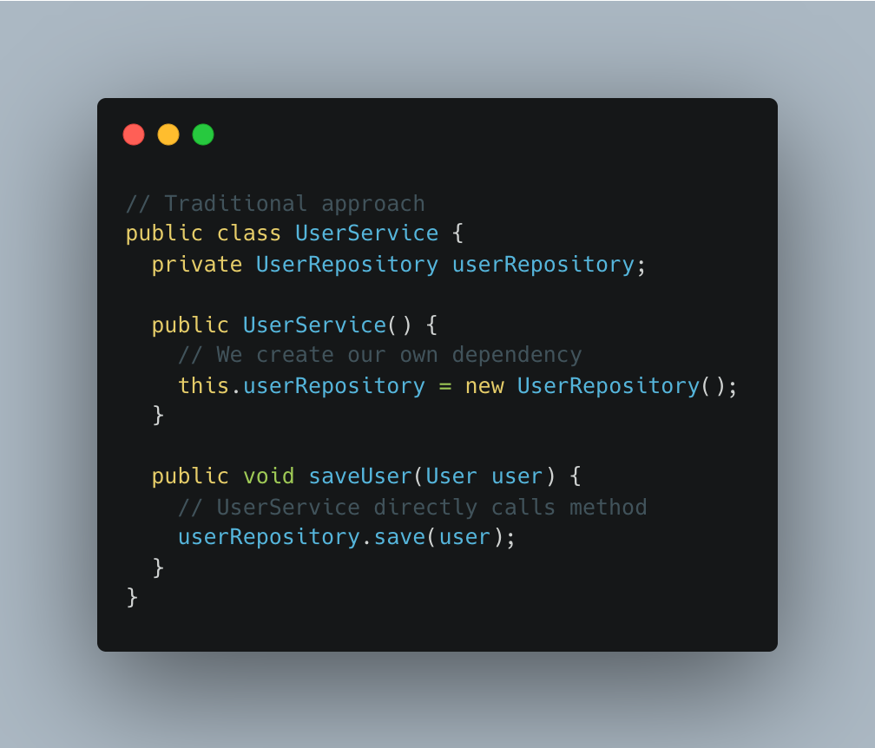
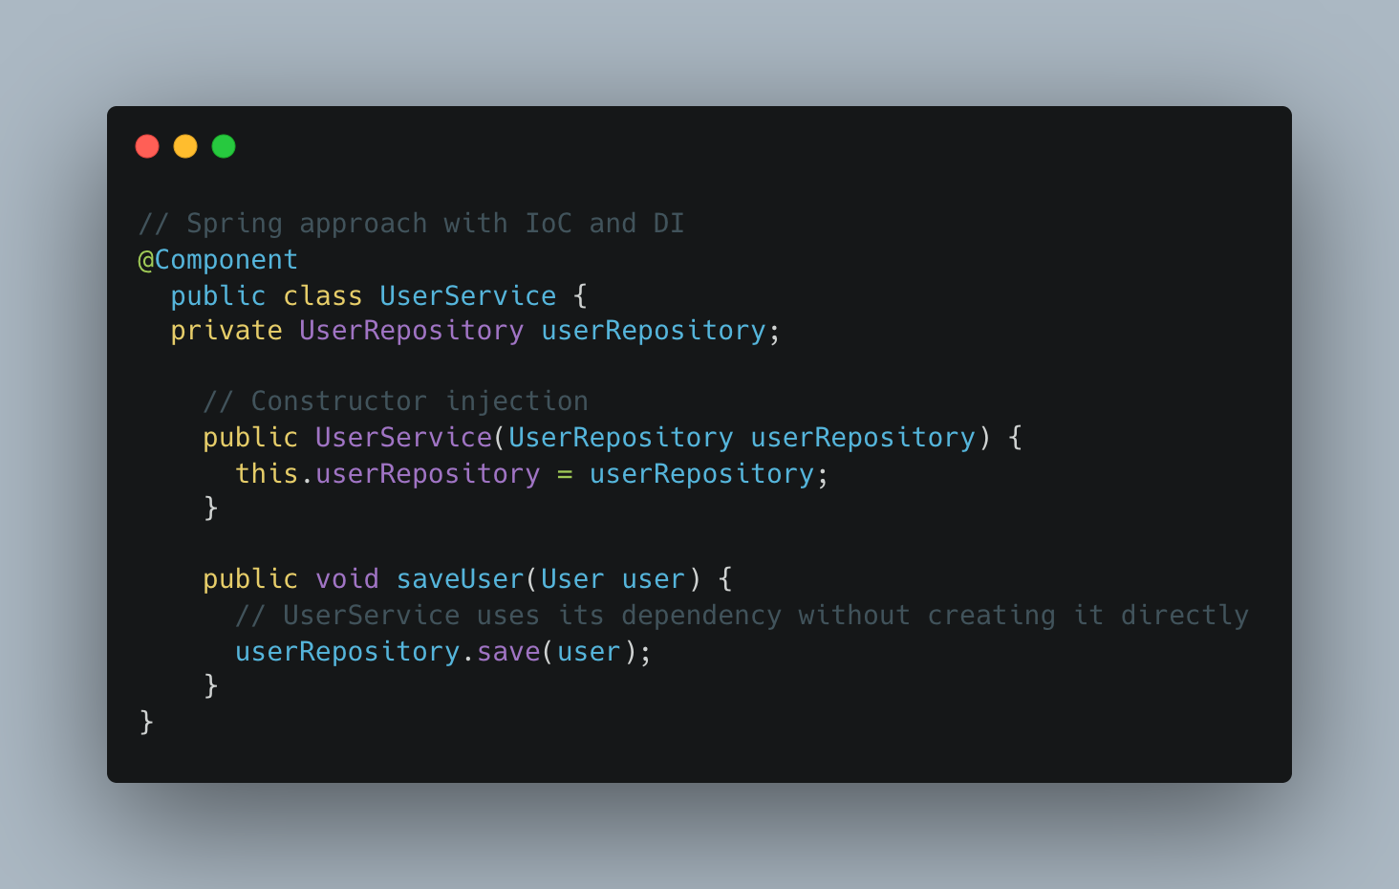
Example Traditional vs IoC
In traditional programming approach, the “UserService” class directly creates its own dependency leading to tight coupling between classes
In Spring, the class receive its dependency via constructor injection, promoting loose coupling and making our service more flexible
Also, constructor injection is the preffered method in Spring for injecting dependencies because it ensures the dependencies are provided at object creation time, promoting better encapsulation and immutability.

Slide 7
Common annotations
Annotations | Description
@Component | Indicates that a class is a Spring-managed component, allowing it to be automatically detected and instatiated by the Spring container
@Configuration | Indicates that a class provides bean definitions and configurations to the Spring IoC container. Typically used with @Bean methods
@Bean | Marks a method as a provider of beans to be managed by the Spring IoC container included in a @Configuration class
@Qualifier | Specifies which bean to autowire when multiple beans of the same type are present.
@Value | Injects values from Spring’s environment (such as properties files or system properties) into a bean’s fields or methods.
@Scope | Specifies the scope (e.g. singleton, prototype, request, session) in which a bean should be created and managed by the Spring IoC container
@PostConstruct | An initialization method annotated with @PostConstruct is executed after the dependency is injected and before the bean is brought into service
@PreDestroy | A cleanup method annotated with @PreDestroy is executed just before the bean is removed from the Spring IoC container, allowing for resource cleanup or shutdown tasks

Slide 8
Logging
Logging is an essential aspect of application development, allowing developers to track and analyze the behaviour of their applications
In Spring, logging is typically handled by popular logging frameworks such as Log4j, Logback, Java Util Logging
These frameworks offer features like configurable log levels, output destinations (console, file, database), log rotation and log formatting.
Supports auditing and compliance requriements by capturing user actions, security events and data access activities
Facilitates application monitoring and performance tuning by recording metrics, warning and errors in runtime environments

Slide 9
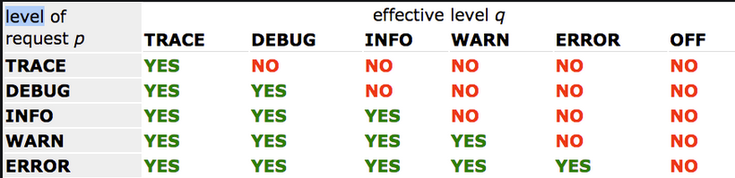
Logging levels

Slide 10
What is Spring Boot?
Spring Boot is a framework that simplifies the process of creating stand-alone, production grade Spring-based applications
It builds on top of the Spring framework and provides a set of conventions and defaults to streamline development (convention over configuration)
Spring boot aims to reduce configuration overhead and improve developer productivity

Slide 11
Key features
Auto-configuration: Spring Boot automatically configures common application components based on the project dependencies and settings, reducing boilerplate code
Starter dependencies: Introduces starter dependencies, which provides pre-configured sets of dependencies for common use cases such as web applications, data access and security
Spring Boot Actuator: Introduces the Actuator, which provides procution-ready features for monitoring, managing and troubleshooting Spring Boot applications.
Enables rapid development of web applications by providing embedded servers like Tomcat, Jetty allowing developers to run applications as standalone JAR files

Slide 12
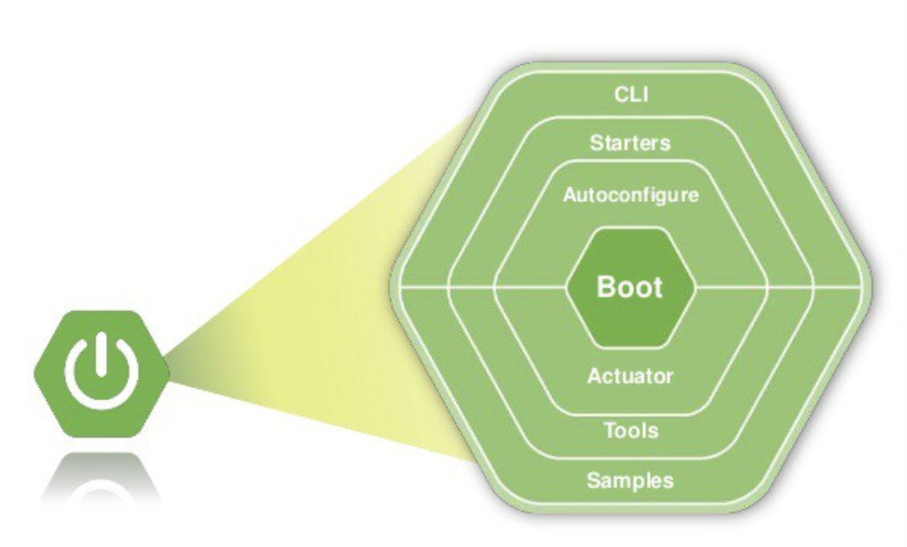
Modules

