Slide 1
REST

Slide 2
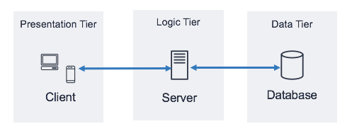
Three-tier architecture

Slide 3
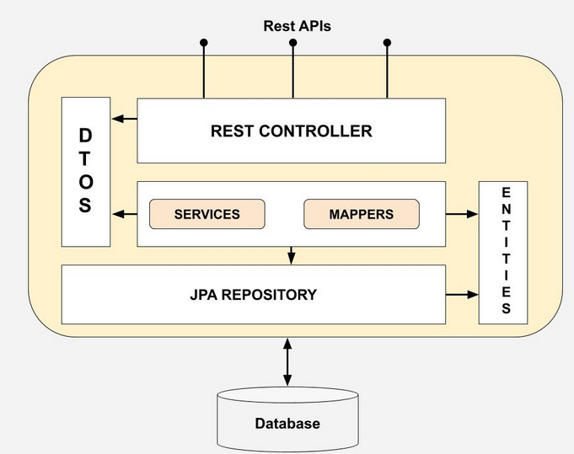
DTO vs DAO

Slide 4
REST (Representational State Transfer)
HTTP – a communcation protocol
API – Application programming interface
REST represents a collection of network architecture principles for API creation and it’s based on HTTP.
It was introduced in the doctoral dissertation of Roy Fielding (One of the authors of the HTTP specification)
Simple
Scaleable
Stateless

Slide 5
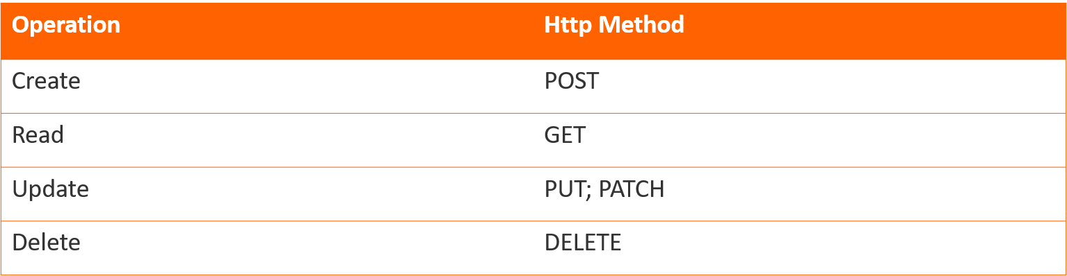
Http methods & CRUD

Slide 6
HTTP Status Codes
1xx – Informational responses. The server is thinking through the request.
2xx – Success. The request was successfully completed.
3xx – Redirection. You got redirected somewhere else.
4xx – Client errors.
5xx – Server errors.

Slide 7
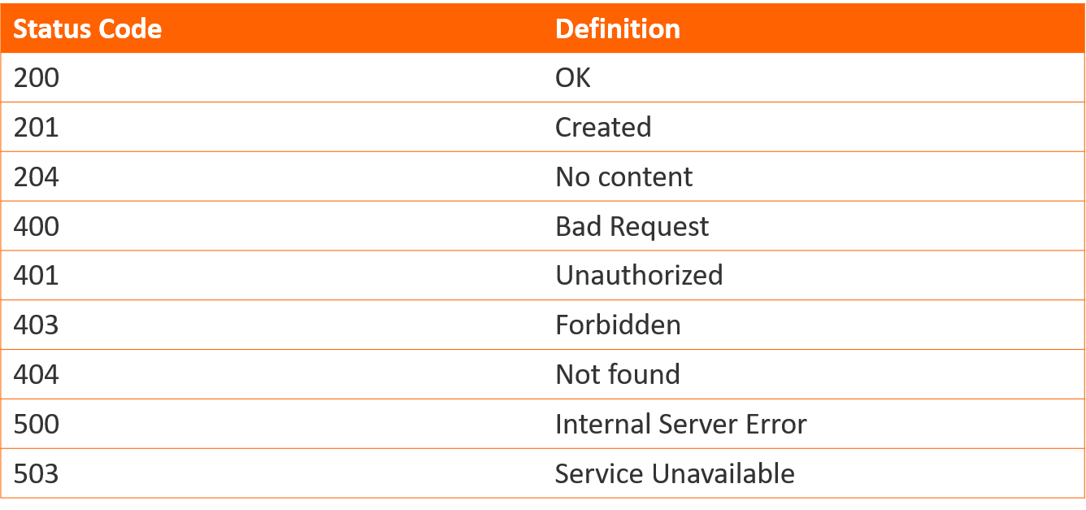
HTTP Status Codes

Slide 8
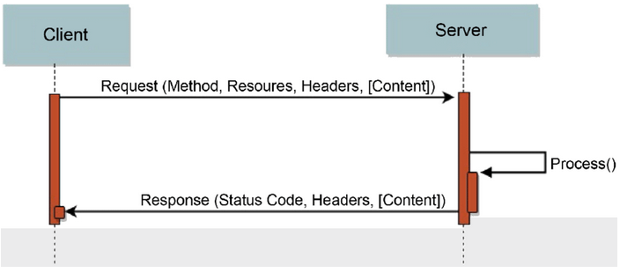
HTTP Request & Response

Slide 9
REST (Representational State Transfer)
Nouns (Resources) unconstrained i.e., http://example.com/employees/12345
REST
Verbs constrained i.e., GET
Representations constrained i.e., XML, JSON

Slide 10
REST (Representational State Transfer)
The key abstraction of information in REST is a resource.
A resource is a conceptual mapping to a set of entities.
They should be nouns.
Examples:
Create a car: POST /cars
Fetch all the cars: GET /cars
Get a specific car: GET /cars/1
Delete a car: DELETE /cars/1

Slide 11
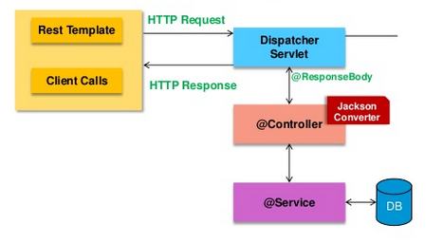
SPRING
11

