Slide 1
Docker Continuous integration Continuous delivery

Slide 2
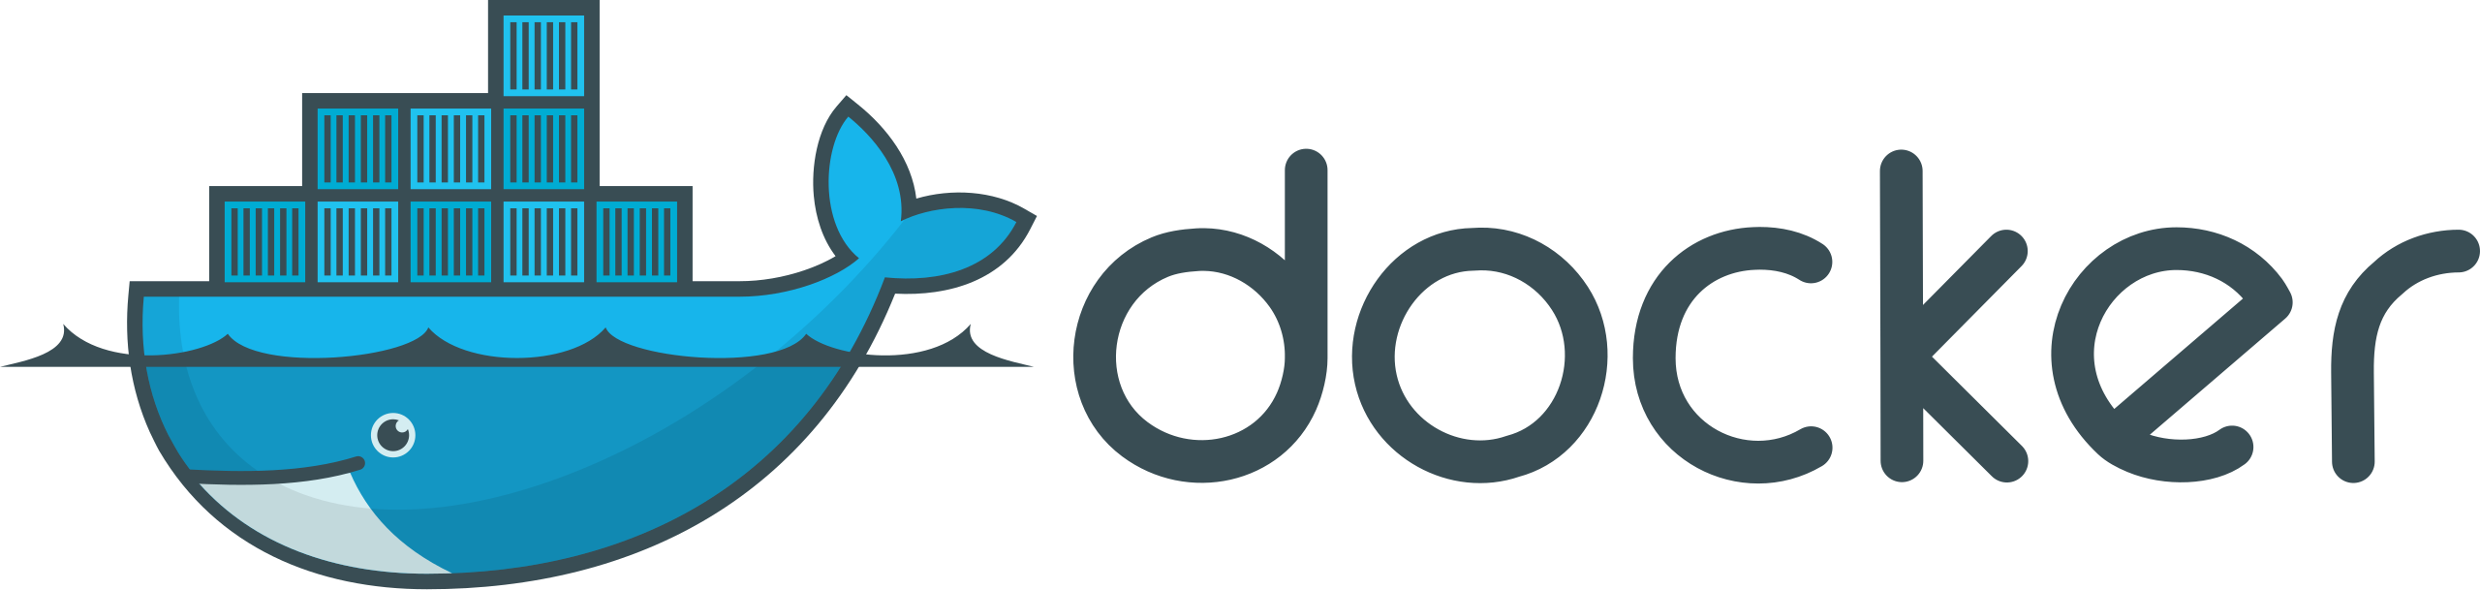
What is docker?
An open-source project that automates the deployment of software applications inside containers by providing an additional layer of abstraction and automation of OS-level virtualization on Linux.
Allows users to package an application with all its dependencies into a standardized unit for software development.
Unlike virtual machines, containers do not have high overhead and hence enable more efficient usage of the underlying system and resources.

Slide 3
Terminology
Images - The blueprints of our application which form the basis of containers
Containers - Created from Docker images and run the actual application
Docker Daemon - The background service running on the host that manages building, running and distributing Docker containers. The daemon is the process that runs in the operating system which clients talk to.
Docker Client - The command line tool that allows the user to interact with the daemon.
Docker Hub - A registry of Docker images. The registry is as a directory of all available Docker images. If required, one can host their own Docker registries and can use them for pulling images.

Slide 4
Docker commands with a basic image
$ docker pull hello-world // fetches the image
$ docker images // see a list with all the images in the system
$ docker run hello-world // runs the container
$ docker ps // shows the running containers
$ docker ps -a // shows all the containers
$ docker stop <container_id> // stops the container
$ docker rm <container_id> // removes the container

Slide 5
MySQL – How to use a container as a database for the application

Slide 6
Docker compose
A tool for defining and running multi-container Docker applications.
It provides a configuration file called docker-compose.yml that can be used to bring up an application and the suite of services it depends on with just one command.
Compose works in all environments: production, staging, development, testing, as well as CI workflows, although Compose is ideal for development and testing environments.
$ docker compose up -d // runs containers in detached mode

Slide 7
Our application – Run the application in a container

Slide 8
CI/CD (Continuous integration / Continuous Delivery)

Slide 9
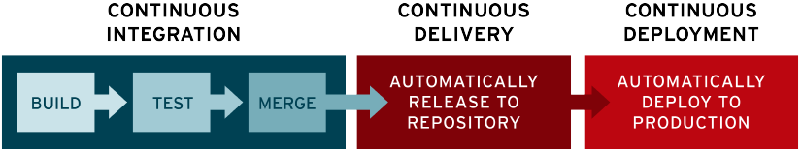
What is CI/CD?
CI/CD is a method to frequently deliver apps to customers by introducing automation into the stages of app development
The main concepts attributed to CI/CD are continuous integration, continuous delivery, and continuous deployment
CI/CD is a solution to the problems integrating new code can cause for development and operations team

Slide 10
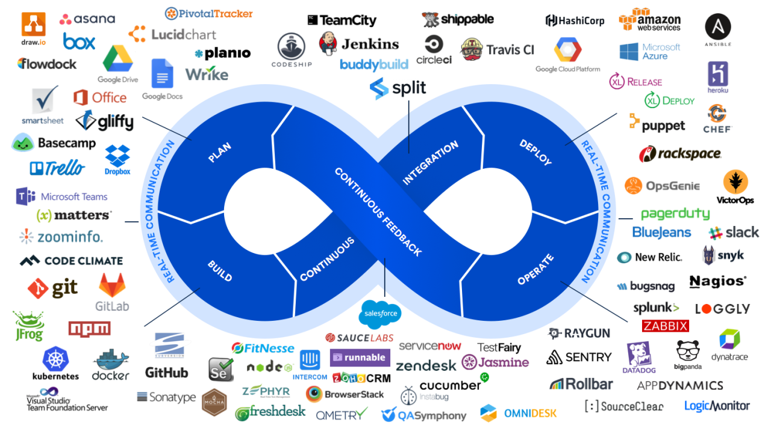

Slide 11
Let’s code

