Slide 1
DevOps
P Mohamed Riyaz

Slide 2
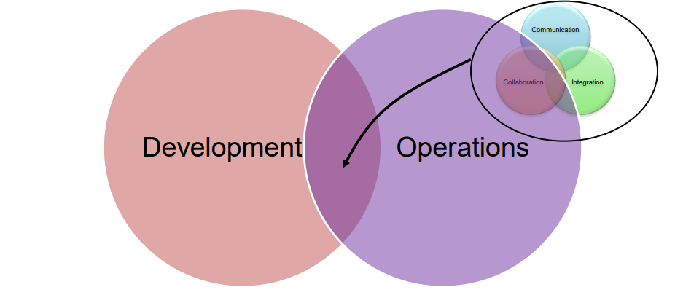
What is DevOps ?
Software Development Practices
Continuous Collaboration Communication
I Built It, I Run It

Slide 3
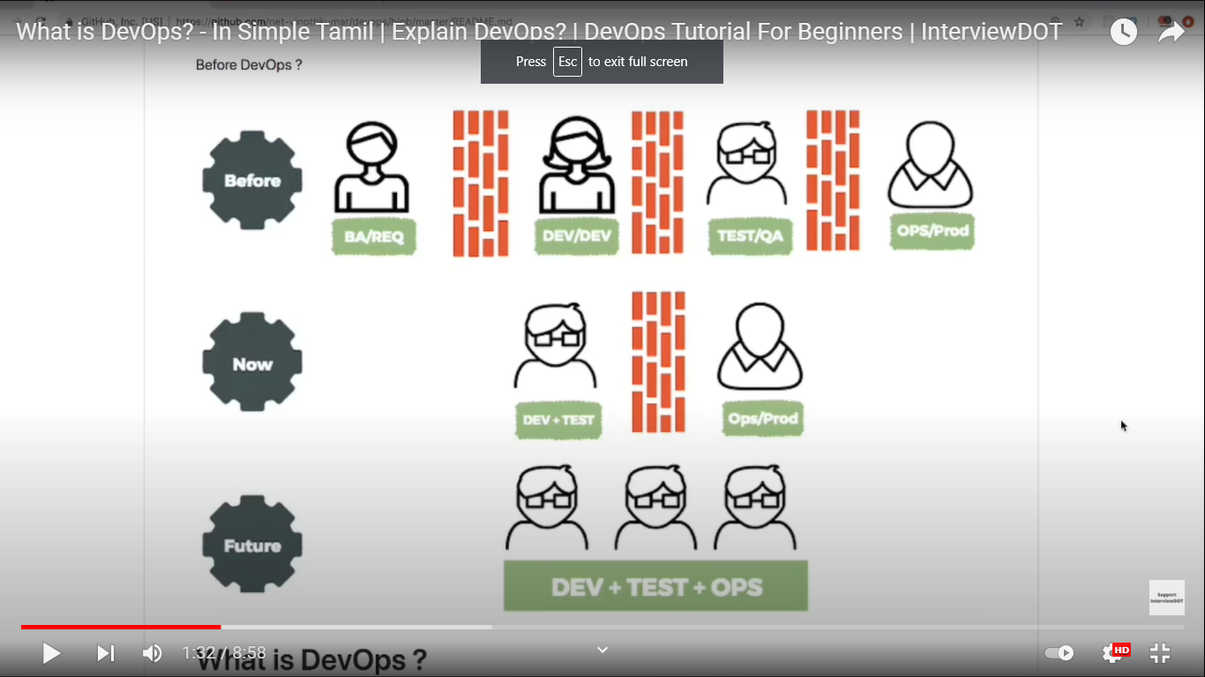
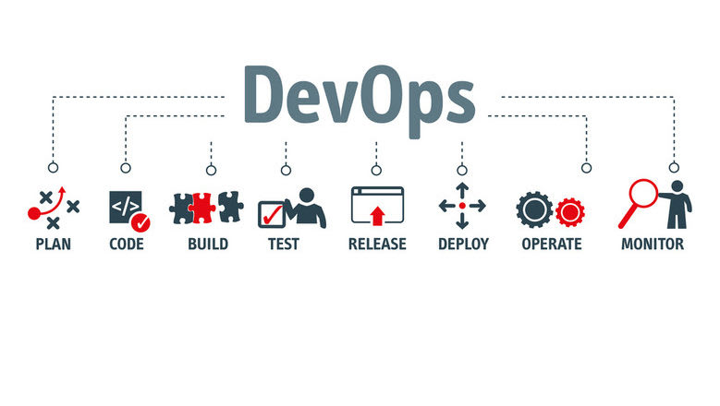
I Build It, I Run It
Waterfall Method
Agile Method

Slide 4
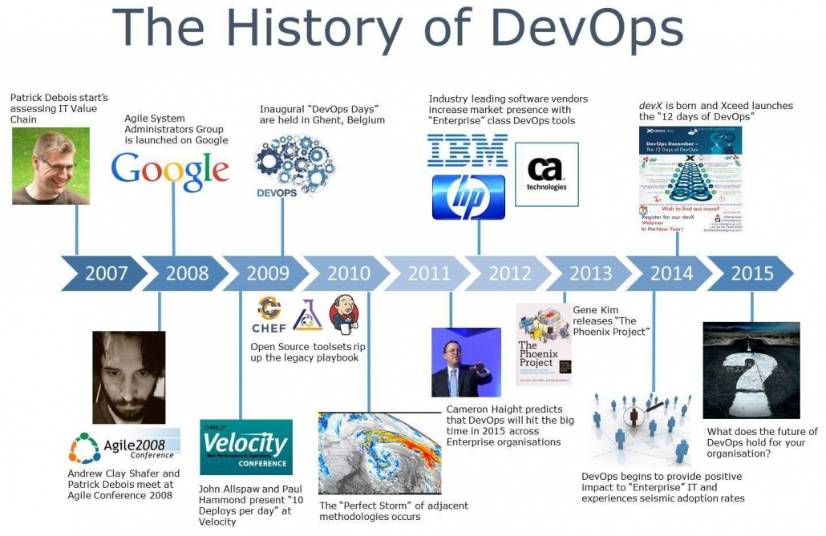
History of DevOps

Slide 5
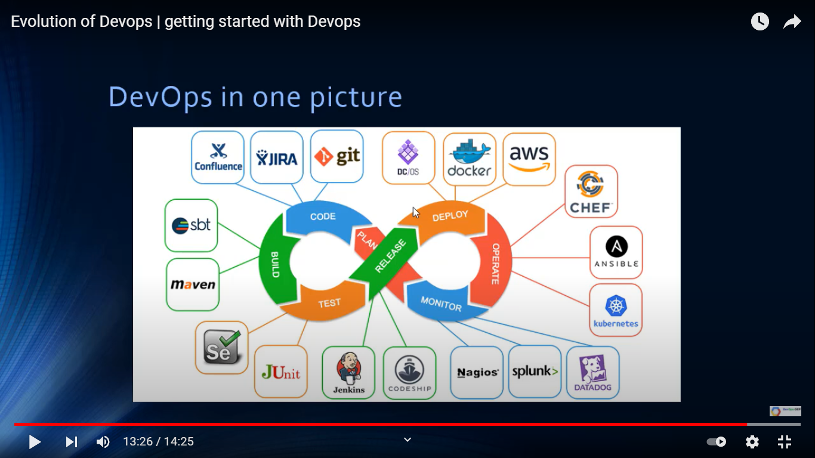
DevOps Life Cycle with Tools

Slide 6
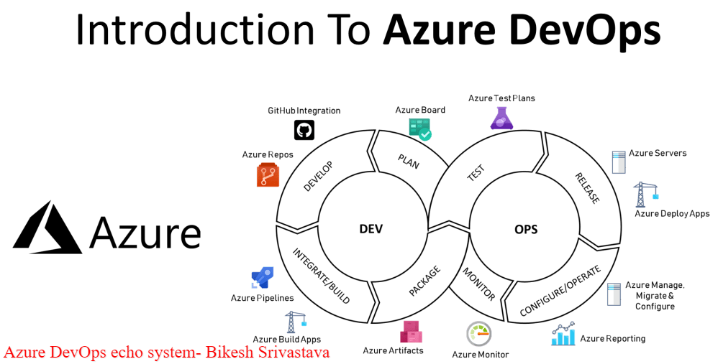
Azure DevOps Tools

Slide 7
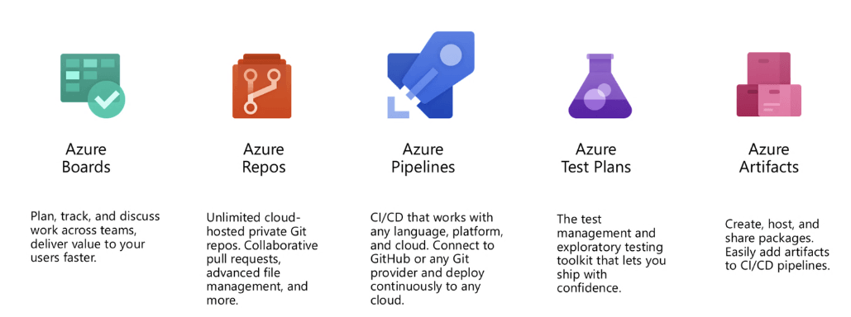
Usage of Azure Tools

Slide 8
The First Approach as a DevOps Engineer ?
First approach that I will take a DevOps
engineer in a project where there is no DevOps
- Understand the Build Phase and Automate the process using DevOps tools

Slide 9
Thank You ...
P Mohamed Riyaz

