Slide 1


Machine Learning approach in 5G network energy consumption prediction
Krzysiek Pawłowski
Aleksander Samek
Witold Pietroń

Slide 2
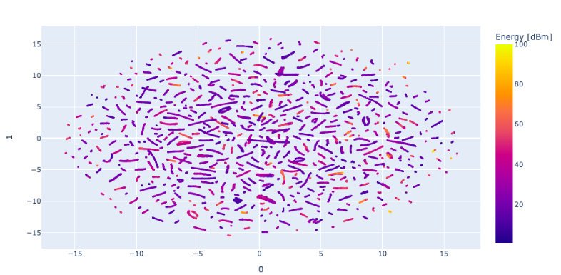
Data mining

Slide 3
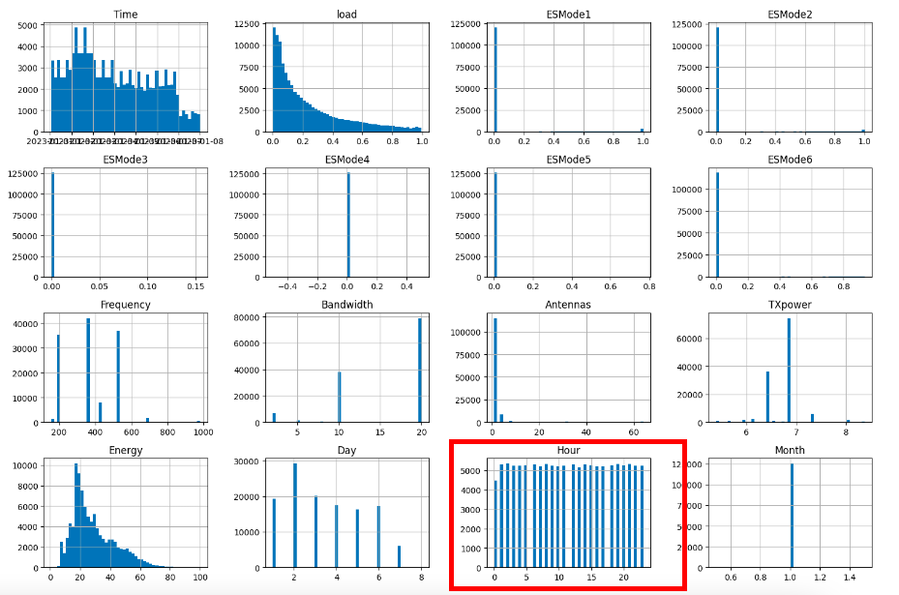
Histograms of the training data variables

Slide 4
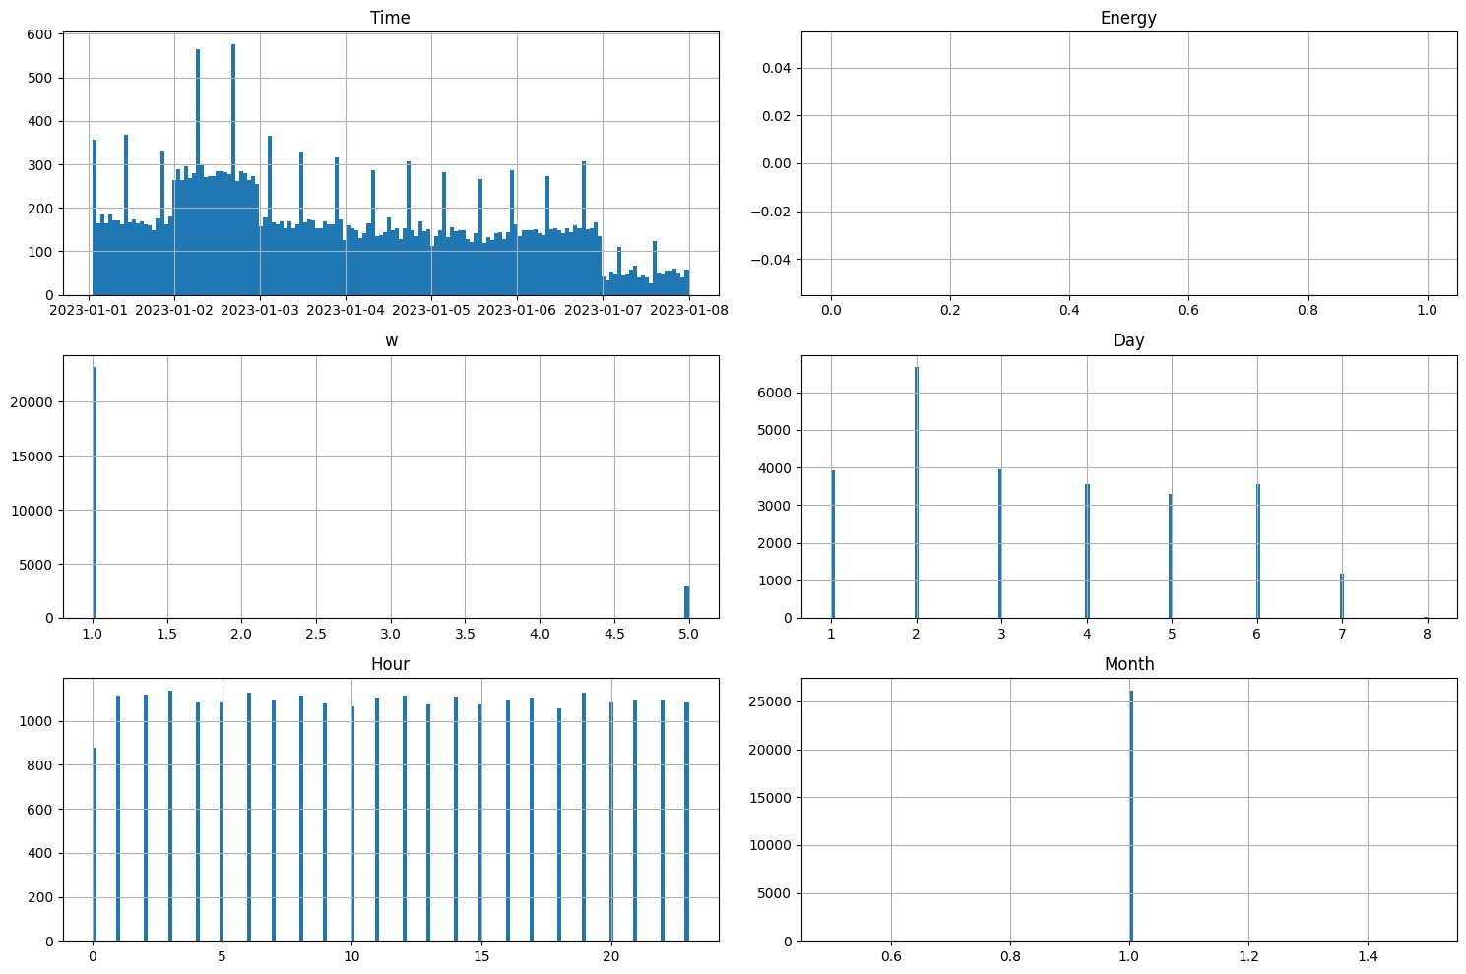
Histograms of data in prediction file

Slide 5
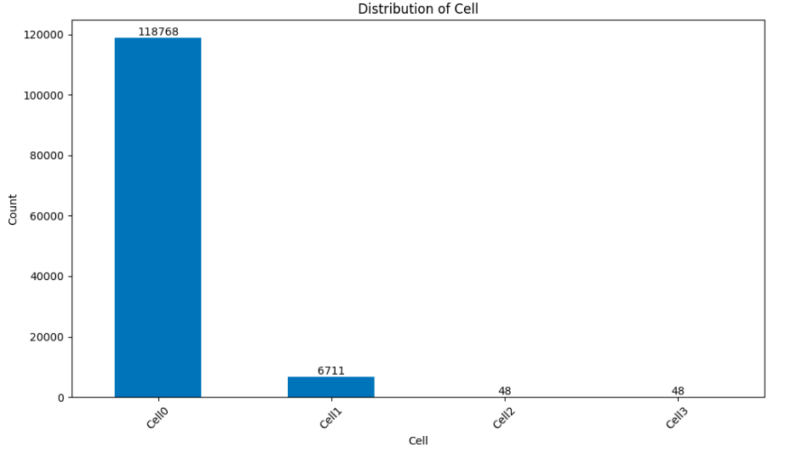
Distribution of cell data in training data
To address imbalance in Cell’s data, separate neural networks were implemented

Slide 6
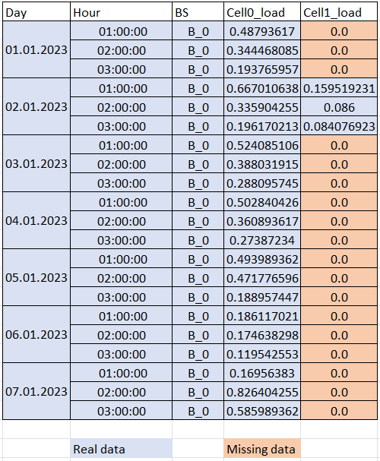
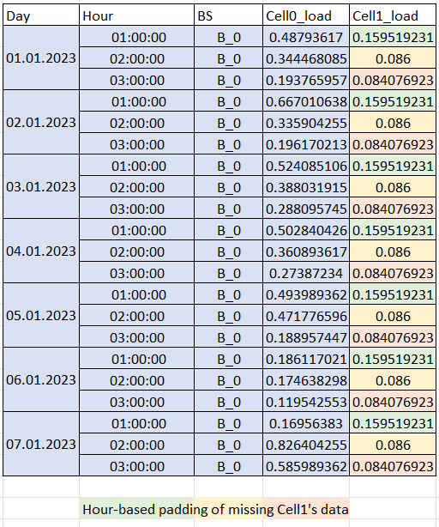
Padding-logic example

Slide 7
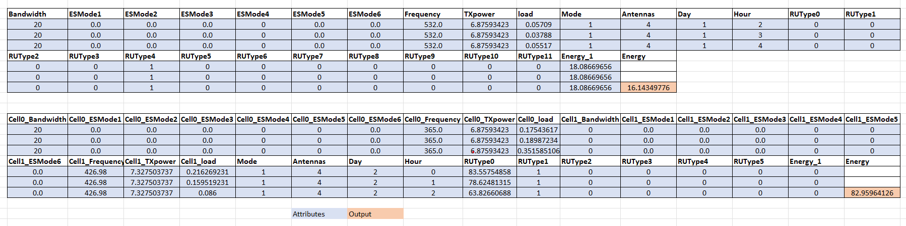
Input vector

Slide 8
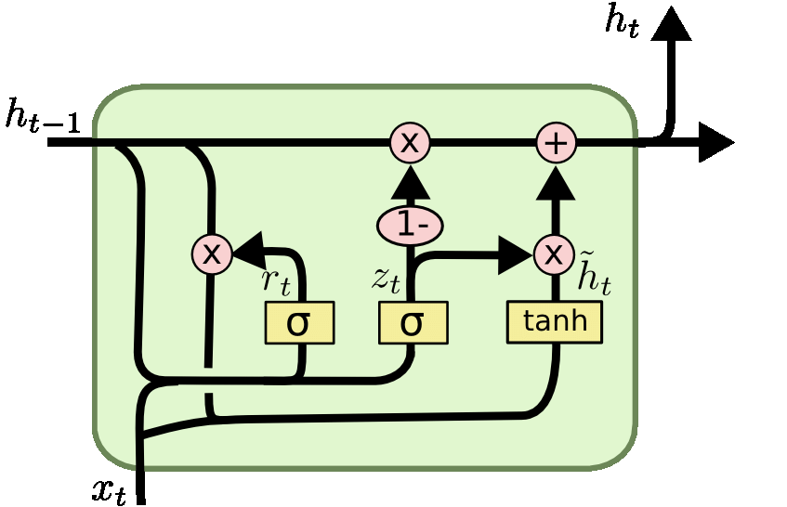
Model
Predictions made by static model where included in final GRU dataset for better generalization

Slide 9
Thank you!

