Slide 1

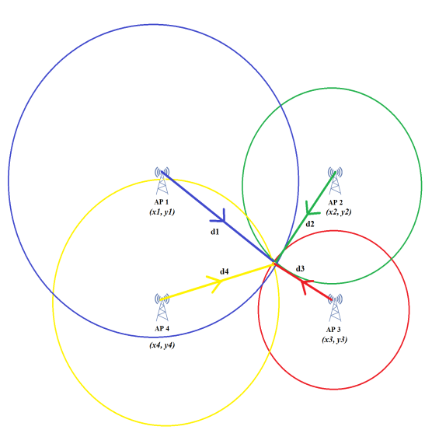

ITU AI/ML in 5G Challenge – Grand Finale 02/12/2021
ITU-ML5G-PS-016 : LOCATION ESTIMATION USING RSSI OF WIRELESS LAN
TEAM C-LAMP (CDAC Localization using AI ML Platform)
Centre for Development of Advanced Computing
A premier R&D organisation of Ministry of Electronics and Information Technology (MeitY)
image source: itu.int; 3GPP;

Slide 2

C-LAMP (CDAC - Localization using AI ML Platform) Team
Sl | Name | Designation | Organization
1 | Mr. Suresh V | Associate Director | CDAC Pune
2 | Mr. Anil Kumar Gupta | Associate Director | CDAC Pune
3 | Ms. Irene S | Joint Director | CDAC Chennai
4 | Mr. Pradeep Kumar CH | Senior Technical Officer | CDAC Pune
5 | Mr. Chirantan Ganguly | CDAC Research Intern | Institute of Radio Physics and Electronics, University of Calcutta
6 | Mr. Sagnik Nayak | CDAC Research Intern | Institute of Radio Physics and Electronics, University of Calcutta

Slide 3



Background
Location Estimation
CDAC Localization using AI ML Platform (C-LAMP)
To explore AI/ML models for accurate location estimation so as to empower ground-breaking solutions for 5G.
Known Challenges
To build a machine learning model that predicts the location of any object based on the Wi-Fi RSSI readings.
Problems like multipath fading and shadowing affects the RSSI value and hence makes the problem of localization a challenging one.
5G

Slide 4
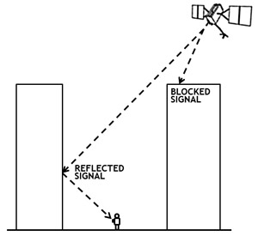
GPS - Localization
Accuracy of the GPS degrades in indoor conditions
Number of satellites which can be seen from the receivers decrease and the impact of reflection from the structures degrades the signal quality.
Indoor attenuation levels of GPS signals: Approx. 2.9 dB/mtr of structure
Power levels of GPS signals indoors: -150dBw to -200dBW
Noise power level at room temp: -130dBW
Development of location estimation techniques leveraging WLAN parameters and AI/ML algorithms plays vital role for futuristic applications

Slide 5

RSSI - Localization
RSSI is ten times the logarithm of the ratio of power of the received signal and a reference power.
Power dissipates from a point source as it moves further out and the relationship between power and distance is that power is inversely proportional to the square of the distance travelled.
A direct theoretical relationship exist between RSSI and distance:
With the distance of an unknown point known from a set of known points, its location can be estimated.
RSSI based technique is especially popular among researchers as it is readily available and no extra hardware is required.

Slide 6
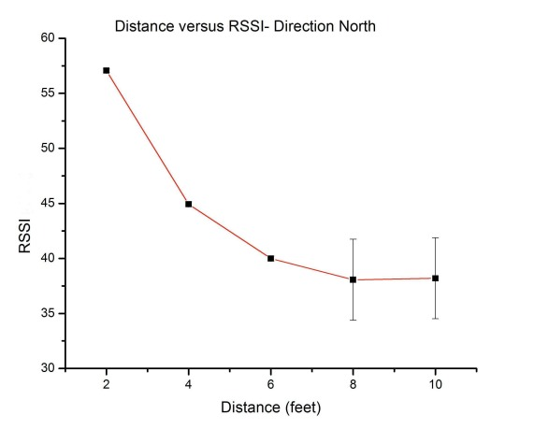
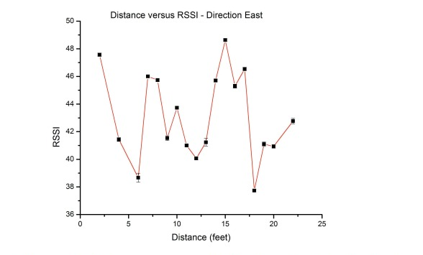
Challenges with RSSI
Highly Sensitive to changes in the environment and RSSI values varies rapidly, reducing its reliability
Source: Parameswaran, A.T., Husain, M.I. and Upadhyaya, S., 2009, September. Is RSSI a reliable parameter in sensor localization algorithms: An experimental study. In Field failure data analysis workshop (F2DA09) (Vol. 5). IEEE.

Slide 7
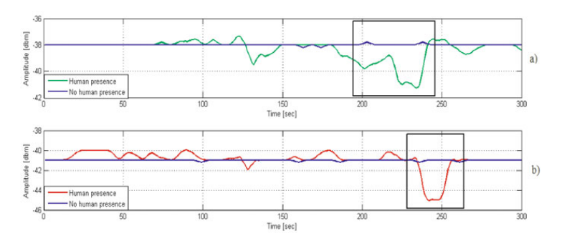
Challenges with RSSI
Difficult to put to use in busy environments, as Human Body (70% water) shadows RSSI heavily
Source: Choraś, Ryszard S. (2010). [Advances in Intelligent and Soft Computing] Image Processing and Communications Challenges 2 Volume 84 || Evaluation of Smoothing Algorithms for a RSSI-Based Device-Free Passive Localisation. , 10.1007/978-3-642-16295-4(Chapter 52), 469–476. doi:10.1007/978-3-642-16295-4_52

Slide 8
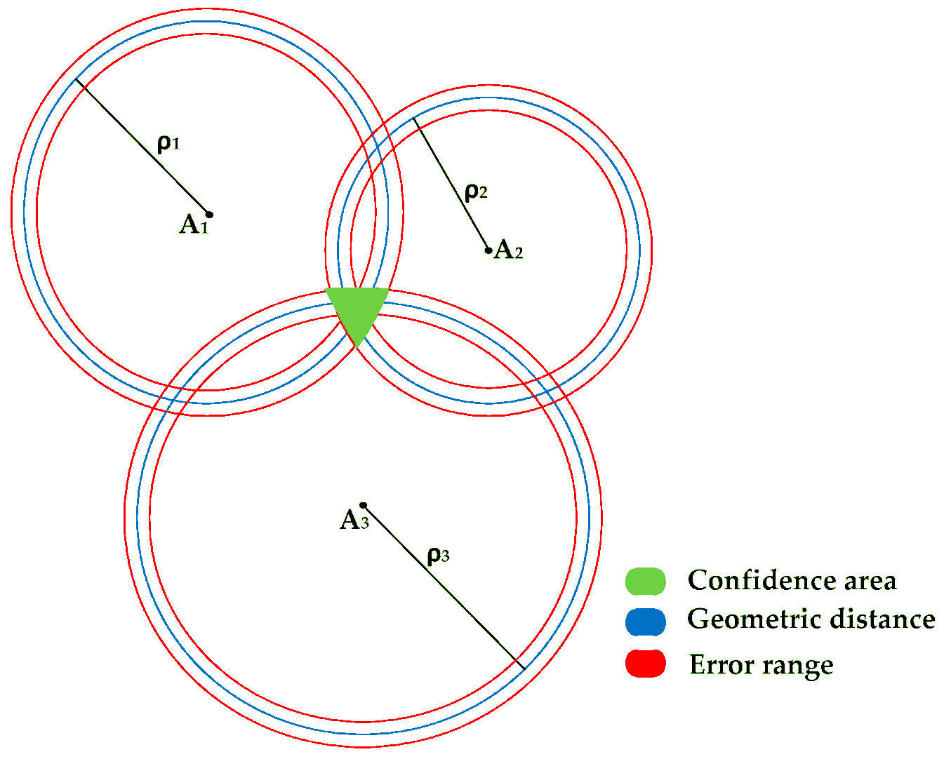
Localization procedures using RSSI
Multilateration

Slide 9

Multilateration
Known Parameters
Location of the 4 APs(x_{i} ,y_{i})
RSSI values of the AP
Unknown Parameters
Distance of the RP from each AP (d_{i})
Location of the RP (x,y)
Access Point
Access Point
Reference Point
Access Point
Access Point

Slide 10
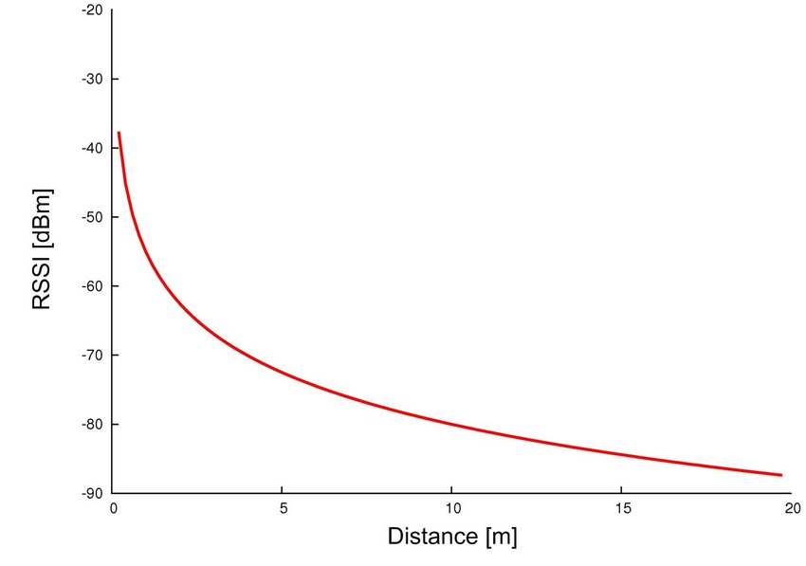
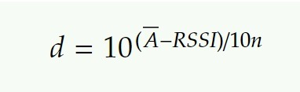
Multilateration
Determining the Unknown Parameters
Distance of the RP from each AP (d_{i})
As RSSI conveys information about strength of received signal, a relationship exists between RSSI and distance.
Where, n is the path loss index (depends on transmission environment)
and A is the average measured RSSI when the AP is 1 meter away from RP
n, A to be found by proper experimentation in the environment.
Source: Parameswaran, A.T., Husain, M.I. and Upadhyaya, S., 2009, September. Is rssi a reliable parameter in sensor localization algorithms: An experimental study. In Field failure data analysis workshop (F2DA09) (Vol. 5). IEEE.

Slide 11

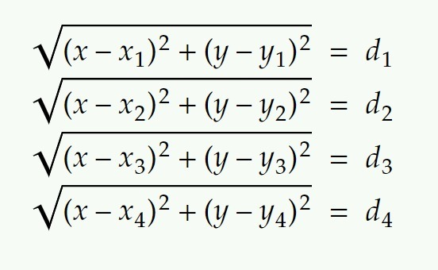
Multilateration
Determining the Unknown Parameters
Location of the RP (x,y)
Location of the RP can be determined from the distance of RP from AP calculated from RSSI value

Slide 12
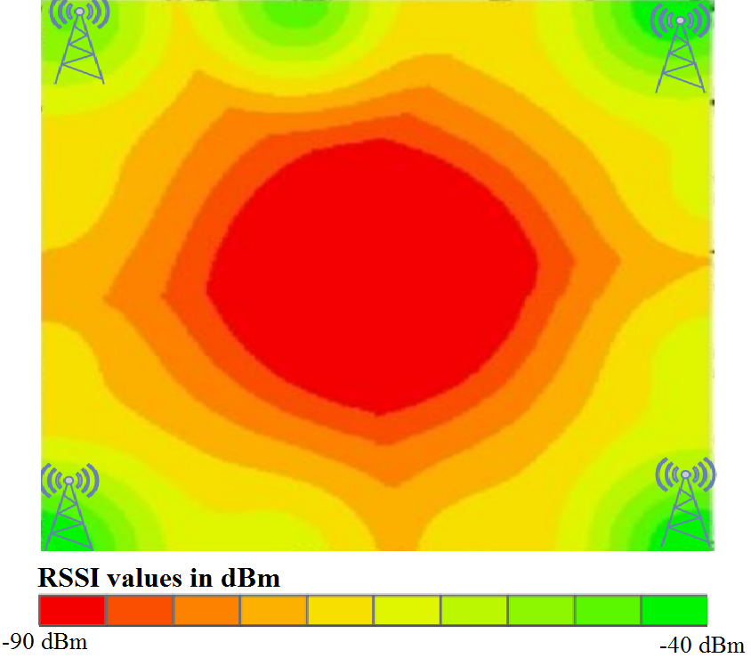
Localization Procedures using RSSI
RSSI Fingerprinting

Slide 13
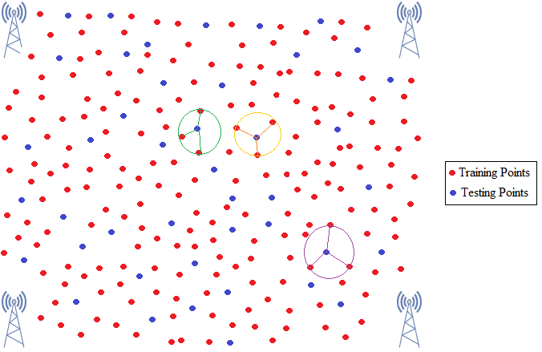
RSSI Fingerprinting
Precondition:
Presence of large number of Reference Points in the
training dataset, uniformly spread throughout the area.
Algorithms used for fingerprinting:
k-Nearest Neighbour.
Advantage:
High Accuracy in localization.
Disadvantage:
Thorough Training phase required.
Sensitive to changes in Environment

Slide 14
Dataset

Slide 15
Training and Validation Data
The Latitude & Longitude of the 4 Access Points (AP) with its environmental specification
The Latitude & Longitude of the 13 Reference Points (RP) for training and validation each.
Each Reference Point has its RSSI value (dBm) with corresponding timestamp, SSID of AP and the channel number
5200 observations for training and validation data
- 100 observations per RP wrt each AP
- 13 RP x 4 AP x 100 Observations = 5200 Data Points

Slide 16
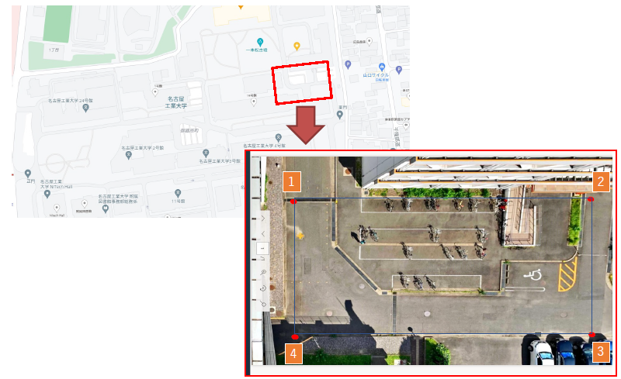
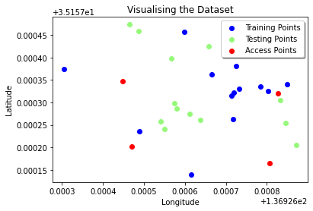
Data Exploration

Slide 17
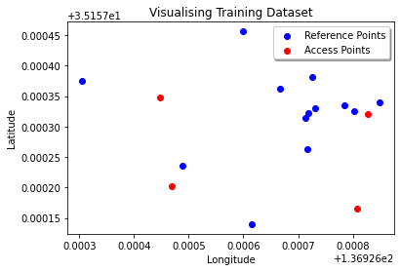
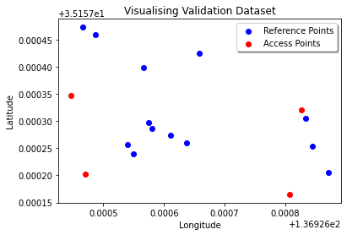
Visualising the Data points

Slide 18

Uniqueness of the Problem
RSSI values have been recorded for 100 seconds at the rate of 1 Sample/Second at every RP wrt each AP
The RSSI values of the signals from an RP to all the APs are mostly synchronized
The number of RPs in the dataset is sparse considering the complexity of the problem (only 13)

Slide 19
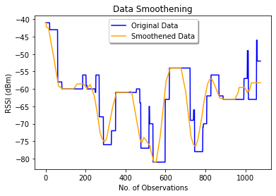
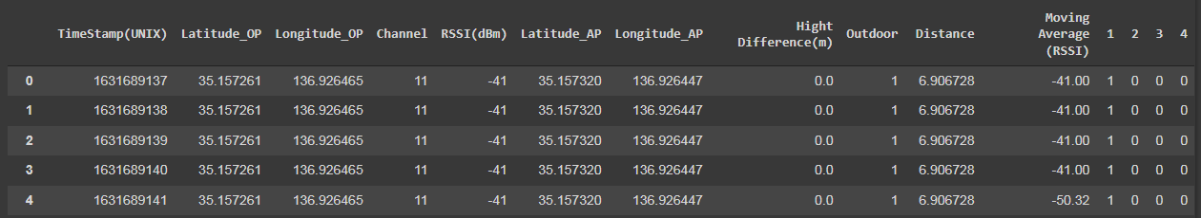
Data Pre-processing
Data Restructuring – Using combination of AP and RP features, to suit model training
Data Smoothening – Moving average of RSSI values to smoothen the sudden variations in data
Removed the outlying values

Slide 20
Proposed Solution
Methods
Method 1:
ML algorithms used
Linear Regression
AdaBoost
K-Nearest Neighbour Regression
Estimate distance from RSSI values using machine learning (ML) methods.
Method 2:
From the distance of more than three APs, apply triangulation method to get the location of the RP.
RSSI Fingerprinting – Direct estimation of location without calculating distance

Slide 21
Choice of the ML Algorithms
Multilateration Based Approach
As seen previously, RSSI follows an inverse square law wrt distance, that is RSSI ∝ (1/distance^2)
Therefore, to estimate the distance using ML algorithm we used,
Linear Regression with polynomial features of Degree 2
Fingerprinting Based Approach
K-NN Regressor algorithm was used for implementing localization using the fingerprinting procedure.
AdaBoosting was implemented as it improved the accuracy of regression using its ensemble approach.

Slide 22
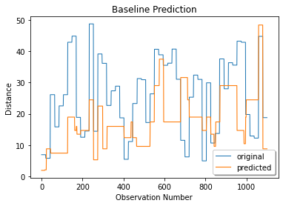
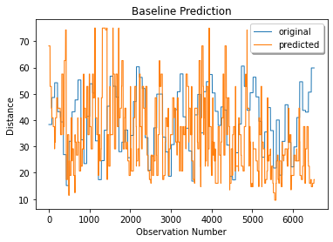
Baseline
Final Dataset Mean Distance Error : 12.13167 meters Maximum Distance Error : 32.4605 meters Percentage of data with less than 2m error : 7.63% | Japan Round Dataset Mean Distance Error : 14.9074 meters Maximum Distance Error : 50.4239 meters Percentage of data with less than 2m error : 8.85%

Slide 23
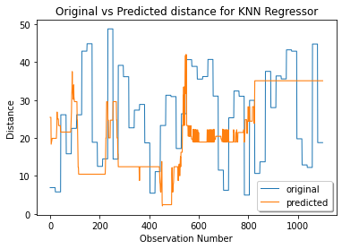
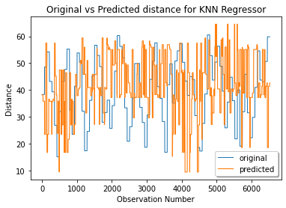
K-NN Regression
Final Dataset Mean Distance Error : 19.225 meters Maximum Distance Error : 38.0 meters Percentage of data with less than 2m error : 0% | Japan Round Dataset Mean Distance Error : 20.55 meters Maximum Distance Error : 47.28 meters Percentage of data with less than 2m error : 2.42%

Slide 24
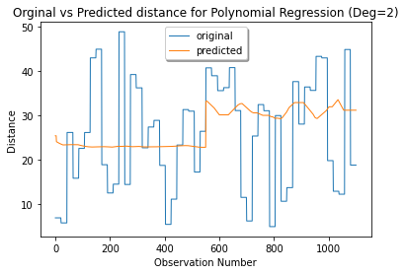
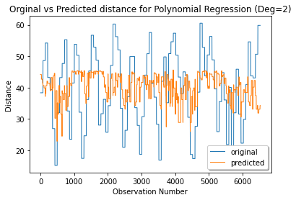
Linear Regression
Final Dataset Mean Distance Error : 22.53 meters Maximum Distance Error : 38.0 meters Percentage of data with less than 2m error : 0% | Japan Round Dataset Mean Distance Error : 15.28 meters Maximum Distance Error : 29.72 meters Percentage of data with less than 2m error : 2.42%

Slide 25
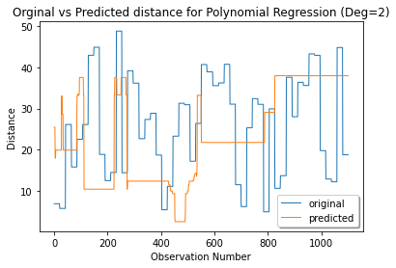
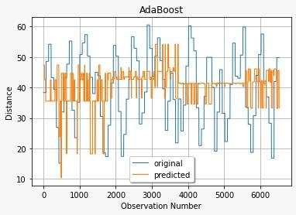
AdaBoost
Final Dataset Mean Distance Error : 13.15 meters Maximum Distance Error : 27.30 meters Percentage of data with less than 2m error : 15.64% | Japan Round Dataset Mean Distance Error : 15.33 meters Maximum Distance Error : 23.29 meters Percentage of data with less than 2m error : 7.79%

Slide 26
Evaluation & Results

Slide 27



Evaluation Metrics
Lower is Better
Formula
Lower is Better
Higher is Better

Slide 28
Multilateration Results
Sl | Method | Final Round |  |  | Japan Round |  |  | Latency
 |  | Mean error | Max error | <2m error | Mean error | Max error | <2m error
1 | Baseline (Math equation) | 12.13 m | 32.46 m | 7.63 % | 14.9 m | 50.4 m | 8.85 % | -
2 | Linear regression with degree 2 | 10.07 m | 25.79 m | 11.80 % | 9.98 m | 27.99 | 13.23 % | 0.08
3 | Adaboost | 13.78 m | 34.41 m | 7.72 % | 10.5 m | 28.99 m | 11.27 % | 0.37

Slide 29
Fingerprinting Results
Sl | Method | Final Round |  |  | Japan Round |  |  | Latency
 |  | Mean error | Max error | <2m error | Mean error | Max error | <2m error
1 | KNN- Regression | 19.23 m | 38.0 m | 0 % | 20.55 m | 47.28 m | 1.06 % | 0.017
2 | Linear regression with degree 2 | 22.53 m | 38 m | 0 % | 15.28 m | 29.72 m | 2.42 % | 0.08
3 | Adaboost | 12.33 m | 25.09 m | 23.27 % | 15.33 m | 23.29 m | 7.79 % | 0.35

Slide 30
Summary
Closing Remarks
Future Considerations
Various ML approaches have been applied to estimate distance from RSSI values
ML models could be able to map the relationship between RSSI values and distance from RP to AP.
The best result was achieved using AdaBoost Regressor
Increased datasets in terms of RP & RSSI values, will improve the model performance
Filters such as Kalman & Gaussian can be leveraged to handle the fluctuations in the RSSI values
Augmenting Link Quality Index (LQI), Time of Arrival (ToA) and Angle of Arrival (AoA) along with RSSI values will fetch more robust results

Slide 31
References
Shen, Y., Hwang, B. and Jeong, J.P., 2020. Particle Filtering-Based Indoor Positioning System for Beacon Tag Tracking. IEEE Access, 8, pp.226445-226460.
Li, G., Geng, E., Ye, Z., Xu, Y., Lin, J. and Pang, Y., 2018. Indoor positioning algorithm based on the improved RSSI distance model. Sensors, 18(9), p.2820.
Bullmann, M., Fetzer, T., Ebner, F., Ebner, M., Deinzer, F. and Grzegorzek, M., 2020. Comparison of 2.4 GHz WiFi FTM-and RSSI-based indoor positioning methods in realistic scenarios. Sensors, 20(16), p.4515.
Sung, Y., 2016. RSSI-based distance estimation framework using a Kalman filter for sustainable indoor computing environments. Sustainability, 8(11), p.1136.
Parameswaran, A.T., Husain, M.I. and Upadhyaya, S., 2009, September. Is rssi a reliable parameter in sensor localization algorithms: An experimental study. In Field failure data analysis workshop (F2DA09) (Vol. 5). IEEE.
Li, G., Geng, E., Ye, Z., Xu, Y., Lin, J., Pang, Y.: Indoor Positioning Algorithm Based on the Improved RSSI Distance Model. Sensors. 18, 2820 (2018).

Slide 32
References
Kraus and Fleisch, Electromagnetics, 5th Ed., McGraw-Hill, 1999
Navarro, E., Peuker, B., Quan, M., Clark, A.C. and Jipson, J., 2010. Wi-fi localization using RSSI fingerprinting (Doctoral dissertation, California Polytechnic State University).
Chan, S. and Sohn, G., 2012. Indoor localization using wi-fi based fingerprinting and trilateration techiques for lbs applications. International Archives of the Photogrammetry, Remote Sensing and Spatial Information Sciences, 38(4), p.C26.
Choraś, Ryszard S. (2010). [Advances in Intelligent and Soft Computing] Image Processing and Communications Challenges 2 Volume 84 || Evaluation of Smoothing Algorithms for a RSSI-Based Device-Free Passive Localisation. , 10.1007/978-3-642-16295-4(Chapter 52), 469–476. doi:10.1007/978-3-642-16295-4_52

Slide 33



