Slide 1

ITU-ML5G-PS-018
Compression of Deep Learning models
ERICSSON

Slide 2

ITU-ML5G-PS-018TU-ML5G-PS-018
Multi-Context based Knowledge Distillation
Data and Model aware Knowledge Distillation
Team Name: Pentagon
Thrivikram G L
Intern, Ericsson Research, Chennai
Vidya G
Intern, Ericsson Research, Chennai
Sethuraman T V
Indian Institute of Technology, Madras
Satheesh Kumar Perepu
Mentor, Senior Researcher, EGI
Ericsson Research & Development, Chennai
Saravanan Mohan
Mentor, Principal Researcher
Ericsson Research & Development, Chennai

Slide 3

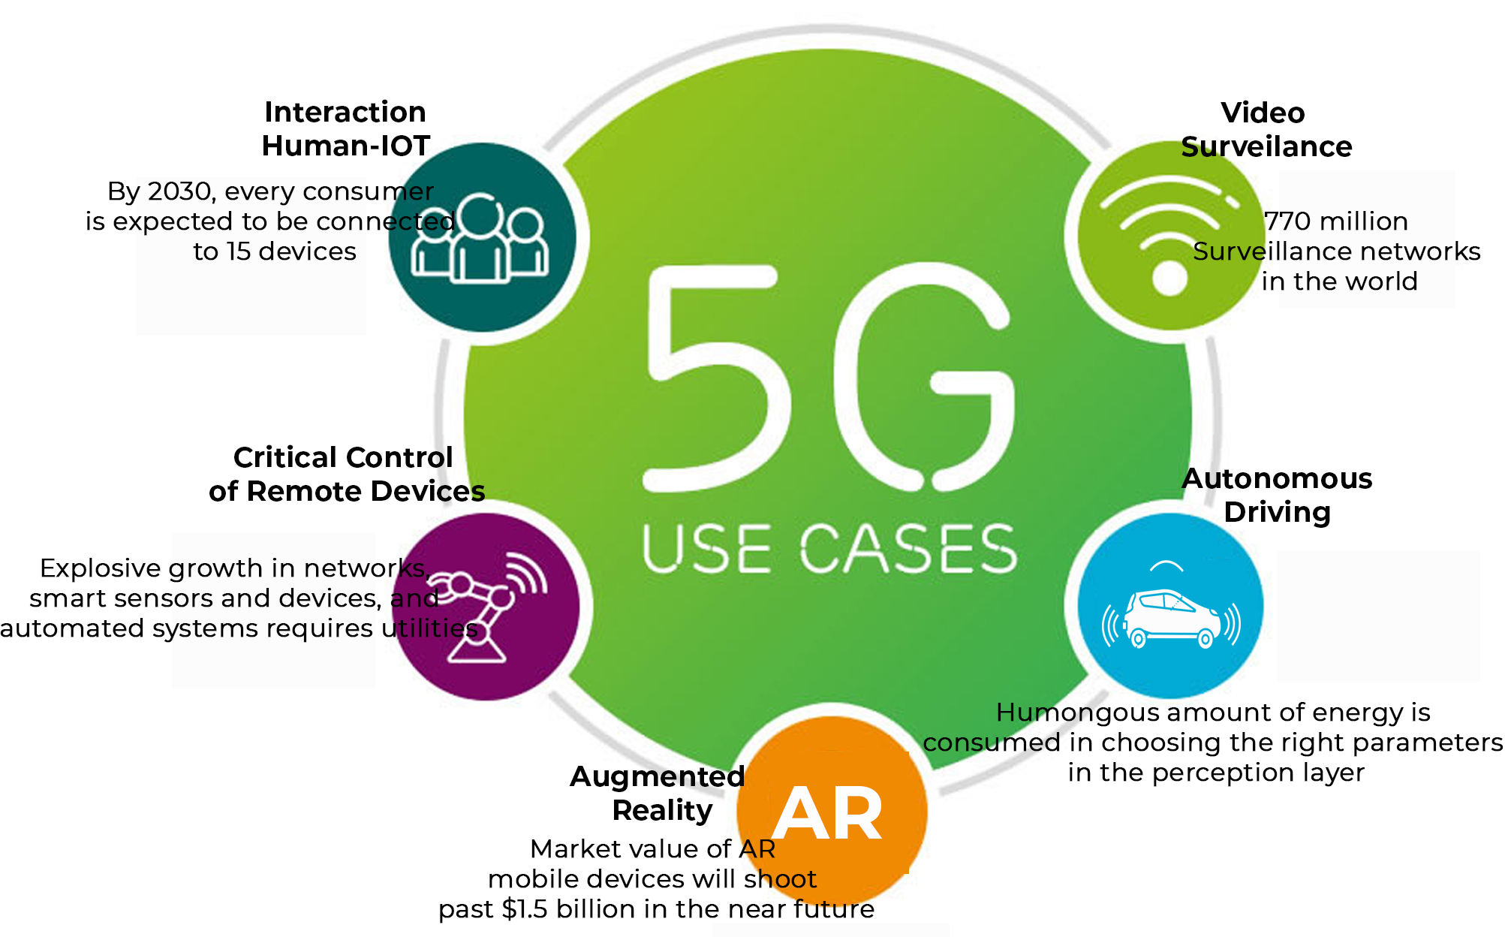

BACKGROUND
Deep Learning Models Today :
During the last few years, deep learning has been the basis of many successes in artificial intelligence, including a variety of applications in computer vision, reinforcement learning, and natural language processing. But it has the following challenges:
Millions (and even billions) of parameters
Demands heavy computation power
Too large to be deployed on
edge devices.
Difficult to be operated in real
time.
Large latency

Slide 4
PRIOR ARTS
Model Pruning | Model Quantization | Knowledge Distillation
A model optimization technique that involves eliminating unnecessary values in the weight tensor | The process of reducing the number of bits that represent a number (the format has so far been 32-bit floating point, or FP32). | An effective technique to transfer information from one network to another network whilst training constructively.
Challenges Very difficult to train from scratch. Suffers from some loss of accuracy. Difficult to generalise. | Challenges Reduced memory footprint but not much increase in computing efficiency. Difficult to generalise | Challenges A teacher can’t effectively distill it’s knowledge to students for all the data distribution. Not much insight on best student teacher combination.
Hardware Constraints: TensorFlow, TFLite, MXNet, and PyTorch enable developers to quantize models but they are not well suited to execute on a variety of hardware platforms. Eg. TFLite is optimized to run inference on ARM CPU edge devices but it does not have efficient support for Intel CPUs and Nvidia GPUs. **
Notes:
Advantages
General purpose technique
Less regularisation
Widely applicable and complements all other compression techniques.

Slide 5
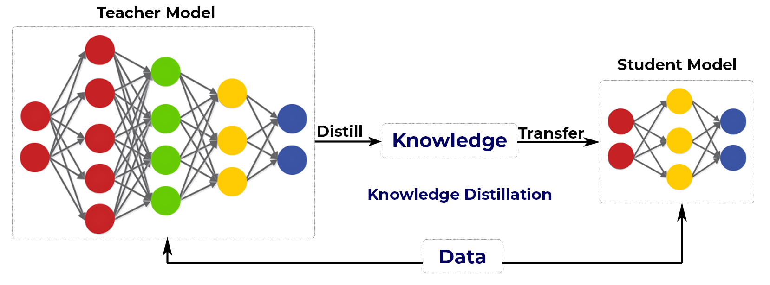
Knowledge Distillation (KD) : (S-T) learning framework
A large (teacher) pre-trained network is used to train a smaller (student) network. However, different student architectures can perform better on different distributions data. A teacher can’t effectively distill it’s knowledge to students for all the data distribution. To alleviate this shortcoming, we introduce multi-student knowledge distillation, which employs a multiple student model to bridge the gap between the data distribution and the student meta architecture. To the best of our knowledge we are the first group to attempt multi-student KD framework.

Slide 6
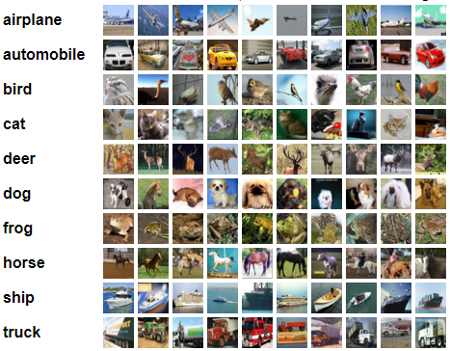
RESOURCES
CIFAR-10 dataset
The CIFAR-10 dataset consists of 60000 32x32 colour images in 10 classes, with 6000 images per class.
GPU: Nvidia P100
RAM: 16GB
LIBRARIES:
CUDA 10.0
CUDNN 8.0
Pytorch 1.6.0
Python 3
Torchvision

Slide 7
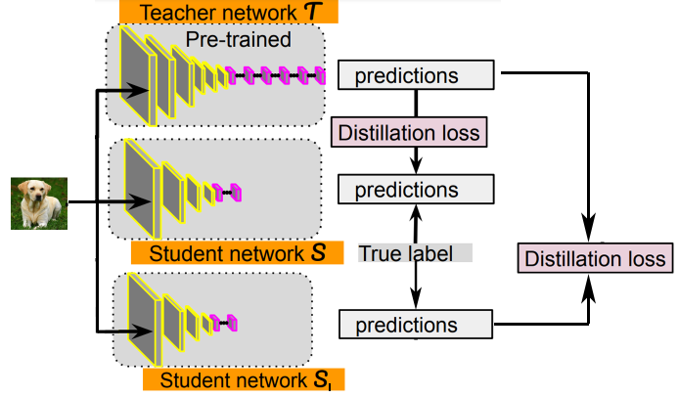
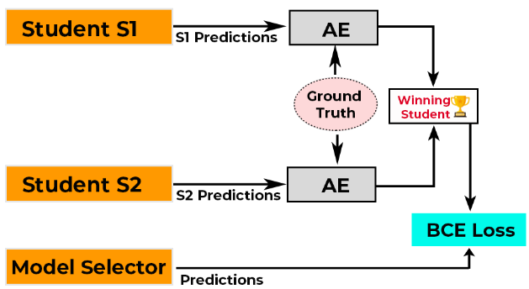
HIGH LEVEL OVERVIEW OF OUR APPROACH - TRAINING
MULTI-STUDENT KD
MODEL SELECTION
Teacher network T : ResNet50
Student network S1 : DenseNet121
Student network S2 : GoogleNet
AE : Absolute Error
BCE Loss: Binary Cross Entropy Loss
Distillation Loss =KD Loss+ BCE Loss

Slide 8

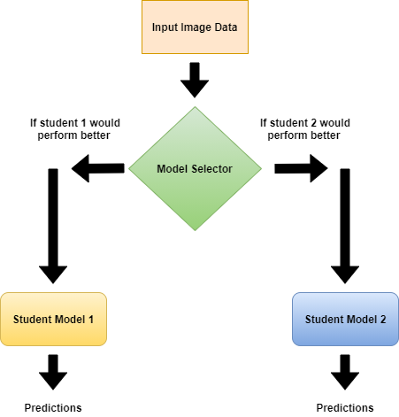
Final Stand Alone Architecture – Inference Phase
Proposed Architecture for Inference
Student network S1 : DenseNet121
Student network S2 : GoogleNet
Here the Model Selector extracts the features of the input data and estimates the student model that would work better on that input data and route the data to the corresponding student model to perform the desired task.

Slide 9
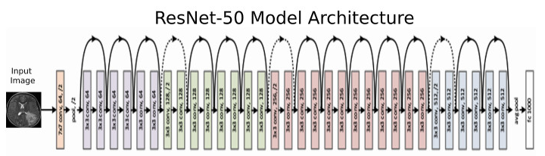
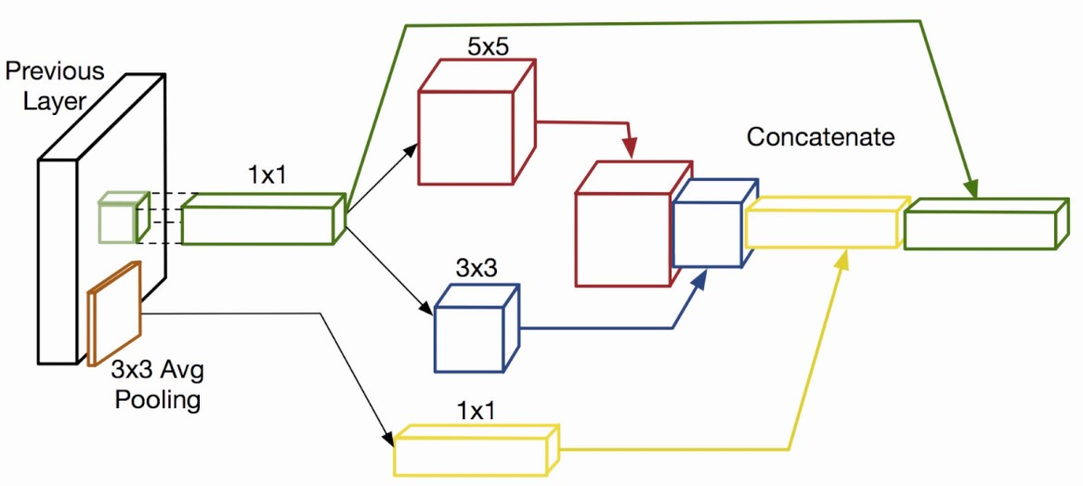
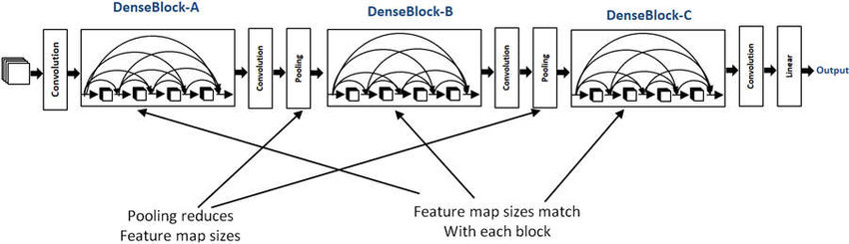

META ARCHITECTURE
DenseNet121
Inception GoogleNet
Curtesy: Google Images

Slide 10
MODEL ATTRIBUTES
Model Attribute | Teacher | Student 1 | Student 2 | Model Selector
Model | ResNet50 | DenseNet121 | GoogleNet | CNN (3 Layers)
No. of Parameters | 25.6M | 3.27M | 6.07M | 0.55M
Parameter size | 98MB | 31MB | 25MB | 2.21MB
No. of layers | 50 | 11 | 22 | 3
WORKFLOW:
Training the teacher model.
Using the softmax outputs of teacher to train both the student networks.
Optimising both Binary Cross Entropy loss and knowledge distillation loss.
Using a model selector network to learn the attributes of the input image data and map it to the corresponding student model. (by learning the attributes of the model also)
Optimising the model selector loss over the period of time.
Model selector becomes better at predicting the corresponding student model for a given data that would give better predictions.

Slide 12
COMPRESSION
Compression with respect to Teacher
Compression of Individual Student Models | No. of Parameters | Space consumed | MAC
DenseNet-121 | 87.30% | 68.40% | 21%
GoogleNet | 76.30% | 74.49% | 68.10%
Compression with our proposed approach | No. of Parameters | Space consumed
DenseNet-121+ Model Selector | 85.17% | 66%
GoogleNet+Model Selector | 74.15% | 72.23%
Overall compression( If the Model Selector fails) | No. of Parameters | Space consumed
Teacher(ResNet-50)+DenseNet-121+GoogleNet+ Model Selector | 61.40% | 40.61%

Slide 13
SELECTION CRITERIA
WHY DensNet121 and GoogleNet as Student Models??
We observed that both model’s behaviour was complementary to each other across all the classes unlike other combinations.
Also, the chosen models had very less number of parameters (3M and 6.07M) and provided nearly the same accuracy as the teacher.
Model Selector
Model Selector plays a fundamental role in identifying which student model will give the best accuracy for a given image data. So, the role of the model selector is to extract the features from the input image data and select the corresponding student model which will provide the best estimation.
CNN Model | Batch Norm | Without Batch Norm
2 Layer | Poor performance | Poor performance
3 Layer | Good Performance | Poor performance
4 Layer | Poor generalisation | Poor generalisation

Slide 14
Model | Accuracy
Teacher: ResNet50 | 81%
Student1:DenseNet121 | 74.19%
Student2: GoogleNet | 73.21%
Model Selector + Students(Both 1 and 2) | 81.79%
It can be inferred from the table that both the student model perform much better when augmented with a model selector.
We can observe that the individual student models accuracy and the accuracy of the proposed approach have not been compromised and in fact exceeded the teacher models accuracy. We are able to gain this accuracy with a huge margin of compression . (Refer compression Table)

Slide 15
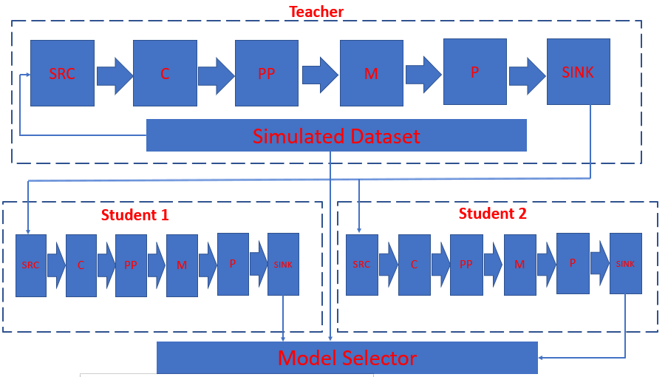
ML ARCHITECTURE FOR TRAINING – ITU FORMAT

Slide 16
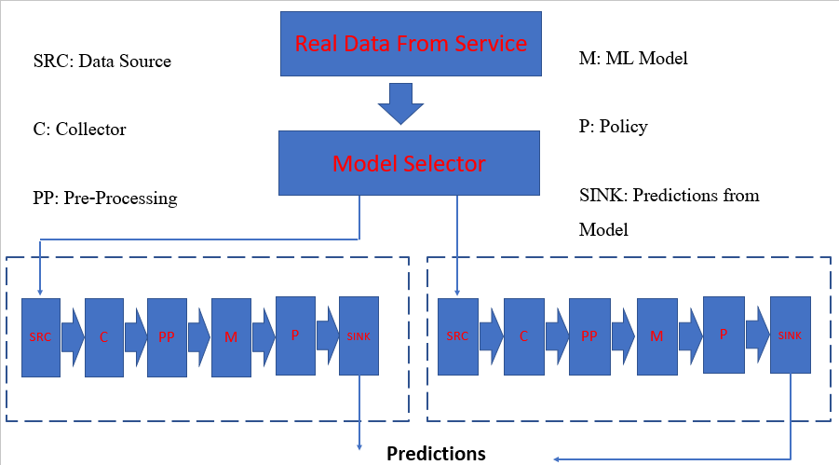
ML ARCHITECTURE FOR INFERENCING ITU FORMAT

Slide 17
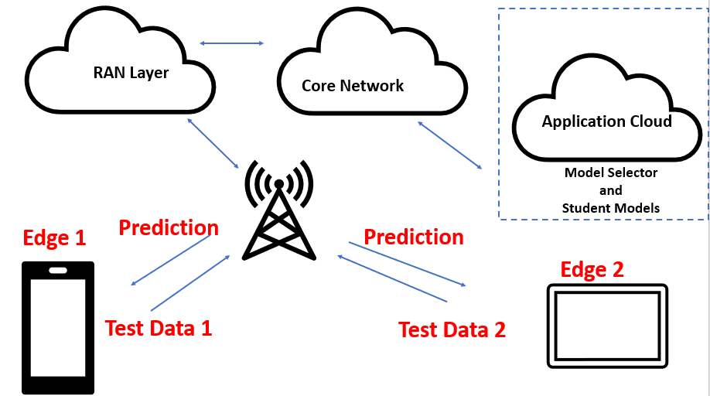
EDGE IMPLEMENTATION OVER NETWORK

Slide 18
CONCLUSION
In this work, we observe that the underlying data geometry affects the models predictions and convergence to a great extent. Our key finding is that, knowledge Distillation (KD) is not a panacea for inferencing on all kinds of data.
Since the world is moving more towards an active learning paradigm, one student model on an edge device will not suffice to accommodate all the variations in the attributes. So, we proposed a multi-student Architecture augmented with a highly compressed model selector network which can understand the attributes of an input data and route it to the corresponding student model which can give better results by utilising least amount of computing resources.
To prove our hypothesis we have shown the benefits of this approach on CIFAR-10 Dataset by carrying out extensive empirical study. The results reveal that, the proposed Multi-context Aware architecture perform better than independent student models.
The observed results demand a pressing need for understanding the nuances of context aware meta architectures which can be deployed in 5G Edge computing scenarios, as we believe this can succeed as a general and a practical approach

Slide 19
FUTURE DIRECTIONS
Increase the number of student models in order to understand the distribution of data thoroughly.
Try to further simply the student architectures for better compression results.
Implement the framework on cross modality datasets.

