Slide 1


Federated Learning for 5G Base Station Traffic Forecasting
Vasileios Perifanis
PhD Student
Dept. of Electrical and Computer Engineering
Democritus University of Thrace
Greece
Team Euclid
Joint work Nikolaos Pavlidis, Remous-Aris Koutsiamanis and Pavlos Efraimidis
November 30, 2022
2022 ITU AI/ML in 5G Challenge Play-offs

Slide 2
Challenge Overview
Traffic prediction is of great importance towards the 5G era.
Smart and efficient infrastructure planning
Suitable Deep Learning models: MLPs, RNNs, CNNs.
Traditional approaches build forecasting models using combined base station data.
Privacy violations
Business competitiveness and confidentiality issues
Solution: Collaborative Learning without exchanging data
Challenge:
Goal: Build a Federated Model Architecture
Input: 10 past observations (11 measurements/observation)
Output: Next-step prediction (5 measurements)

Slide 3
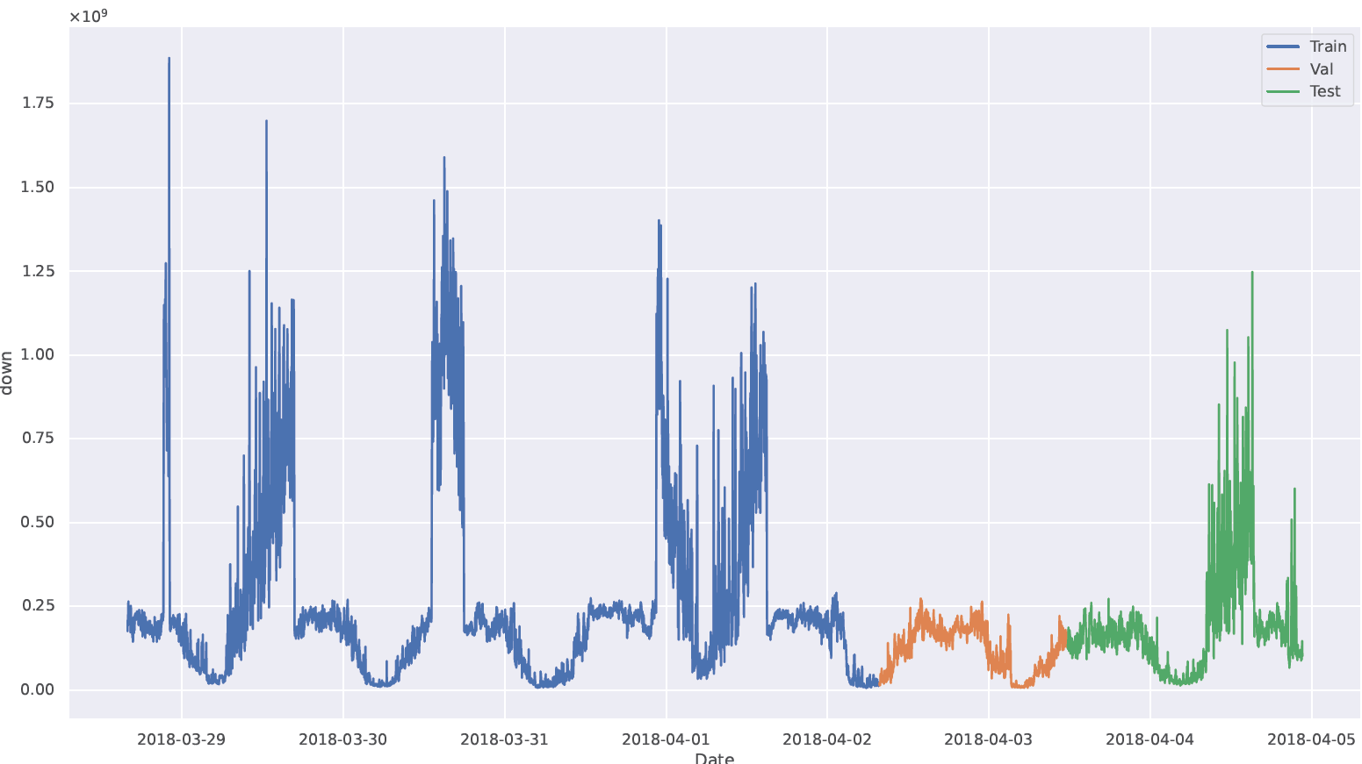
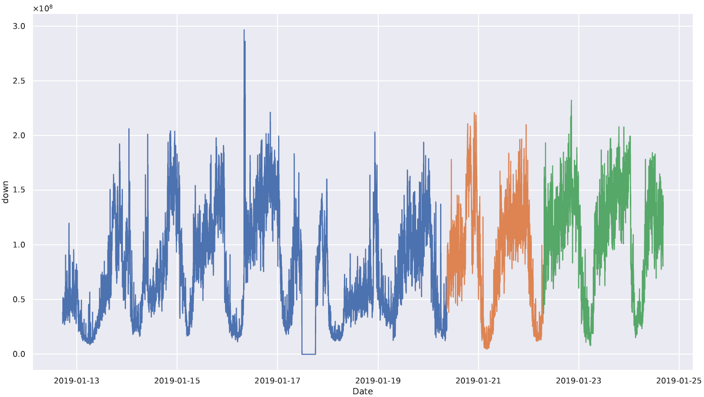
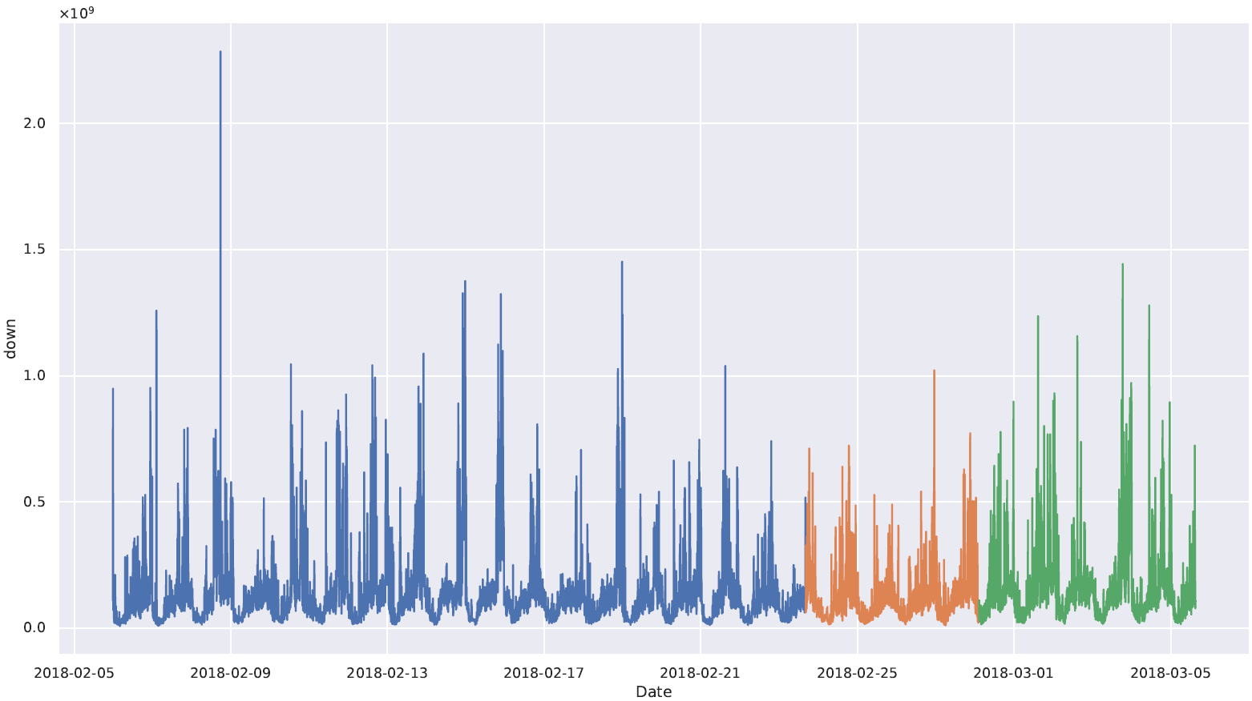
Dataset
Collection of measurements from three base stations in the metropolitan area of Barcelona, Spain.
ElBorn: 5421 samples (7 days)
LesCorts: 8615 samples (12 days)
PobleSec: 19909 samples (28 days)
Notes:
Train, Validation, Test split by color, What exactly each sample contains (the 11 features)

Slide 4
Dataset
Collection of measurements from three base stations in the metropolitan area of Barcelona, Spain.
ElBorn: 5421 samples (7 days)
LesCorts: 8615 samples (12 days)
PobleSec: 19909 samples (28 days)
Notes:
Train, Validation, Test split by color, What exactly each sample contains (the 11 features)

Slide 5
Dataset
Collection of measurements from three base stations in the metropolitan area of Barcelona, Spain.
ElBorn: 5421 samples (7 days)
LesCorts: 8615 samples (12 days)
PobleSec: 19909 samples (28 days)
Notes:
Train, Validation, Test split by color, What exactly each sample contains (the 11 features)

Slide 6
Dataset
Collection of measurements from three base stations in the metropolitan area of Barcelona, Spain.
ElBorn: 5421 samples (7 days)
LesCorts: 8615 samples (12 days)
PobleSec: 19909 samples (28 days)
Notes:
Train, Validation, Test split by color, What exactly each sample contains (the 11 features)

Slide 7
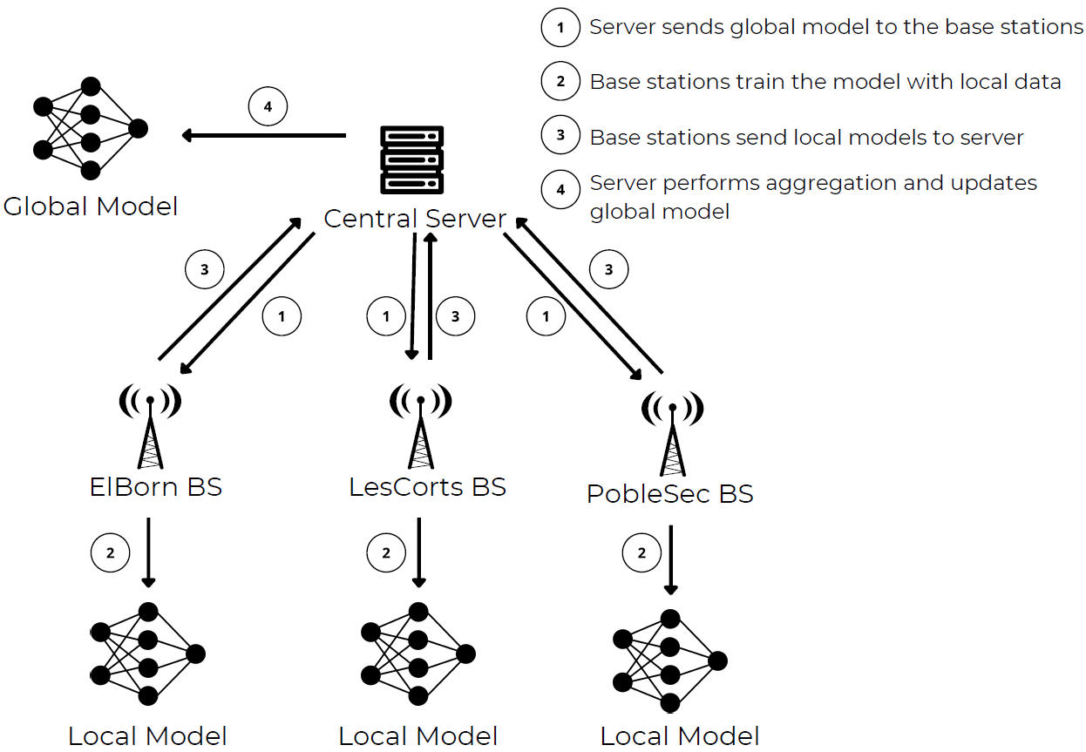
Federated Learning
NaN Handling
Train/Val Split
Flooring & Capping
Outlier Handling
Global vs Local Scaling
Feature Scaling
Time-Series
Pre-processing
Unique Characteristics
Feature and target distribution skew
Quantity skew
Temporal skew
Notes:
Why you choose this type of NaN handling and Scaling? Justify. Elaborate more on different skews

Slide 8
Federated Learning
NaN Handling
Train/Val Split
Flooring & Capping
Outlier Handling
Global vs Local Scaling
Feature Scaling
Time-Series
Pre-processing
Unique Characteristics
Feature and target distribution skew
Quantity skew
Temporal skew
Notes:
Why you choose this type of NaN handling and Scaling? Justify. Elaborate more on different skews

Slide 9
Federated Learning
NaN Handling
Train/Val Split
Flooring & Capping
Outlier Handling
Global vs Local Scaling
Feature Scaling
Time-Series
Pre-processing
Unique Characteristics
Feature and target distribution skew
Quantity skew
Temporal skew
Notes:
Why you choose this type of NaN handling and Scaling? Justify. Elaborate more on different skews

Slide 10
Federated Learning
NaN Handling
Train/Val Split
Flooring & Capping
Outlier Handling
Global vs Local Scaling
Feature Scaling
Time-Series
Pre-processing
Unique Characteristics
Feature and target distribution skew
Quantity skew
Temporal skew
Notes:
Why you choose this type of NaN handling and Scaling? Justify. Elaborate more on different skews

Slide 11
Federated Learning
NaN Handling
Train/Val Split
Flooring & Capping
Outlier Handling
Global vs Local Scaling
Feature Scaling
Time-Series
Pre-processing
Unique Characteristics
Feature and target distribution skew
Quantity skew
Temporal skew
Notes:
Why you choose this type of NaN handling and Scaling? Justify. Elaborate more on different skews

Slide 12

Learning Setting
Deep Learning models
MLP, RNN, LSTM, GRU, 3D-CNN
Aggregation Algorithms
Avg, Median, FedAvg, FedProx, FedAvgM, FedNova, FedAdagrad, FedYogi, FedAdam
Evaluation Metrics
NRMSE regarding the uplink and downlink measurements
Energy and CO₂ consumption
Simulation
Python programming language with PyTorch [GitHub].
Notes:
What is Normalized RMSE?, Why only these models? Maybe another one (they give an example) is better

Slide 13
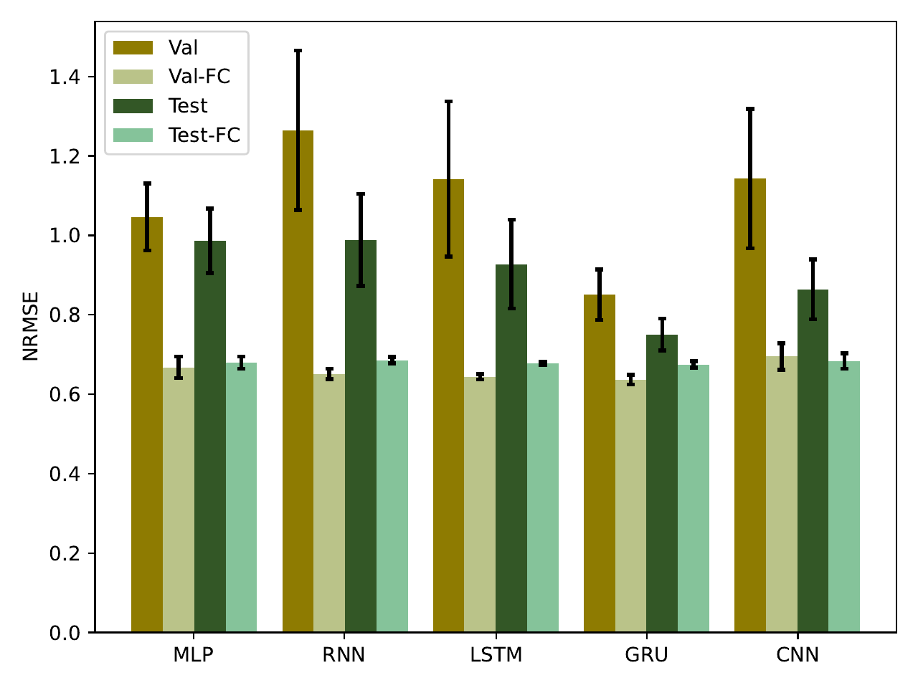
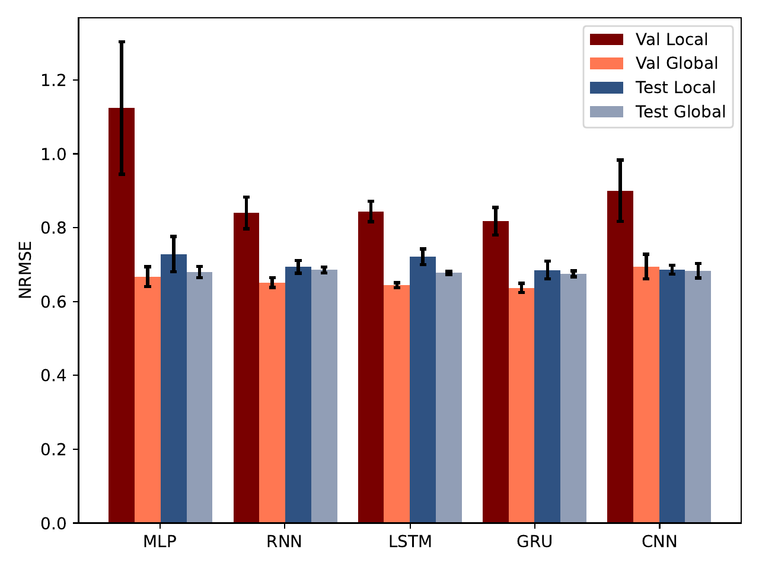
Results – Influence of Pre-processing
Averaged validation and test NRMSE using the raw data and with outliers handling.
Averaged validation and test NRMSE using the global and local scaling.

Slide 14
Results – Influence of Pre-processing
Averaged validation and test NRMSE using the raw data and with outliers handling.
Averaged validation and test NRMSE using the global and local scaling.

Slide 15
Results – Influence of Pre-processing
Averaged validation and test NRMSE using the raw data and with outliers handling.
Averaged validation and test NRMSE using the global and local scaling.

Slide 16
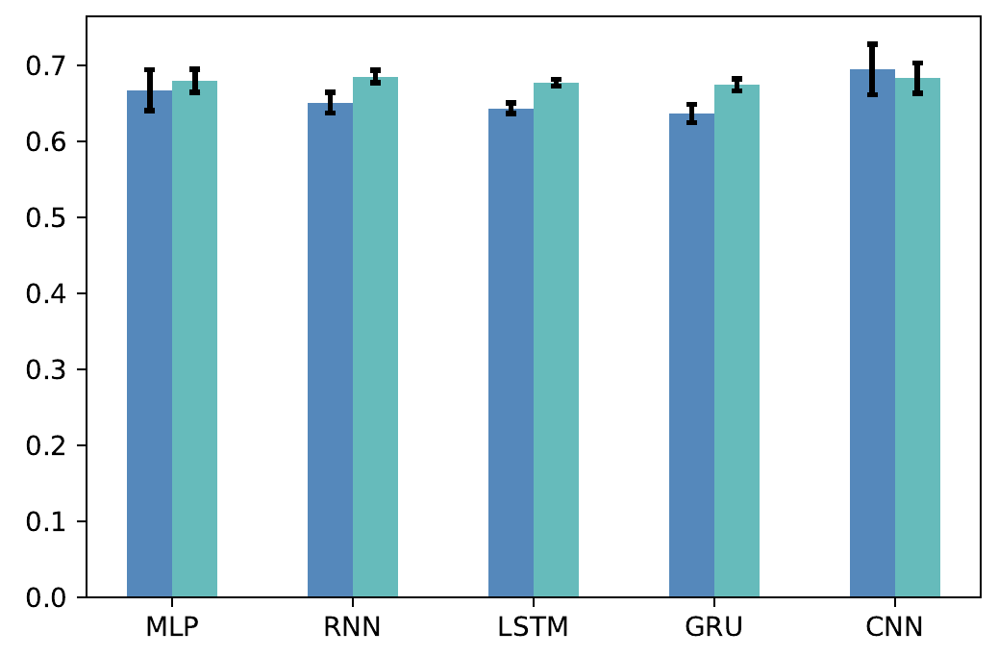
Results – Federated Learning
Model | NRMSE (Cen) | NRMSE (FL)
MLP | 0.6705±0.013 | 0.6797±0.015
RNN | 0.6852±0.0085 | 0.6856±0.0081
LSTM | 0.6927±0.0058 | 0.6776±0.0049
GRU | 0.6734±0.0057 | 0.6747±0.0079
CNN | 0.6701±0.0219 | 0.6836±0.0198
Averaged validation and test NRMSE per federated model.

Slide 17
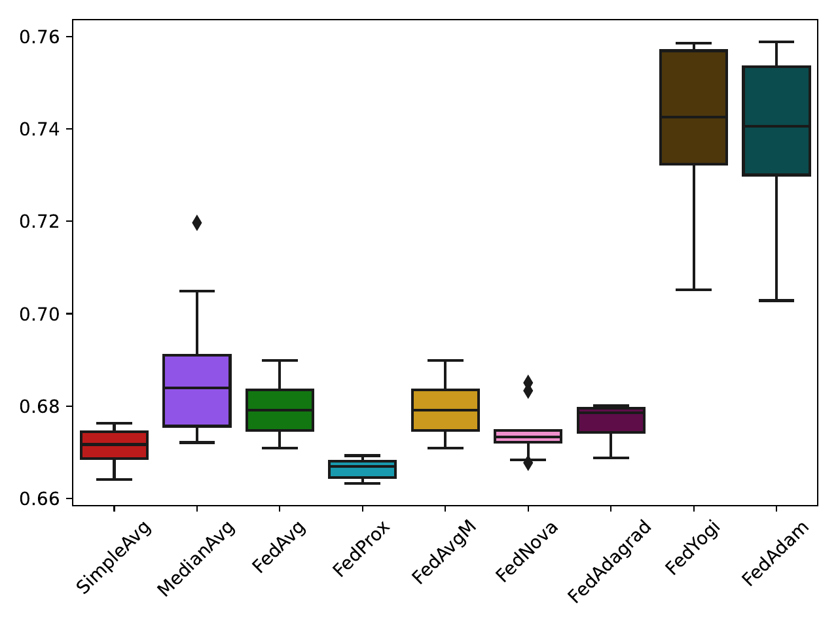
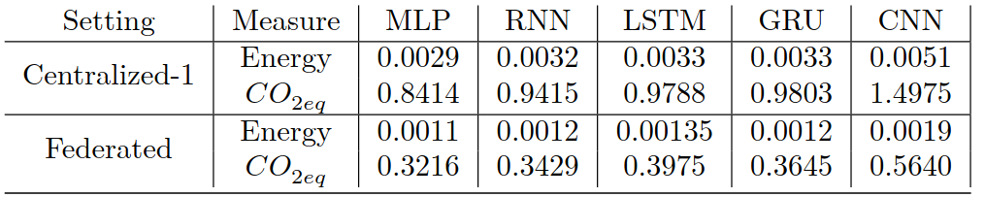
Results – Aggregation & Energy Consumption
Averaged test NRMSE per aggregation algorithm using the federated LSTM model.

Slide 18
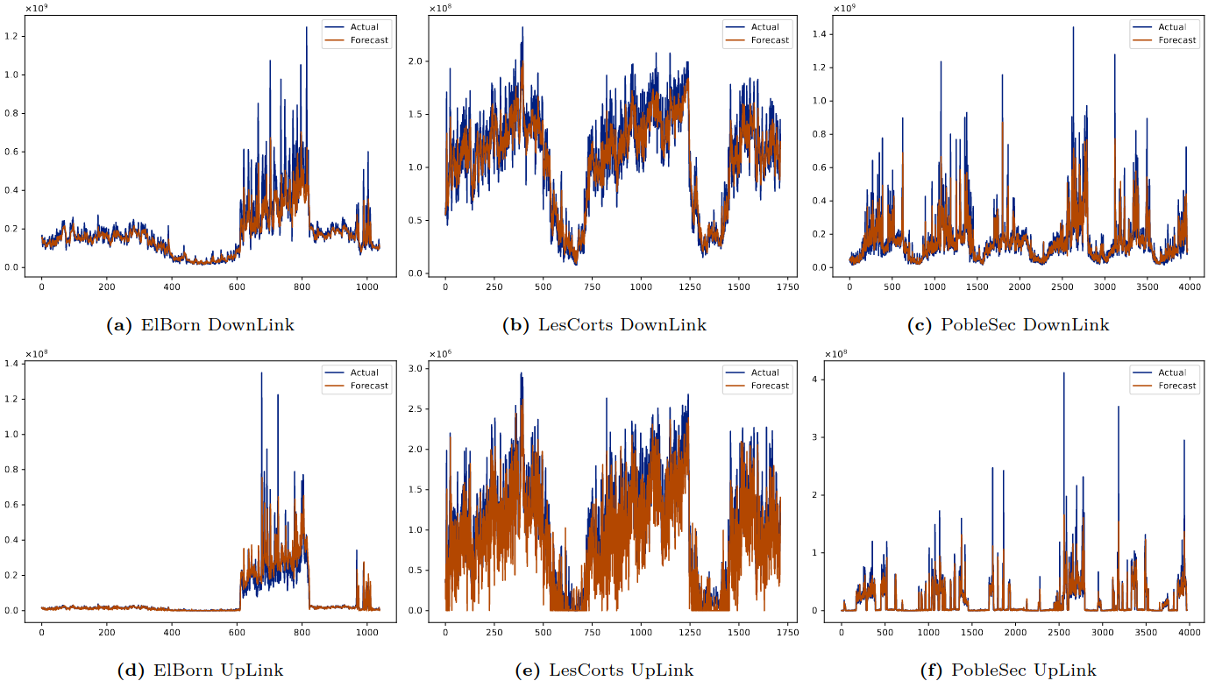
Results – Forecasting

Slide 19
Results – Forecasting

Slide 20
Conclusion
Pre-processing hugely affects the forecasting error
Outlier handling leads to lower error
Global scaling results in higher accuracy than local scaling
Federated Learning is on par with the centralized setting
Privacy
Dynamic execution
Fine-Tuning
Aggregation algorithms do not heavily influence the learning performance
Future Direction: Temporal Models & Aggregators
Notes:
Is global scaling violates Federated Learning rules? How is it performed?

Slide 21
Thank you
Any questions?

