Slide 1




ML5G-PS-001: Federated Traffic Prediction for 5G and Beyond
Vasileios Perifanis
PhD Student
Dept. of Electrical and Computer Engineering
Democritus University of Thrace
Greece
Team Euclid
ITU AI/ML in 5G: Grand Challenge Finale
14 December 2022

Slide 2
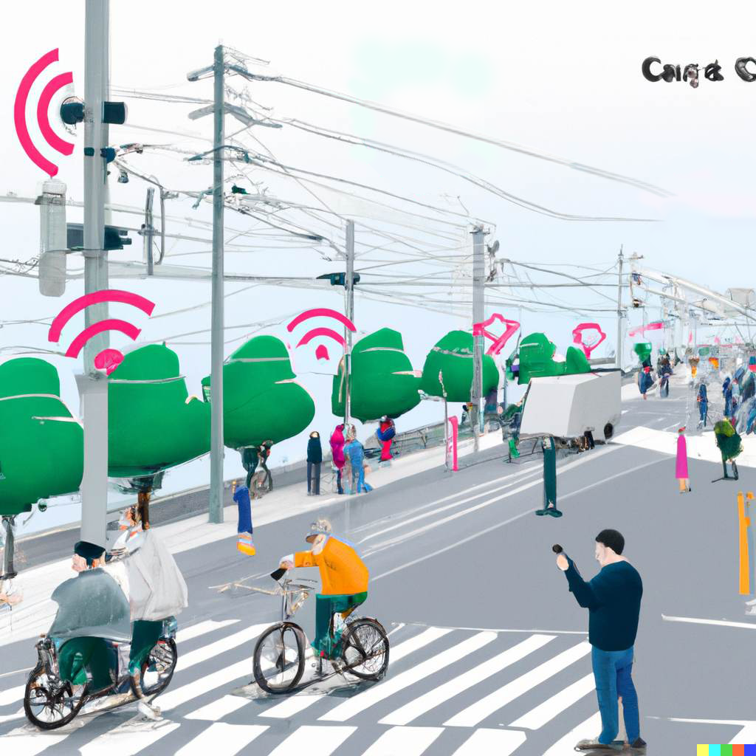
Base Station Traffic Forecasting
Main Challenges:
Data privacy
Real-time accurate predictions
Robust against non-iid data
* This image has been generated using DALL·E 2

Slide 3
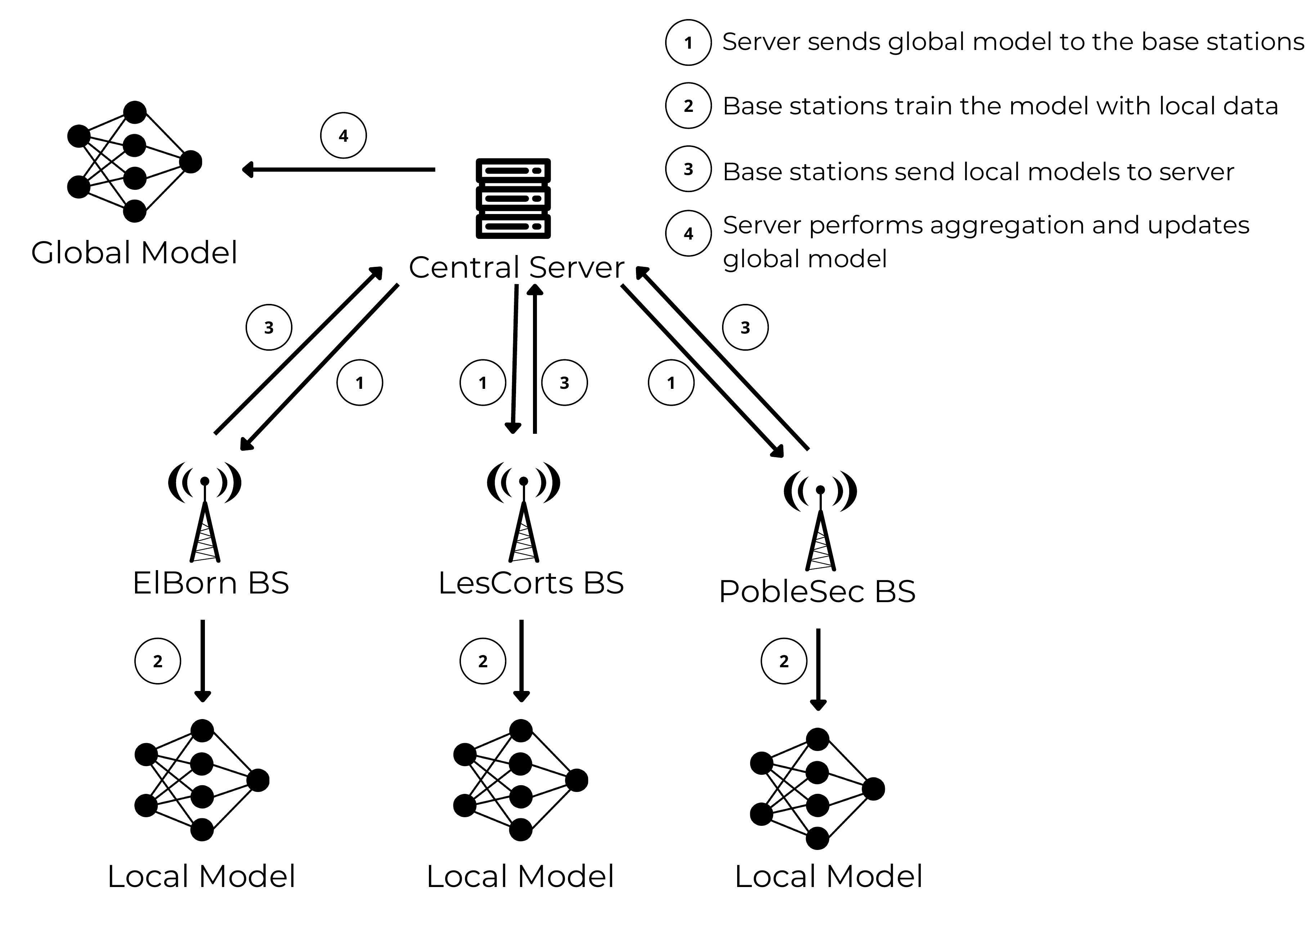
Federated Learning Approach
Advantages:
Privacy by-design
Low server latency
Generalization

Slide 4
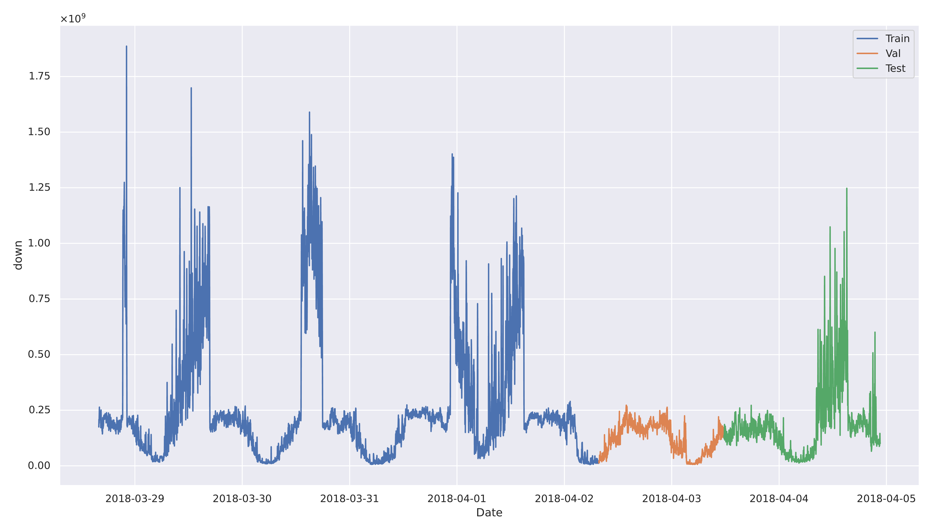
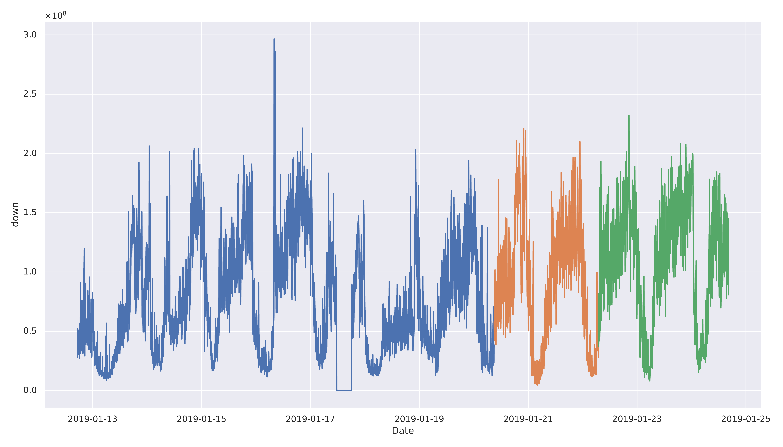
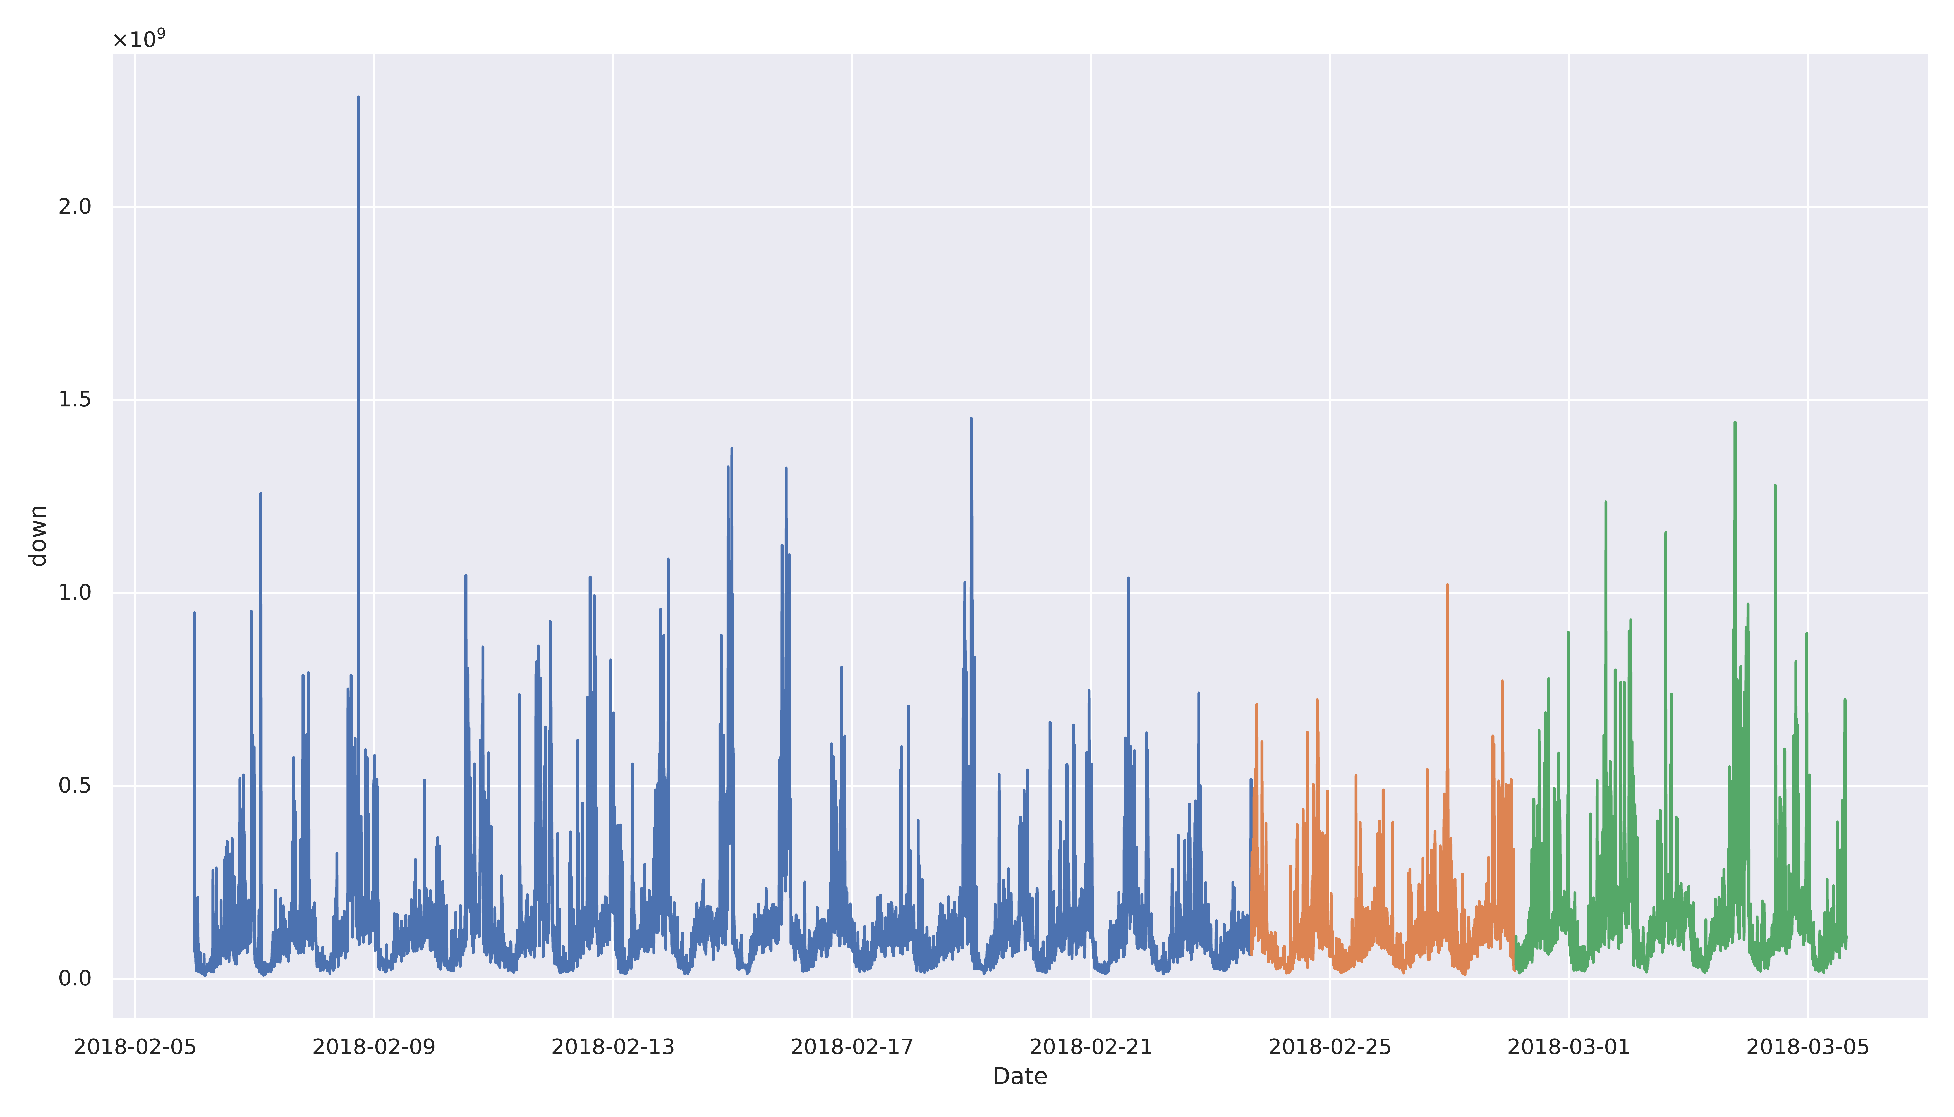
Challenges: non-iid data
Three base stations in Barcelona, Spain.
Differ in:
1) Quantity
2) Distribution
3) Temporality
?
How can we generalize a federated model?

Slide 5
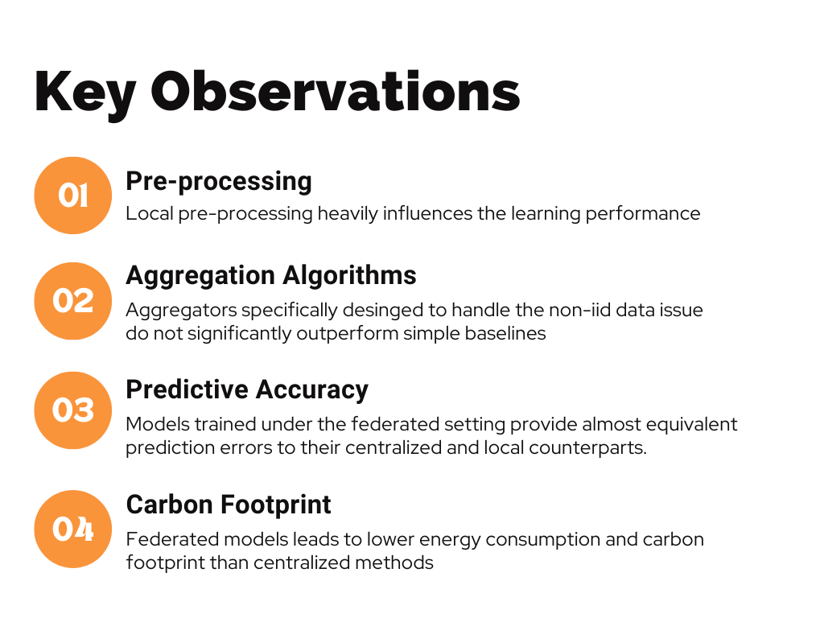
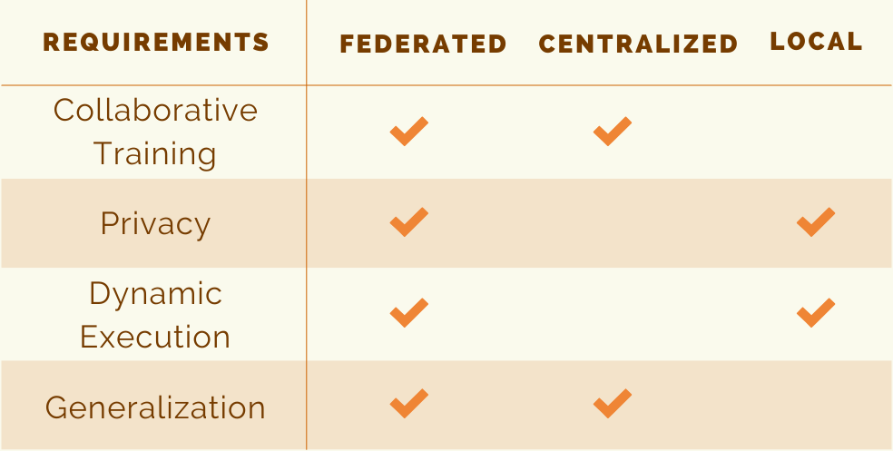
Experiments

Slide 6
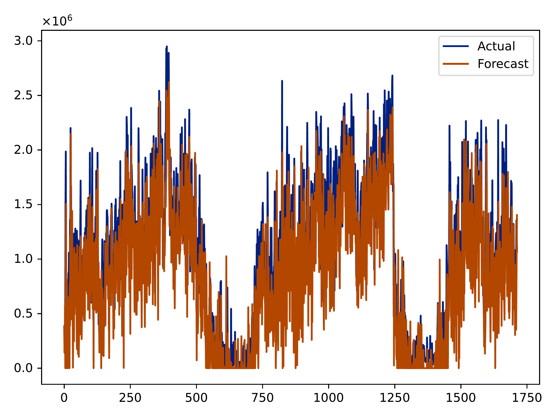
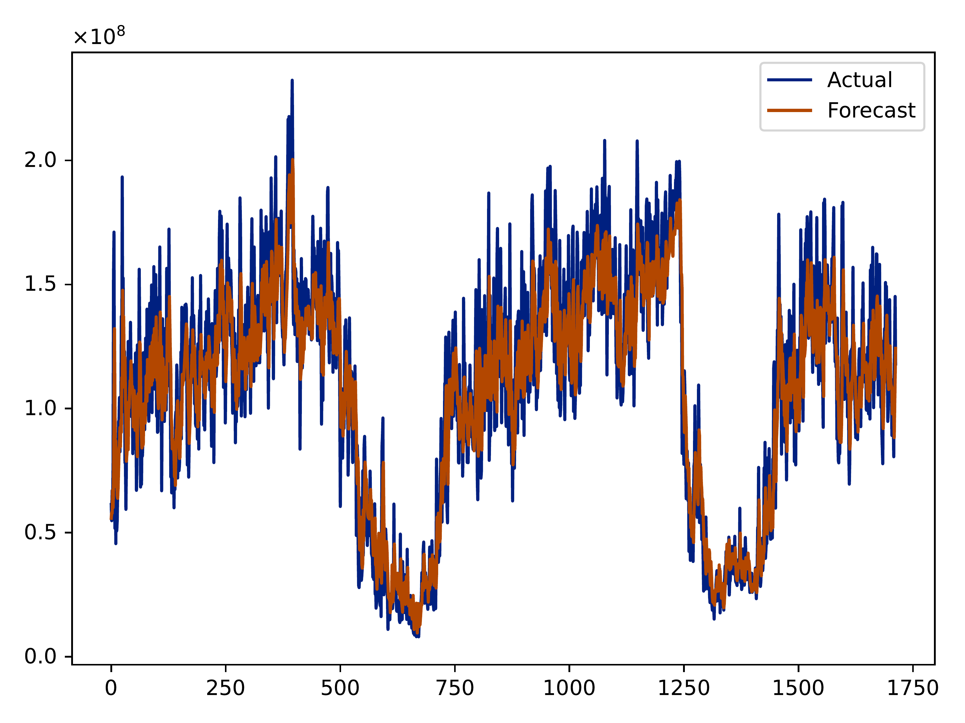


Federated Learning Results
Less CO2 emissions, power consumption
New research directions

Slide 7
Thank you!
Team Euclid
Vasileios Perifanis
PhD Student
Contact: vperifan@ee.duth.gr
Nikolaos Pavlidis
PhD Student
Contact: npavlidi@ee.duth.gr
Remous-Aris Koutsiamanis
Associate Professor
Contact: remous-aris.koutsiamanis@imt-atlantique.fr
Pavlos Efraimidis
Associate Professor
Contact: pefraimi@ee.duth.gr
pefraimi@athenarc.gr

