Slide 1




Network anomaly detection based on logs
ITU AI/ML in 5G Global Challenge
Chin：Qin YuKun，Song Yong，Xie Yuchen，Wei QiangShen

Slide 2

Logs are valuable for network maintenance with existing challenges
ITU AI/ML in 5G Global Challenge
Huge chunks of data was generated by Network Equipment and these information can be used to detect existing faults to improve the network maintenance.
Log Application
Challenges
Increasingly vast amount（1GB/H+）
Various types (Exchanger、Server、Router, etc.）
Unstructured data
Unsupervised / No-Label
Tradeoff between effect and efficiency
Anomaly Detection
Event Alarm Convergence
Root Cause Analysis
Fault Location
System Evaluation
Fault Warning
……

Slide 3
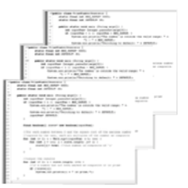
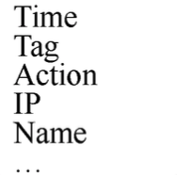
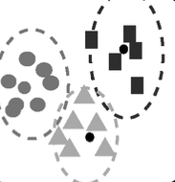
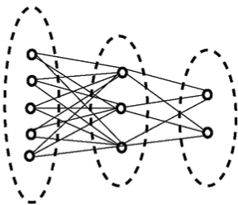
Ensemble Solution: NLP & Abnormal Detection
ITU AI/ML in 5G Global Challenge
Network Abnormal Detection based on Logs was composed by NLP and abnormal detection.
Log Collection
Log Parsing
Feature
Extraction
Anomaly
Detection
Batch logs/Streaming logs/Offline log/…
Templates/Keywords/Phrase…
Sequence feature/ Template aggregation/
…
Normal/Abnormal

Slide 4
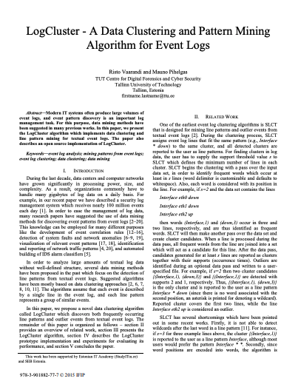
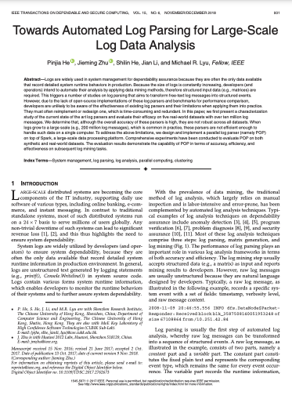
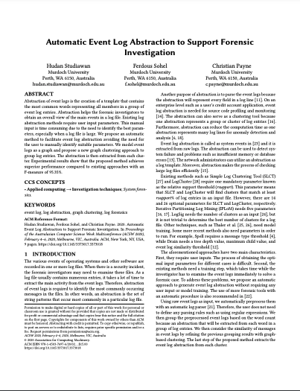
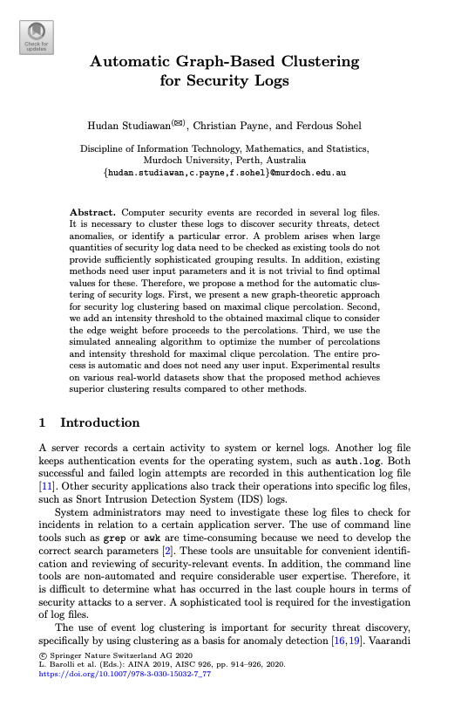
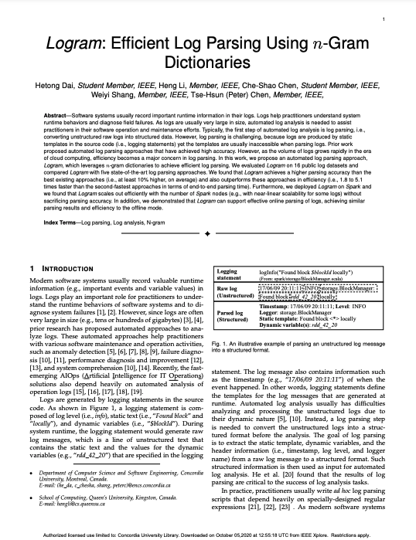
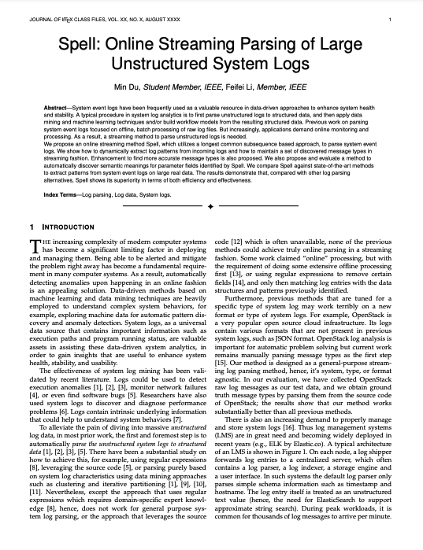
Key-word Dictionary Construction is the most important
ITU AI/ML in 5G Global Challenge
Although there are plenty of AI algorithms such as Deep Learning involved in log anomaly detection, all methods without key words performs not good enough.
RISTO V, PIHELGAS M. LogCluster — a data clustering and pattern mining algorithm for event logs[C]// Conference on Net-work and Service Management (CNSM). 2015: 1-7.
HEPJ, ZHUJM, HESL, etal. Towards automated log parsing for large-scale log data analysis[J]. IEEE Transactions on Dependable and Secure Computing, 2018, 15(6): 931-944.
STUDIAWAN H, SOHEL F, PAYNE C. Automatic event log ab- straction to support forensic investigation[C]// ACSW 2020. 2020: 1-9.
STUDIAWAN H, PAYNE C, SOHEL F. Automatic graph-based clustering for security logs[C]// Advanced Information Networking and Applications(AINA). 2019: 914-926.
DAI H, LI H, CHEN C S, et al. Logram: efficient log parsing using n-gram dictionaries[R]. 2020.
DU M, LI F F. Spell: online streaming parsing of large unstructured system logs[J]. IEEE Transactions on Knowledge and Data Engi- neering, 2019, 31(11): 2213-2227.

Slide 5
Industry-level Solution is empowered by iteration
ITU AI/ML in 5G Global Challenge
Log Template
Extraction
Abnormal Candidate
Detection
Log Key Information
Extraction
Abnormal
Detection
Knowledge
Dictionary
Log Parsing
Log Template
Aggregation
Template Detection
Series Detection
Weighted Key
Words
Template Match
Key-Word Match
Series Detection
Key Words
Aggregation
SimHash Aggregation
Spell (LCS)
Drain
Template Match
DeepLog/LSTM
Set-based：Difference
Stats-based: TF-IDF
Weighted Aggregation
Voting
Word2Vec
Dictionary-based
Milestone 1
Milestone 2
Milestone 3
Milestone 4
Milestone 5

Slide 6

Pre-Detection is used to update key word dictionary for detection fixing
ITU AI/ML in 5G Global Challenge
In Put
Output
Logs
Logs
Log Template Parse
Template
Template Match
N
Candidate
Y
Series Detection
Detecting Window
Prediction Match
N
Candidate
Abnormal Logs
Y
Log Key Words Extraction
Synonym Filter
Key-Word Match
N
Candidate

Slide 7
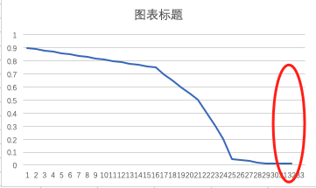
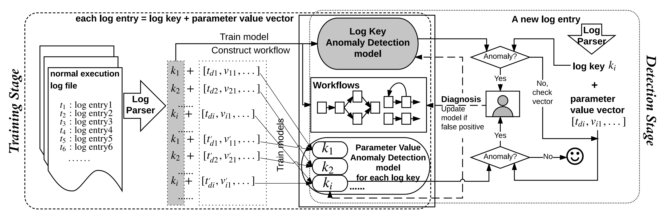
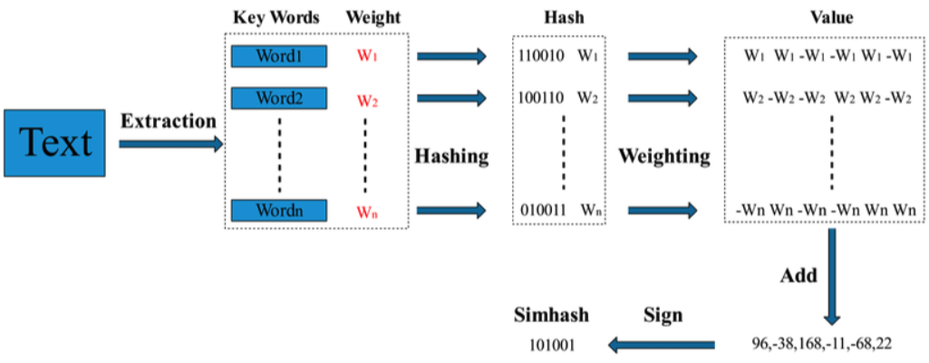
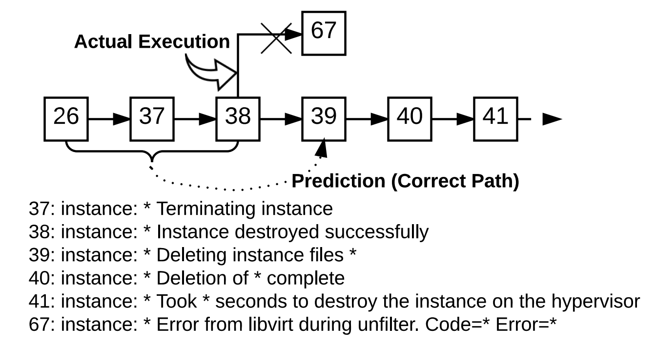

Fast template extraction is utilized to make pre-detection based on LSTM much more efficient
ITU AI/ML in 5G Global Challenge
Frequency-based Template Extraction
Series Anomaly Detection by LSTM
Tokenization
Workflow
Log Key
Parameter Variable
Frequency Filter
LSTM
Wildcard Replace
Simhash Aggregation
Anomaly Candidate
Template
Notes:
事件复杂度

Slide 8





Weighted detection with key-words filter generates the final anomaly
ITU AI/ML in 5G Global Challenge
Key Word Dictionary
Synonym Weight
Customized TF-IDF
Difference
Anomaly Detection
Key Word Weights $ω$
$Y=t\sum_{i∈T}{ω_{i}}$+ s$\sum_{i∈S}{ω_{i}}$+ k$\sum_{i∈K}{ω_{i}}$
$$T$$
$$S$$
$$K$$
Template-anomaly
Series-anomaly
Key-word-anomaly

Slide 9
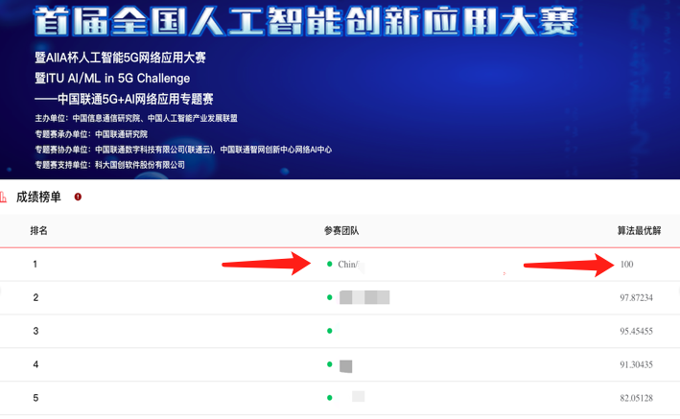
The only 100 out of 100 score in competition dataset
ITU AI/ML in 5G Global Challenge
P=100%；R=100%；F1=1.00，Top 1 at China Unicom 5G+AI Network Application Special Competition 。
Advantages
More efficient template extraction；
Increasingly accumulated knowledge dictionary and potential knowledge graph construction；
Perfect tradeoff of time consumption and performance；
Optional fast detection with dictionary
Result

Slide 10
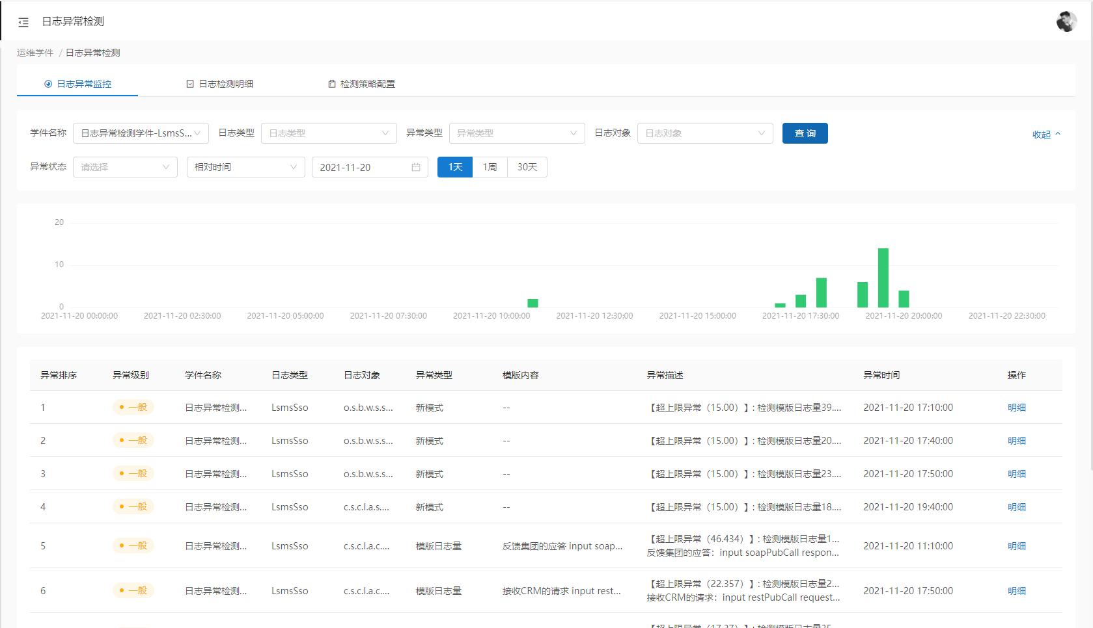
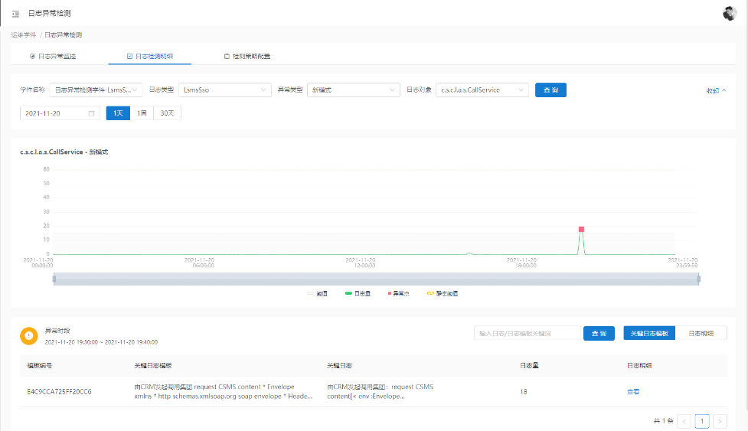
Industrial Application is perfect
ITU AI/ML in 5G Global Challenge
Productization in AIOps
Deployed for 20+ system
Daily processed 0.92TB data with 92% precision

Slide 11
Knowledge Graph will be constructed by log detection and potential root cause analysis
ITU AI/ML in 5G Global Challenge
Knowledge Graph
Further Application
Anomaly Detection
Root Cause Analysis
Alarm Convergence
cause
log2
cause
alarm2
Root Cause Analysis
Fault Location
log1
cause
alarm1
cause
cause
cause
log4
cause
cause
alarm4
Event Alarm Convergence
Fault Warning
log3
alarm3
Self-healing

Slide 12

Thank you
ITU AI/ML in 5G Global Challenge

