Slide 1




ITU-ML5G-PS-007
Lightning-Fast Modulation Classification
With Hardware-Efficient Neural Networks
Aaronica Team
Mohammad Chegini ^{[1]} , Pouya Shiri ^{[2]} , Amirali Baniasadi ^{[3]}
International Telecommunication Union
Organized by Xilinx
[1] Shahid Beheshti University. mohammad.chegini@hotmail.com [2] University of Victoria. pouyashiri@uvic.ca
[3] University of Victoria. amiralib@uvic.ca

Slide 2
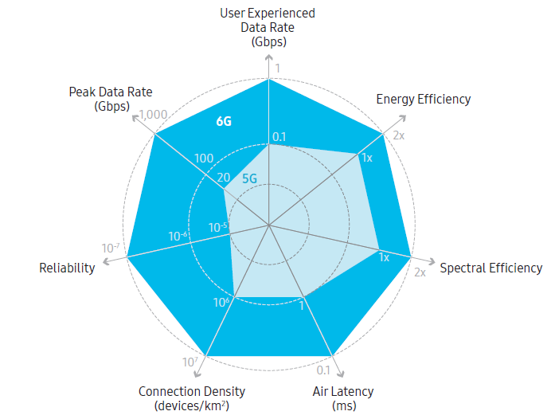
Our Goal
Develop a Deep Neural Network (DNN)
Target: Radio Frequency (RF) applications
Extreme Throughput
Ultra-Low Latency
High Energy Efficiency
Example RF Application
6G Communication Networks
Modulation Classification

Slide 3
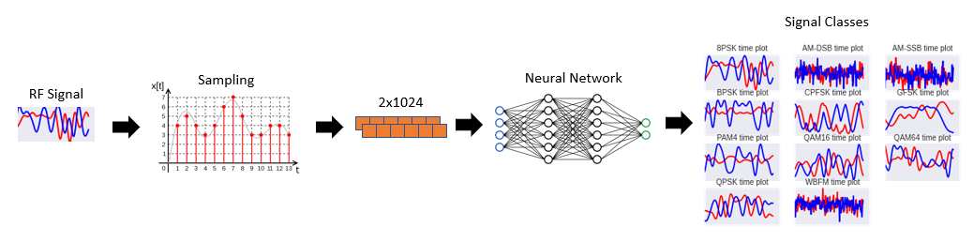
Modulation classification (MC)
Modulation Classification
A well-known problem in RF domain
Requires high throughput and low latency
MC Applications
Spectrum interference monitoring
Radio fault detection
Dynamic spectrum access
Numerous regulatory and defense applications
Fig. Modulation Classification procedure
Notes:
Reference: https://static-01.hindawi.com/articles/mpe/volume-2020/2678310/figures/2678310.fig.001.svgz

Slide 4
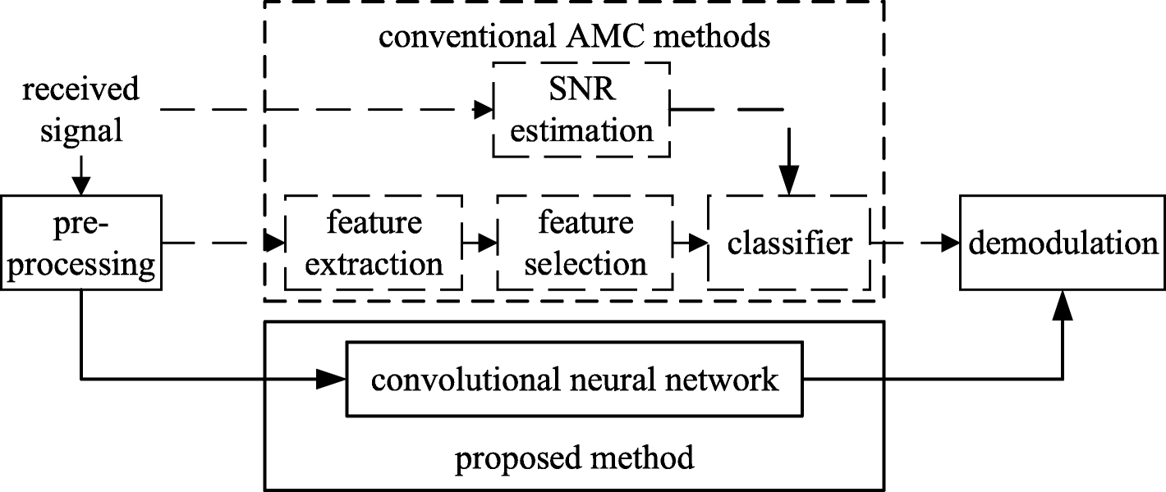
DNN for Modulation Classification
DNNs are promising tools for analyzing raw data
Pros:
Higher accuracy w.r.t conventional methods
Automatic feature extraction
Cons:
Design complications
Computationally expensive
Resource demanding (but we need high throughput and low-latency!)
Our objective: design a DNN specialized for RF domain applications
Fig. Comparison of conventional and proposed method
Notes:
What is reference

Slide 5
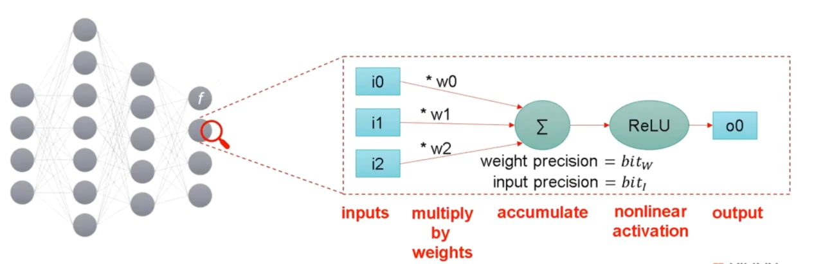
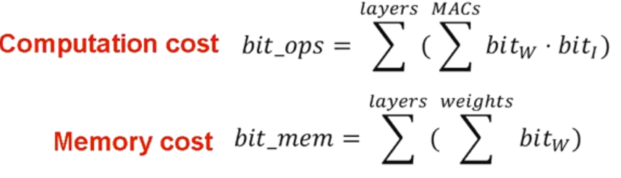
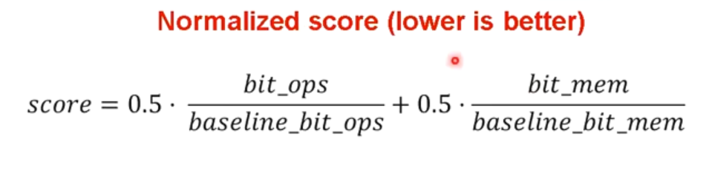
Evaluation metrics
In RF-Domain, we generally require hardware implementation.
H/W performance indices:
FLOPs
MACs

Slide 6
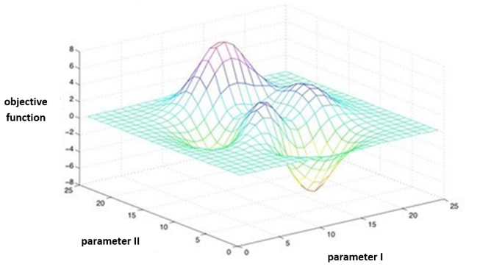
Design Complications
Domain-specific DNN Design
Choice of network architecture
Network modifications:
Type/Number of layers/filters
Network compression techniques (Quantization, etc.)
First option: Exhaustive search
Grid Search
Evolutionary Algorithms (Genetic Algorithm, PSO, …)
Neural Architecture Search (Using Reinforcement Learning, …)
Time-Consuming and Resource Hungry for large Datasets (highly unpractical)
Notes:
Grid search: https://www.oreilly.com/library/view/statistics-for-machine/9781788295758/e4dac91e-0078-4c8a-a44f-78a28abb649b.xhtml

Slide 7

Problem statement
Minimize inference cost on the challenging and well known RadioML 2018 dataset
Minimum final accuracy: 56%
Solutions of Aaronica Team
Initial round: Pruning MobileNet
Got 3rd place
Final round: AaronNet Network
Designed a specialized DNN after the initial round

Slide 8
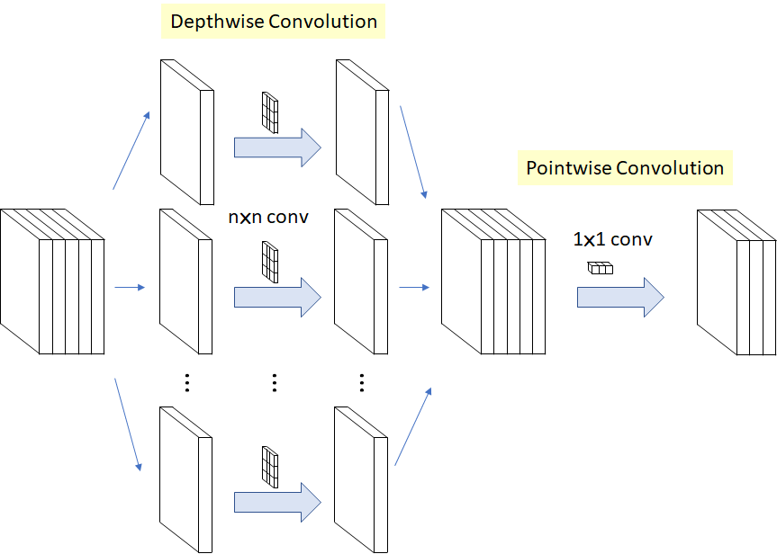
Possible Architectures
VGG, Inception, ResNet, MobileNet, ShuffleNet
Each networks has innovations to stand out
MobileNet
Pointwise and depth-wise convolution
Reducing the number of multiplications
Higher throughput with lower computation cost
Notes:
Mobilenet: https://towardsdatascience.com/review-xception-with-depthwise-separable-convolution-better-than-inception-v3-image-dc967dd42568

Slide 9
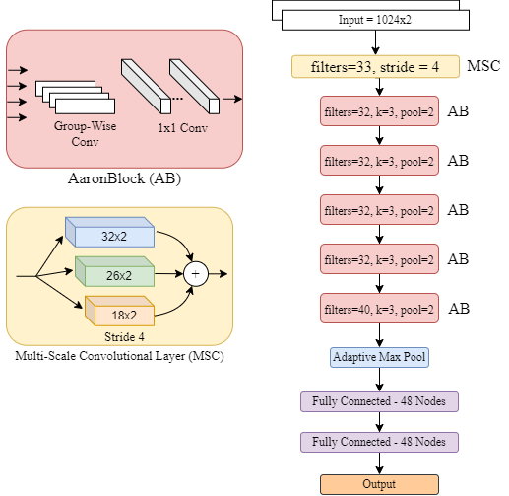
AaronNet
Specialized for RF-domain
Group-Wise convolutions
Introducing Multi-Scale Convolutional (MSC) layer
Adaptive Max Pooling
Variations
AaronNet32: 32 filters
AaronNet48: 48 filters
AaronNet Architecture

Slide 10
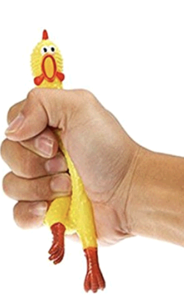
Optimizing AaronNet
Significant results using the following methods:
Layer-wise quantization and pruning
Using Self-attention mechanism SE block
Unstructured pruning (More energy efficiency)
Structured pruning (More hardware friendly)
The best results we had so far: Unstructured Pruning
AaronNet+: Slightly pruned version of AaronNet while having the same accuracy as AaronNet
AaronNet++: Pruned to it’s limit, while meeting minimum accuracy of competition
Finalizing our paper for submission
Notes:
Spring: https://alexanderteachingstudio.com/dont-compress-yourself-improving-your-posture-by-doing-less/

Slide 11
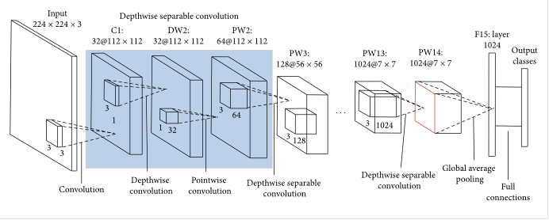
Results: Initial Round
Baseline for inference cost: VGG network
Inference cost = 1
Accuracy = 59.46%
Unstructured Pruning of MobileNet (initial round)
Using P100 GPU on Kaggle
Pruned 30% of the weights
Accuracy = 56.15%
21x inference cost improved (0.046)
MobileNet Architecture

Slide 12
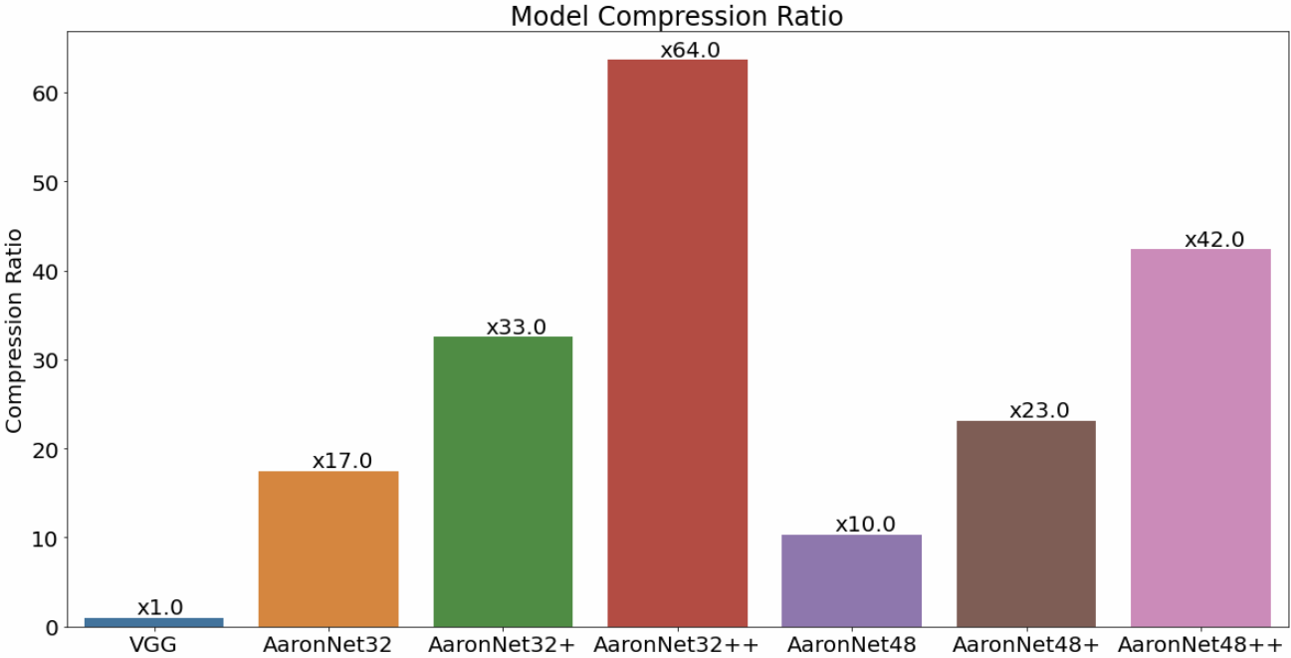
Results: Final Round
Higher is better

Slide 13
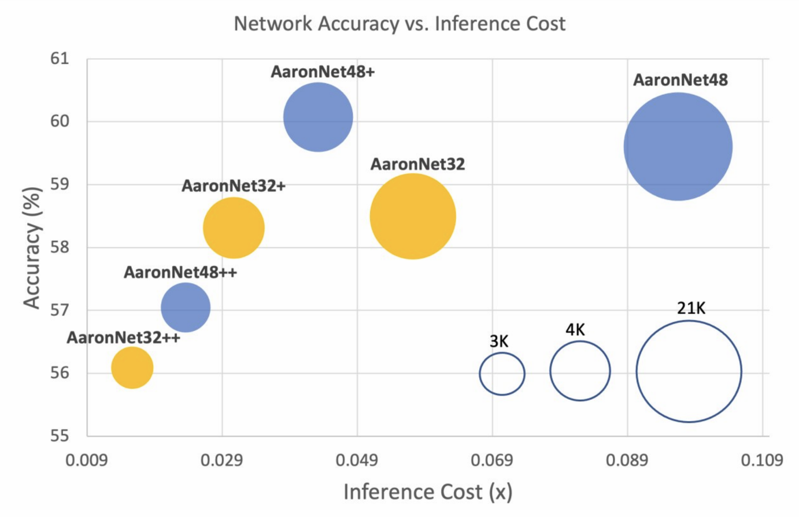
Results: Final Round
Using A6000 RTX GPU
Trained and pruned variations of AaronNet
Highest Accuracy: AaronNet48+
Accuracy = 60.07%
23x inference cost (0.04320)
Best Cost: AaronNet32++
Acceptable accuracy 56.07%
64x inference cost (0.01539)
Lower is better

Slide 14
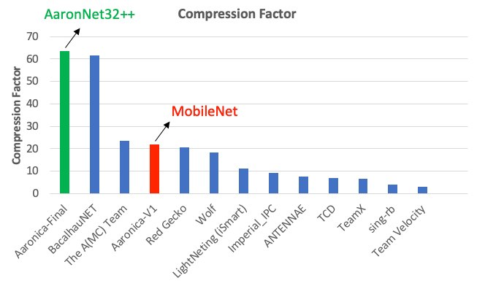
Results: Final Standing

Slide 15

Questions

