Slide 1




ITU-ML5G-PS-007
Lightning-Fast Modulation Classification
With Hardware-Efficient Neural Networks
Aaronica Team
Mohammad Chegini ^{[1]} , Pouya Shiri ^{[2]} , Amirali Baniasadi ^{[3]}
International Telecommunication Union
Organized by Xilinx
[1] Shahid Beheshti University. mohammad.chegini@hotmail.com [2] University of Victoria. pouyashiri@uvic.ca
[3] University of Victoria. amiralib@uvic.ca

Slide 2
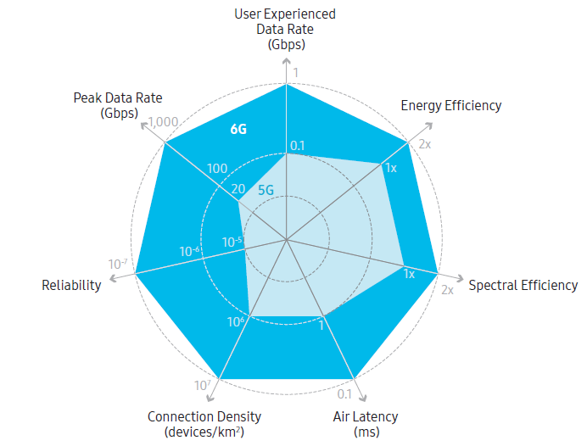
Our Goal
Develop a Deep Neural Network (DNN)
Target: Radio Frequency (RF) applications
Extreme Throughput
Ultra-Low Latency
Highly Energy Efficiency
Example RF Application
6G Communication Networks
Modulation Classification

Slide 3
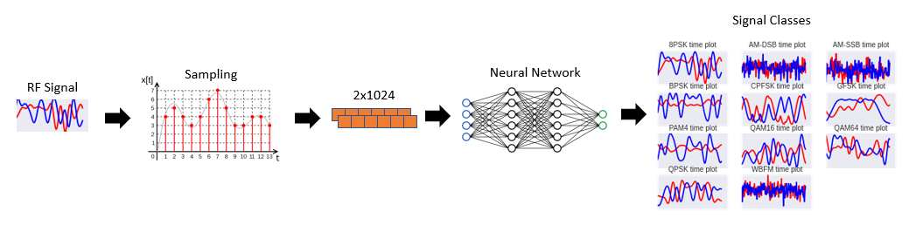
Modulation classification (MC)
Modulation Classification
A well-known problem in RF domain
Requires high throughput and low latency
MC Applications
Spectrum interference monitoring
Radio fault detection
Dynamic spectrum access
Numerous regulatory and defense applications
Notes:
Reference: https://static-01.hindawi.com/articles/mpe/volume-2020/2678310/figures/2678310.fig.001.svgz

Slide 4
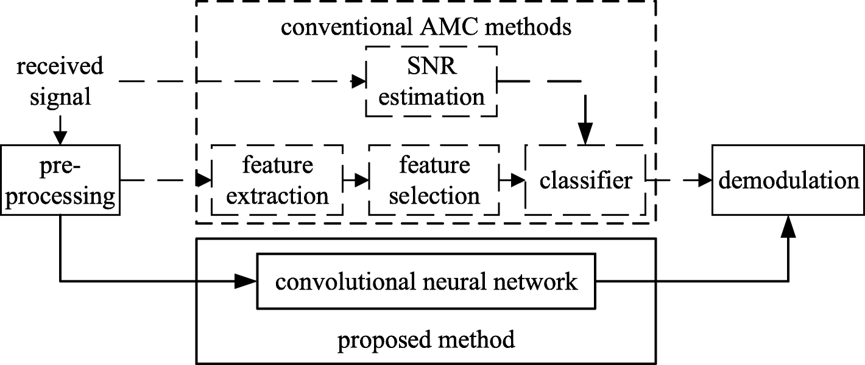
DNN for Modulation Classification
DNNs are promising tools for analyzing raw data
Pros:
Higher accuracy w.r.t conventional methods
Automatic feature extraction
Cons:
Design complications
Computationally expensive
Resource demanding (but we need high throughput and low-latency!)
Our objective: design a DNN specialized for RF domain applications
Notes:
What is reference

Slide 5
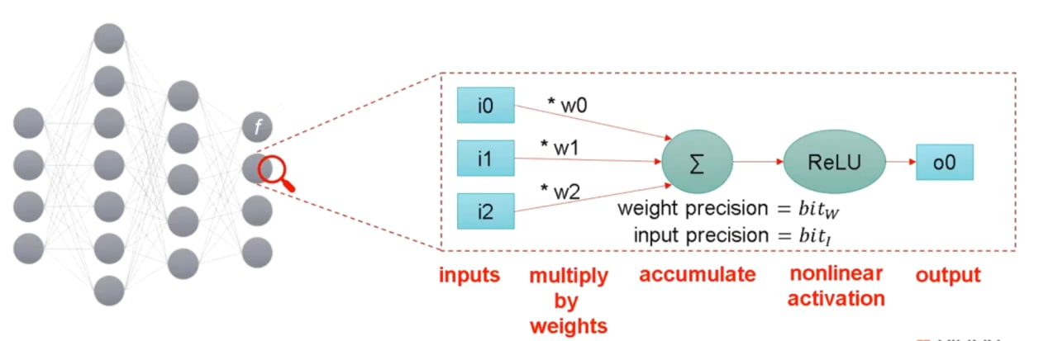
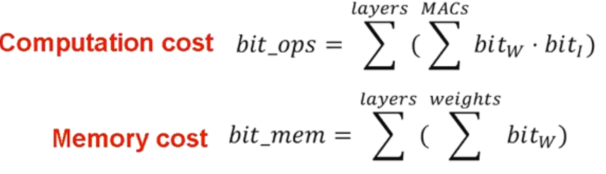
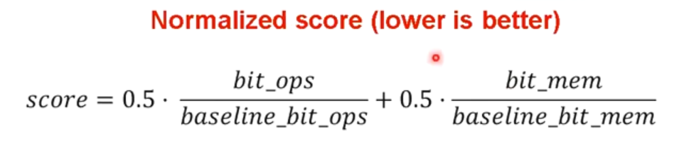
Evaluation metrics
In RF-Domain, we generally require hardware implementation.
Hardware implementation performance indexes:
FLOPs
MACs
Accuracy

Slide 6
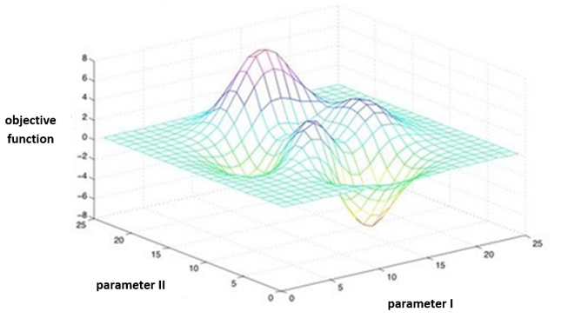
Design Complications
Domain-specific DNN Design
Choice of network architecture
Network modifications:
Type/Number of layers/filters
Network compression techniques (Quantization, etc.)
Exhaustive search options
Grid Search
Evolutionary Algorithms (Genetic Algorithm, PSO, …)
Neural Architecture Search (Using Reinforcement Learning, …)
Time-Consuming and Resource Hungry
Notes:
Grid search: https://www.oreilly.com/library/view/statistics-for-machine/9781788295758/e4dac91e-0078-4c8a-a44f-78a28abb649b.xhtml

Slide 7
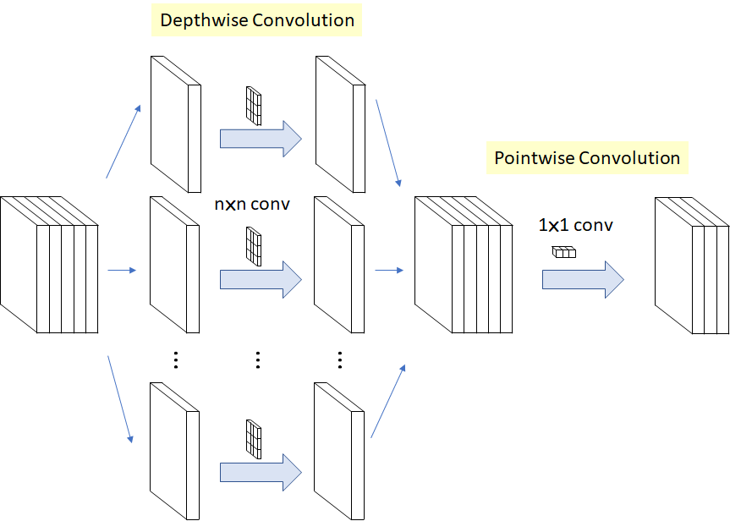
Possible DNNs
VGG, Inception, ResNet, MobileNet, ShuffleNet
Each networks has innovations to stand out
MobileNet
Pointwise and depthwise convolution
Reducing the number of multiplications
More processing power in shorter time
Notes:
Mobilenet: https://towardsdatascience.com/review-xception-with-depthwise-separable-convolution-better-than-inception-v3-image-dc967dd42568

Slide 8

Problem statement
Minimize inference cost on the challenging and well known RadioML 2018 dataset
Minimum final accuracy: 56%
Solutions of Aaronica Team
Initial round: Pruning MobileNet
Final round: Designing AaronNet Network
A potential network for RF domain applications
Identification of RF-interference
RF Fingerprint

Slide 9
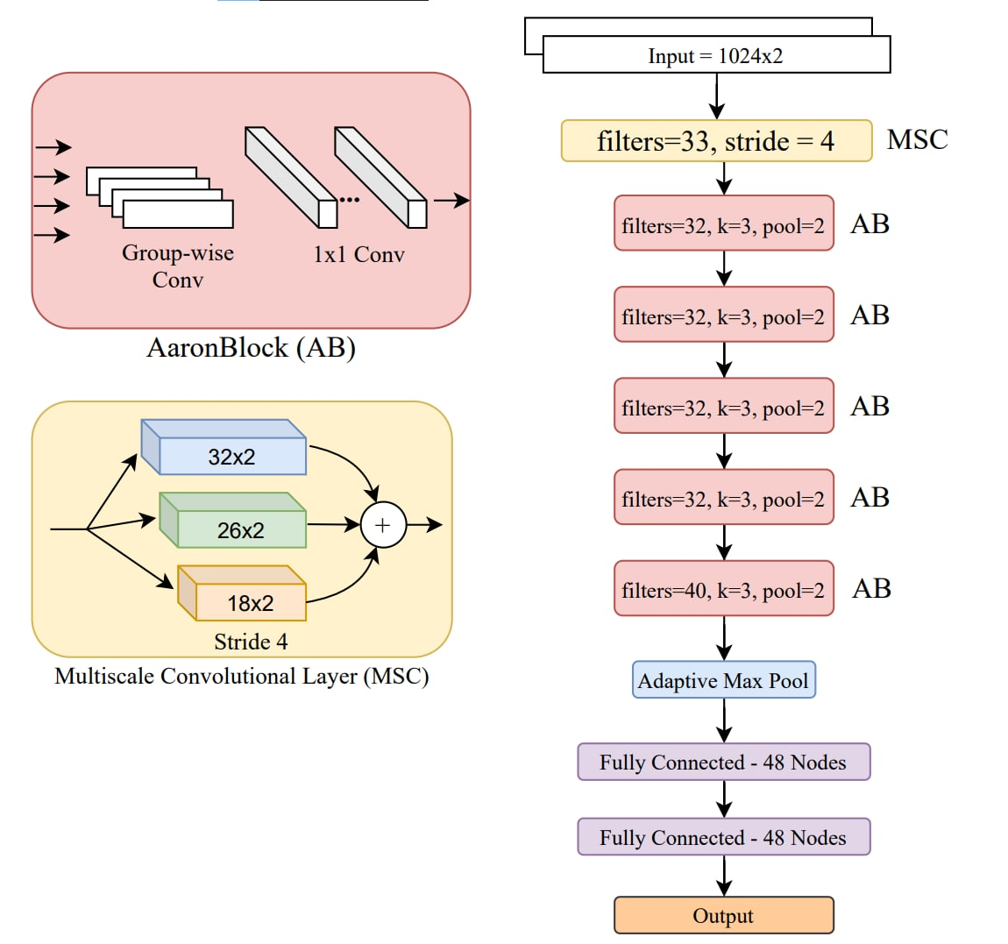
AaronNet
Specialized for RF-domain
Group-Wise convolutions
Introducing Multi-Scale Convolutional (MSC) layer
Customized for RF signal input
Adaptive Max Pooling

Slide 10
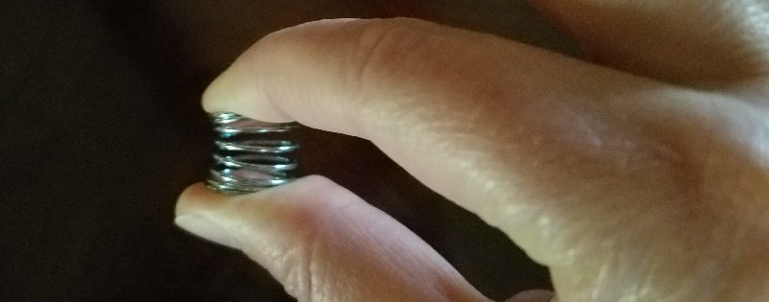
AaronNet Variations
Compressing AaronNet -> AaronNet-Small
Significant results using the following methods:
Knowledge distillation
Layer-wise quantization
Layer-wise pruning
Using Self-attention mechanism SE block
Unstructured pruning (More energy efficiency)
Structured pruning (More hardware friendly)
The best results we had so far: Unstructured Pruning
Finalizing our paper for submission
Notes:
Spring: https://alexanderteachingstudio.com/dont-compress-yourself-improving-your-posture-by-doing-less/

Slide 11
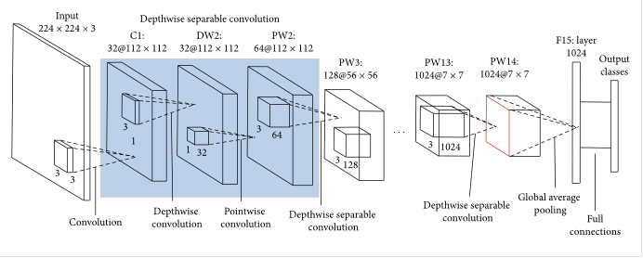
Results: Initial Round
Baseline for inference cost: VGG network
Inference cost = 1
Accuracy = 59.46%
Unstructured Pruning of MobileNet (initial round)
Using P100 GPU on Kaggle
Accuracy = 56.15%
21x inference cost (0.046)

Slide 12
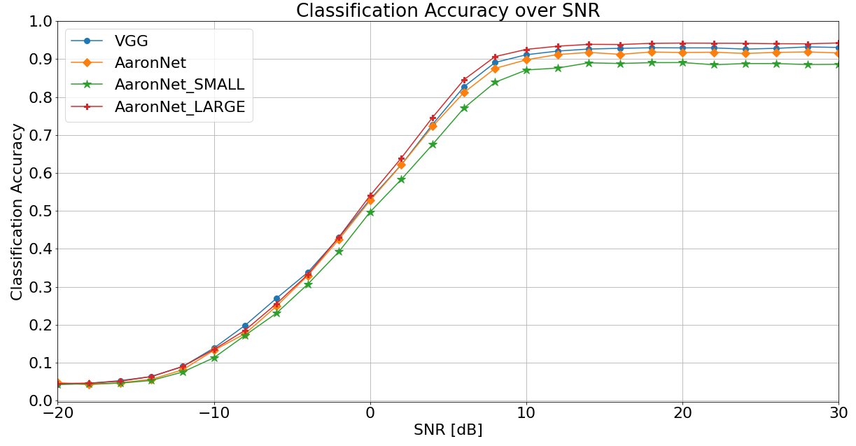
Results: Final Round
AaronNet_LARGE
AaronNet with more filters
Accuracy = 60.07%
23x inference cost (0.04320)
AaronNet
Base net used for pruning
Accuracy = 58.48
17x inference cost (0.05722)
AaronNet_SMALL
Pruned AaronNet
Acceptable accuracy 56.07%
64x inference cost (0.01539)
Using A6000 RTX GPU (LambdaLabs)

Slide 13

Questions

