Slide 1




ITU-ML5G-PS-007
Lightning-Fast Modulation Classification
With Hardware-Efficient Neural Networks
Aaronica Team
Mohammad Chegini ^{[1]} , Pouya Shiri ^{[2]} , Amirali Baniasadi ^{[3]}
International Telecommunication Union
Organized by Xilinx
[1] Shahid Beheshti University. mohammad.chegini@hotmail.com [2] University of Victoria. pouyashiri@uvic.ca
[3] University of Victoria. amiralib@uvic.ca

Slide 2
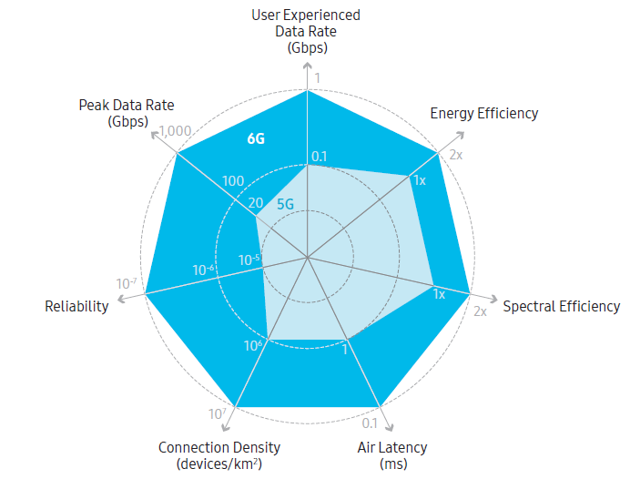
Our Goal
Develop a Deep Neural Network (DNN)
Target: Radio Frequency (RF) applications
Extreme Throughput
Ultra-Low Latency
Highly Energy Efficiency
Example RF Application
6G Communication Networks
Modulation Classification

Slide 3
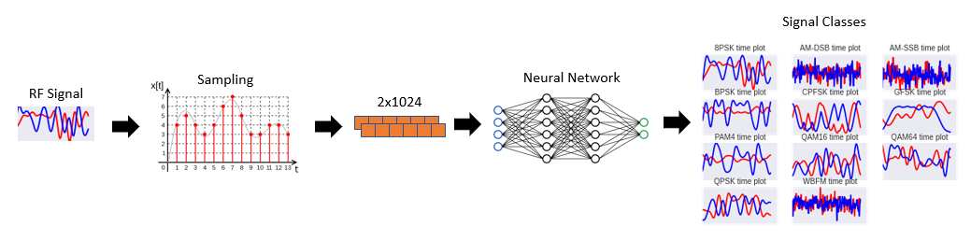
Modulation classification (MC)
Modulation Classification
A well-known problem in RF domain
Requires high throughput and low latency
MC Applications
Spectrum interference monitoring
Radio fault detection
Dynamic spectrum access
Numerous regulatory and defense applications
Notes:
Reference: https://static-01.hindawi.com/articles/mpe/volume-2020/2678310/figures/2678310.fig.001.svgz

Slide 4
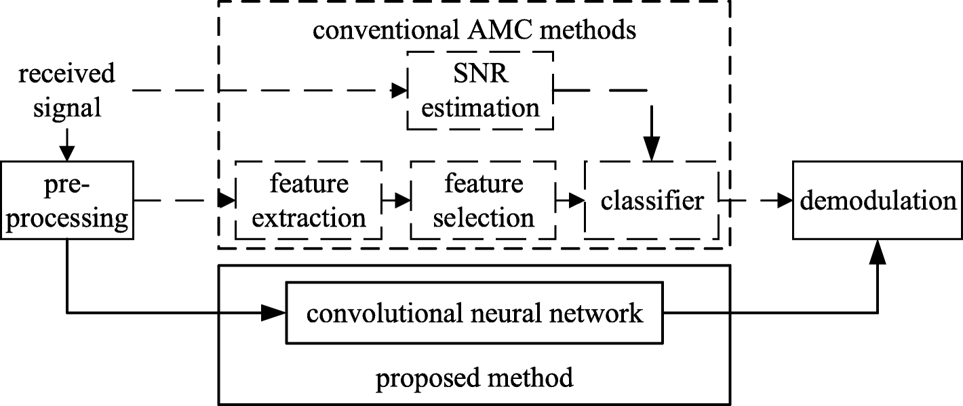
DNN for Modulation Classification
DNNs are promising tools for analyzing raw data
Pros:
Higher accuracy w.r.t conventional methods
Automatic feature extraction
Cons:
Design complications
Computationally expensive
Resource demanding (but we need high throughput and low-latency!)
Our objective: design a DNN specialized for RF domain applications
Notes:
What is reference

Slide 5
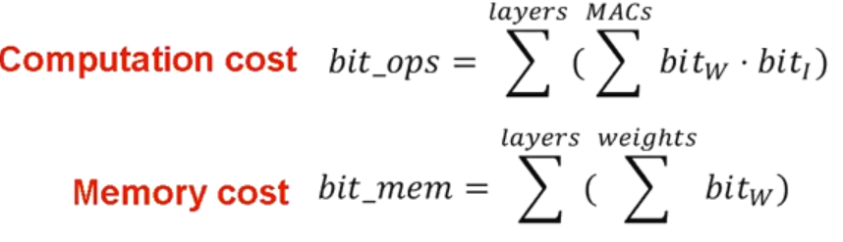
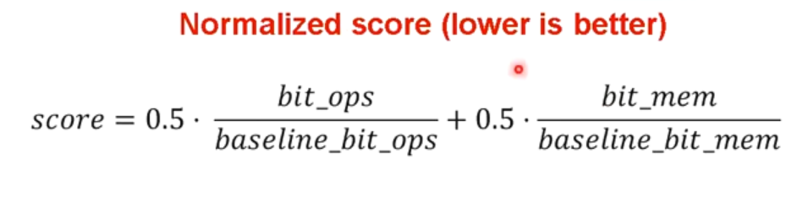
Evaluation metrics
In RF-Domain, we generally require hardware implementation.
Hardware implementation performance indexes:
FLOPs
MACs
Accuracy
Inference Cost:

Slide 6
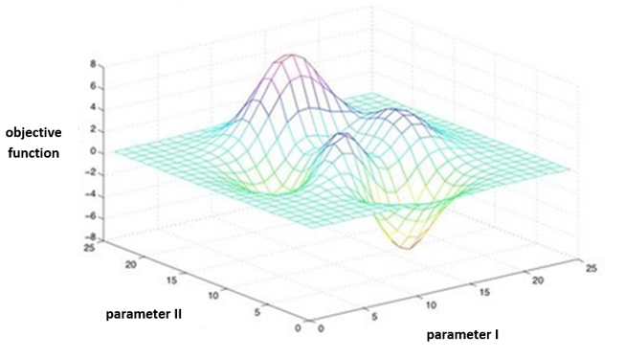
Design Complications
Domain-specific DNN Design
Choice of network architecture
Network modifications:
Type/Number of layers/filters
Network compression techniques (Quantization, etc.)
Exhaustive search options
Grid Search
Evolutionary Algorithms (Genetic Algorithm, PSO, …)
Neural Architecture Search (Using Reinforcement Learning, …)
Time-Consuming and Resource Hungry
Notes:
Grid search: https://www.oreilly.com/library/view/statistics-for-machine/9781788295758/e4dac91e-0078-4c8a-a44f-78a28abb649b.xhtml

Slide 7
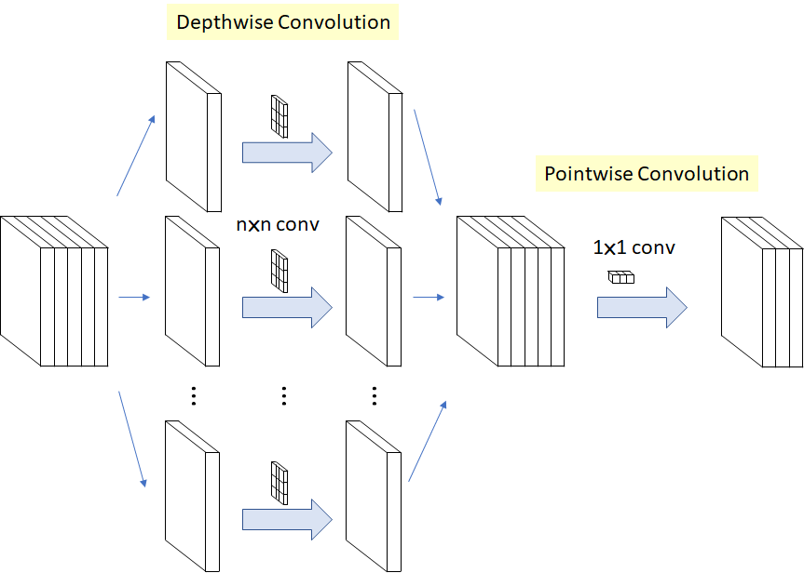
Possible DNNs
VGG, Inception, ResNet, MobileNet, ShuffleNet
Each networks has innovations to stand out
MobileNet:
Pointwise and depthwise convolution
XXX PROS
Notes:
Mobilenet: https://towardsdatascience.com/review-xception-with-depthwise-separable-convolution-better-than-inception-v3-image-dc967dd42568

Slide 8

Problem statement
Minimize inference cost on the challenging and well known RadioML 2018 dataset
Our solution: AaronNet Network
A potential network for RF domain applications
Identification of RF-interference
RF Fingerprint

Slide 9
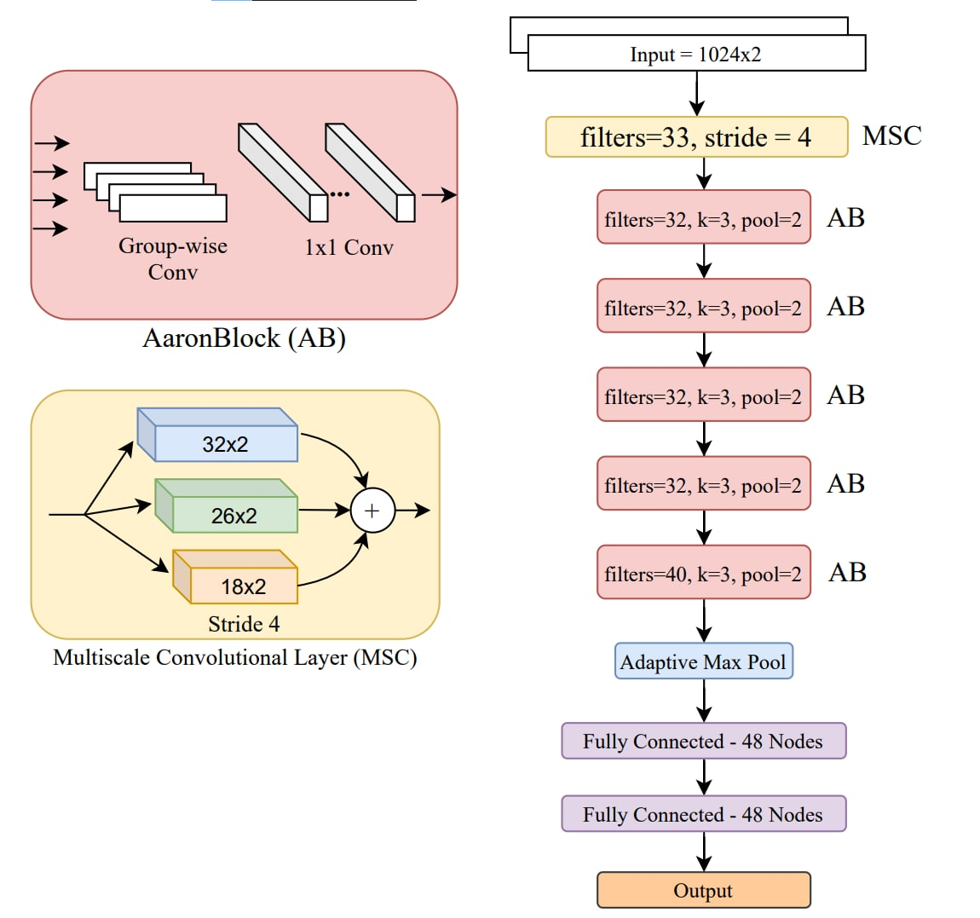
AaronNet
Specialized for RF-domain
Group-Wise convolutions
Introducing Multi-Scale Convolutional (MSC) layer
Customized for RF signal input
Adaptive Max Pooling

Slide 10
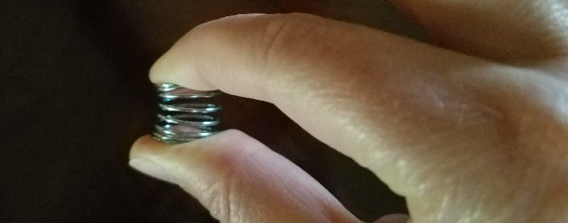
AaronNet++
Compressing AaronNet -> AaronNet-Small
Significant results using the following methods:
Knowledge distillation
Layer-wise quantization
Layer-wise pruning
Using Self-attention mechanism SE block
Unstructured pruning (More energy efficiency)
Structured pruning (More hardware friendly)
We have ongoing research on these methods and here we present out best result so far.
Notes:
Spring: https://alexanderteachingstudio.com/dont-compress-yourself-improving-your-posture-by-doing-less/

Slide 11
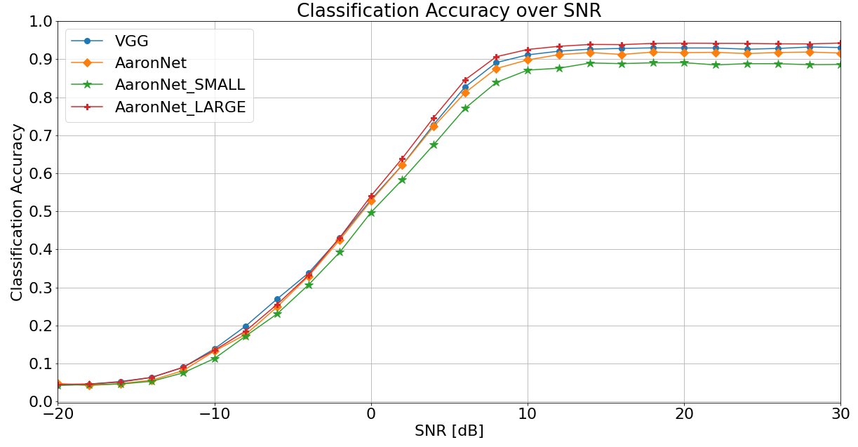
Results
24x smaller inference cost vs. baseline (VGG)
Higher Accuracy (60.07% vs. 59.46%)

Slide 12
Results
 |  | total_bops | total_mem_w_bits | Inference Cost | Compression
Base | VGG_Xilinx | 807699904 | 1244936 | 1 | 1
Highest Acc | Inception 48 | 36058800 | 52002 | 0.04320731533 | 23.14422899
Base | Inception 32 | 43816008 | 74946 | 0.05722428284 | 17.47509886
Smallest | Inception 32 | 13068840 | 18960 | 0.01570500748 | 63.67395887

Slide 13

Questions

