Slide 1




ITU-ML5G-PS-007
Lightning-Fast Modulation Classification
With Hardware-Efficient Neural Networks
Aaronica Team
Mohammad Chegini ^{[1]} , Pouya Shiri ^{[2]} , Amirali Baniasadi ^{[3]}
International Telecommunication Union
Organized by Xilinx
[1] Shahid Beheshti University. mohammad.chegini@hotmail.com [2] University of Victoria. pouyashiri@uvic.ca
[3] University of Victoria. amiralib@uvic.ca

Slide 2
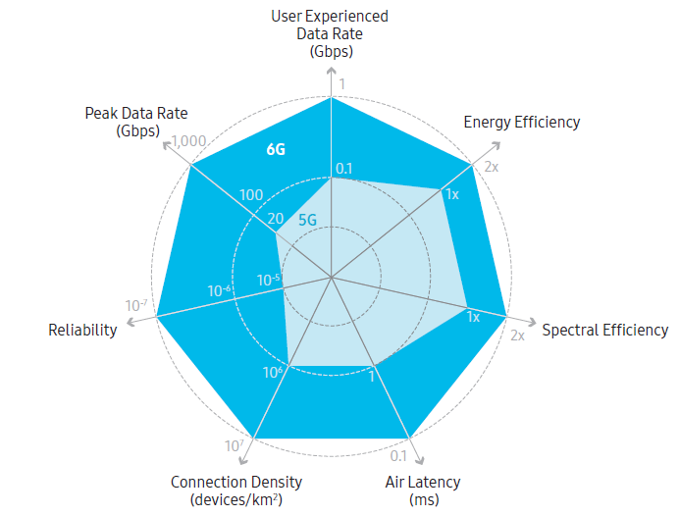
Our Goal
Develop a Deep Neural Network (DNN)
Target: Radio Frequency (RF) applications
Extreme Throughput
Ultra-Low Latency
Highly Energy Efficiency
Example RF Application
6G Communication Networks
Modulation Classification

Slide 3
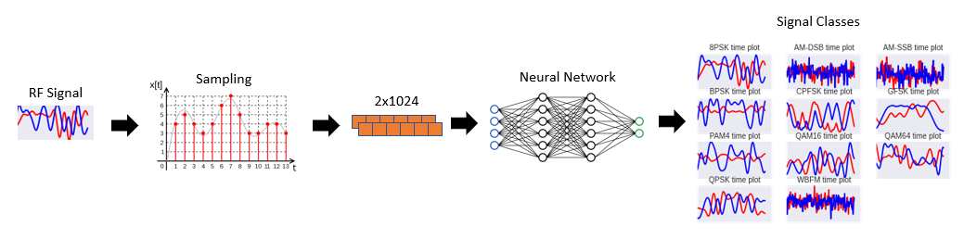
Modulation classification (MC)
Modulation Classification
A well-known problem in RF domain
Requires high throughput and low latency
MC Applications
Spectrum interference monitoring
Radio fault detection
Dynamic spectrum access
Numerous regulatory and defense applications
Notes:
Reference: https://static-01.hindawi.com/articles/mpe/volume-2020/2678310/figures/2678310.fig.001.svgz

Slide 4
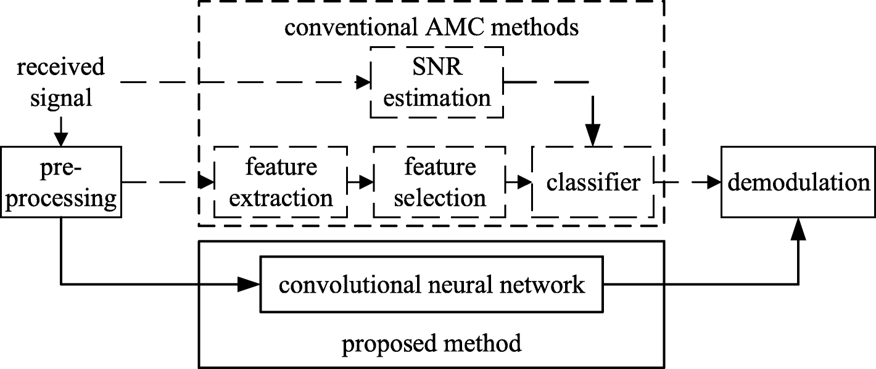
DNN for Modulation Classification
DNNs are promising tools for analyzing raw data
Pros:
Higher accuracy w.r.t conventional methods
Automatic feature extraction
Cons:
Design complications
Computationally expensive
Resource demanding (but we need high throughput and low-latency!)
Our objective: design a DNN specialized for RF domain applications
Notes:
What is reference

Slide 5
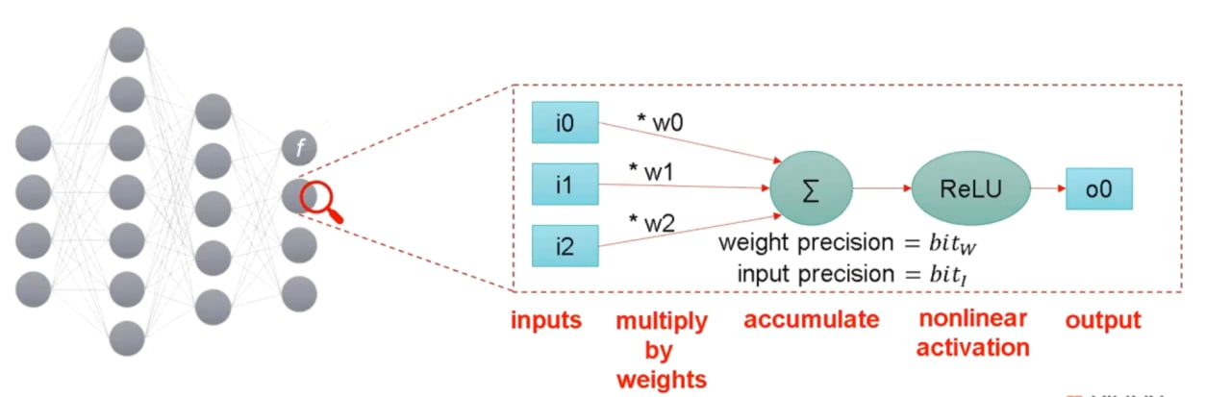
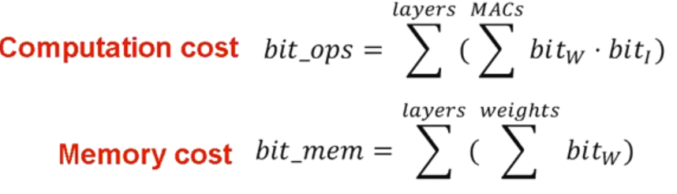
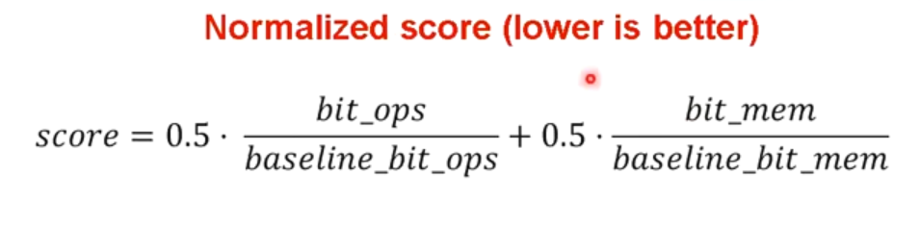
Evaluation metrics
In RF-Domain, we generally require hardware implementation.
H/W performance indexes:
FLOPs
MACs
Accuracy

Slide 6
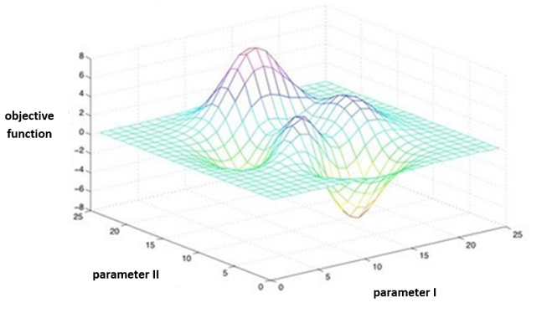
Design Complications
Domain-specific DNN Design
Choice of network architecture
Network modifications:
Type/Number of layers/filters
Network compression techniques (Quantization, etc.)
First option: Exhaustive search
Grid Search
Evolutionary Algorithms (Genetic Algorithm, PSO, …)
Neural Architecture Search (Using Reinforcement Learning, …)
Time-Consuming and Resource Hungry for large Datasets
Notes:
Grid search: https://www.oreilly.com/library/view/statistics-for-machine/9781788295758/e4dac91e-0078-4c8a-a44f-78a28abb649b.xhtml

Slide 7

Problem statement
Minimize inference cost on the challenging and well known RadioML 2018 dataset
Minimum final accuracy: 56%
Solutions of Aaronica Team
Initial round: Pruning MobileNet
Got 3rd place
Final round: AaronNet Network
Designd a specialized DNN after the initial round
A potential network for RF domain applications
Identification of RF-interference
RF Fingerprint

Slide 8
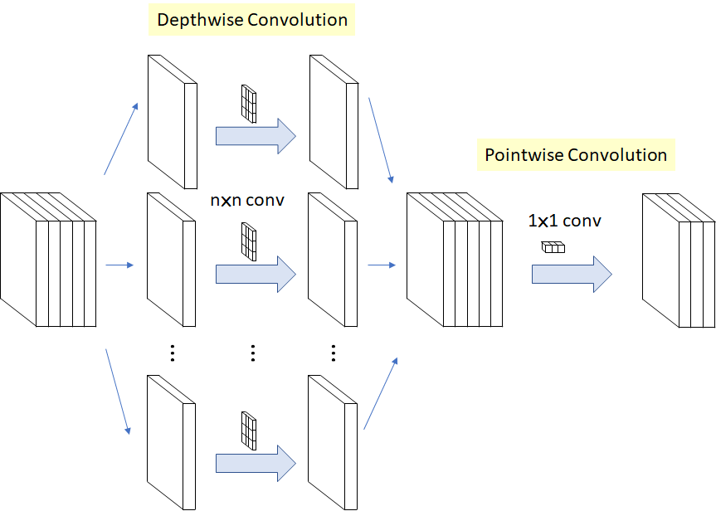
Possible DNNs
VGG, Inception, ResNet, MobileNet, ShuffleNet
Each networks has innovations to stand out
MobileNet
Pointwise and depth-wise convolution
Reducing the number of multiplications
Higher throughput with lower computation cost
Notes:
Mobilenet: https://towardsdatascience.com/review-xception-with-depthwise-separable-convolution-better-than-inception-v3-image-dc967dd42568

Slide 9
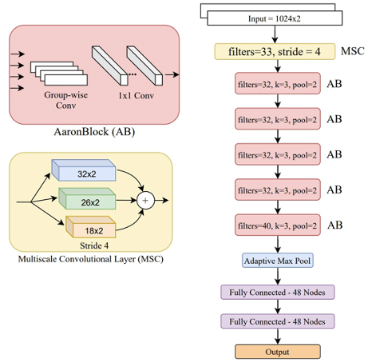
AaronNet
Specialized for RF-domain
Group-Wise convolutions
Introducing Multi-Scale Convolutional (MSC) layer
Specialized for RF signal input
Adaptive Max Pooling
Variations
AaronNet32: 32 filters
AaronNet48: 48 filters
AaronNet Architecture

Slide 10
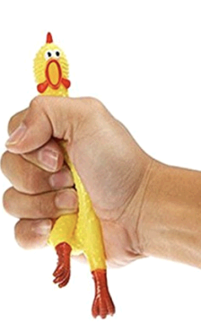
Optimizing AaronNet
Significant results using the following methods:
Layer-wise quantization and pruning
Using Self-attention mechanism SE block
Unstructured pruning (More energy efficiency)
Structured pruning (More hardware friendly)
The best results we had so far: Unstructured Pruning
AaronNet+ → Slightly pruned AaronNet
AaronNet++ → Highly pruned AaronNet
Finalizing our paper for submission
Notes:
Spring: https://alexanderteachingstudio.com/dont-compress-yourself-improving-your-posture-by-doing-less/

Slide 11
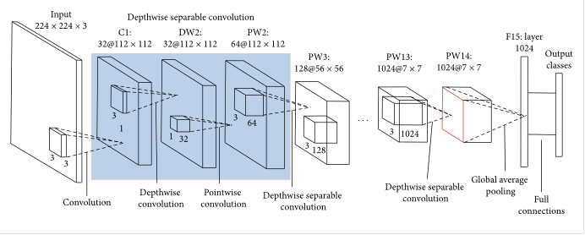
Results: Initial Round
Baseline for inference cost: VGG network
Inference cost = 1
Accuracy = 59.46%
Unstructured Pruning of MobileNet (initial round)
Using P100 GPU on Kaggle
Accuracy = 56.15%
21x inference cost improved (0.046)
MobileNet Architecture

Slide 12
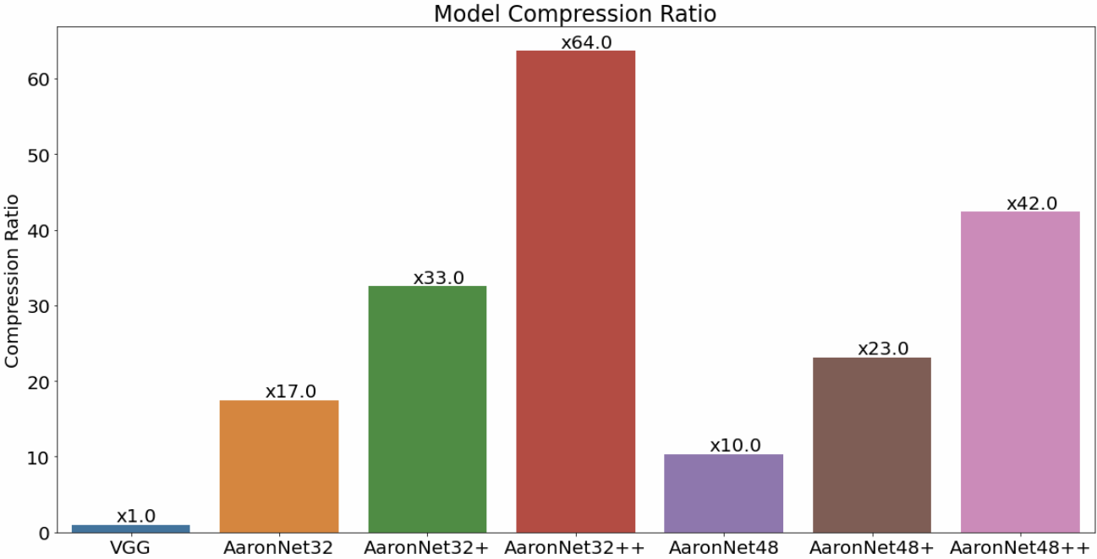
Results: Final Round
Highest Accuracy: AaronNet48+
Accuracy = 60.07%
23x inference cost (0.04320)
Best Cost: AaronNet32++
Acceptable accuracy 56.07%
64x inference cost (0.01539)
Using A6000 RTX GPU

Slide 13
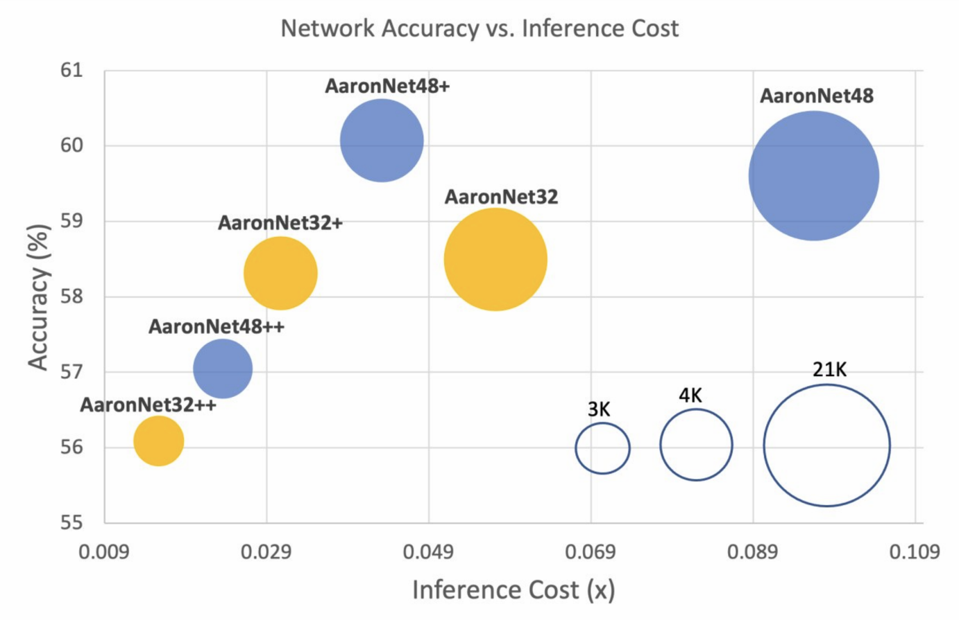
Results: Final Round

Slide 14
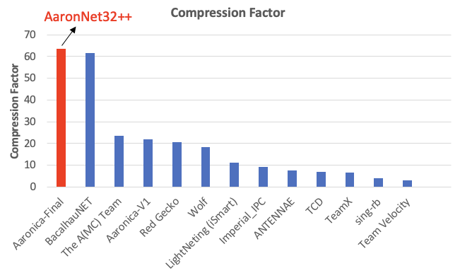
Results: Final Standing

Slide 15

Questions

