Slide 1
ITU-ML5G-PS-007: Automatic Modulation Classification
December 2, 2021

Slide 2
Red GECKO Team
Members:
Brad Stimpson
Shahram Mollahasani (Postdoc at Dr. Melike Erol-Kantarci’s lab. at University of Ottawa)
Armand Kamary
Advisors:
Alex Shatsky
Felix Dujmenovic
Ali Arad

Slide 3
Literature Review and Study

Slide 4
List of Articles
Real-time Automatic Modulation Classiﬁcation using RFSoC, Stephen Tridgell et al.
Automatic Modulation Classification Using CNN-LSTM Based Dual-Stream Structure, Zufan Zhang et al.
AMC-IoT: Automatic Modulation Classification Using Efficient Convolutional Neural Networks for Low Powered IoT Devices, Muhammad Usman et al.
Deep Learning Techniques for Automatic Modulation Classification: A Systematic Literature Review, Sara Ali Ghunaim et al.
Automatic Modulation Classification Using Gated Recurrent Residual Network, Sai Huang et al.
Acceleration of Deep Convolutional Neural Networks Using Adaptive Filter Pruning, Pravendra Singh et al.
Hardware Implementation of Automatic Modulation Classification with Deep Learning, Satish Kumar et al.

Slide 5
Alternative Neural Networks
Thinking out of the box

Slide 6
Alternative networks
Our team has implemented several alternative automatic modulation classification neural networks such as
VGG-16
Ternary Weight Network (TWN) based on Stephen Tridgell et al. research

Slide 7
Red Gecko Team approach

Slide 8
SNR Based Outlier Rejection
Low SNR samples act as outliers and reduce the accuracy
We manually removed/pruned the low SNR samples
# you could train on a subset of the data, e.g. based on the SNR
# here we use all available training samples
if snr_idx >= 4:
train_indices.extend(train_indices_subclass)
test_indices.extend(test_indices_subclass)

Slide 9
Change the network Hyperparameters
We set number of input quantization, weights and activation bits to 5
We downsized the kernel size of our convolutional layers to 28
Following the above change, we downsized the dense layer input size to 28

Slide 10
Pruning
We use L1 unstructured pruning technique with ratio 0.5 on all convolutional layers.
def prune_model_l1_unstructured(model, layer_type, proportion):
for module in model.modules():
if isinstance(module, layer_type):
prune.l1_unstructured(module, 'weight', proportion)
prune.remove(module, 'weight')
return model
model = prune_model_l1_unstructured(model, qnn.QuantConv1d, 0.5)

Slide 11
Training Improvements
We changed the starting learning rate of Adam optimization algorithm to 0.1
We further changed the learning rate scheduler:
For epochs less than 100 we used Cosine Annealing learning rate scheduler
For epochs beyond 100 we used Stochastic Weight Averaging (SWA) learning rate scheduler
optimizer = torch.optim.Adam(model.parameters(), lr=0.01)
swa_model = torch.optim.swa_utils.AveragedModel(model)
swa_scheduler = torch.optim.swa_utils.SWALR(optimizer, swa_lr=0.001)
lr_scheduler = torch.optim.lr_scheduler.CosineAnnealingLR(optimizer, T_max=num_epochs)

Slide 12
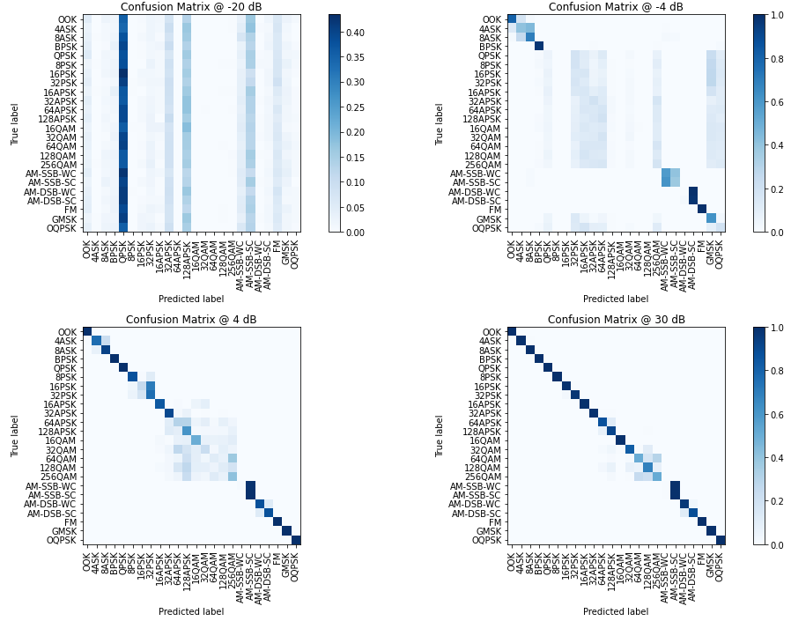
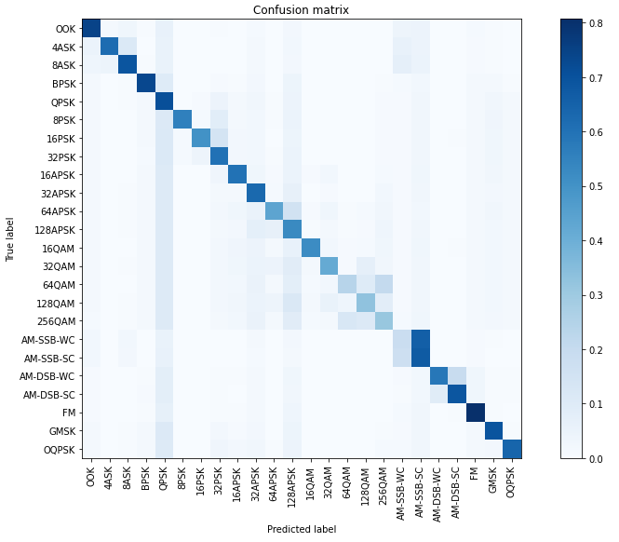
Results

Slide 13
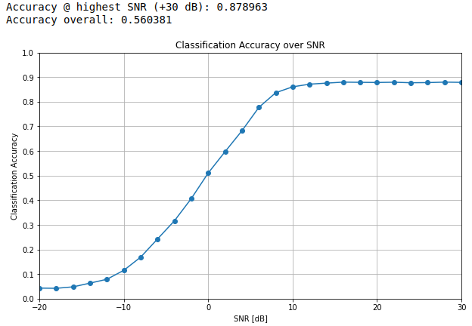
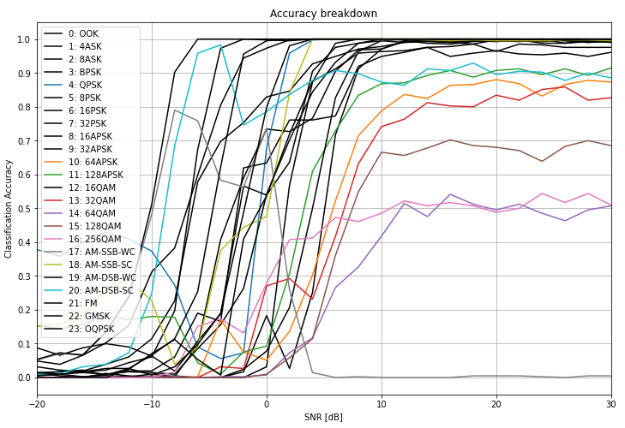
Results

Slide 14
Red Gecko

