Slide 1
Build-a-thon: A Journey from Usecase, Graph to Deployment
Presented by: Tech Rangers Team
Emmanuel Othniel Eggah emmanueleggah@gmail.com
Ebeledike Frank Chukwubuikem frankcebeledike@gmail.com
Abel Oche Moses oche.m1902995@st.futminna.edu
Mentors
Professor James Agajo james.agajo@futminna.edu.ng
Mr. Blessed Guda gudablessed@gmail.com

Slide 2
TABLE OF CONTENT
The problem
The existing solutions
Our solutions
Advantages of our solution
Gaps for current work
Demo points and results

Slide 3
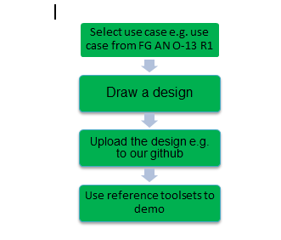
THE PROBLEM
High complexity of network management in 5G
Lack of domain knowledge base related to the usecase
deploying components in the network is error prone and complex
Need resource heavy development environment

Slide 4
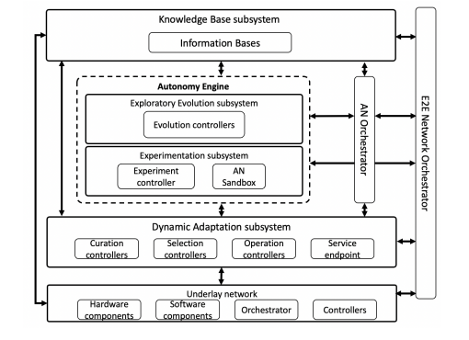
THE EXISTING SOLUTION
Manual steps for creating and deploying the components
Domain knowledge is captured in the code.
Use Python/Jupyter lab with hosted database from a workstation

Slide 5
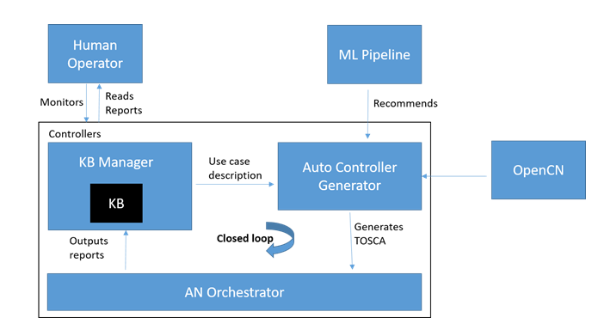
OUR SOLUTION
We built a closed loop system that is able to manage storage, querying, export, import and optimization of knowledge, including structured or unstructured data from various components within and outside the system.
We automated the process of translating, parsing and validating an abstracted use case description, with high level objectives of a controller (use case) into a controller description.

Slide 6
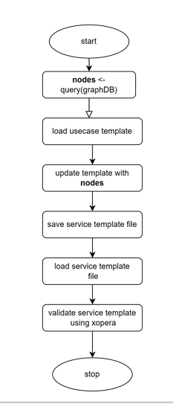
ADVANTAGES OF OUR SOLUTION
The closed loop AN design by the team will be able to import, export, store and optimize knowledge independently at high speed and low latency with no human intervention
Our solution automates the process of translating, parsing and validating an abstracted use case description.

Slide 7
GAPS FOR CURRENT WORK
intents may be specified in natural human language into network configuration

Slide 8
VIDEO DEMO
Video demo url: https://youtu.be/x3DUNSKg4yk

Slide 9
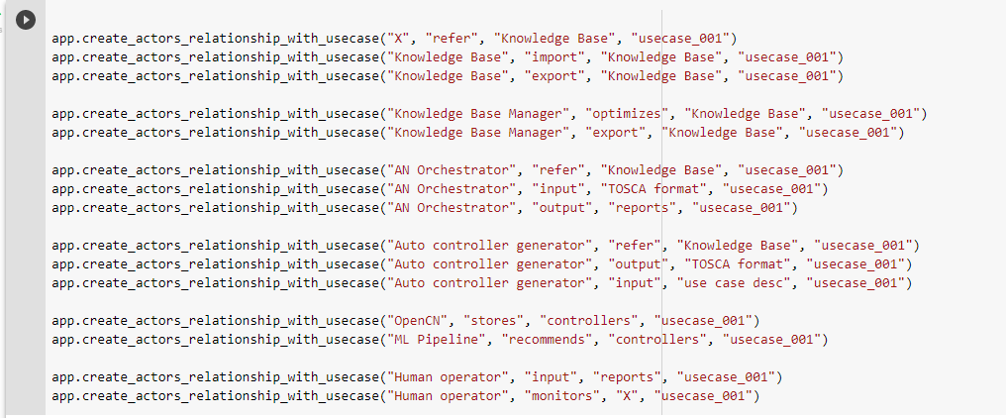
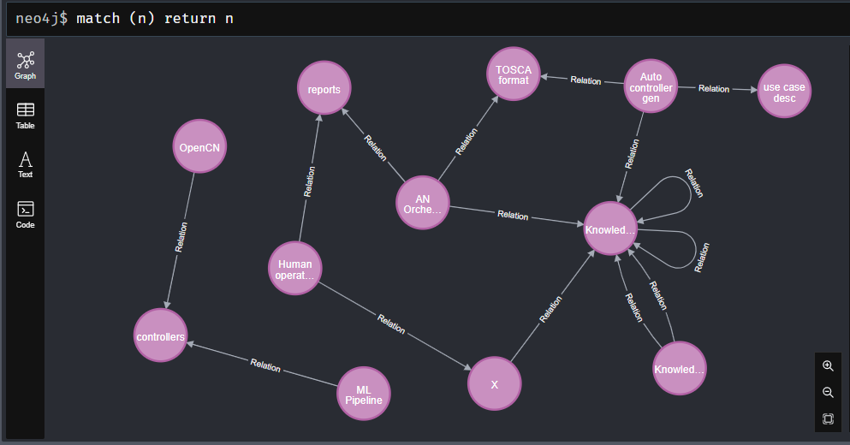
PoC Results
Usecase Template
Neo4j DB Graph

Slide 10
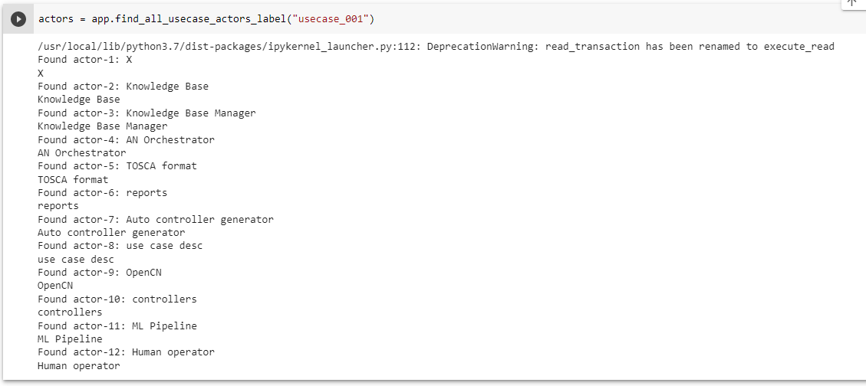
PoC Results
Querying graph database

Slide 11
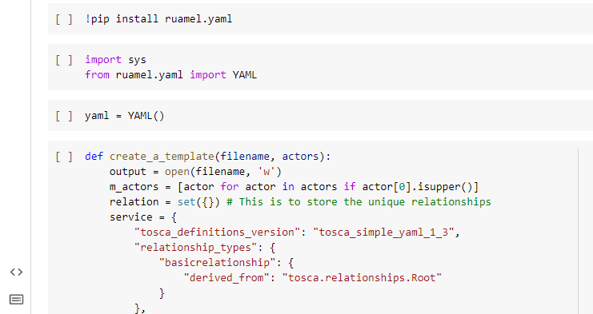
PoC Results
Graph Conversion to Service template

Slide 12
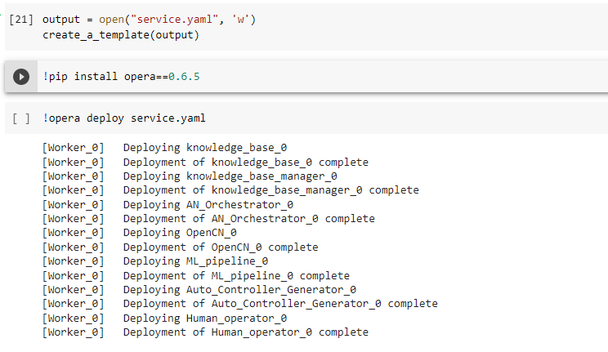
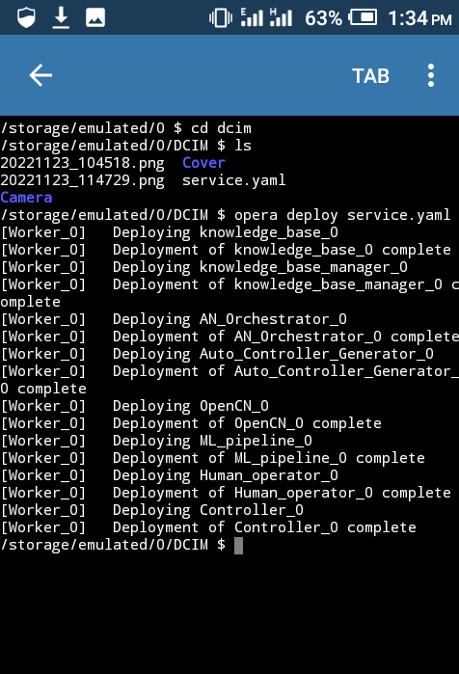
PoC Results
Validation of Service Template using XOpera
on Colab
on Pydroid (Android)

Slide 13

THANK YOU

