Slide 1
Build-a-thon: A Journey from Usecase, Graph to Deployment
Presented by: Tech Rangers Team

Slide 2
TABLE OF CONTENT
The problem
The existing solutions
Our solutions
Advantages of our solution
Recommendation for future works
Demo points and results

Slide 3
THE PROBLEM
High complexity of network management in 5G
Lack of usecase related to knowledge base domain
Manual task for creating deployable components from actors in use cases
Need resource heavy development environment

Slide 4
THE EXISTING SOLUTION
Manual steps for creating and deploying the components
Use Jupyter lab with hosted database from a workstation

Slide 5
OUR SOLUTION
We built a closed loop system that is able to manage storage, querying, export, import and optimization of knowledge, including structured or unstructured data from various components within and outside the system.
We automated the process of translating, parsing and validating an abstracted use case description, with high level objectives of a controller (use case) into a controller description.

Slide 6
ADVANTAGES OF OUR SOLUTION
The closed loop AN design by the team will be able to import, export, store and optimize knowledge independently at high speed and low latency with no human intervention
Our solution automates the process of translating, parsing and validating an abstracted use case description.

Slide 7
RECOMMENDATION FOR FUTURE WORKS
Possibility on how intents can be translated from natural human language into network configuration

Slide 8
VIDEO DEMO

Slide 9
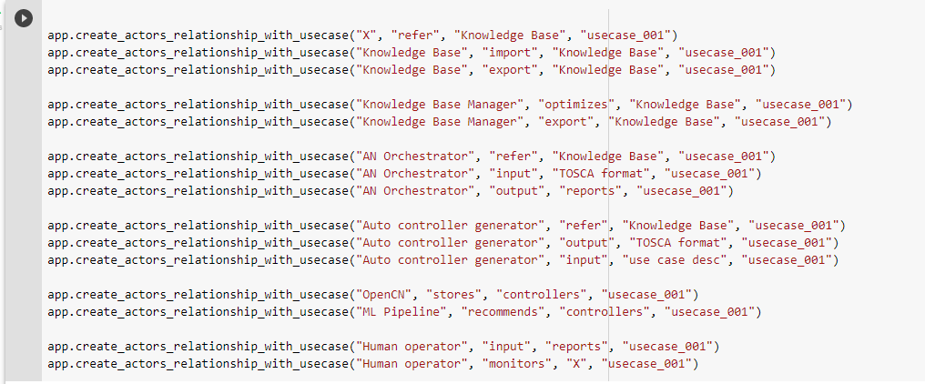
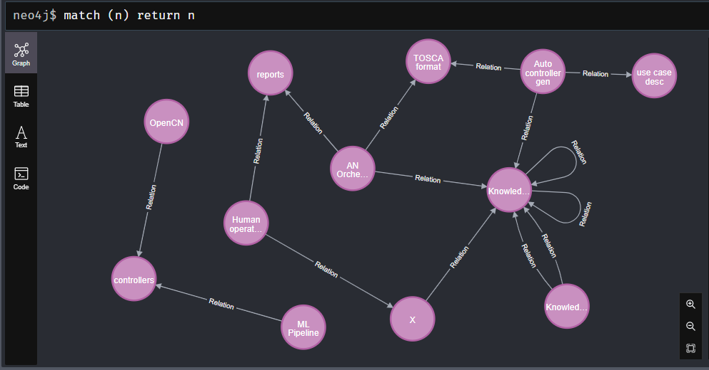
PoC Results
Usecase Template
Neo4j DB Graph

Slide 10
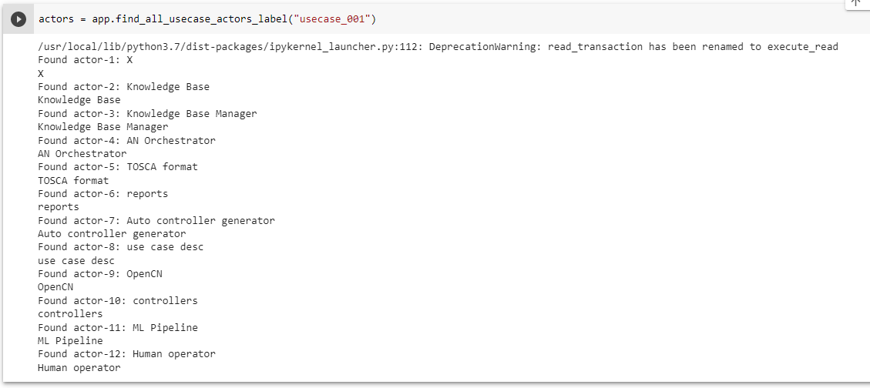
PoC Results
Querying graph database

Slide 11
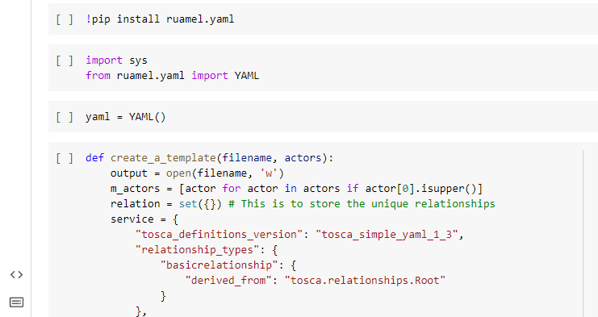
PoC Results
Graph Conversion to Service template

Slide 12
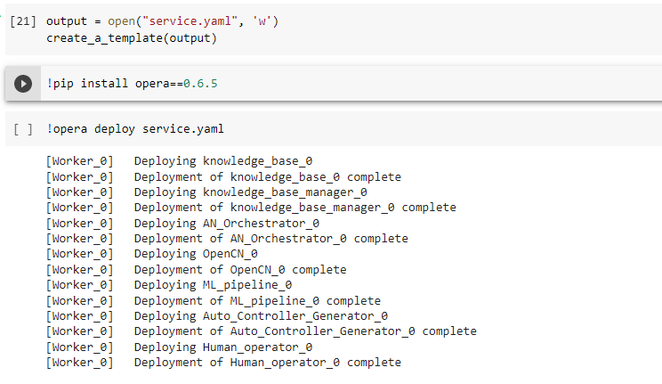
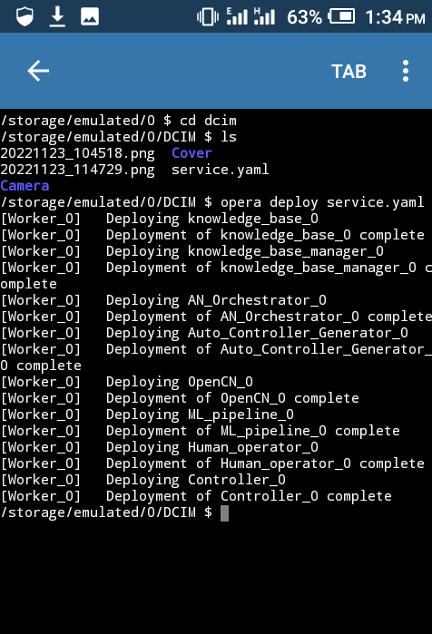
PoC Results
Validation of Service Template using XOpera
on Colab
on Pydroid (Android)

Slide 13

THANK YOU

