Slide 1

ITU-ML5G-PS-014: Build-a-thon(PoC)
Team: Automato
Mehmet Karaca & Doruk TaylI & Özge simay demirci 30 Nov 2021
HOST: ITU Focus Group Autonomous networks (FG-AN)

Slide 2
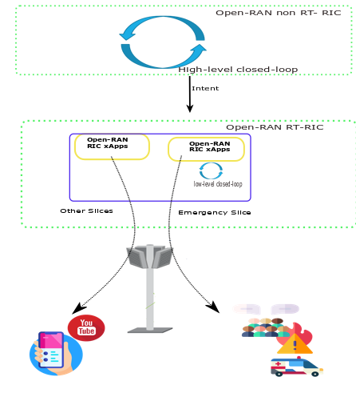
Problem Definition
Make resource allocation decision for
emergency slice İn an autonomous way:
Get & parse high-level intent
Requirements for ES
Information regarding data, ML models
Make traffic analysis
Admission & priority control
Make resource allocation

Slide 3
Building Blocks
İnten parsing
(.json)
Traffic Forcasting
Admission & Priority control
Resource Allocation
ML Model Selection
Slice information & requirements
PRB utilization
Slice admission and priority
Different ML models in a pool
PRB allocation
Closed-loop

Slide 4
Intent Parsing
İnten parsing
(.json)
Traffic Forcasting
Admission & Priority control
Resource Allocation
ML Model Selection
Slice information & requirements
PRB utilization
Slice admission and priority
Different ML models in a pool
PRB allocation
We get intent from higher-loop (Open-RAN NonRT-RIC).
Indicates if there is an emergency case and monitoring xApp is triggered.
Information about where data and ML models are.
Intent is created by another team in this Challenge.

Slide 5
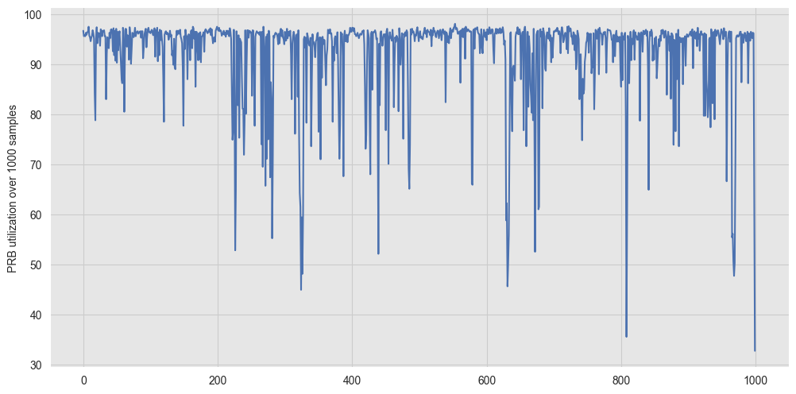
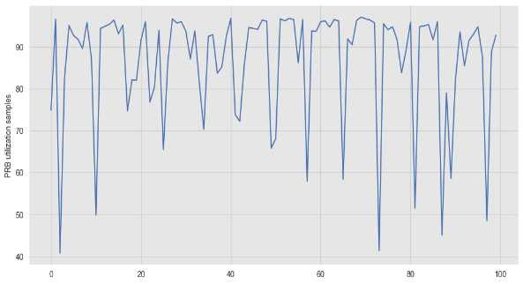
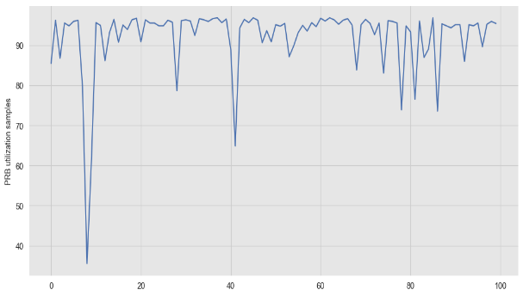
Traffic Forecasting
İnten parsing
(.json)
Traffic Forcasting
Admission & Priority control
Resource Allocation
ML Model Selection
Slice information & requirements
PRB utilization
Slice admission and priority
Different ML models in a pool
PRB allocation
We monitor RAN resource utilization
Checks for available PRBs for emergency slice
We apply Gaussian Process Regression (GPR) for time-series forecast of PRB utilization

Slide 6
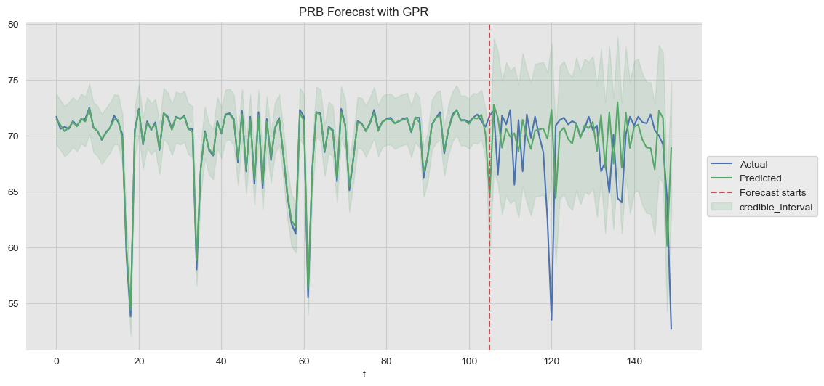
Traffic Forecasting (cont)
We develope this building block as a RIC xApp. This is our first xApp for this problem.
Real data (PRB utilization) taken from paper [1].
used for training (last P samples)
Upper bound for
the prediction over W samples
PRB utilization of a given slice
[1] Vaclav Raida , Philipp Svoboda, Markus Rupp : “Real World Performance of LTE Downlink in a Static Dense Urban Scenario - An Open Dataset “ , IEEE GLOBECOM 2020.

Slide 7
Priority Control
İnten parsing
(.json)
Traffic Forcasting
Admission & Priority control
Resource Allocation
ML Model Selection
Slice information & requirements
PRB utilization
Slice admission and priority
Different ML models in a pool
PRB allocation
RAN is shared with other possible slices that have certain number of PRBs dedicated to them. How much resource should we allocate to emergency slice (ES)?
Level of emergency
Protect the excisting slices first (ES is the second priority)
Algorithm 1 (ALG 1)
Always give the first priority to ES
Algorithm 2 (ALG 2)

Slide 8
Resource Allocation
İnten parsing
(.json)
Traffic Forcasting
Admission & Priority control
Resource Allocation
ML Model Selection
Slice information & requirements
PRB utilization
Slice admission and priority
Different ML models in a pool
PRB allocation
ALG 1 and ALG 2 decide on resource allocation
How many PRB should we allocate for ES?
Resource Allocation block is impelemtned as RIC xApp. This is our second RIC xApp.

Slide 9
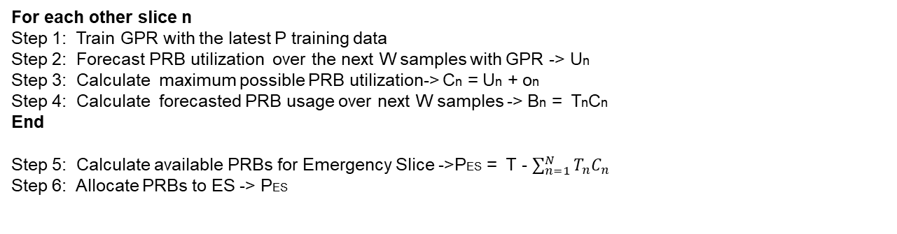
ALG 1
IDEA: Amount of PRBs allocated to other slices are not always used (underutilization). Predict unused PRBs of other slices (leftover from other network slices) and allocate them to ES.
Resource allocation
(ALG 1)
For each other slice n
Step 1: Train GPR with the latest P training data
Step 2: Forecast PRB utilization over the next W samples with GPR -> Un
Step 3: Calculate maximum possible PRB utilization-> Cn = Un + on
Step 4: Calculate forecasted PRB usage over next W samples -> Bn = TnCn
End
Step 5: Calculate available PRBs for Emergency Slice ->PES = T - $\sum_{n=1}^{N}{T_{n}C_{n}}$
Step 6: Allocate PRBs to ES -> PES
Example: Two slices
Total system PRBs = 100
Amoun of PRBs allocated to first slice is 40, utilization is %80 (predicted)-> 8 PRBs unused
Amoun of PRBs allocated to second slice is 60, utilization is %90 (predicted)-> 6 PRBs unused
PRBs allocated to emergency slice is 8 +6 = 14 PRBs

Slide 10
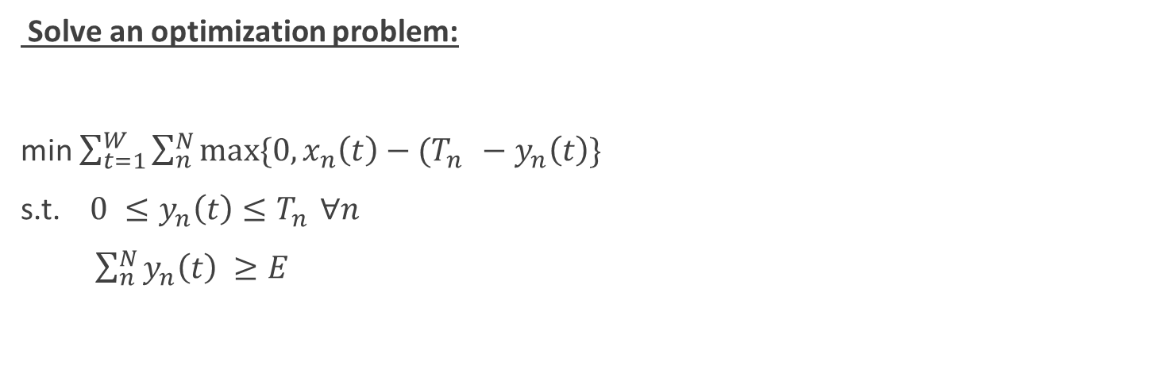
ALG 2
IDEA:Emergency slice needs E amount of PRBs (fixed). Allocate the available PRBs to ES first. If it is not enough borrow PRBs from other slices. Aim is to always give E PRBs to ES. ES has the first priority.
Resource allocation
(ALG 2)
Solve an optimization problem:
min $\sum_{t=1}^{W}{\sum_{n}^{N}{max⁡\{0,x_{n}\left(t\right)−(T_{n }−y_{n}\left(t\right)\}}}$
s.t. ${ 0 ≤y}_{n}\left(t\right)≤T_{n }∀n$
$\sum_{n}^{N}{y_{n}\left(t\right) ≥E}$
PRB needed for slice n at time t
Total PRBs given to slice n
Number of PRB taken from slice n at time t to be used for emergency slice
We damage slice n this amount by taking PRBs from it
Guarantee that emergency slice gets enough PRBs
Transform this problem to a solvable integer problem
[2] X. Foukas et al., “Orion: RAN Slicing for a Flexible and Cost-Effective Multi-Service Mobile Network Architecture,” in ACM MobiCom, 2017.
[3] Armin Okic, Lanfranco Zanzi, Vincenzo Sciancalepore, Alessandro Redondi, Xavier Costa-Pérez, “ π-ROAD: a Learn-as-You-Go Framework for On-Demand Emergency Slices in V2X Scenarios “, IEEE INFOCOM, 2020.

Slide 11

ALG 2 (cont)
IDEA: Emergency slice needs E amount of PRBs (fixed). Allocate the available PRBs to ES first. If it is not enough borrow PRBs from other slices. Aim is to always give E PRBs to ES. ES has the first priority.
Resource allocation
(ALG 2)
Solve an integer programming using auxiliary variable $u_{n}$:
min $\sum_{t=1}^{W}{\sum_{n}^{N}{u_{n}(t)}}$
${\tilde{x}}_{n}\left(t\right){+ o}_{n}(t)−(T_{n }−y_{n}\left(t\right)$) $≤ u_{n}(t)$ $x_{n}\left(t\right)= {\tilde{x}}_{n}$(t) + $o_{n}(t)$
${ 0 ≤y}_{n}\left(t\right)≤T_{n }∀n$
$\sum_{n}^{N}{y_{n}\left(t\right) ≥E}$
${ u}_{n}(t)$ $≥0$
Actual PRB usage at time t in future.
This cannot be known in advance
Estimated PRB usage with GPR
Estimation error.
Upper bound can be used provided by GPR.
We have implemented ALG1 & ALG2 and next we will show a demo for ALG2

Slide 12
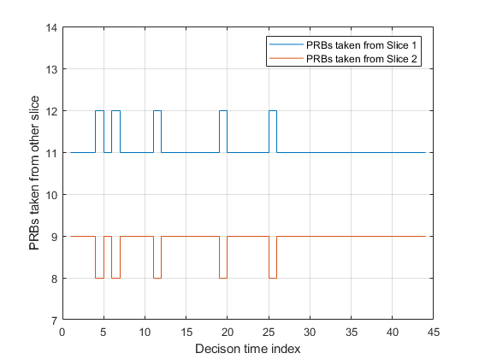
Experiment: resource allocation
Two other slices:
40 and 60 PRBs allocated these two slices
The network has 100 PRBs (ES should borrow from others)
Emergence slice needs E = 20 PRBs
Result from the Figure: at every decision-time,
sum of these PRBs is always 20, which ES needs.

Slide 13
ML model selection for forecasting
Different ML models with different performance, comlexity and cost can be available in a pool.
We implement this scheme as a microservice (docker).
Webserver stores different ML model
Possible to fetch a differebt ML model when forevasting
İnten parsing
(.json)
Traffic Forcasting
Admission & Priority control
Resource Allocation
ML Model Selection
Slice information & requirements
PRB utilization
Slice admission and priority
Different ML models in a pool
PRB allocation

Slide 14
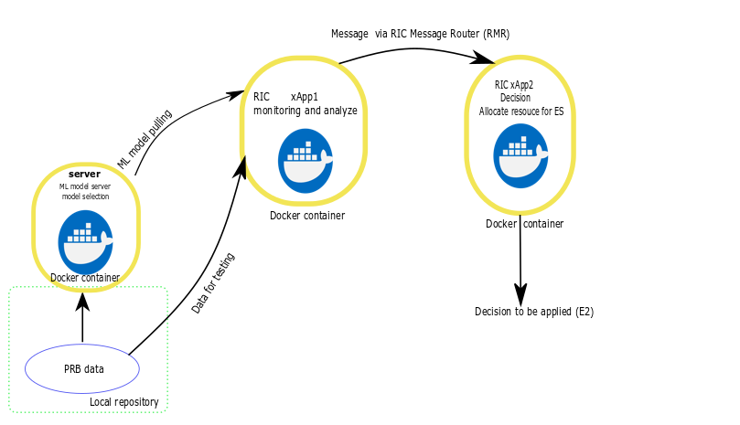
Our implementation
M1
We have developed and implemented RIC xApp1, xApp2 and server as a microservice.
These xApps can communicate through a RIC (O-RAN messaging) message.
e.g., xApp1 can send prediction to xApp2 over the network
ML pipeline
RAN
sink
src
C

Slide 15
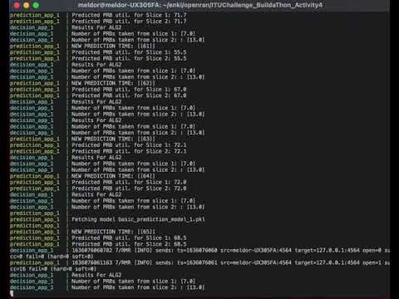
Demo
We have a quick demo:
Ubuntu 20.04 Works fine
Need docker and docker compose
Check for details: https://github.com/ITU-AI-ML-in-5G-Challenge/ITU-ML5G-PS-014-Build-a-thon-PoC---Team-AUTOMATO-

Slide 16
Conclusion and Future Works
A PoC for autonomous slice management
Resource allocation handled with an autonomous closed-loop
Machine learning and ML module are crucial
Flexible and modular O-RAN RIC xApps design
Future Works:
Integration of all xApps to testbed, real O-RAN infrastructure
Other optimizations & improvements
Dynamic estimation of emergency slice
This work has been supported by Scientific and Technological Research Council of Turkey (TÜBİTAK, grant no. 120E485)

Slide 17
Thank you for listening!
Q & A
mehmet.karaca@tedu.edu.tr
doruktayli@gmail.com
osimay.demirci@tedu.edu.tr

