Slide 1

ITU AI/ML 5G Challenge
Theme 1 from KDDI
Analysis on route information failure in IP core networks by NFV-based test environment
UT-NakaoLab-AI Team 2020-10-15
Team Members: Fei Xia (M1), Aerman Tuerxun (M1), Jiaxing Lu (D1), Ping Du

Slide 2
Background
Network failure and anomaly detection is desired to be automatically performed by AI/ML for operating 5G mobile networks.
Challenges in AI/ML
How to extract features from the huge amount of unstructured log files collected from network routers and devices.
How to identify important features to reduce the computation.
How to detect failures with a small amount of data in real-time.
2

Slide 3
Summary
First, we extract features from huge amount of log files into 997 features.
Then, we refine features to with differential data to highlight the difference between normal and abnormal data.
Third, we identify the most important 30 features so that we can reduce computation without degrading the performance.
Moreover, our work extended KDDI’s NOMS2020 paper as follows:
Our model can target 7 failure cases while the NOMS2020 paper address only 3 failure cases.
We can use use one unified model to predict both device and interface errors, while NOMS2020 paper use different models to predict network and network failures separately.
Besides the Multiple-layer perceptron (MLP), Random Forest (RF), and Support Vector Machine (SVM) machine learning algorithms, we also add Decision Tree (DT) and XGBoost (XGB) to the comparative analysis.

Slide 4
01
Feature Extraction
02
Feature Refinement
02
Agenda
Feature Reduction
03
04
Model Training
05
Model Evaluation

Slide 5


Feature Extraction
01
PART ONE

Slide 6
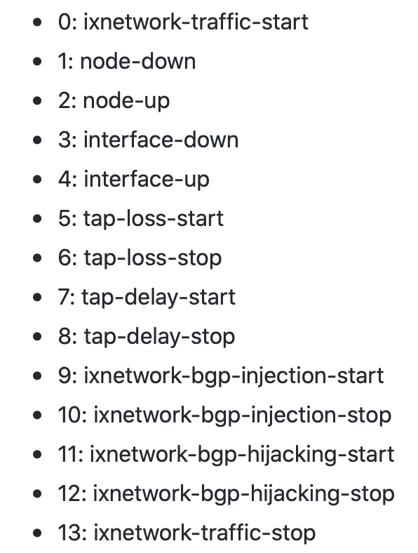


Feature Extraction
Extract features from Log files (JSON format) and merged features with label based on time it into CSV files
Log files
(14 Types of Events)
Label files
CSV files
Merge based on time
Physical File
Virtual File
Network File
Physical CSV
Virtual CSV
Network CSV

Slide 7
Feature Extraction
Key Points in Feature Extraction
For all log files, we utilize path like “key1/key1-1/key1-1-1…” as keys to extract features from physical-infrastructure, virtual-infrastructure, and network-device JSON log files.
For BGP related entries, we use the number of next-hops in each array and their prefixes as features.

Slide 8
Feature Refinement
02
PART TWO

Slide 9
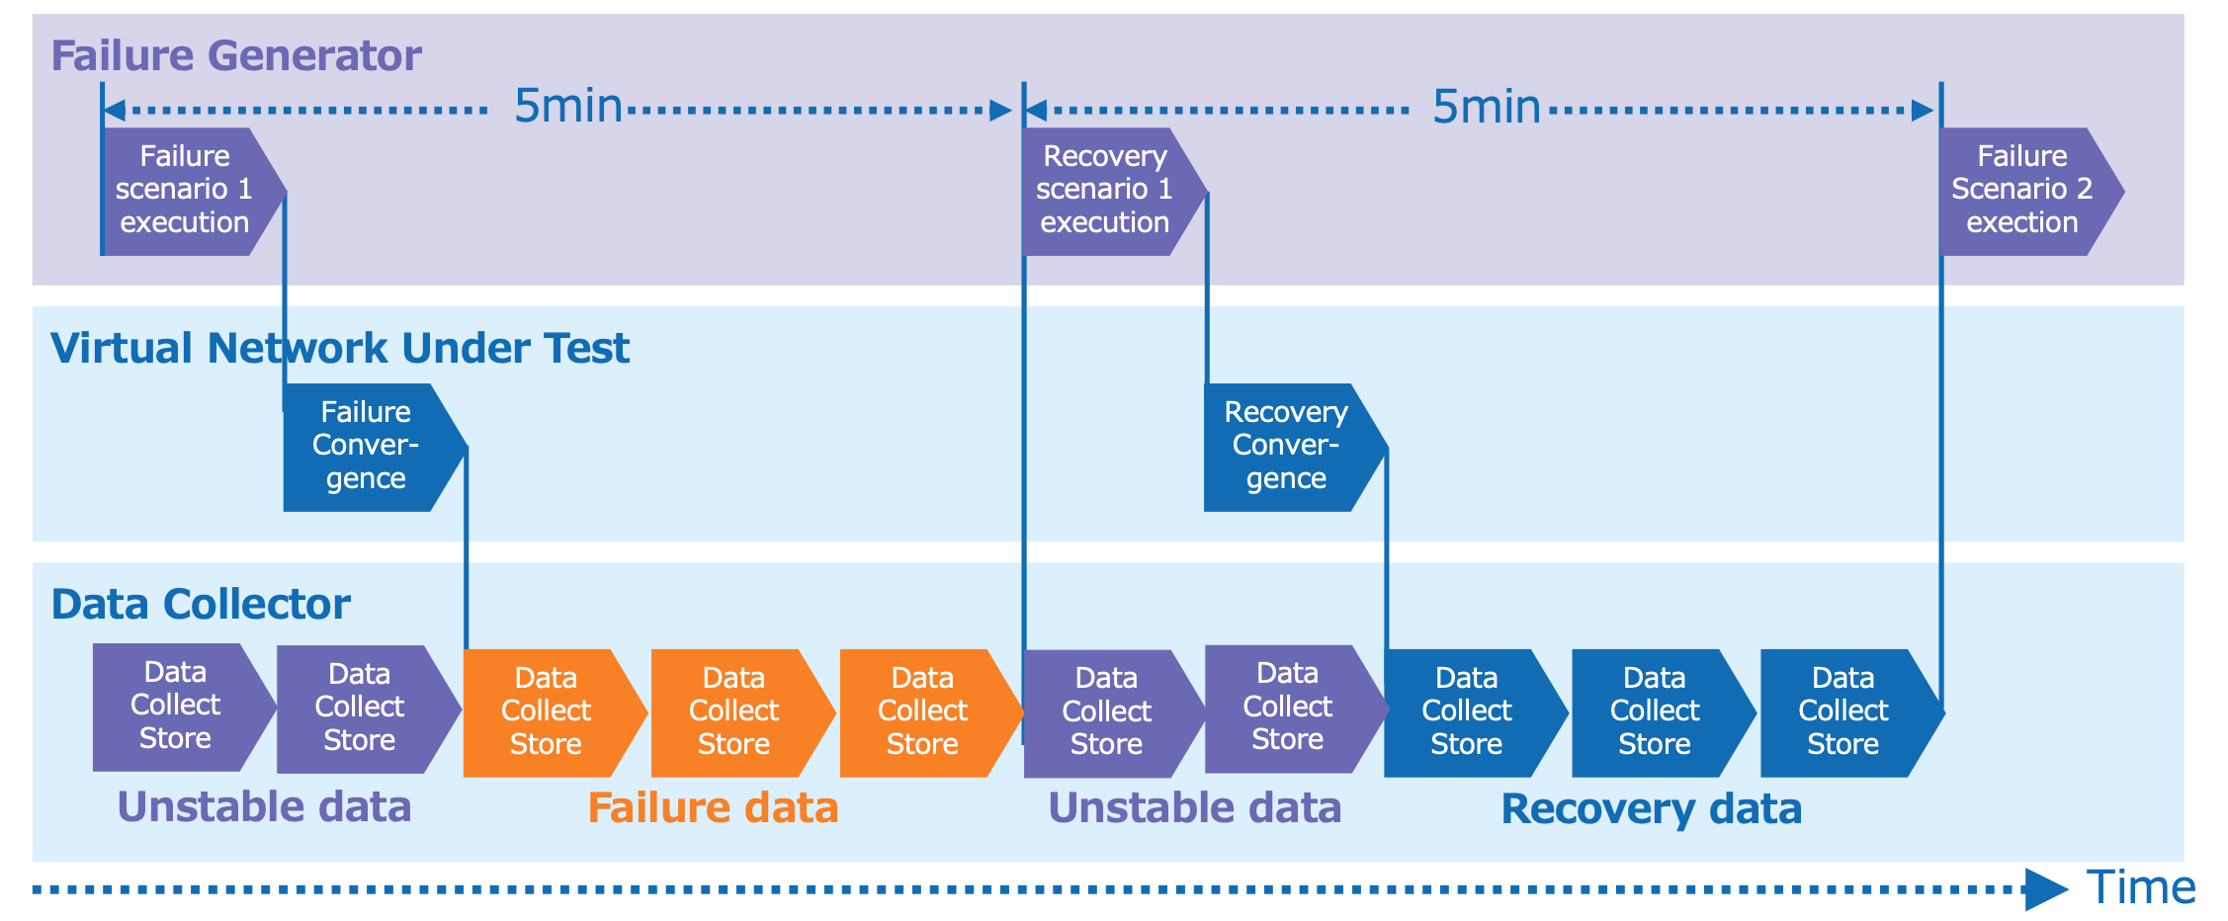
Feature Refinement
Differentiate Data as Input
To highlight the difference between normal and abnormal data sets to derive metrics which have changed since the occurrence of a failure, we use differential data between the 5th minute data and the 1st minute data as input.
$$Diff Data=5th Minute Data−1st Minute Data$$

Slide 10



Feature Refinement
Merge diverse datasets
To train a unified model for diverse network events, we merge all datasets into one csv file for training and testing.
Physical
Virtual
Network
Merge
For Training
learning
data-for-learning, CSV format
CSV
Physical
Virtual
Network
Merge
For Testing
evaluation
data-for-evaluation, CSV format
CSV

Slide 11
Feature Reduction
03
PART THREE

Slide 12
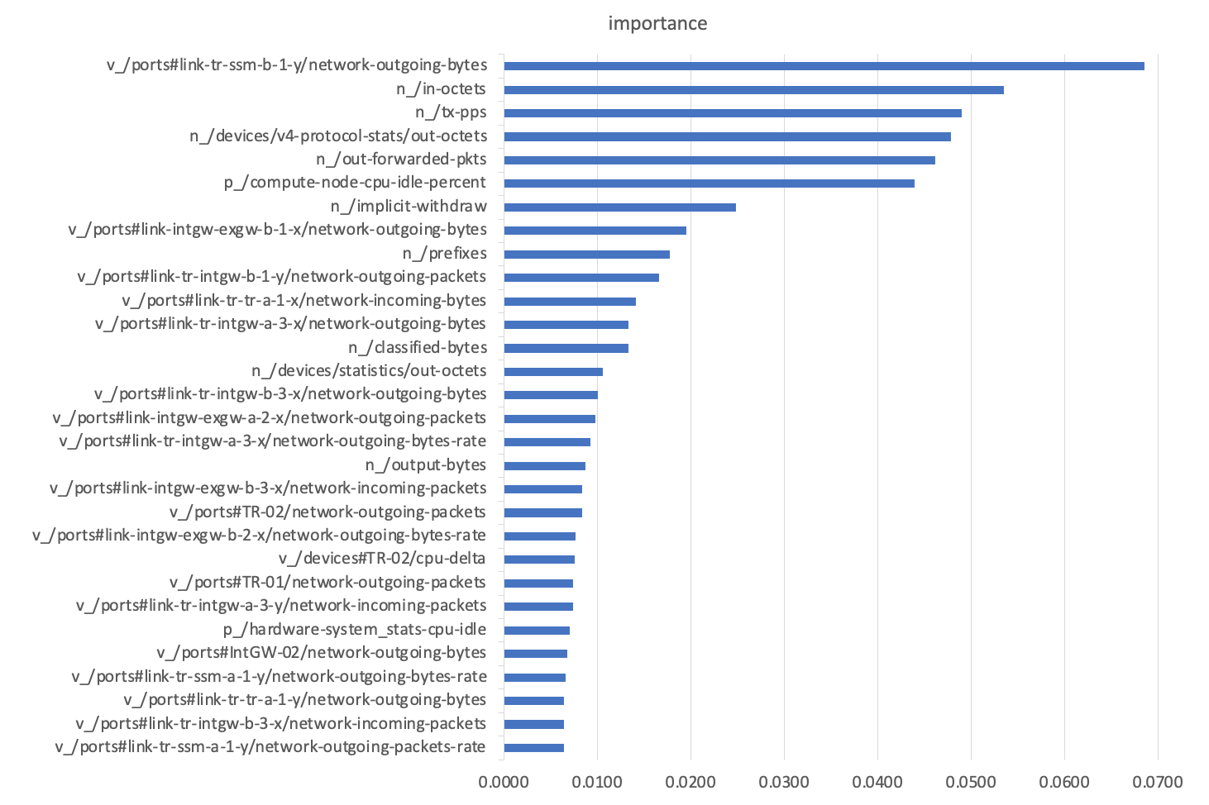
Feature Reduction
Feature Importance Analysis
Importance is calculated for a single decision tree by the amount that each attribute split point improves the performance measure, weighted by the number of observations the node is responsible for.
The performance measure may be the purity used to select the split points or another more specific error function.
The feature importance is then averaged across all of the the decision trees within the model.

Slide 13
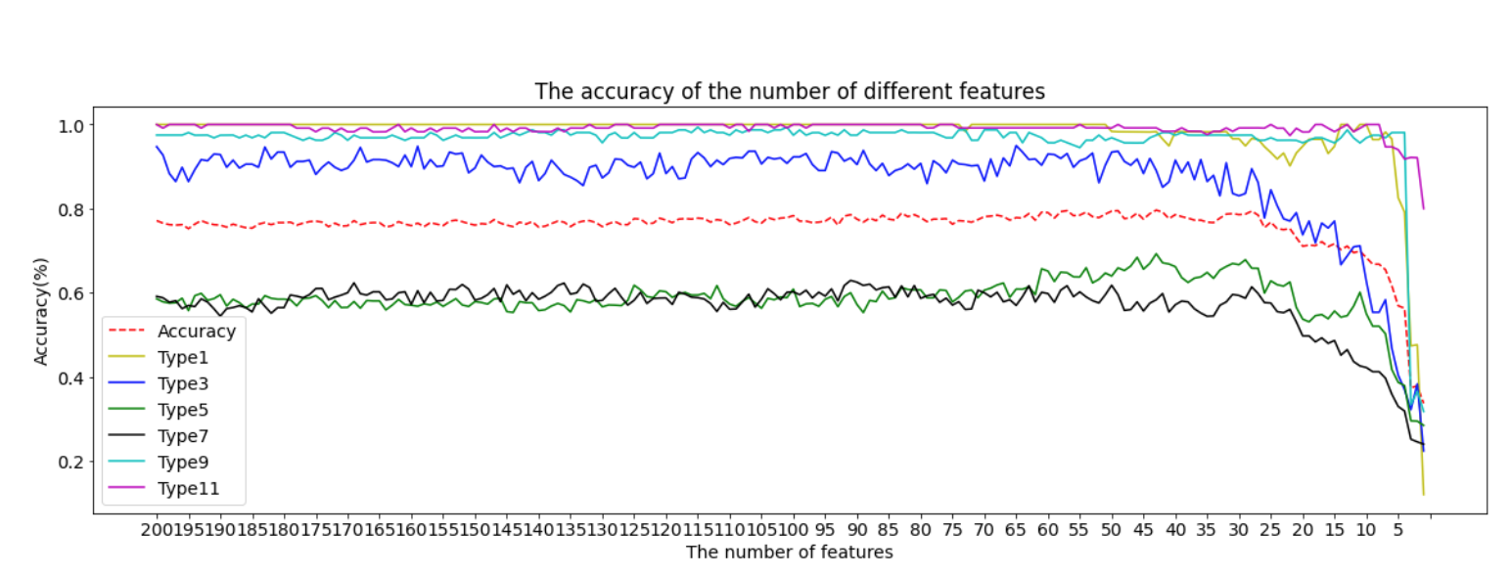
Feature Reduction
Different Features Accuracy
Use different numbers of features to train the data and observe the changes in accuracy.
Through importance analysis of features, we can only use top 30 important features to achieve the same high performance.

Slide 14
Model Training
04
PART FOUR

Slide 15
Model Training
Training & Validation with Learning Data
Dataset Files for Learning
Failure Management
Virtual
No. | Method | Accuracy
1 | XGBoost | 0.77
2 | Radom Forest | 0.76
3 | Decision Tree | 0.73
4 | SVM | 0.58
5 | MLP | 0.54
Physical
Network
Data Pre-process
Training
Validation
Validation accuracy during training
8 : 2
Training Model

Slide 16
Model Evaluation
05
PART FIVE

Slide 17
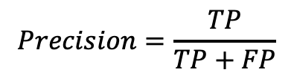
Model Evaluation
Evaluate By Precision
Type 1, 3, 9 and 11 are identified very well using most of the models while the accuracies of type 5 (Packet Loss) and 7 (Packet Delay) are very low
$$Precision=\frac{TP}{TP+FP}$$
(True Positive (TP), False Positive (FP) )
 | All Data
Label Type | dt | rf | xgb
1: node-down | 0.97 | 1.00 | 1.00
3: interface-down | 0.41 | 0.97 | 0.85
5: tap-loss | 0.45 | 0.56 | 0.54
7: tap-delay | 0.40 | 0.50 | 0.55
9: ixnetwork-bgp-injection | 0.97 | 0.99 | 0.97
11: ixnetwork-bgp-hijacking | 0.84 | 1.00 | 1.00

Slide 18
Comparative Analysis
Our comparative analysis confirm the KDDI’s finding that Random Forest (RF) outperforms SVN and MLP algorithms.
We also find that the XGBoost algorithm has a comparable performance as that of RF.
We also found there is still room for improvement for the the failure cases: tap-loss and tap-delay, which are not discussed the NOMS2020 paper. These are left for our future work

Slide 19
Contributions
First, we introduce our feature extraction mechanism especially for network BGP data
Then, we use differential data as input to highlight features of abnormal data.
Third, we analyze and identify the most important 30 features to reduce computation without degrading the performance.
Comparing to the work in NOMS2020 paper:
Our model can target all list 7 failure cases while the NOMS2020 paper address only 3 failure cases.
We use one unified model for all failure cases, while NOMS2020 paper use different models to predict network and network failures separately.
We also add Decision Tree (DT) and XGBoost (XGB) to the comparative analysis and point out that XGBoost has a comparable performance as Random Forest.

Slide 20
Thanks
UT-NakaoLab-AI Team 2020-10-15

