Slide 1



ITU-T GNNetChallenge2023
2nd Solution
Zicheng Wang
on behalf of team BUPT_CMCC
2023.12
Network Intelligence Research Center
at Beijing University of Posts and Telecommunications
Notes:
Good afternoon, my name is Zicheng Wang. I am a graduate student from the Network Intelligence Research Center at Beijing University of Posts and Telecommunications. I am very honored to represent the BUPT_CMCC team to introduce our solution for this competition.

Slide 2
Team Introduction
Members of Team BUPT_CMCC:
Zicheng Wang, NIRC lab at Beijing University of Posts and Telecommunications
Yuanjie Duan, NIRC lab at Beijing University of Posts and Telecommunications
Lingqi Guo, NIRC lab at Beijing University of Posts and Telecommunications
Danyang Chen, China Mobile
Supervisor:
Zirui Zhuang, NIRC lab at Beijing University of Posts and Telecommunications
Jingyu Wang , NIRC lab at Beijing University of Posts and Telecommunications
Notes:
First, please allow me to introduce our team members. Our team consists of three students from the Network Intelligence Research Center at Beijing University of Posts and Telecommunications, and one researcher from China Telecom. Additionally, two professors from the NIRC laboratory have also provided us with some assistance.

Slide 3
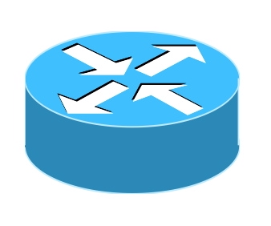









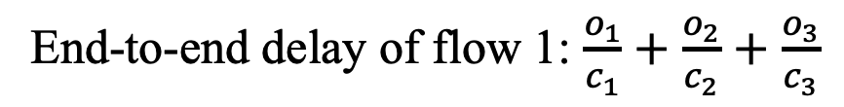
Principle of Baseline
End-to-end delay is composed of:
queueing delay
transmission delay
propagation delay
Occupancy: bits in the send queue
$$o_{2}$$
$$o_{3}$$
End-to-end delay of flow 1: $\frac{o_{1}}{c_{1}}+$ $\frac{o_{2}}{c_{2}}$ $+$ $\frac{o_{3}}{c_{3}}$
$$o_{1}$$
$$c_{2}$$
$$c_{1}$$
$$c_{3}$$
Baseline (simplified RouteNet-Fermi): link_state + flow_state + queue_state
Readout()
[$o_{1}$, $o_{2}$, …, $o_{n}$]
flow_state_sequence
[$o_{1}$, $o_{2}$, …, $o_{n}$]
end-to-end delay of each flow
[$o_{1}$, $o_{2}$, …, $o_{n}$]
Notes:
Our solution is based on modifications made to the official Baseline RouteNet-Fermi model. Therefore, I’ll begin by explaining our understanding of this model. The task of the competition is to predict the average end-to-end delay for each flow. The end-to-end delay of a packet consists of three components: queuing delay, transmission delay, and propagation delay. As the testbed for this competition is a network constructed with several closely spaced switches in a data center network, we consider the propagation delay of the links to be negligible. Therefore, the model only needs to model queuing delay and transmission delay. The figure on the right illustrates a simple scenario, simulating the passage of a stable-rate flow (flow1) through three forwarding devices in the network. Each node has a transmission queue to store packets awaiting transmission. Let's denote the bit counts in these three transmission queues as o1, o2, o3, and the bandwidths of the links as c1, c2, c3, respectively. By calculating the queuing delay and transmission delay for each forwarding device, we can then sum them up to obtain the average end-to-end delay for flow 1.
To make predictions, RouteNet-Fermi models the state of each link, the state of each flow, and the state of each queue. It uses a graph neural network to transform and iterate between these three states. Since the queues in the dataset for this competition are uniform, the Baseline simplifies the RouteNet-Fermi model by excluding the queue's state during modeling. After multiple iterations, a sequence of flow state is obtained. The model then transforms it into occupancy through a readout function, and obtain the estimated delay using the formula mentioned above.

Slide 4
Limitation of Baseline
When the flow state and flow rate are constant, the queuing delay remains stable, leading to a consistent delay for each individual flow. Under such circumstances, the baseline model demonstrates great performance.
However, when multiple flows in the network are operating in an burst (on-off) mode, the delay for each individual flow would fluctuate over time. In such a scenario, the performance of the baseline model is quite poor.
Flow1:
Bit rate
time
Flow2:
Bit rate
time
Notes:
When the traffic in the network is stable, the baseline model can achieve excellent performance. This is because when the flow state and flow rate are constant, the queuing delay remains stable, leading to a consistent delay for each individual flow. However, when the network traffic is unstable, such as in burst mode, the delay for each flow varies over time. Take the following figure as an example. When there are two flows in the network, both in burst mode, and their burst durations and intervals are different, the queue depth at each node would fluctuate over time. This fluctuation would lead to variations in the end-to-end delay for each flow. As a result, in such a scenario, the performance of the baseline model is quite poor. Because the baseline model only knows the average sending rate, packet count, and packet size for each flow throughout the entire experiment, it has no awareness of the fluctuations in the flows.

Slide 5
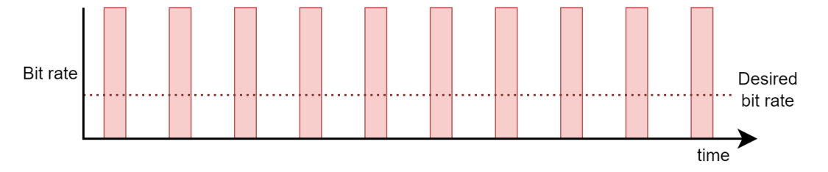
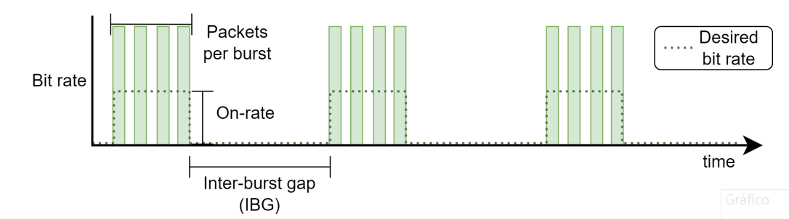
Analysis of Traffic Pattern
There are two types of flow：
Generate traffic at Constant-Bit Rate(CBR);
Generate traffic at Multi-Burst (MB);
The samples in the dataset has two types: MB and CBR+MB
CBR
MB
Notes:
To address this issue, we need to analyze the traffic patterns in the dataset provided for this competition. Firstly, there are two forms of traffic: flows generated with Constant-Bit Rate (CBR) and flows generated in a Multi-Burst (MB) fashion. The dataset samples also come in two types: the first type where all flows are in MB mode, and the second type where some flows are in MB mode while others are in CBR mode. To achieve better performance, we trained a dedicated model for each type of sample corresponding to each mode.

Slide 6
Our Solution
Our Solution:
Extract more temporal features and use them to initialize the link_state，we tried the following features:
IPG(Inter-packet gap) , IBG(Inter-burst gap), On-Rate(average packet sending rate during burst) , PPB(number of packets per burst)
Train a model for each type of sample, CBR+MB, and MB, respectively.
Adding different features to them.
Notes:
Next, we will explain our approach. First, in order for the model to learn the fluctuation patterns of the traffic, we extracted some temporal features and use them to initialize the link_state. Specifically, we tried the following features: IPG(Inter-packet gap) , IBG(Inter-burst gap), On-Rate(average packet sending rate during burst) , PPB(number of packet per burst). To achieve the best performance, we tried many different combinations of these parameters, which will be shown later.
Second, we train a model for each type of sample, CBR+MB, and MB, respectively. For the MB model, all the training data consists of MB-type samples. During the evaluation phase, the respective model is used to predict the samples in the evaluation set. For different models, we ultimately selected different sets of features.

Slide 7

Detailed Solution
Compare the link transmission delay to the estimated delay.
Since the end-to-end delay should be greater than the sum of transmission delay along the path. We add the following judgments to our model inference during the evaluation phase.
Use 5-fold cross-validation to perform the training.
Notes:
Third, during the evaluation phase, we add the following judgments to our model inference since the end-to-end delay should be greater than the sum of transmission delay along the path. If the predicted delay is smaller than the sum of transmission delays, we would replace the value.
Finally, we use 5-fold cross-validation to perform the training because this allows us to have a more comprehensive assessment of the model's performance. Our experimental results indicate that the model's performance varies slightly across 5 randomly sampled folds.

Slide 8
Detailed Solution
Hyper-parameters of CBR+MB model
iterations | 10
path_state_dim | 64
link_state_dim | 64
epoch | 50
loss | MAPE
optimizer | Adam
Learning rate | 0.001
Hyper-parameters of MB model
iterations | 8
path_state_dim | 64
link_state_dim | 64
epoch | 50
loss | MAPE
optimizer | Adam
Learning rate | 0.001
Notes:
On this page, we present the optimal parameters we obtained after tuning. It can be observed that the iteration count for graph neural network updates differs between the two models. Other parameters such as the path_state dimension and link_state dimension are same for the two models.

Slide 9
Experimental results
CBR+MB model
MAPE | Fold 0 | Fold 1 | Fold 2 | Fold 3 | Fold 4 | Average
None(Baseline) | 40.17642593 | 35.9564476 | 37.38474655 | 36.64234924 | 37.98288345 | 37.62857056
Add Feature IPG | 42.8320961 | 35.55578613 | 38.30007935 | 35.58163452 | 35.05449677 | 37.46481857
Add Feature IPG Add Feature On-Rate | 22.12659645 | 26.49090958 | 26.66577148 | 21.22968483 | 20.30379105 | 23.36335068
MB model
MAPE | Fold 0 | Fold 1 | Fold 2 | Fold 3 | Fold 4 | Average
None (Baseline) | 36.0941925 | 36.78473663 | 36.15675735 | 37.54171371 | 36.6777153 | 36.6510231
Add Feature IPG | 32.19689941 | 33.04437256 | 33.66588211 | 31.8786869 | 33.11622238 | 32.78041267
Add Feature IPG Add Feature PPB | 36.87373734 | 36.23926544 | 38.94083405 | 34.52573776 | 35.97927856 | 35.46103706
Add Feature IPG Add Feature PPB Add Feature IBG | 26.19252396 | 26.65249825 | 26.8210659 | 24.28470993 | 26.32581139 | 26.05532188
Add Feature IPG Add Feature PPB Add Feature IBG Add Feature On-Rate | 21.8938961 | 22.34586525 | 22.83009338 | 21.12554169 | 22.25577927 | 22.09023514
Add Feature IBG | 22.84088326 | 23.30004883 | 23.96886253 | 21.73176956 | 23.3187809 | 23.03206902
Add Feature IBG Add Feature On-Rate | 21.65055847 | 22.37553406 | 22.59537125 | 21.30610275 | 22.06289864 | 21.99809303
Notes:
On this page, we showcase some different combinations of features we tried and the models' performance trained with them. Due to time constraints in the competition, we didn't cover all possible combinations of parameters. For the CBR+MB mode, the best-performing model utilized IPG and On-Rate, achieving a MAPE of 20.3 on the validation set. Meanwhile, for the MB mode, the top-performing model employed IBG and On-Rate, achieving a MAPE of 21.3 on the validation set.

Slide 10
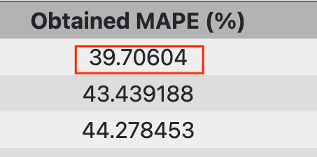
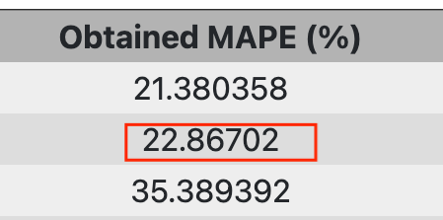
Experimental results
Best model
CBR+MB: Add feature IPG、On-Rate
Fold 0 | Fold 1 | Fold 2 | Fold 3 | Fold 4
22.12659645 | 26.49090958 | 26.66577148 | 21.22968483 | 20.30379105
MB: Add feature IBG、On-Rate
Fold 0 | Fold 1 | Fold 2 | Fold 3 | Fold 4
21.65055847 | 22.37553406 | 22.59537125 | 21.30610275 | 22.06289864
Only use CBR+MB model: 39.70%
Using two models: 22.86%
Notes:
These are the two best-performing models we trained. During the competition, we observed a significant improvement in performance by using separate models to predict the two traffic modes. Specifically, if only the CBR+MB model is used to predict all samples, it achieves a MAPE of 39.7%. However, using two models for prediction results in a MAPE of 22.86%.

Slide 11
Thanks! ☺
Contact e-mails:
zhuangzirui@bupt.edu.cn
wangjingyu@bupt.edu.cn
Notes:
The above constitutes an overview of our solution. We believe there is still significant room for improvement in the current model architecture, and we look forward to more refined solutions. Finally, I would like to express our gratitude to the organizers and the committee for providing us with this valuable opportunity for practical experience. Here is the contact information for our NIRC laboratory. We would be delighted to stay in touch with all of you.

