Slide 1




Machine Learning Models for Home User Network Classification
Team Xdding
Rushat Rai
3rd Year B.Eng. Information Engineering
The Chinese University of Hong Kong

Slide 2
TABLE OF CONTENTS
01
02
03
PROBLEM
DATA
SOLUTION
What is the problem statement about?
Analysis of the data given for the problem statement.
Models, Results, Improvements.

Slide 3
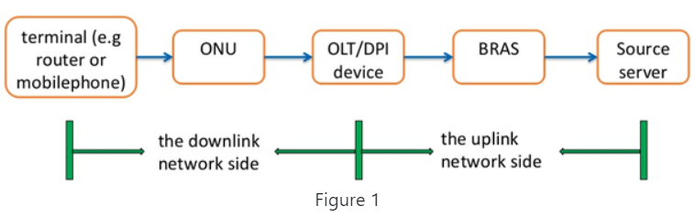
PROBLEM: Motivation
User experience while using the internet is becoming a top priority for network operators worldwide
Eight key indicators from DPI probe readings on the downlink network side reflect the kind of experience the user is having.
Source: https://challenge.aiforgood.itu.int/match/matchitem/73

Slide 4
PROBLEM: Eight Indicators
Indicator 1: In the first step of the three-way handshake, the time interval between the syn ack packet and the ack packet;
Indicator 2: In the second step of the three-way handshake, the time interval between the syn ack packet and the ack packet;
Indicator 3: The time interval between the ack packet and the first payload packet in the three-way handshake;
Indicator 4: The response delay of the first packet with payload after the establishment of TCP for multiple flows in the session;
Indicator 5: In TCP transmission, the actual delay of transmission from the DPI position to the user terminal;
Indicator 6: In TCP transmission, the transmission delay from the DPI position to the website;
Indicator 7: In TCP transmission, the percentage of downlink retransmitted packets in the current session;
Indicator 8: In TCP transmission, the percentage of upstream retransmission packets of the current session.
Notes:
First 6 indicators are time-based
Last 2 indicators are percentage values

Slide 5
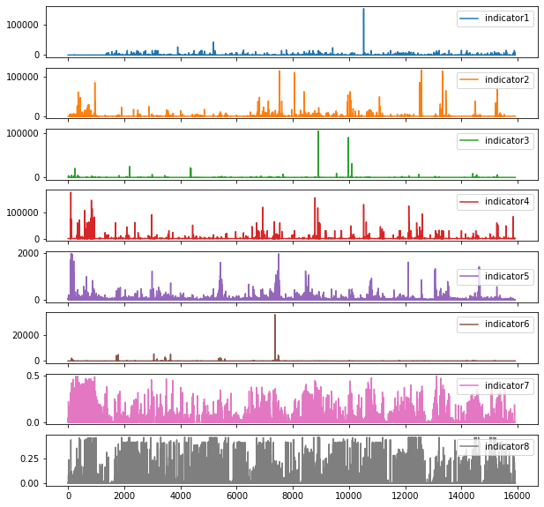
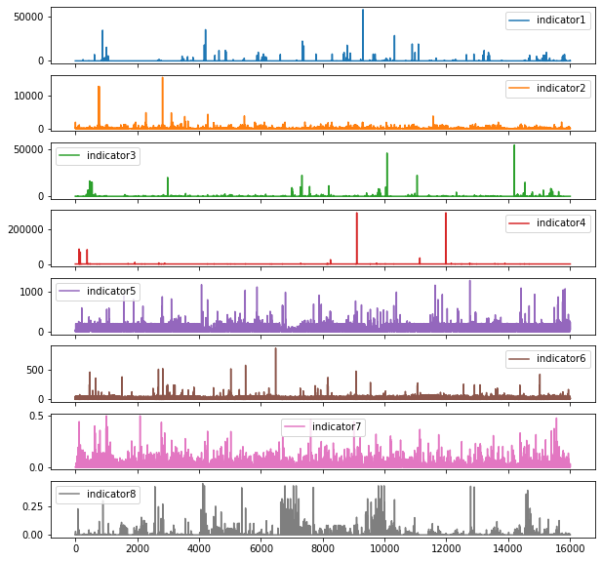
PROBLEM: UBE vs UGE
User with bad experience (UBE)
User with good experience (UGE)

Slide 6
DATA: Dataset
Records for 500 Users
Eight Time Series of Indicator Readings per User
Class Distribution 50/50 Between UBE-UGE
80% Training Set (400 Users)
20% Validation Set (100 Users)

Slide 7
DATA: Challenge
Sampling Rate and Time Range of Records are Not Standard
Dense (up to 43828 observations) and Sparse Records (566 observations)
Multiple Observations for Single Time Stamp
Small Sample Size of 500 Users
UGE Data Has Outliers Similar Statistical Distribution with UBE

Slide 8
DATA: Statistical Distribution Similarity

Slide 9
DATA: Statistical Distribution Similarity

Slide 10
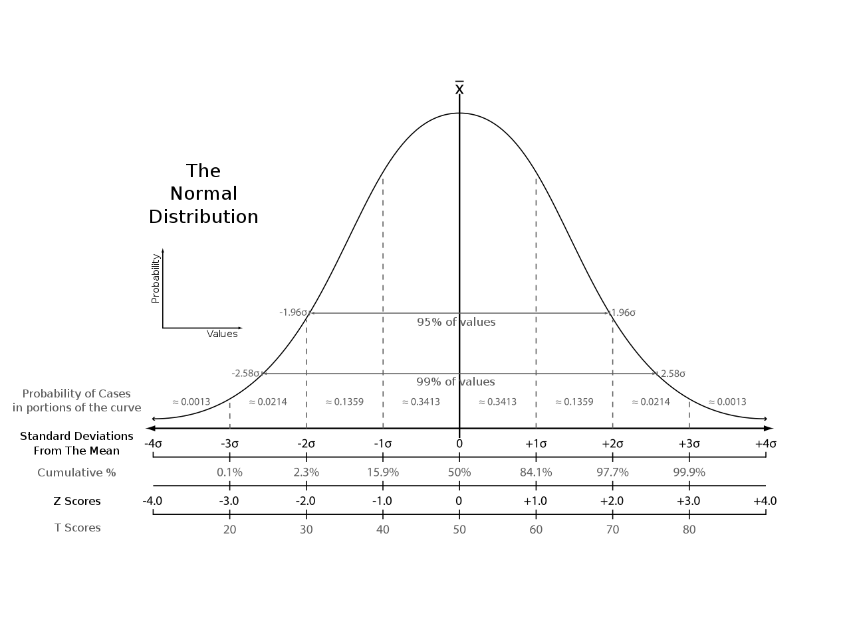
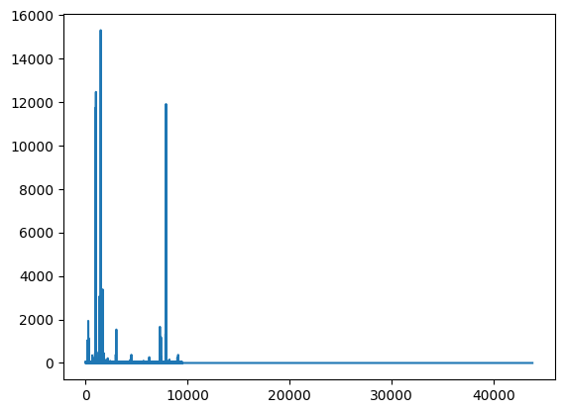
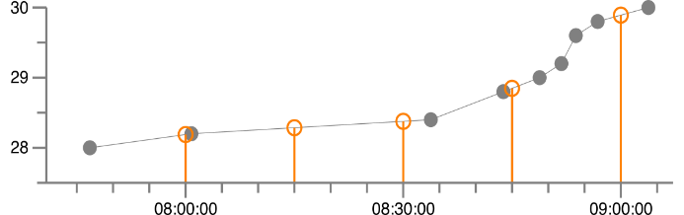

SOLUTION: Data Preprocessing
Source (image 1): https://stackoverflow.com/a/39730384/6453452
Source (image 2): https://commons.wikimedia.org/w/index.php?curid=2799839
Linear Interpolation
Z-Normalization
Low-Noise Padding
Resamples time series to a fixed interval
Fixes problem of uneven sampling rates, dense time series, multiple observations
Up to 95% length reduction while preserving predictive power
$x_{i}^{′}=\frac{x_{i}−μ}{σ}, where i ε N$
Allows model to focus on structural similarities rather than on the amplitude-driven ones
Necessary since units used in the indicator columns are not the same and the scales differ
Adds a low amplitude noise to the suffix of shorter time series to obtain sequences as long as the longest one.
Better performance than alternatives such as uniform scaling and ARIMA-based future value forecasting
Fixes uneven length time series problem

Slide 11

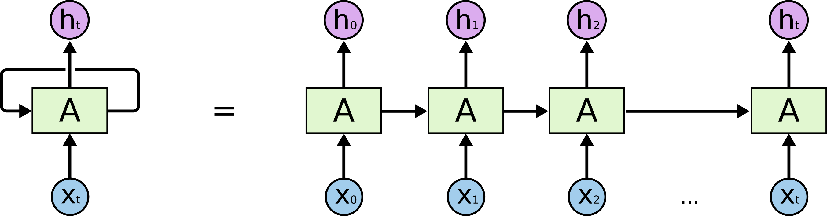
SOLUTION: LSTM RNN Model
Well-established model for deep-learning-based time series classification
Can model deeper relationships than traditional methods
1.3 million parameter final model
~1 hour training time on single P5000
Source: https://colah.github.io/posts/2015-08-Understanding-LSTMs/

Slide 12
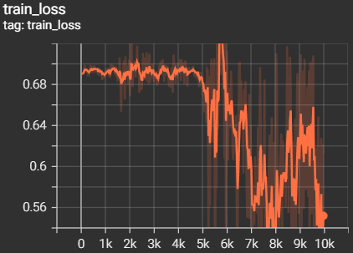
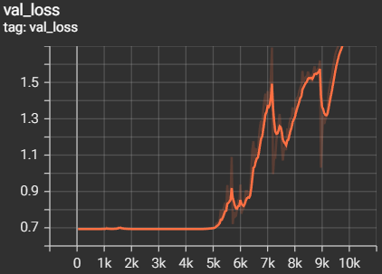
SOLUTION: LSTM RNN Results
Most promising solution given more data availability
Validation accuracy: 58%
Up to 18% accuracy improvement over traditional methods tested (ROCKET, DTW-KNN, etc.)
~4000 steps training loss stagnates and validation loss spikes
Overfitting, unable to find more predictive features
Implies possible improvement with more data at user-level

Slide 13
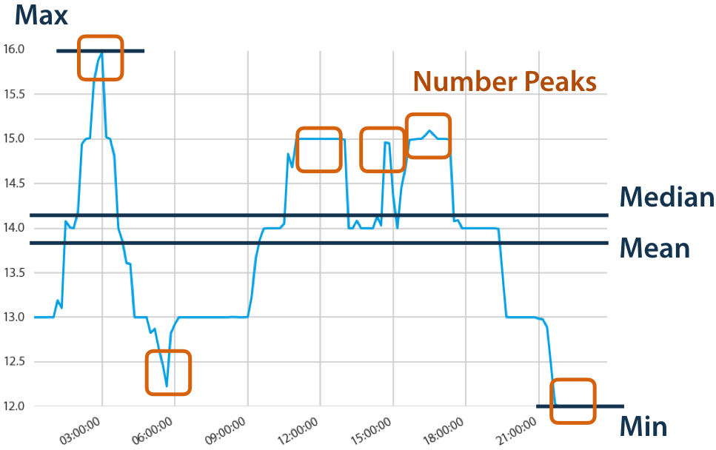
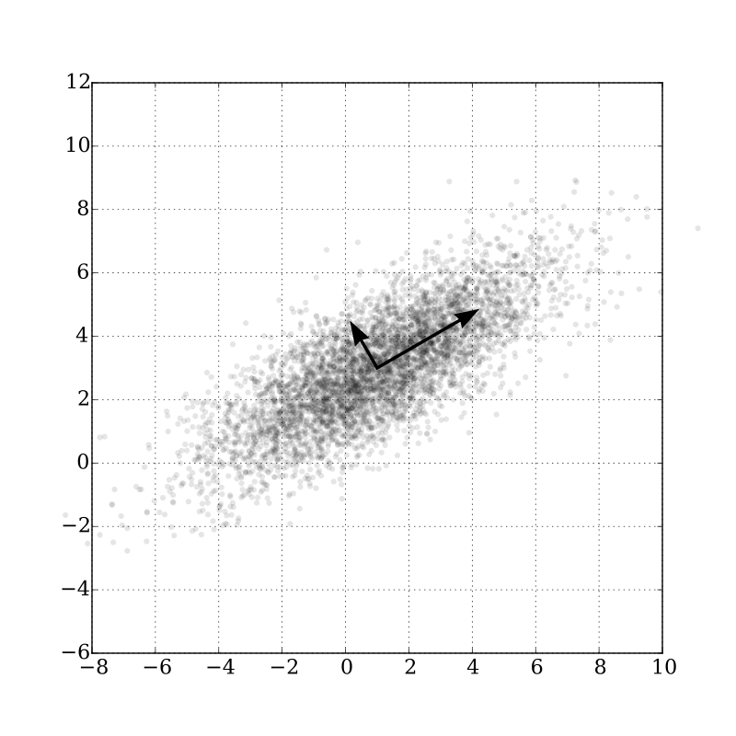
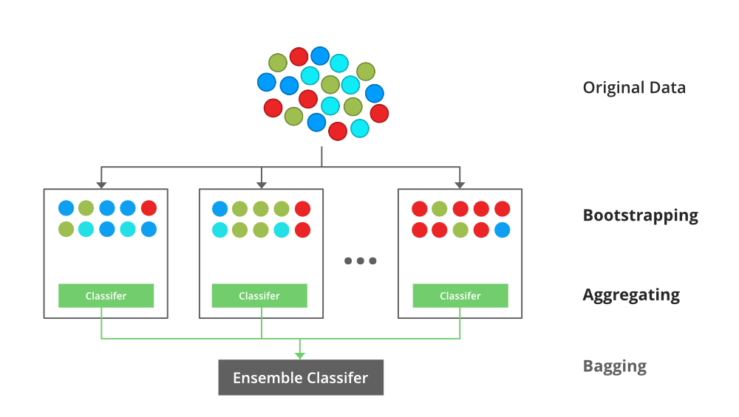
SOLUTION: TSFresh Model
Source (image 1): https://tsfresh.readthedocs.io/en/latest/text/introduction.html
Source (image 2):https://commons.wikimedia.org/w/index.php?curid=46871195
Source (image 3): https://www.geeksforgeeks.org/xgboost/
TSFresh Feature Extraction
PCA
XGBoost
Dimensionality reduction to solve Big-p, Little-n (p>>n) problem
Min-max normalization included for PCA
397 final features
State-of-the-art gradient boosted classifier
Robust
Fast
Interpretable
Automatically extracts 1000s of features from time series to give new insights into their dynamics
6242 extracted features
No preprocessing required

Slide 14
SOLUTION: TSFresh Results
Best performing model with provided data
Validation accuracy: 65%
~10% improvement over manually extracted features (e.g. % outliers using Local Outlier Factor, descriptive stats)
Only needs 300 users’ data to reach this accuracy
Total runtime of ~2 hours on 8 core CPU machine
 | Precision | Recall | F1 Score | Samples
UBE | 0.66 | 0.62 | 0.64 | 50
UGE | 0.64 | 0.68 | 0.66 | 50

Slide 15
THANKS
Do you have any questions?

