Slide 1




Machine Learning Models for Home User Network Classification
Team Xdding
Rushat Rai
3rd Year B.Eng. Information Engineering
The Chinese University of Hong Kong

Slide 2
TABLE OF CONTENTS
01
02
03
PROBLEM
DATA
SOLUTIONS
What is the problem statement about? (Slides 3 to 5)
Analysis of the data given for the problem statement. (Slides 6 to 9)
Models, Results, Improvements. (Slides 10 to 15)

Slide 3
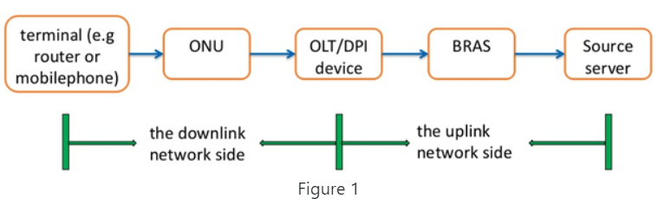
PROBLEM: Motivation
Source: https://challenge.aiforgood.itu.int/match/matchitem/73
User experience while using broadband internet is quickly becoming a top priority for network operators worldwide
Predictive models can help operators discover potential complaining users in advance.
The kind of experience the user is having is dependent on eight key indicators from DPI probe readings (downlink network side problems).

Slide 4
PROBLEM: Eight Indicators (Predictors)
Indicator 1: In the first step of the three-way handshake, the time interval between the syn ack packet and the ack packet;
Indicator 2: In the second step of the three-way handshake, the time interval between the syn ack packet and the ack packet;
Indicator 3: The time interval between the ack packet and the first payload packet in the three-way handshake;
Indicator 4: The response delay of the first packet with payload after the establishment of TCP for multiple flows in the session;
Indicator 5: In TCP transmission, the actual delay of transmission from the DPI position to the user terminal;
Indicator 6: In TCP transmission, the transmission delay from the DPI position to the website;
Indicator 7: In TCP transmission, the percentage of downlink retransmitted packets in the current session;
Indicator 8: In TCP transmission, the percentage of upstream retransmission packets of the current session.
Notes:
First 6 are time-based
Last 2 are percentage values
First 4 relate to three-way handshake
Last 5 relate to TCP transmission

Slide 5
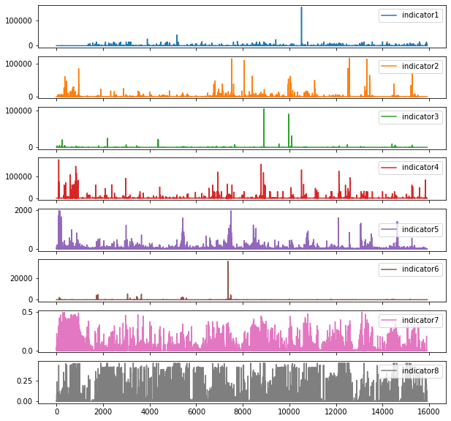
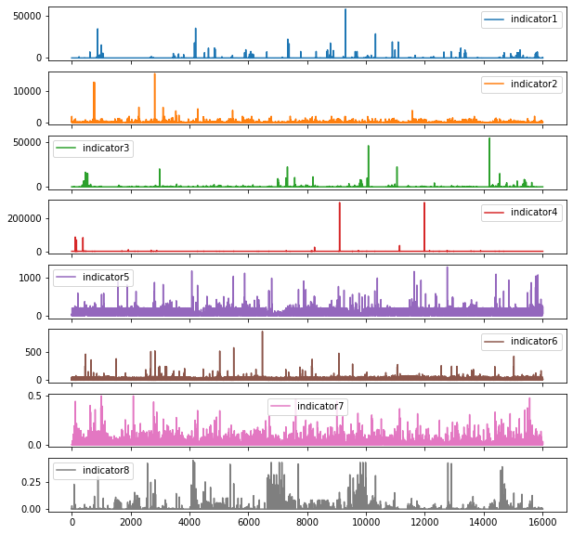
PROBLEM: UBE vs UGE (Labels)
User with bad experience (UBE)
User with good experience (UGE)

Slide 6
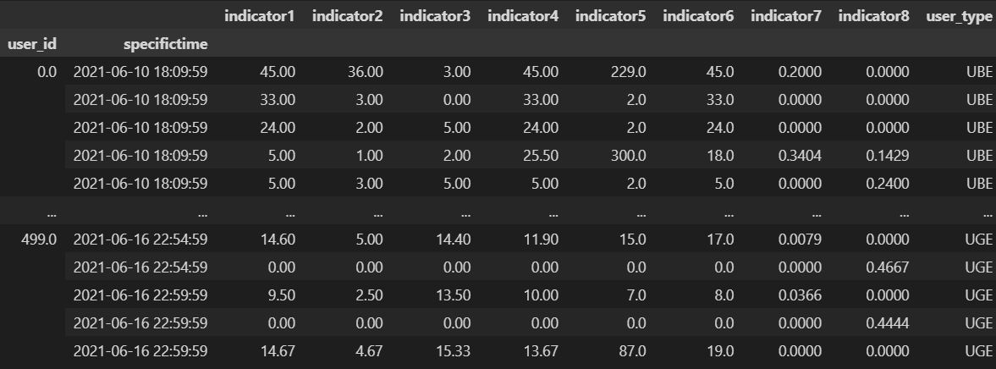
DATA: Dataset Overview
Contains Records of 500 Users
Eight Time Series of Indicator Readings per User
Time Span Generally 1 Week
Class Distribution 50/50 Between UBE-UGE (250 each)

Slide 7
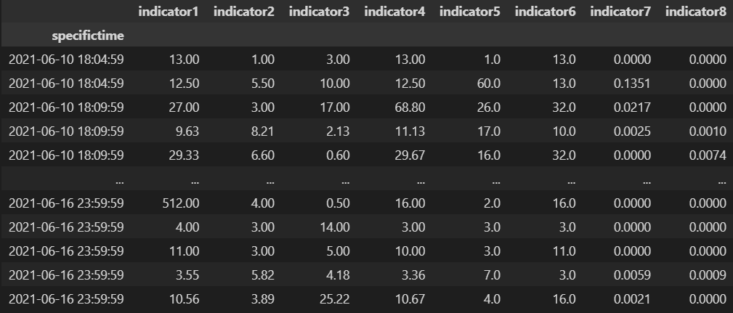
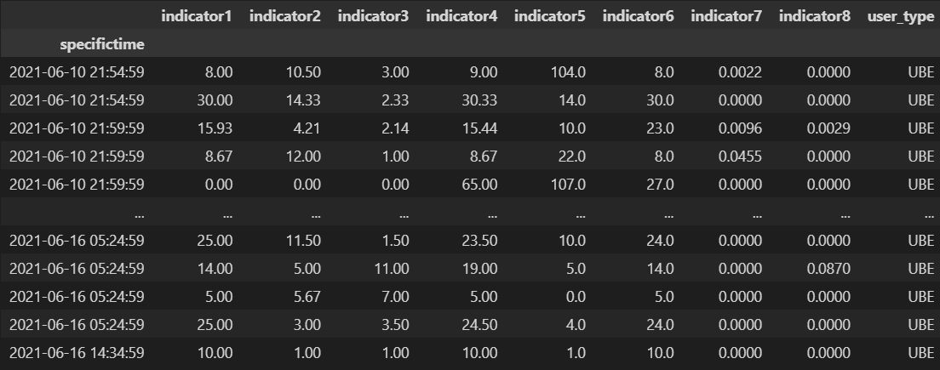
DATA: Challenges
Small Sample Size of 500 Users
Very Dense (up to 43828 observations) and Very Sparse Records (down to 566 observations)
Sampling Rate and Time Range of Records are Not Standard
User A
User B

Slide 8
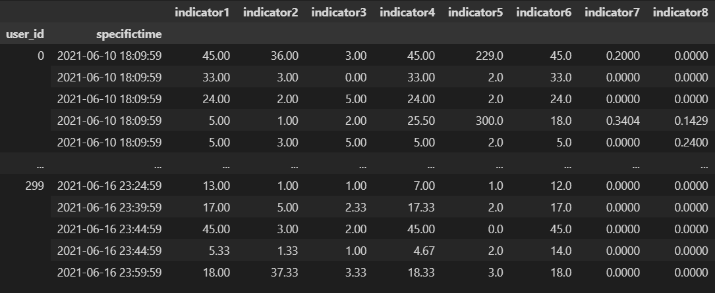
DATA: Challenges
Multiple Observations for Single Time Stamp

Slide 9
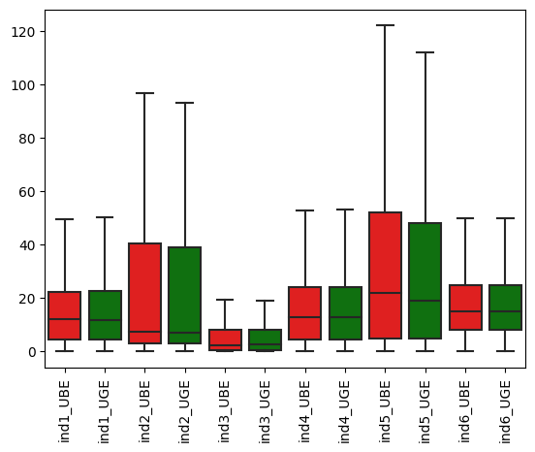
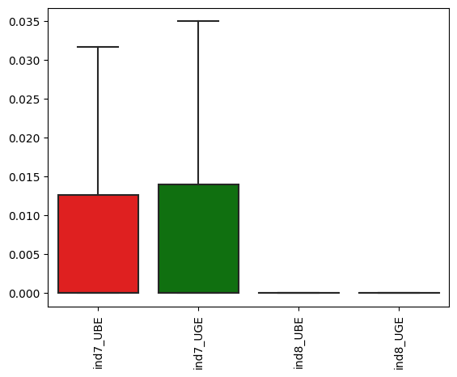
Data: Challenges
UGE Data Has Outliers
UGE/UBE Might Be User-Reported (Different Standards)
Similar Statistical Distributions

Slide 10
SOLUTION: Overview
Multivariate Time Series Classification (MTSC) Problem
Experiments Show Two Promising Model Architectures:
Data Preprocessing Pipeline + Long Short Term Memory Recurrent Neural Network (LSTM RNN)
No Preprocessing + TSFresh Library + PCA + XGBoost

Slide 11
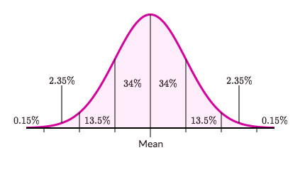
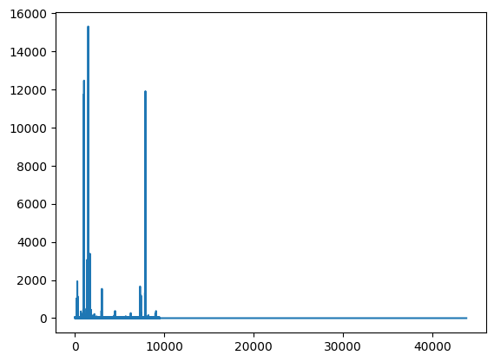
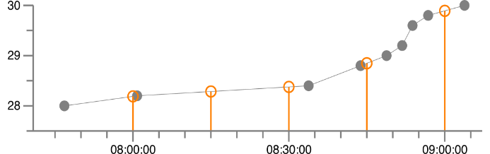

SOLUTION 1: Data Preprocessing
Source (image 1): https://stackoverflow.com/a/39730384/6453452
Source (image 2): https://study.com/cimages/multimages/16/normal005825455157190833177.jpg
Linear Interpolation
Z-Normalization
Low-Noise Padding
Resamples time series to a fixed interval
Fixes problem of uneven sampling rates, dense time series, multiple observations
Up to 95% length reduction while preserving predictive power
$x_{i}^{′}=\frac{x_{i}−μ}{σ}, where i ε N$
Allows model to focus on structural similarities rather than on the amplitude-driven ones
Necessary since units used in the indicator columns are not the same and the scales differ
Adds a low amplitude noise to the suffix of shorter time series to obtain sequences as long as the longest one.
Better performance than alternatives such as uniform scaling and ARIMA-based future value forecasting
Fixes uneven length time series problem

Slide 12

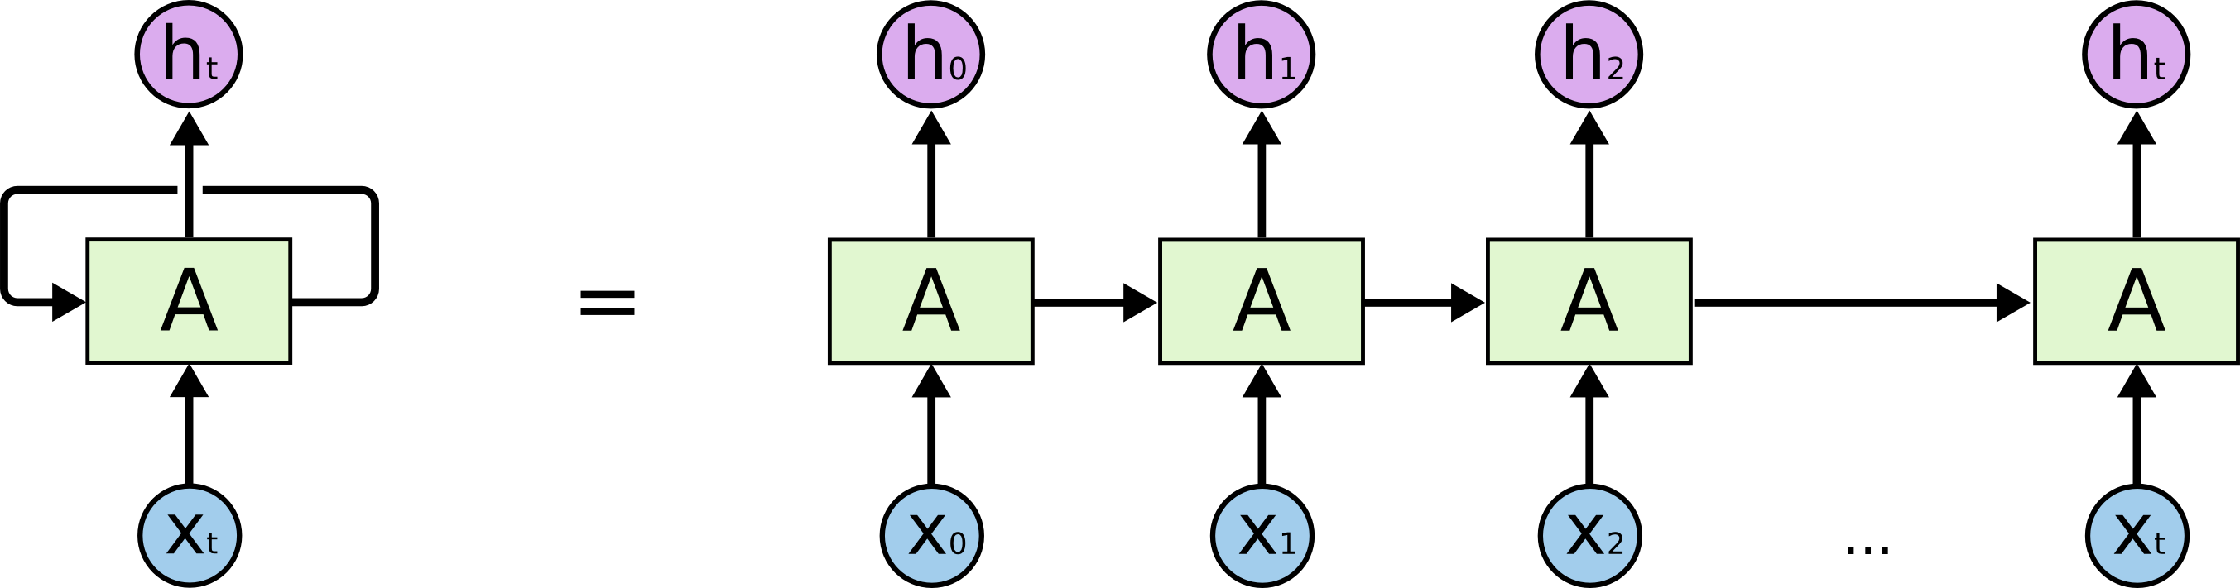
SOLUTION 1: LSTM RNN Model
Well-established model for deep-learning-based time series classification
1.3 million parameter final model
~1 hour training time on single P5000
80% Training Set (400 Users)
20% Testing Set (100 Users)
Source: https://colah.github.io/posts/2015-08-Understanding-LSTMs/

Slide 13
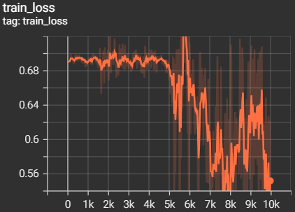
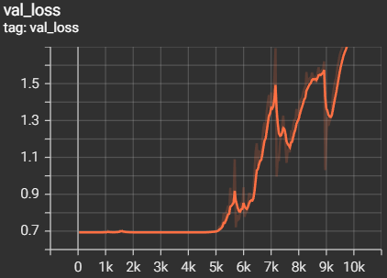
SOLUTION 1: LSTM RNN Results
Most promising solution given more data availability
Test set accuracy: 58%
Up to 18% accuracy improvement over traditional methods tested (ROCKET, DTW-KNN, etc.)
~4000 steps training loss stagnates and validation loss spikes
Overfitting, unable to find more predictive features
Implies possible improvement with more data at user-level

Slide 14
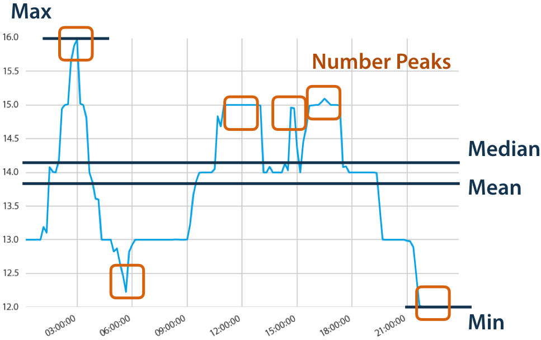
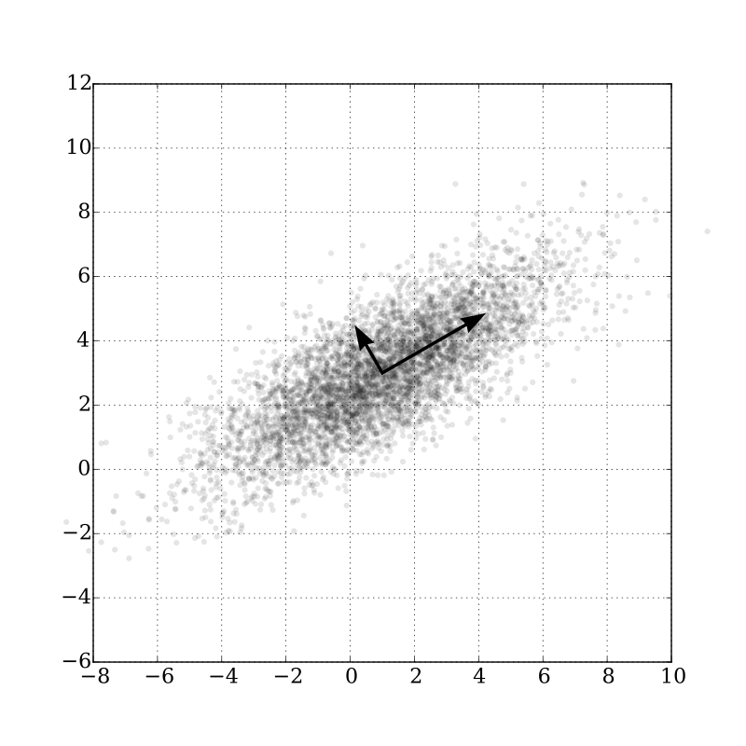
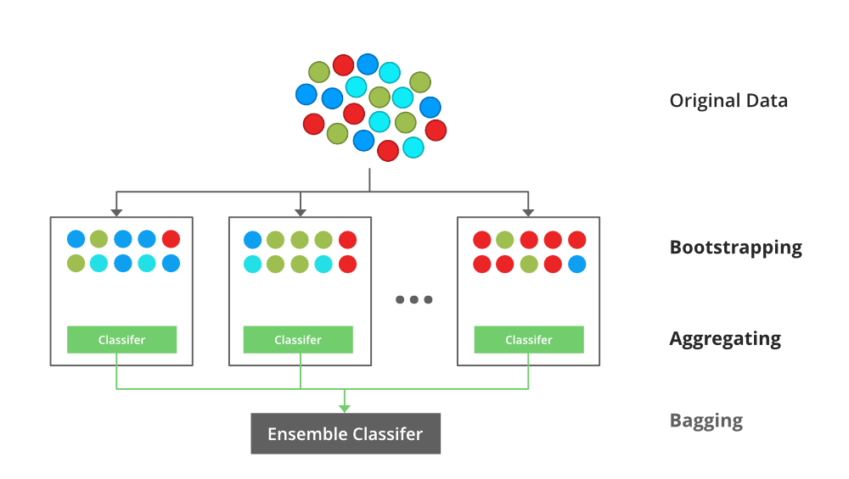
SOLUTION 2: TSFresh Model
Source (image 1): https://tsfresh.readthedocs.io/en/latest/text/introduction.html
Source (image 2):https://commons.wikimedia.org/w/index.php?curid=46871195
Source (image 3): https://www.geeksforgeeks.org/xgboost/
TSFresh Feature Extraction
PCA
XGBoost
Dimensionality reduction to solve Big-p, Little-n (p>>n) problem
Min-max normalization included for PCA
397 final features
State-of-the-art gradient boosted classifier
Robust
Fast
Interpretable
Automatically extracts 1000s of features from time series to give new insights into their dynamics
No preprocessing required
6242 extracted features

Slide 15
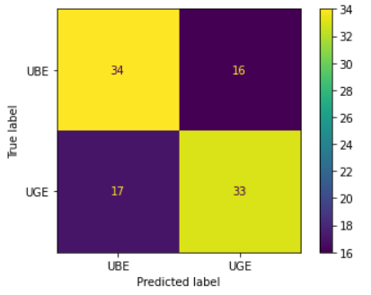
SOLUTION 2: TSFresh Results
Best performing model with provided data
Test set accuracy (best): 67%
~12% improvement over manually extracted features (e.g. % outliers using Local Outlier Factor & MAD, descriptive stats)
Total runtime of ~2 hours on 8 core CPU machine
60% Training Set (300 Users)
20% Testing Set (100 Users)
 | Precision | Recall | F1 Score | Samples
UBE | 0.67 | 0.68 | 0.67 | 50
UGE | 0.67 | 0.66 | 0.67 | 50

Slide 16
THANK YOU
Questions?

