Slide 1
ITU-ML5G-PS-016:
Location estimation using RSSI of wireless LAN
Team Name:
SSN_ITU
Project Students: Charu Jain
Indu Subramanian
Meghna Govind
N Venkateswaran

Slide 2
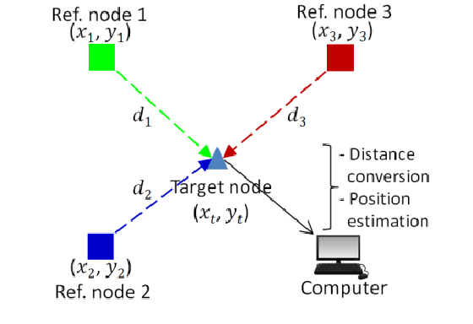
OBJECTIVE
kEY issues with rssi
To propose AI/ML aided localization, utilizing received signal strength indicator (RSSI) observed at the terminal with high accuracy as that of GPS-based localization.
Exploit the relationship between distance and RSSI
To find latitude and longitude of the nodes of a Wireless network
Highly prone to shadowing effects
Multipath fading affects the distance-RSSI relationship

Slide 3
DATASET ANALYSIS

Slide 4
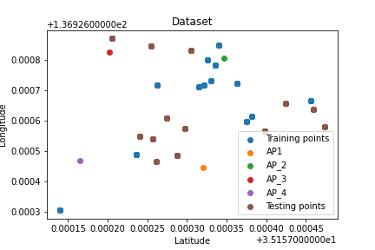
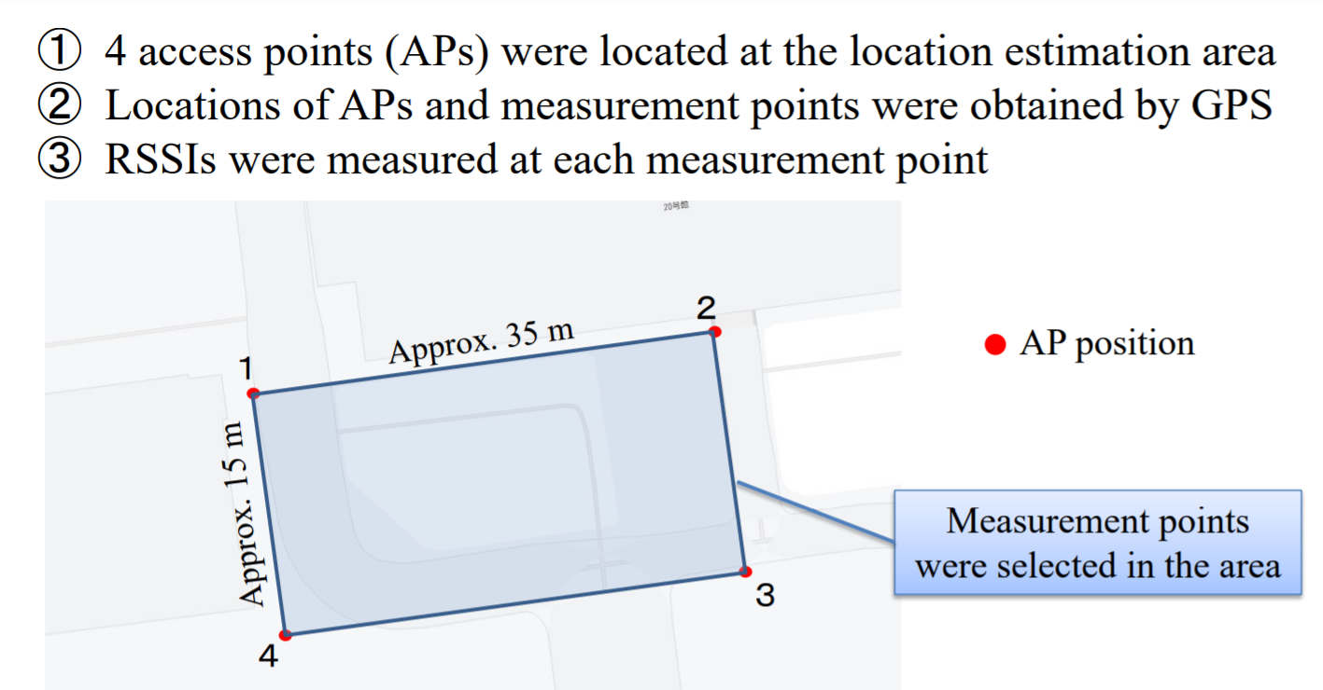
TOPOGRAPHY

Slide 5
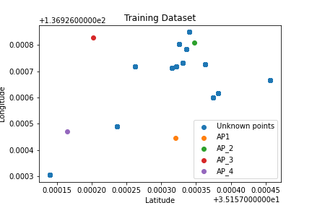
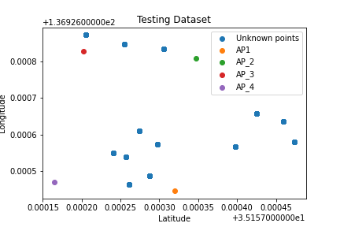
VISUALISING POSITION OF DATA

Slide 6
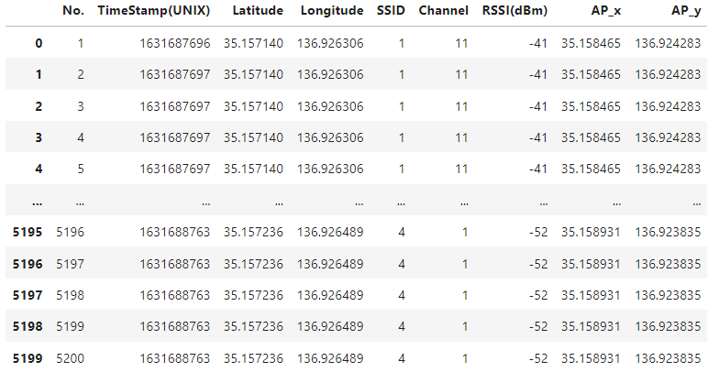
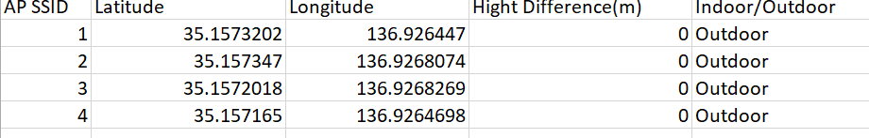
INFORMATION GIVEN
4 Access Points
13 unknown nodes.
Latitude, Longitude of APs
Channel number of each AP
Timestamps
RSSI (dBm)

Slide 7
DATASET INFERENCE

Slide 8
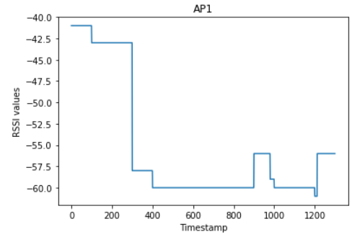
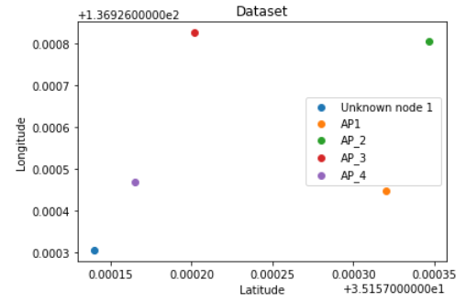
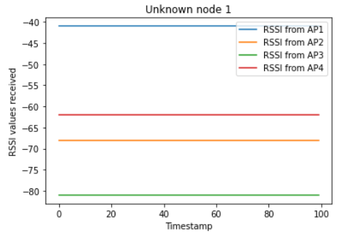
Regression problem
Sampling period is 100 sec for an unknown node from one AP, i.e an unknown node observes 100 RSSI values from one AP in this period.
Does not always satisfy the distance-RSSI relationship
RSSI values to multiple unknown nodes remain the same even though they are in different positions
Less RSSI values ( data points) for a complex environment
Hence we need to model all these inconsistencies in the dataset

Slide 9
PROPOSED SOLUTION
Let’s CHECK OUT THE SOLUTION

Slide 10
TRAINING BLOCK DIAGRAM

Slide 11
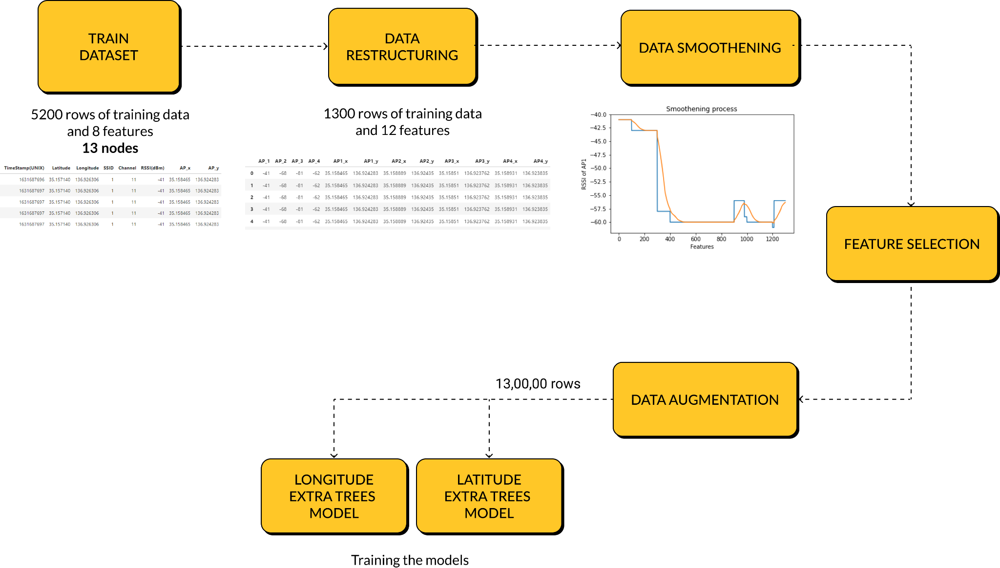

Slide 12
TESTING BLOCK DIAGRAM

Slide 13
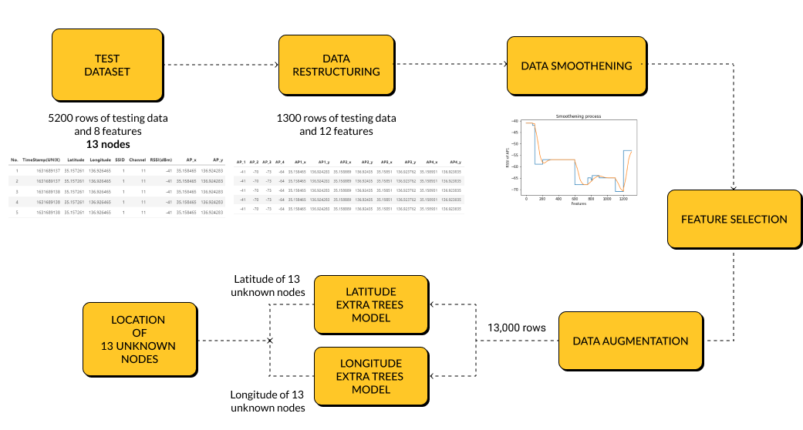

Slide 14
DATA
PREPROCESSING STEPS

Slide 15
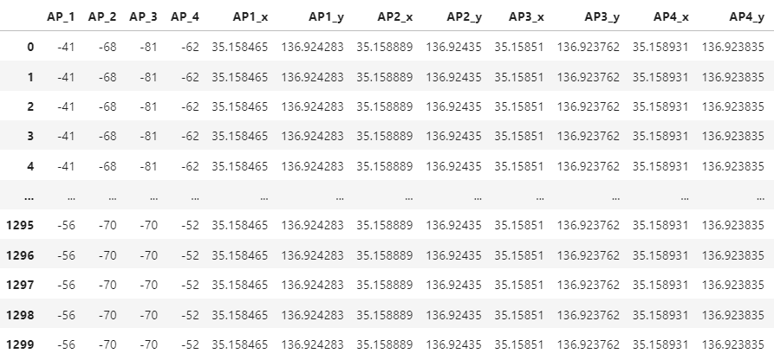
01.
Data RESTRUCTURING
ORIGINAL
5200 rows with 8 features
AFTER RESTRUCTURING
1300 rows with 12 features

Slide 16
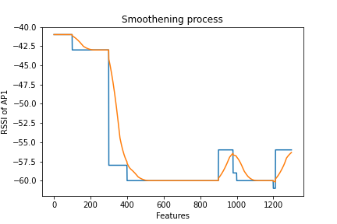
02.
Data SMOOTHENING
The RSSI values observed by the target nodes are highly dynamic. And in some cases, the RSSI values are similar for 2 or more target nodes, which hampers accurate learning process of the model.
This in turn weighs down the accuracy of the model.
Therefore, we formulated a data smoothening method called the windowing method.
The process is to select a window size ‘n’ and to determine the average of these values. The weightage of this average value on the current RSSI values is determined by ‘𝛼’.
𝛼 = 0.2 , to give more weightage to the average of previous values.
curr_val = curr_val*𝛼 + (1-𝛼)*avg_val

Slide 17
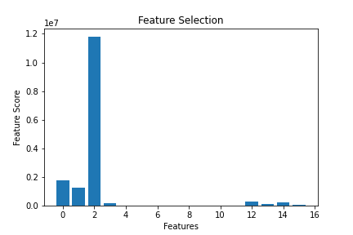
03.
Feature selection
Irrelevant or partially relevant features can negatively impact model performance.
Having irrelevant features in your data can decrease the accuracy of the model.
Hence we select only those features which contribute most to the output that we are interested in.
Correlation is a measure of how 2 variables change together. SelectKBest() from scikit-learn machine library uses correlation statistics to provide scores for all features
The scores that are in the negative range or zero are neglected and the the scores that fall under the positive range are considered.
Feature 7, 8 and 9 are removed

Slide 18
04.
Data AUGMENTATION
We devised a technique that is used to increase the amount of already existing data.
We utilized a factor “num”, which determined by what amount the dataset would increase. Based on this factor, rows belonging to a particular target node were chosen to be appended to the same node’s datapoints.
For every unique target node, “num” number of extra rows are generated.
Reduces the risk of overfitting and the accuracy on unseen data can be improved.
For the given data, we have used num=10000
Shape of training dataset : (1300, 18)
Shape of training dataset after augmenting: (130000, 18)

Slide 19
EXTRA TREES
REGRESSION MODEL

Slide 20
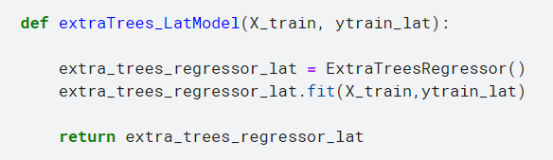
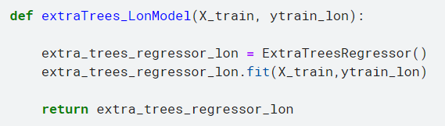
extra trees regression MODEL
The Extra Trees algorithm works by creating a large number of unpruned decision trees from the training dataset.
Predictions are made by averaging the prediction of the decision trees in the case of regression.
An ensemble method
Provided by sklearn library

Slide 21
Why regression MODEL
Regression is a type of supervised learning task. It is used in cases where the value to be predicted is continuous.
Regression is used to predict the value of the dependent variable for which some information concerning the explanatory variables is available, or in order to estimate the effect of some explanatory variable on the dependent variable.
As we need to predict the Latitude and Longitude of the unknown node, given a set of dependent features, we have used Regression
We have used Extra Trees regression model to model the given ITU Dataset.

Slide 22
RESULTS
Let’s see how the model works!

Slide 23
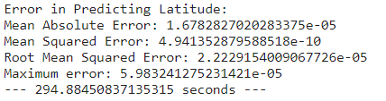
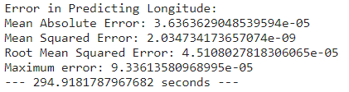
ERROR In MODELS
LATITUDE MODEL
LONGITUDE MODEL

Slide 24
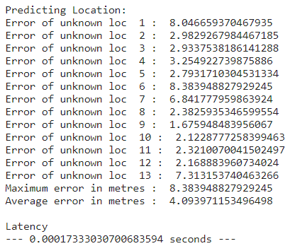

PERFORMANCE OF MODEL

Slide 25


EVALUATION METRICS
Maximum and average error
COmplexity of the model
The maximum error of estimation, also called the margin of error, is an indicator of the precision of an estimate.
The average error of estimation, is an indicator of how close a regression line is to a set of points and gives the average for the set of errors. It acts as the reference error value giving us the maximum and minimum error that can be obtained from the model.
Latency is a measurement that is used to determine the performance of the model. Latency refers to the time taken to process one unit of data provided only one unit of data is processed at a time. Hence it is an indicator of the complexity of the model.

Slide 26
CONCLUSION

Slide 27
CONCLUSION
On the given dataset, we have implemented the AI/ML model called Extra Trees regression model, to localise the unknown node in combination with some data-preprocessing techniques.
The techniques included, data restructuring, data smoothening, feature selection and data augmentation.
Used 2 models, one to predict the latitude and one for the longitude.
Obtained a maximum error of 8.3m with an average error of 4.09m in a 35x15m field.

Slide 28
REFERENCES
S. Hara and D. Anzai, “Experimental Performance Comparison of RSSI- and TDOA-Based Location Estimation Methods,” in VTC Spring 2008 - IEEE Vehicular Technology Conference, May 2008, pp. 2651–2655. doi: 10.1109/VETECS.2008.581.
J. Xu, J. He, Y. Zhang, F. Xu, and F. Cai, “A Distance-Based Maximum Likelihood Estimation Method for Sensor Localization in Wireless Sensor Networks,” International Journal of Distributed Sensor Networks, vol. 2016, pp. 1–8, Apr. 2016, doi: 10.1155/2016/2080536.
A. Poulose and D. S. Han, “Hybrid Deep Learning Model Based Indoor Positioning Using Wi-Fi RSSI Heat Maps for Autonomous Applications,” Electronics, vol. 10, no. 1, Art. no. 1, Jan. 2021, doi: 10.3390/electronics10010002.
R. Mino et al., “A Belief Propagation-Based Iterative Location Estimation Method for Wireless Sensor Networks,” in 2006 IEEE 17th International Symposium on Personal, Indoor and Mobile Radio Communications, Sep. 2006, pp. 1–5. doi: 10.1109/PIMRC.2006.254179.
R. Zemek, S. Hara, K. Yanagihara, and K. Kitayama, A Joint Estimation of Target Location and Channel Model Parameters in an IEEE 802.15.4-based Wireless Sensor Network. 2007, p. 5. doi: 10.1109/PIMRC.2007.4394355.
R. Zemek, D. Anzai, S. Hara, K. Yanagihara, and K. Kitayama, “RSSI-based Localization without a Prior Knowledge of Channel Model Parameters,” Int J Wireless Inf Networks, vol. 15, no. 3, pp. 128–136, Dec. 2008, doi: 10.1007/s10776-008-0085-6.
R. Mino et al., “A Novel Iterative Technique for Collaborative Location Estimations,” in 2006 3rd International Symposium on Wireless Communication Systems, Sep. 2006, pp. 564–568. doi: 10.1109/ISWCS.2006.4362362.

Slide 29
REFERENCES
R. Mino et al., “A Belief Propagation-Based Iterative Location Estimation Method for Wireless Sensor Networks,” in 2006 IEEE 17th International Symposium on Personal, Indoor and Mobile Radio Communications, Sep. 2006, pp. 1–5. doi: 10.1109/PIMRC.2006.254179.
N. Patwari, A. O. Hero, M. Perkins, N. S. Correal, and R. J. O’Dea, “Relative location estimation in wireless sensor networks,” IEEE Transactions on Signal Processing, vol. 51, no. 8, pp. 2137–2148, Aug. 2003, doi: 10.1109/TSP.2003.814469.
Z. Khokhar and M. Siddiqi, “Machine Learning Based Indoor Localization using Wi-Fi and Smartphone,” Journal of Independent Studies and Research Computing - SZABIST, Vol: 18 – Issue: 1, Apr. 2021.
S. Hara and D. Anzai, Comparison of Three Estimation Methods for RSSI-Based Localization with Multiple Transmit Antennas. 2007, p. 3. doi: 10.1109/MOBHOC.2007.4428599.
D. Anzai and S. Hara, “An RSSI-Based MAP Localization Method with Channel Parameters Estimation in Wireless Sensor Networks,” in VTC Spring 2009 - IEEE 69th Vehicular Technology Conference, Apr. 2009, pp. 1–5. doi: 10.1109/VETECS.2009.5073388.
S. Hara, D. Anzai, T. Yabu, K. Lee, T. Derham, and R. Zemek, “A Perturbation Analysis on the Performance of TOA and TDOA Localization in Mixed LOS/NLOS Environments,” IEEE Transactions on Communications, vol. 61, no. 2, pp. 679–689, Feb. 2013, doi: 10.1109/TCOMM.2013.012313.110509.

Slide 30
THANK YOU
SSN_ITU-ML5G-PS-016

