Slide 1

5G PROJECT OVERVIEW TEAM DATA RANGERS
23rd NOV 2022
TEAM MEMBERS:
<ADD NAMES>
<Course>

Slide 2

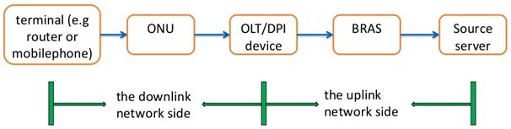
PROBLEM STATEMENT Improve User Experience In Time By Identifying 5G Network Quality Problems
DPI probe divides the end-to-end network into 2 parts: uplink and downlink sides
The downlink side problems account for a large proportion of network problems
To accurately distinguish between users with bad experience (UBE) and users with good experience (UGE) through changes in downlink network side indicators

Slide 3
DATA DESCRIPTION
OVERVIEW
Out of 15+ indicators, 8 were determined as the key, by the problem providers
1
First step of the three-way handshake, the time interval between the syn ack packet and the ack packet
Data obtained from real-world DPI devices were provided
2
The time interval between the syn ack packet and the ack packet
150 training, 50 validation, and 50 Test UBE users
3
The time interval between the ack packet and the first payload packet in the three-way handshake
150 training, 50 validation, and 50 Test UGE users
4
The response delay of the first packet with payload after the establishment of TCP for multiple flows in the session
Each user had a separate CSV with time-series data.

Slide 4

DATA DESCRIPTION (cont..)
5
In TCP transmission, the actual delay of transmission from the DPI position to the user terminal
6
In TCP transmission, the transmission delay from the DPI position to the website
7
In TCP transmission, the percentage of downlink retransmitted packets in the current session
8
In TCP transmission, the percentage of upstream retransmission packets of the current session

Slide 5


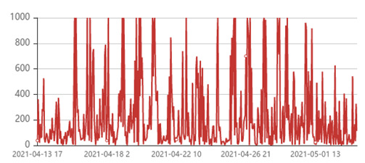
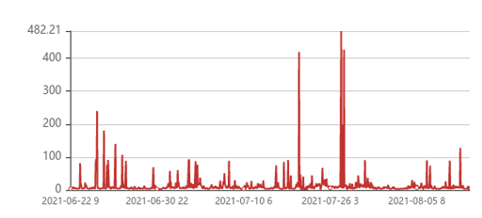
GUIDELINES FOR POTENTIAL SOLUTION
This observation can be used to identify as UBE or UGE
Users with high % of outliers are classified as UBE
Threshold is defined to identify outliers
UBE users have higher indicator values and high outlier proportions compared to UBE
The threshold needs to classify the test data set accurately
Trend Chart of Indicator 1 of Bad Experience User
Trend Chart of Indicator 1 of Good Experience User

Slide 6
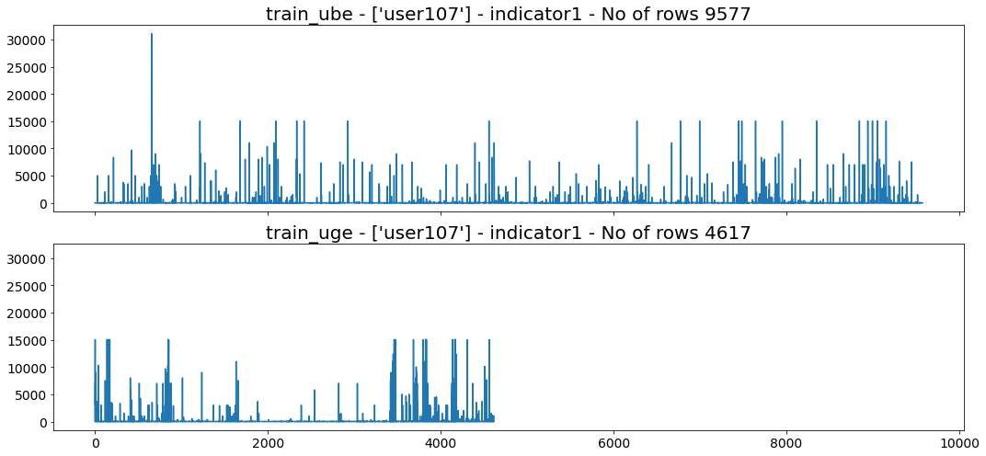
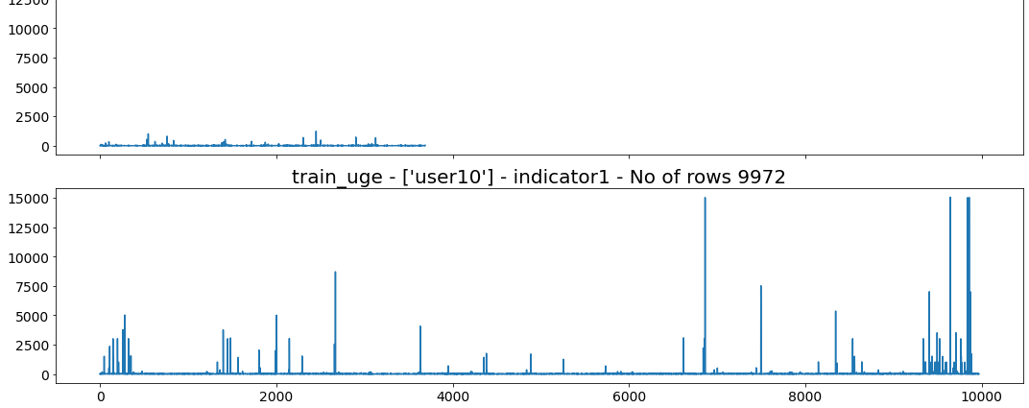
DATA EXPLORATION
01
Visual Differenciation
Plotted pairs of UBE and UGE users’ Indicators side by side
02
Outliers
Some cases showed UBE having more outliers and higher values
03
Pattern
But it was not true for numerous other cases
04
Revisit Assumptions
Made us question the assumption that UBE has more outliers

Slide 7
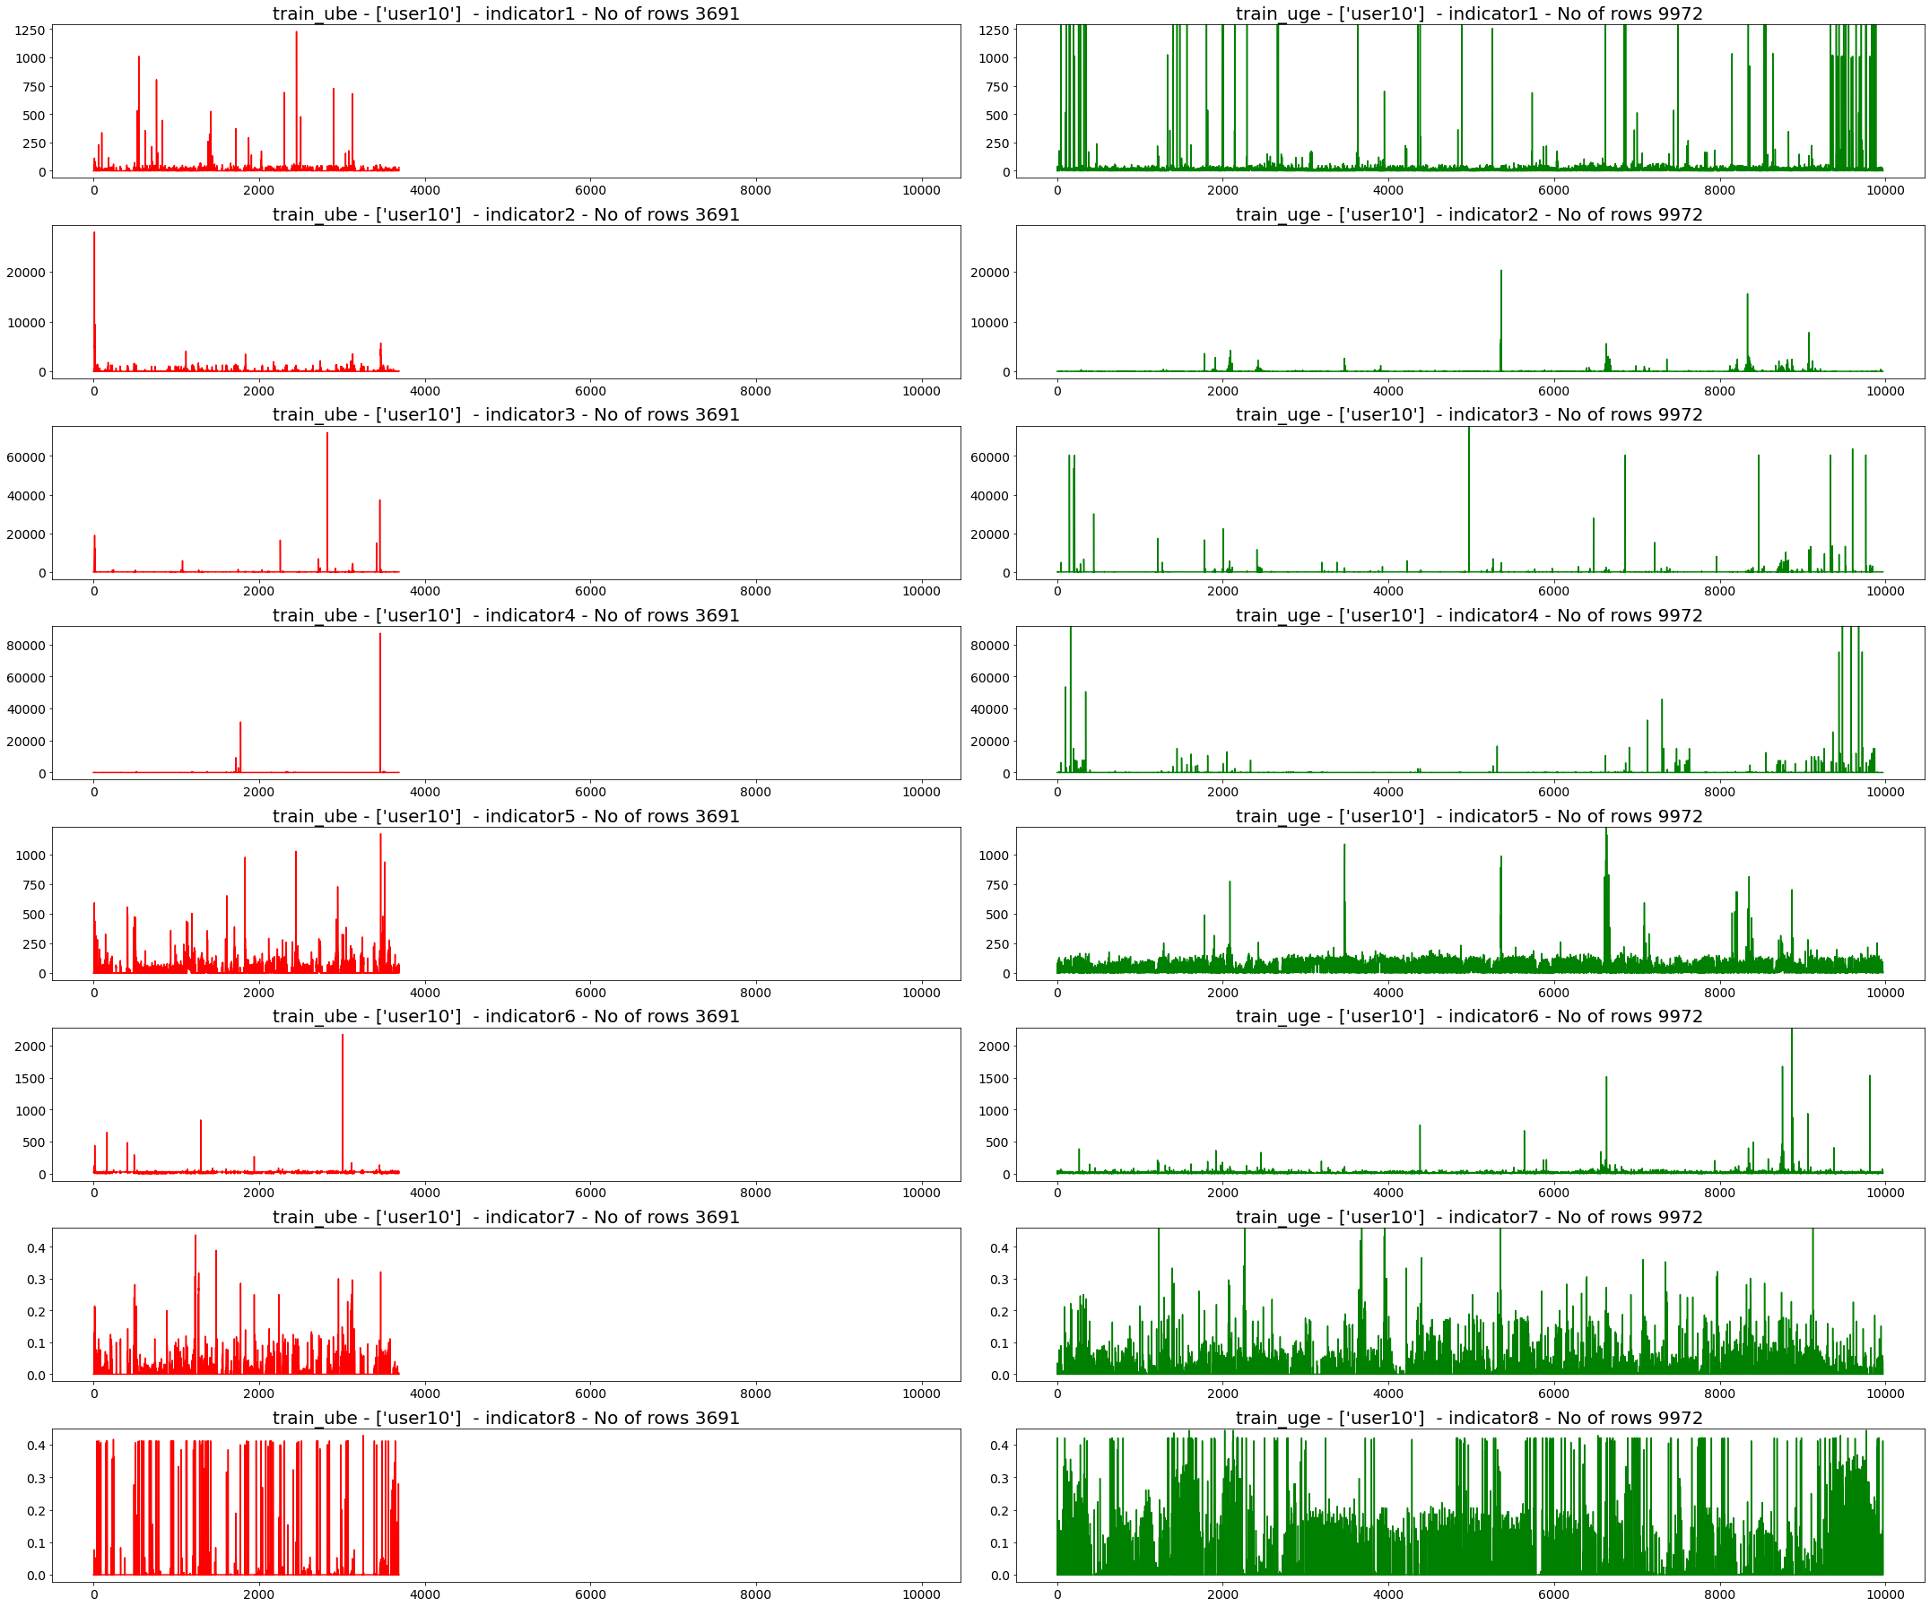
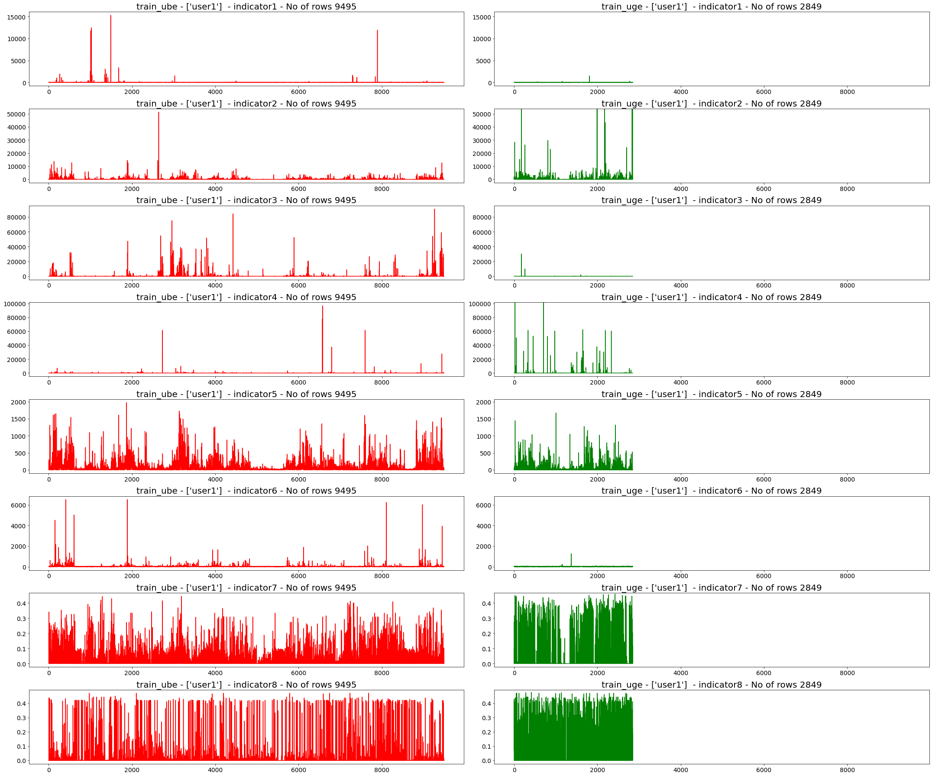
DATA EXPLORATION (cont..)
All 8 indicators were compared side by side
Again, it was revealed that not all cases have high outliers in for UBE

Slide 8
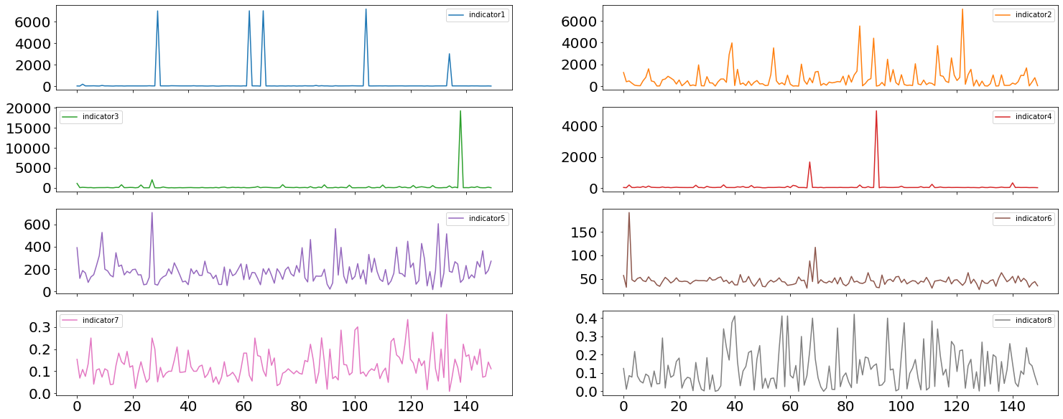
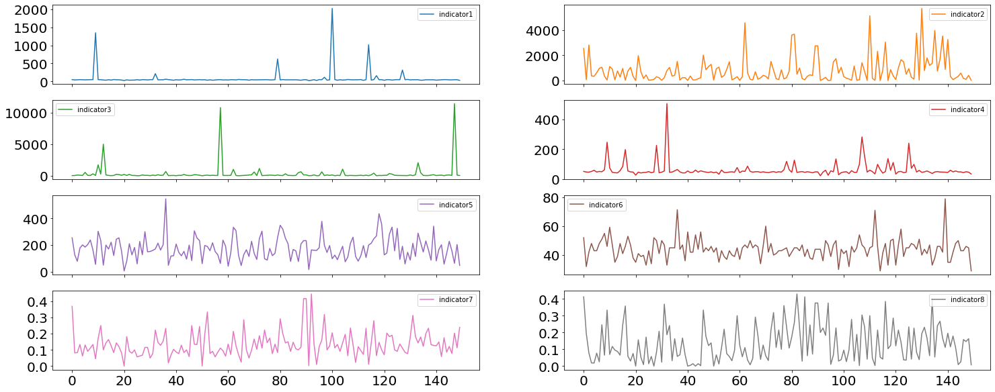
95% PERCENTILES
Revised Approach for Solution
Modified approach to identify threshold
For a user with 95% threshold value, 5% are outliers
Using UGE users’ 95% as a threshold for UBE users
Higher outlier % based on the assumption
Calculated 95% percentile values for all indicators for each user
Plotted this for all UBE and UGE users separately
Ind 1, 3, and 4 seem to have lesser values in UGE
For other indicators we would again not find higher outliers % in UBE based on UGE 95%

Slide 9
COMBINING THE INDICATORS
We combined the Indicators to check if it yields a better differentiation
Based on the functional understanding
Grouping of data based on timestamp:
Grouped users with the same timestamp and parallel events
Combining Indicators:
Aggregated 1-6 indicators since each of them occurs in a sequence
Took average of indicators 7 and 8 as they are ????
Yielded similar results showing no clear differentiation
Principle Component Analysis
PCA is a widely used method to reduce and combine variables
Usually, 2 principal components capture maxim variance (75%)
But here 5+ ??? for needed

Slide 10
A FRESH PERSPECTIVE ON INFORMATION FROM INDICATORS
Shifted focus from absolute Indicator values to other factors like network fluctuations as several scenarios are possible
01
Scenario 1
High speed connection inversely proportional to time delays (lesser outliers)
Exceptions if network fluctuates, multiple packets are transmitted
02
Scenario 2
Size of time delay indicator dataset vs outliers
Correlation of user experience with high-volume downloads/uploads
Scenario 3
High speed connection yet poor performance (package retransmissions and connection failures/delays due to bad performance of the connection)
User reporting good experience with minimal usage and the speed compensates for the connection issues
03

Slide 11



POTENTIAL SOLUTIONS : ML CLASSIFICATION METHODS
Explored various methods of modeling and classification of longitudinal and time series :
Method 01
Isolation Forest Anomaly Detection
While the rest of the methods gave only about 50% test accuracy
Method 5 was selected as the final model, as it gave the highest accuracy of 64%
Method 02
VAR-based Anomaly Detection
Method 03
DTW-based time series classification
Method 04
CWT and CNN-based time series classification
Method 05
DWT and a combination of ML classifiers like Random Forest, XGBoost, KNN

Slide 12
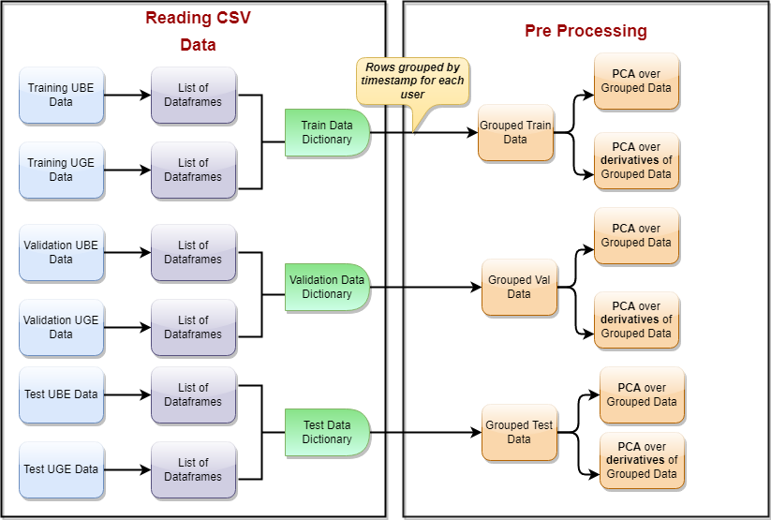
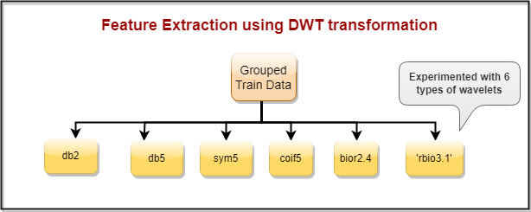
PREPROCESSING, FEATURE EXTRACTION, AND EXPERIMENTATION
Feature Extraction
DWT on Grouped Data :
Developed 6 different sets of features using 6 different wavelet types
Db2,db5,sym5,coif5, bior, 2.4 rbio3.1
DWT on PCA on Grouped Data:
Using PCA, created a new set of variables
8 components to explain maximum variability
DWT on PCA of derivative of Grouped Data
To capture information on the fluctuation of the values, the rate of change of indicators was used
Another set of features using PCA over estimated derivatives of the indicators

Slide 13
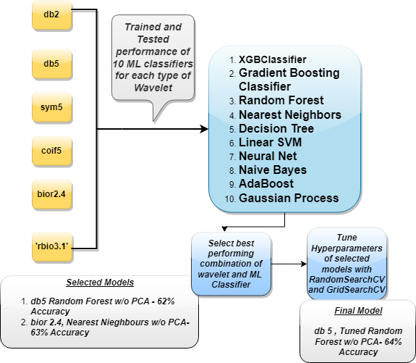
ML CLASSIFIERS
Machine learning algorithm parameters
Experimentation Phase:
All the models are imported from the sklearn python package and are run with the default parameters
Random forest and Nearest Neighbors Classifiers had high accuracy of 62% and 63% respectively
Hyperparameter tuning :
A wide range of parameter grids was chosen for both Random forest and Nearest Neighbors Classifiers to run RandomSearchCV from sklearn with 3-fold cross-validations.
When the best parameters are found a smaller range near the best parameters is used in GridsearchCV with 3-fold cross-validation

Slide 14
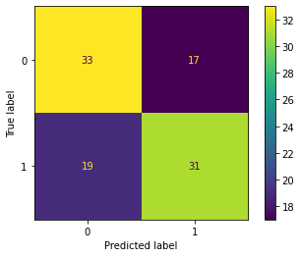
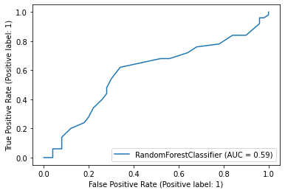
FINAL MODEL METRICS
precision recall f1-score support
0 0.63 0.66 0.65 50
1 0.65 0.62 0.63 50
accuracy 0.64 100
macro avg 0.64 0.64 0.64 100
weighted avg 0.64 0.64 0.64 100

Slide 15

CONCLUSIONS
02
Implications:
It was demonstrated that the best accuracy is achieved using transformation and Machine Learning instead of solely relying on outliers.
Future Scope
Even though 64 % accuracy is decent using such efficient methods we can achieve higher accuracy if we have more informative variables. Thus, adding more indicators is also recommended.
More variables may not always mean more accuracy, but in our case, with variables the feature extraction may ensure more information being extracted giving more accuracy
Can experiment with the transformations more specifically and also use filters
Future Scope
01
03
04

Slide 16
Q&A

