Slide 1

AI for good 5g/ml challenge
Classification of Home Network Users to Improve User Experience

Slide 2




Team Introduction
Data Rangers
Bharath Raj
Muppalla
Cade
Phelan
Srinivas
Pramodh
Tharun
Veeram Reddy

Slide 3
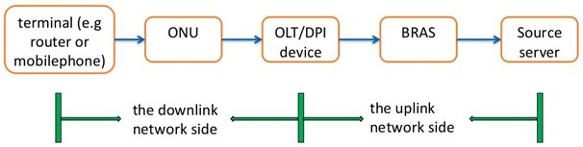

Problem Statement
Business Problem: Improve User Experience In Time By Identifying 5G Network Quality Problems
The DPI probe divides the end-to-end network into 2 parts: uplink and downlink sides
The downlink side problems account for a large proportion of network problems.
Accurately distinguish between users with bad experience (UBE) and users with good experience (UGE) through changes in downlink network side indicators

Slide 4
Data Description
OVERVIEW
Indicator 1: In the first step of the three-way handshake, the time interval between the syn ack packet and the ack packet;
Indicator 2: In the second step of the three-way handshake, the time interval between the syn ack packet and the ack packet;
Indicator 3: The time interval between the ack packet and the first payload packet in the three-way handshake;
Indicator 4: The response delay of the first packet with payload after the establishment of TCP for multiple flows in the session;
Indicator 5: In TCP transmission, the actual delay of transmission from the DPI position to the user terminal;
Indicator 6: In TCP transmission, the transmission delay from the DPI position to the website;
Indicator 7: In TCP transmission, the percentage of downlink retransmitted packets in the current session;
Indicator 8: In TCP transmission, the percentage of upstream retransmission packets of the current session.
Out of 15+ indicators, 8 were determined as the key, by the problem providers
Data obtained from real-world DPI devices were provided
150 training, 50 validation, and 50 Test UBE users
150 training, 50 validation, and 50 Test UGE users
Each user had a separate CSV with time-series data.

Slide 5


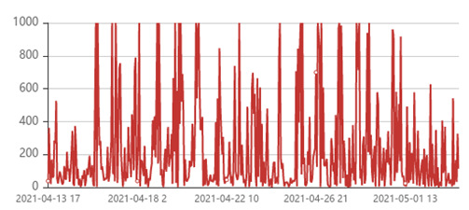
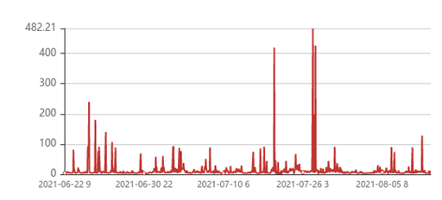
Guidelines for Potential Solution
UBE users have higher indicator values and high outlier proportions compared to UGE
Threshold is defined to identify outliers
The threshold needs to classify the test data set accurately
This observation can be used to identify as UBE or UGE
Users with high % of outliers are classified as UBE
Trend Chart of Indicator 1 of Bad Experience User
Trend Chart of Indicator 1 of Good Experience User

Slide 6
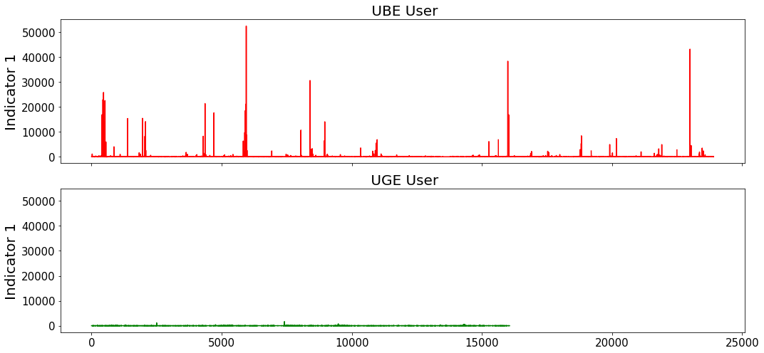
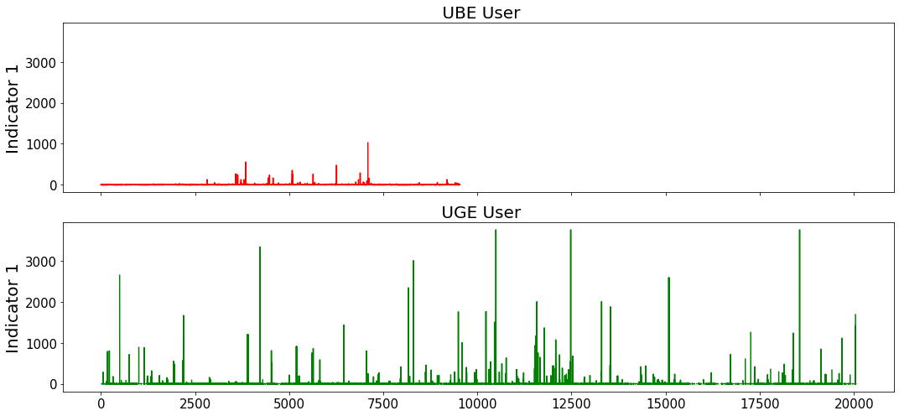
Data Exploration
Case 1
01
Visual Inspection
Plotted pairs of UBE and UGE users’ Indicators side by side
02
Observe Outliers
Some cases showed UBE having more outliers and higher values
03
Inconsistent Pattern
But it was not true for numerous other cases
04
Revisit Assumptions
Made us question the assumption that UBE has more outliers
Case 2

Slide 7
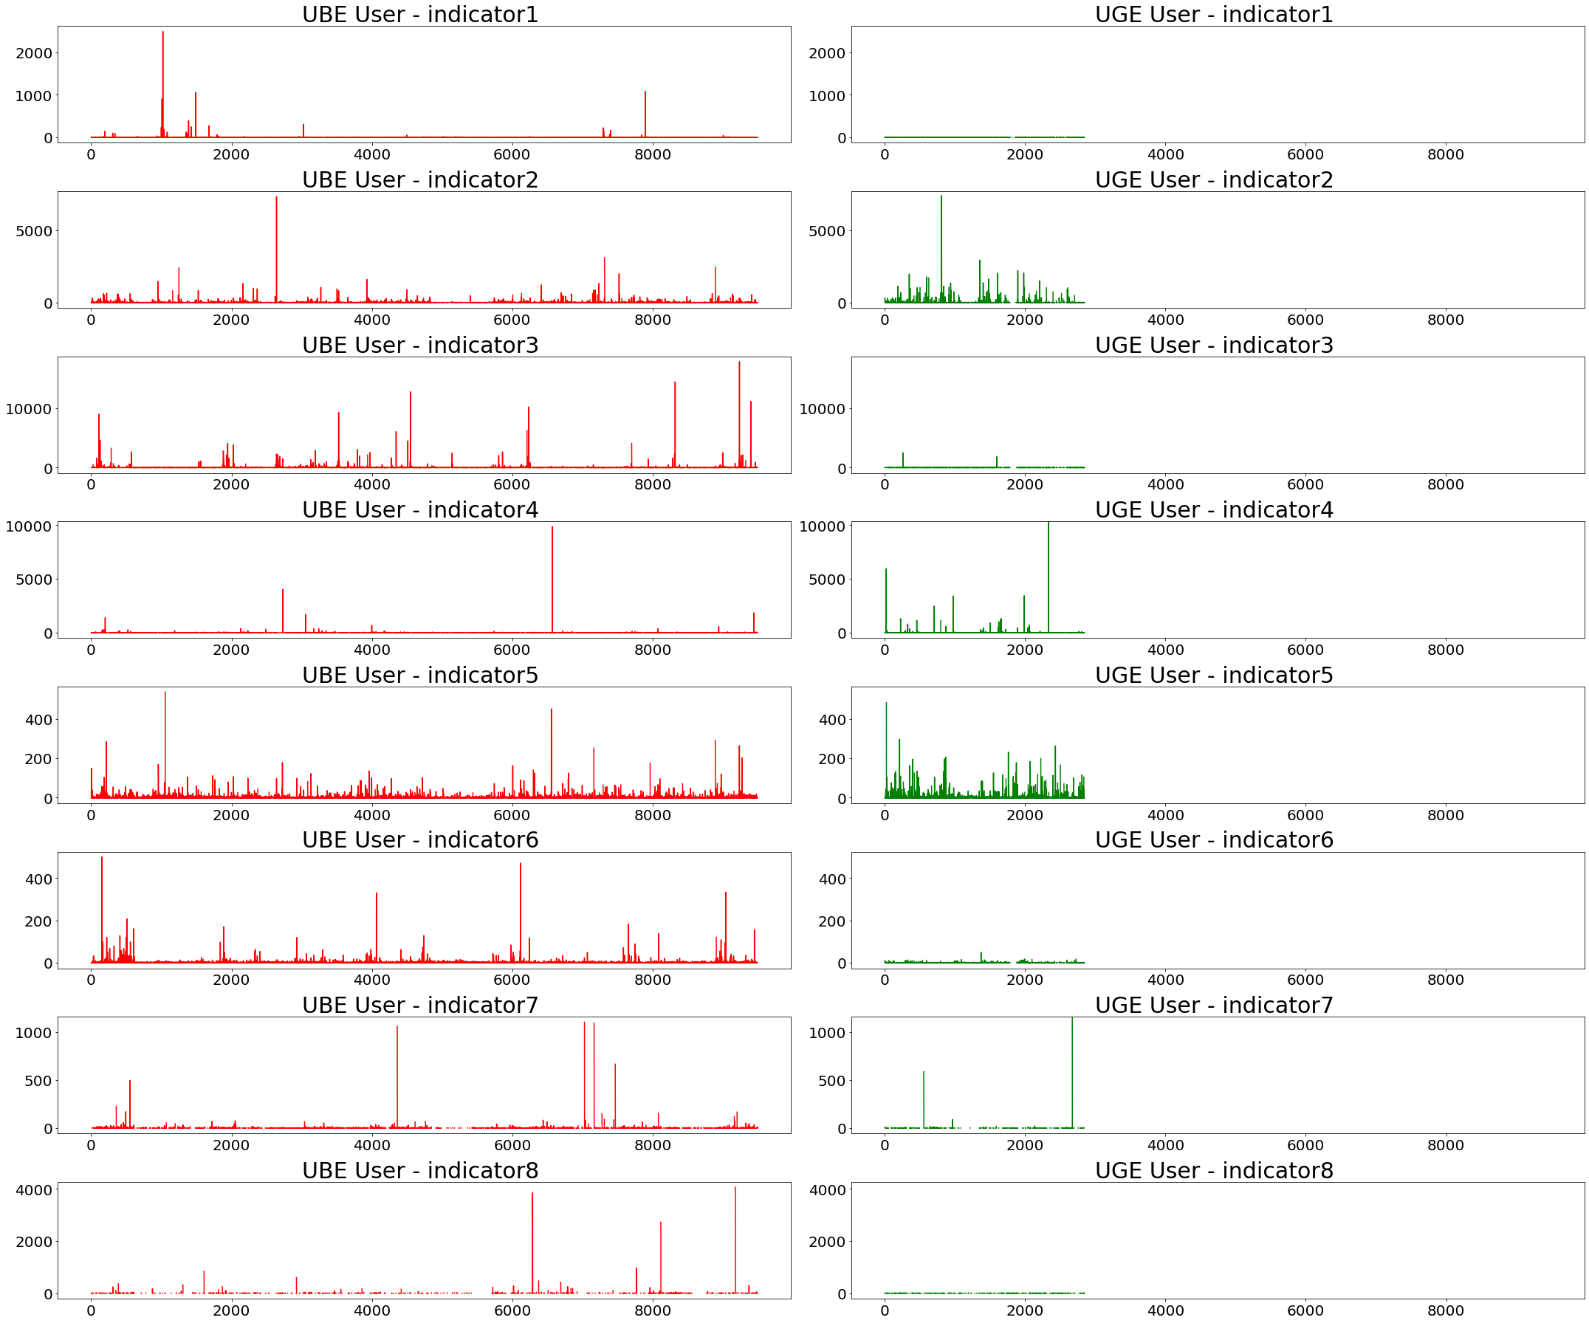
Data Exploration (cont..)
Case 1
All UBE user Indicators have higher values and outliers

Slide 8
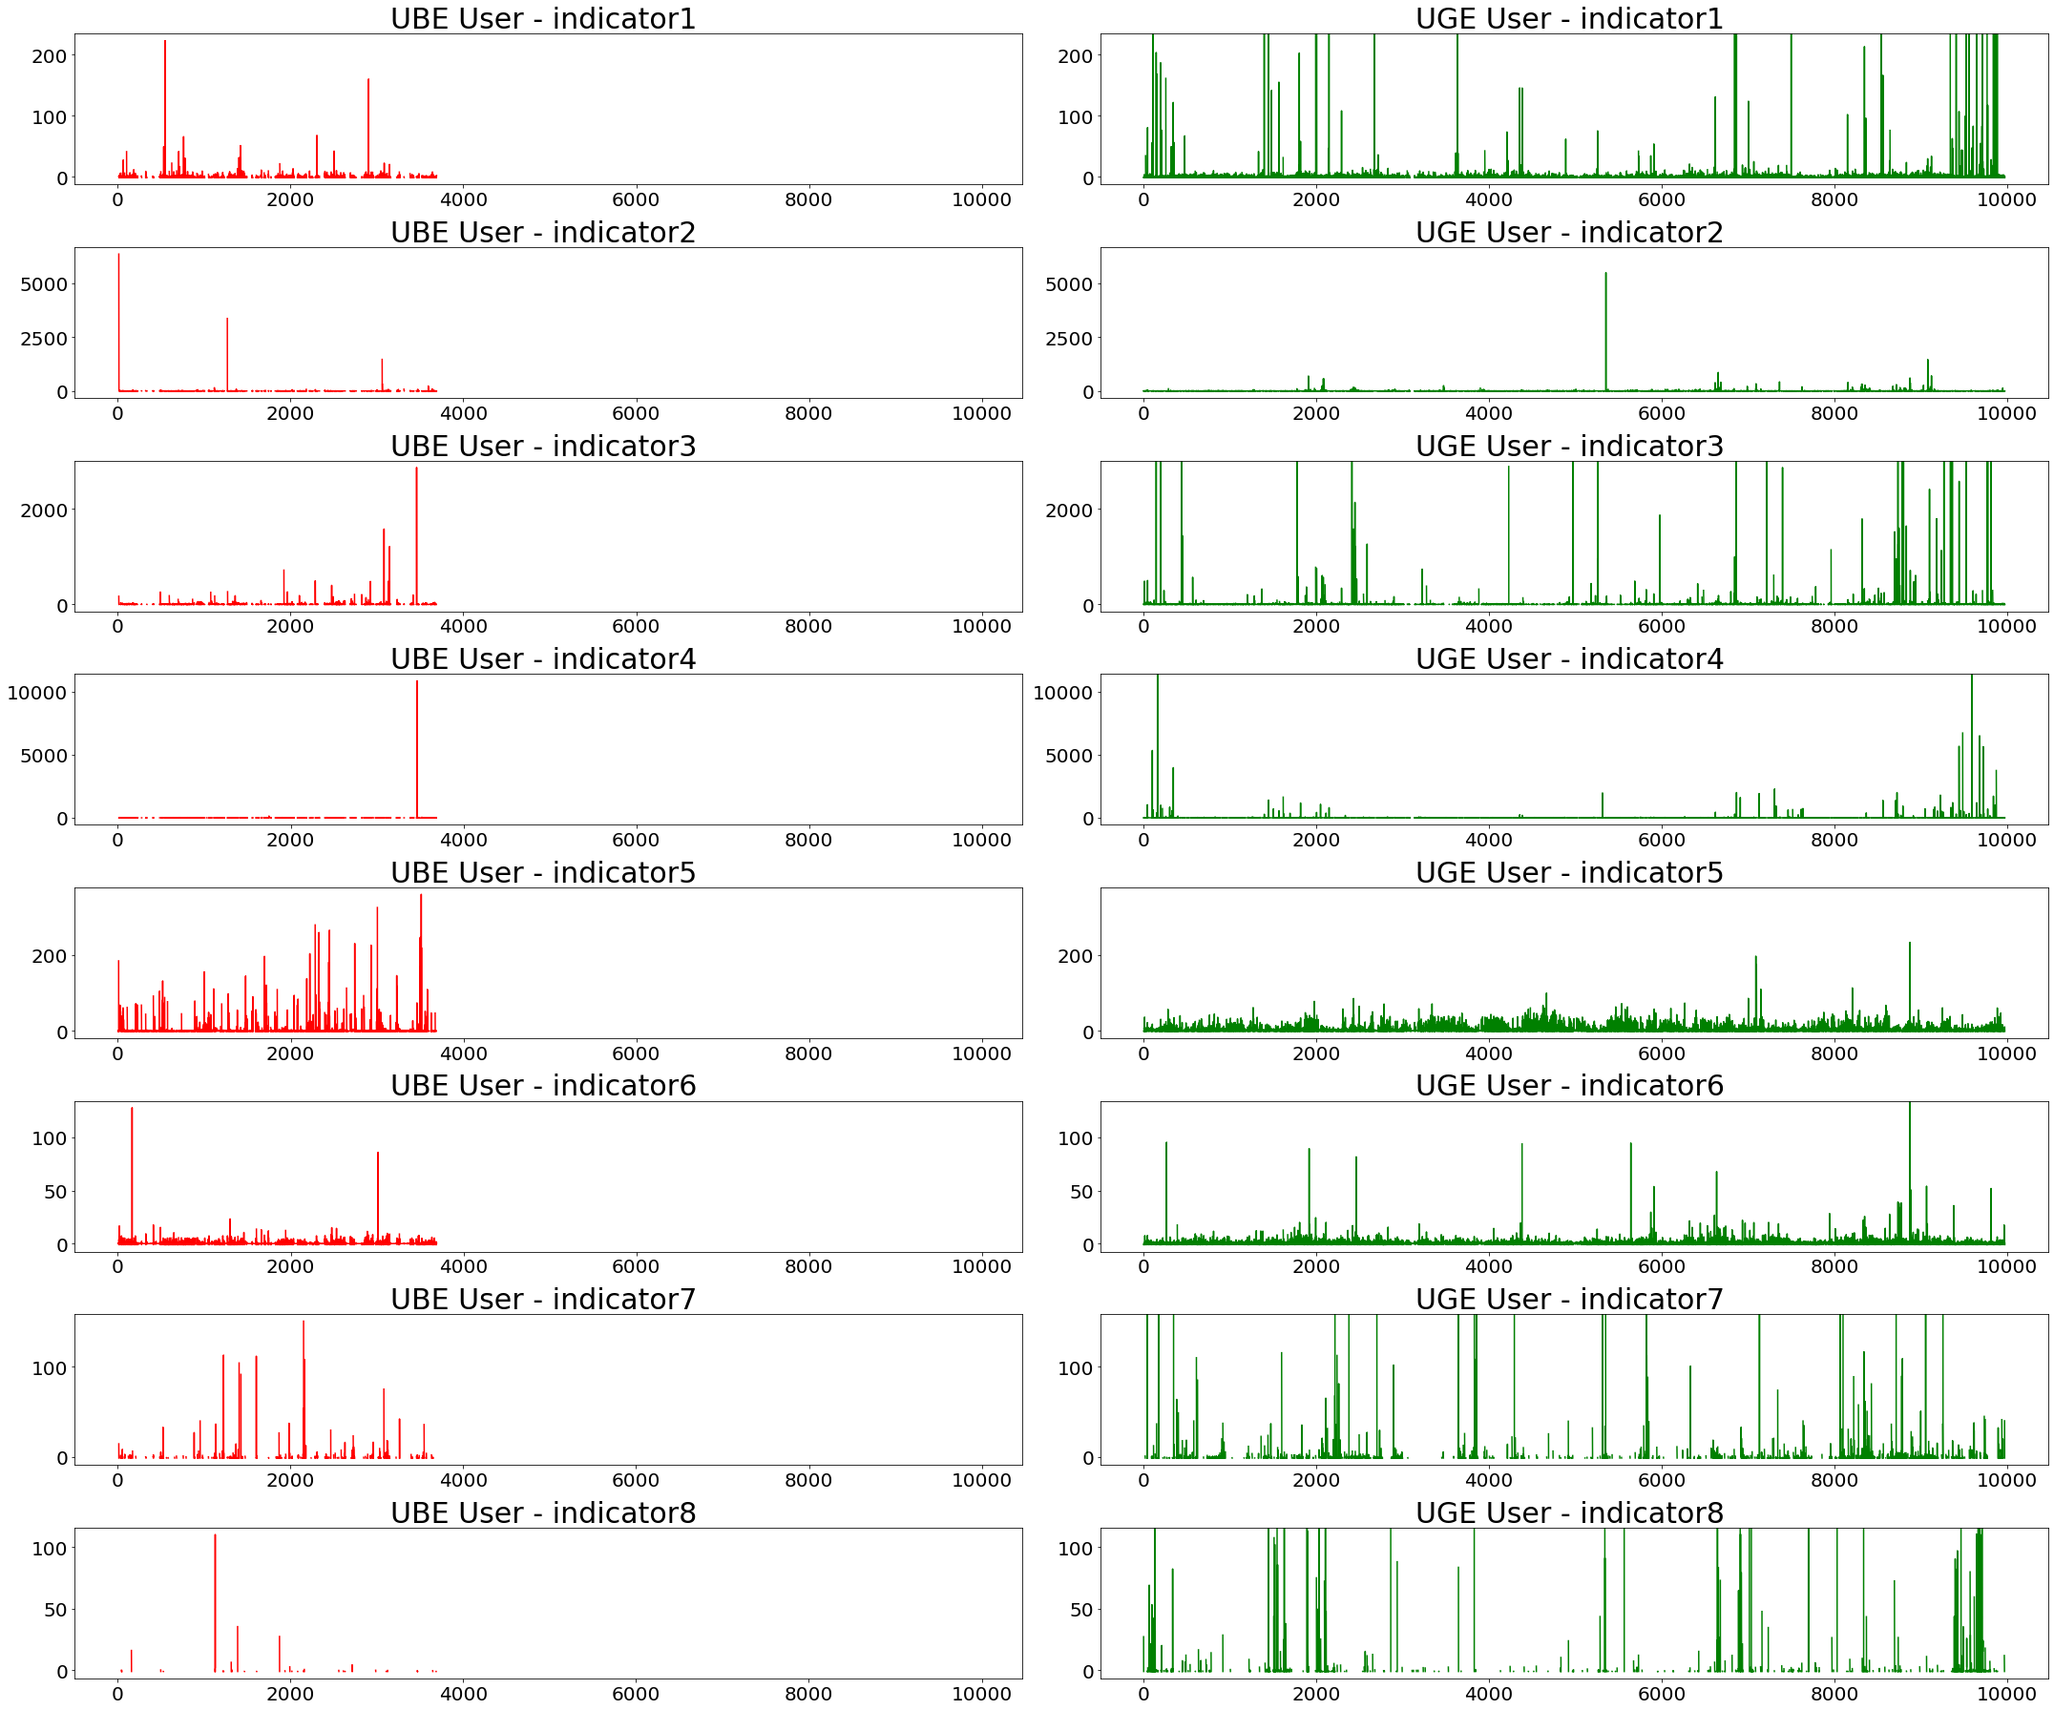
Data Exploration (cont..)
Case 2
Some UGE user Indicators have higher values and outliers

Slide 9
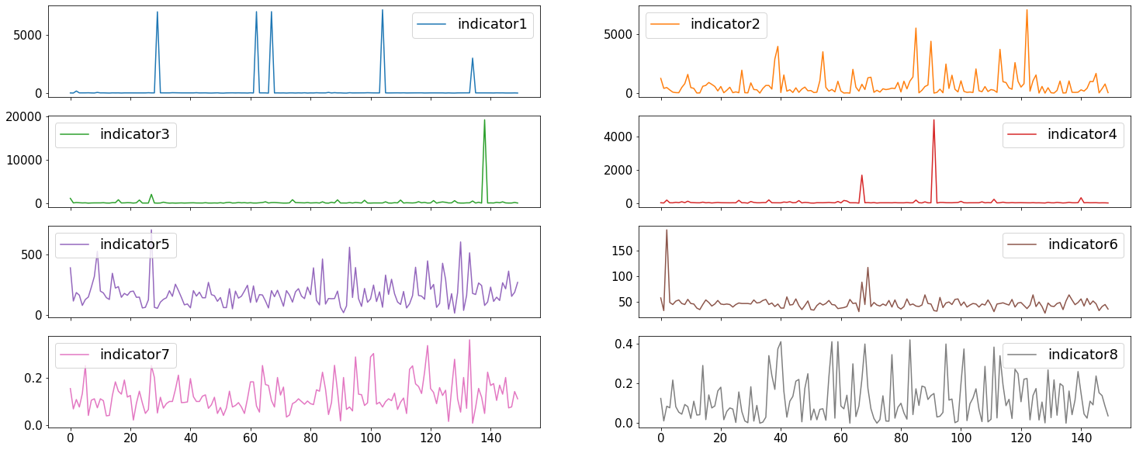
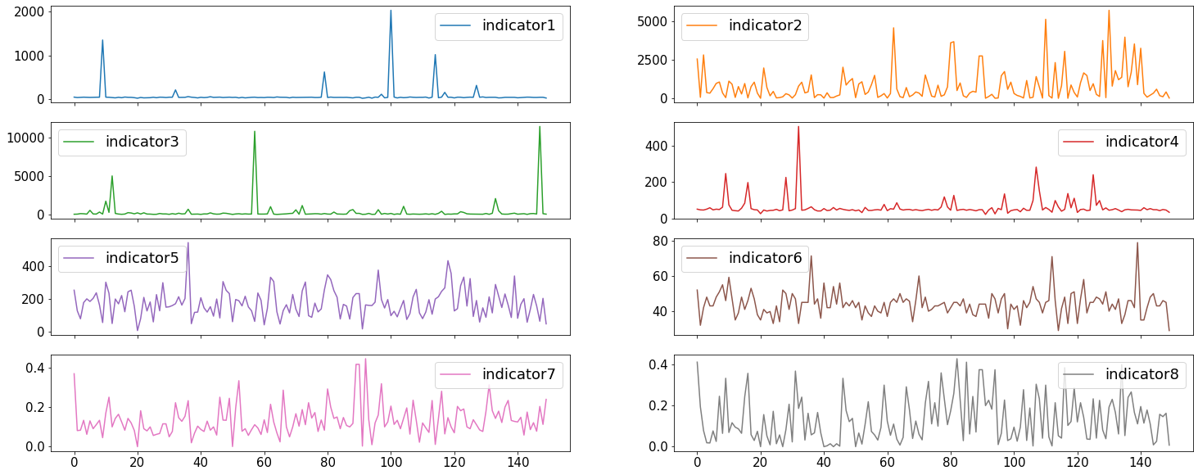
Revised Approach (95% Percentiles)
UBE Users’ 95 % percentiles
Approach :
Used 95 % percentile values to identify outliers
For a user, at the 95% threshold value there are 5% outliers
Using UGE users’ 95% values as a threshold for UBE users
UBE will have higher outlier % based on the assumption
Plots :
Calculated 95% percentile values for all indicators for each user
Plotted this for all UBE and UGE users separately
Ind 1, 3, and 4 seem to have lesser values in UGE
For other indicators we would again not find higher outliers % in UBE based on UGE 95%
UGE Users’ 95 % percentiles

Slide 10
Combining the Indicators
We combined the Indicators to check if it yields a better differentiation
Based on the functional understanding
Grouping of data based on timestamp:
Grouped users with the same timestamp as they are parallel events
Combining Indicators:
Aggregated 1-6 indicators since each of them occurs in a sequence
Took the average of indicators 7 and 8 as they are percentages of retransmission
Yielded similar results showing no clear differentiation
Principle Component Analysis
PCA is a widely used method to reduce and combine variables
Usually, 2 principal components capture maximum variance (75%)
But here 5+ were needed, so this wasn't helpful

Slide 11
Revised Perspective on Information from Indicators
Shifted focus from absolute Indicator values to other factors like network fluctuations as several scenarios are possible
Scenario 1
High-speed connection short connection times and lesser outliers
Yet experience would be bad if the network fluctuates a lot with retransmissions
01
Scenario 2
High volume downloads result in large connection times and more outliers
Yet user might report good experience as it was expected
02
Scenario 3
High-speed connection yet more retransmissions and connection failures/delays
User might report a good experience as usage is minimal and speed compensates for the issues
03

Slide 12



Potential Solutions : ML Classification Methods
Explored various methods of modeling and classification of longitudinal and time series data:
Method 01
Isolation Forest Anomaly Detection
While the rest of the methods gave only about 50% test accuracy
Method 5 was selected as the final model, as it gave the highest accuracy of 64%
Method 02
VAR-based Anomaly Detection
Method 03
DTW-based time series classification
Method 04
CWT and CNN-based time series classification
Method 05
DWT and a combination of ML classifiers like Random Forest, XGBoost, KNN

Slide 13
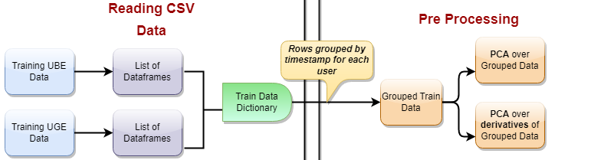
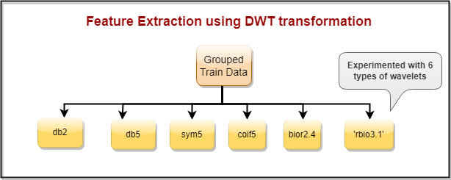
Preprocessing, Feature Extraction, and Experimentation
Feature Extraction
DWT on Grouped Data :
Developed 6 different sets of features using 6 different wavelet types
db2,db5,sym5,coif5, bior, 2.4 rbio3.1
DWT on PCA on Grouped Data:
Using PCA, created a new set of variables
8 components to explain maximum variability
DWT on PCA of derivative of Grouped Data
To capture information on the fluctuation of the values, the rate of change of indicators was used
Another set of features using PCA over estimated derivatives of the indicators

Slide 14
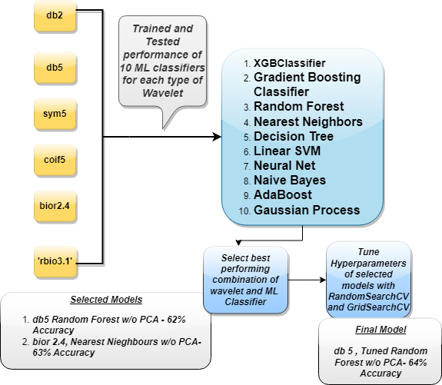
ML Classifiers
Machine learning algorithm parameters
Experimentation Phase:
Random forest and Nearest Neighbors Classifiers had high accuracy of 62% and 63% respectively
Hyperparameter tuning :
A wide range of parameter grids was chosen for classifiers to run RandomSearchCV with 3-fold cross-validation
A smaller range near the best parameters is used in GridsearchCV with 3-fold cross-validation

Slide 15
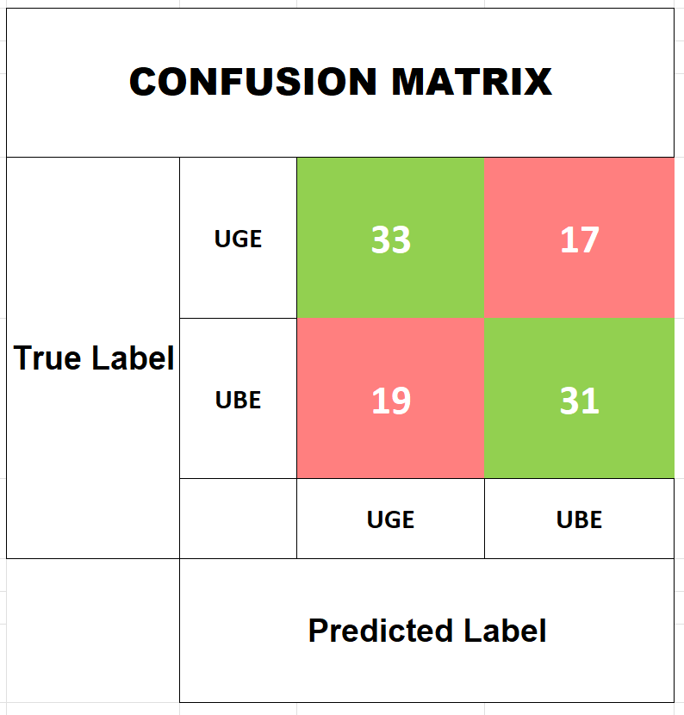
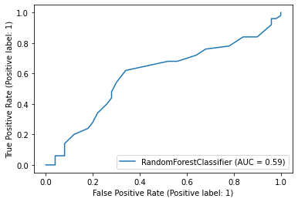
Final Model Metrics
AUC Curve
Label | Precision | Recall | F1-Score
UGE | 0.63 | 0.66 | 0.65
UBE | 0.65 | 0.62 | 0.63
Accuracy
0.64

Slide 16
Conclusion
Conclusion:
We found that the best accuracy is achieved using time-series transformation and Machine Learning instead of solely relying on outliers.
Such identification has great Business Value in long term as the users’ problems can be solved proactively before complaints are raised
Even though 64 % accuracy is decent, more informative variables will give higher accuracy. Thus, adding more indicators is recommended.
More variables may not always mean more accuracy, but in our case, the feature extraction may ensure more information is extracted
We can experiment with the more mother wavelets
Future Scope

Slide 17
Q&A

