Slide 1
Intrusion and Vulnerability Detection in Software Defined Networks
Sotiris Chatzimiltis
Mohammad Shojafar
Mahdi Boloursaz Mashhadi
Rahim Tafazolli
5G & 6G Innovation Center (5GIC & 6GIC)
University of Surrey
Notes:
Hello everyone. My name is Sotiris Chatzimiltis, and this is our proposed approach to create an Intrusion and Vulnerability Detection System for SDNs.

Slide 2
Introduction
Motivation, Problem Definition, and Challenges
Machine Learning (ML)-Intrusion Detection System (IDS).
Create models that distinguish normal and malicious behaviors to stop a possible attack
Normal data constitutes most of the data traffic whereas malicious data occupies small percentage.
Class imbalance can pose significant problems on the IDS performance.
Our aim was to develop a solution capable to handle the class imbalance problem while achieving a strong classification performance.
Traffic | Number of Instances
Benign | 1337046
BOT | 1228
DDoS | 80653
DoS GoldernEye | 6480
DoS Hulk | 109334
DoS Slowhttptest | 3302
DoS Slowloris | 3411
FTP-Patator | 3819
Hearbleed | 6
Infiltration | 22
Portscan | 66659
SSH-Patator | 2086
Web Attack Brute Force | 935
Web Attack Sql Injection | 12
Web Attack XSS | 410
[1] J. Xie et al., "A Survey of Machine Learning Techniques Applied to Software Defined Networking (SDN): Research Issues and Challenges," in IEEE Communications Surveys & Tutorials, vol. 21, no. 1, pp. 393-430, 2019.
[2] R. Sebopelo, B. Isong, N. Gasela and A. M. Abu-Mahfouz, "A Review of Intrusion Detection Techniques in the SDN Environment," 2021 3rd International Multidisciplinary Information Technology and Engineering Conference (IMITEC), Windhoek, Namibia, 2021, pp. 1-9.
Notes:
In this project, we aim to create a ML-IDS that will distinguish between normal and malicious data traffic.
Normal data makes up most of the data traffic in the network, whereas malicious data just occupies a small percentage.
** Having a quick glance at the table. We can clearly see the high number of benign instances and the low number for individual attacks. **
Not having equal data distribution for each traffic type can pose a big problem on the final IDS performance. Due to severe class imbalance, conventional techniques from the literature like those described in [1], [2] are not readily applicable to our problem.
Our aim was to develop a solution capable to mitigate the class imbalance problem and achieve a strong per-class classification performance.
[1]
[2] Talks about several approaches to create a ML-IDS, no techniques talks about handling class imbalances

Slide 3
Our Proposed Method (1)
Overall system design
1. Data
Pre-processing
3. Data Resampling
4. Classification
2. Feature Selection
Notes:
The outline of our approach is illustrated in the slide and comprises of 4 major stages.
Those are: Data preprocessing, Feature Selection, Data Resampling and Classification.

Slide 4
Our Proposed Method (2)
Dataset Pre-processing
Initial Train & Test Sets
1. Drop records with NaN or Infinite values and Duplicate Records
2. Replace -1 values with the mean value of the respective training feature
3. Remove 8 zero value features
4. Label Encoding for ‘Label’ column
Notes:
Getting a view of the Pre-processing stage we have 4 minor tasks to be applied to the initial datasets.
Firstly, records containing NaN and Infinite values, as well as duplicate records were dropped.
Then, features containing -1 values were replaced with the mean value of the respective training feature.
Subsequently, 8 zero value features were removed.
And finally, the label column was encoded to transform categorical values into numerical.

Slide 5
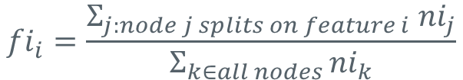
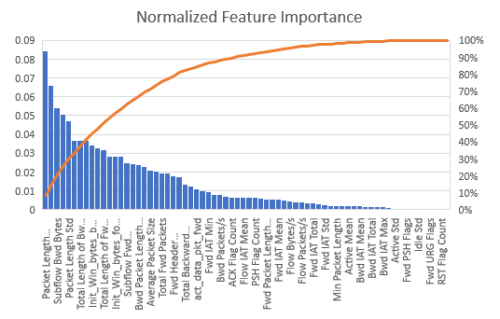
Our Proposed Method (3)
Feature Selection
Our approach:
Split Train Data into a stratified 5-Fold
Train a RF classifier on every fold
Average the importance of every feature over the 5 RF classifiers trained
Sort in descending order the features based on importance
Keep features until cumulative importance is at 90%
$${ni}_{j}=w_{j}C_{j}−w_{left\left(j\right)}C_{left\left(j\right)}−w_{right(j)}C_{right(j)}$$
$${fi}_{i}=\frac{Σ_{j:node j splits on feature i} {ni}_{j}}{Σ_{k∈all nodes }{ni}_{k}}$$
[3] "Towards Data Science." The mathematics of decision trees, random forest, and feature importance in scikit-learn and Spark.
Notes:
For the feature selection stage, we used Random Forest Classifier feature importance.
Our approach was:
Splitting the train dataset into 5folds.
Train a classifier for each fold.
Compute the average importance of every feature over the 5 classifiers.
Sort the average importances in descending order.
Keep the top N features that had a cumulative importance of 90%.
In our case the final number of features were 34.
The figure on the right illustrates the feature importances of our approach, along with the cumulative importance line.
The Mathematics of Decision Trees, Random Forest and Feature Importance in Scikit-learn and Spark | by Stacey Ronaghan | Towards Data Science

Slide 6
Our Proposed Method (4)
Tackling the Class Imbalance (1): Common Methods
Common methods used in the literature to tackle class imbalance:
Random Under-sampling
Random Over-sampling
Cost-Sensitive training
SMOTE Oversampling
Under-sampling Tomek Links
[4] "Analytics Vidhya." 10 Techniques to Deal with Class Imbalance in Machine Learning, 2020
Notes:
Let’s talk now about the most important stage of our approach.
There is an extensive literature that provides ways to handle class imbalance in a dataset.
Some approaches include:
Random under-sampling that randomly removes instances of the majority class
Random oversampling, that adds copies of existing instances of minority classes.
And Cost-sensitive training were learning algorithms are getting penalized more when they misclassify minority classes.
In our approach though we combined two of the most effective resampling techniques.
Which are SMOTE, and Tomek’s link. Applying only either one technique can show improvement in results but combining them together can make the difference.

Slide 7
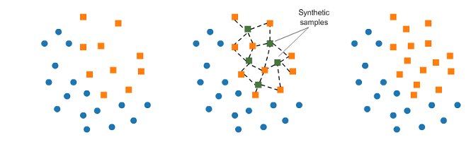
Our Proposed Method (5)
Tackling the Class Imbalance (2): SMOTE over-sampling
Synthetic Minority Over-sampling Technique (SMOTE)
Over-sample minority classes for better class distribution in the Dataset
Creates artificial instances by:
Sampling a minority class instance
Sampling k neighbors of that instance that belong to the same class
Create a new instances that lie in between the two minority instances
New Instance
Selected Instance
Find 3-NN of sample
[5] N. V. Chawla, K. W. Bowyer, L. O. Hall, and W. P. Kegelmeyer “SMOTE: Synthetic minority over-sampling technique,” Journal of Artificial Intelligence Research, vol. 16, pp. 321–357, jun 2002
Notes:
Firstly we used the SMOTE over sampling technique to create a better class distribution in the dataset.
SMOTE works by picking an instance of a minority class, compute it’s k-nearest neighbours.
And create a synthetic point between the instance and its neighbours.
**can potentially lead to overfitting since minority instances are replicated**

Slide 8
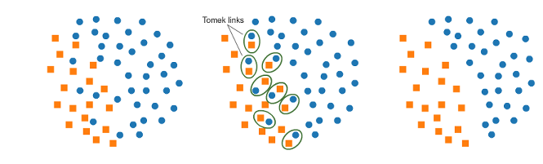
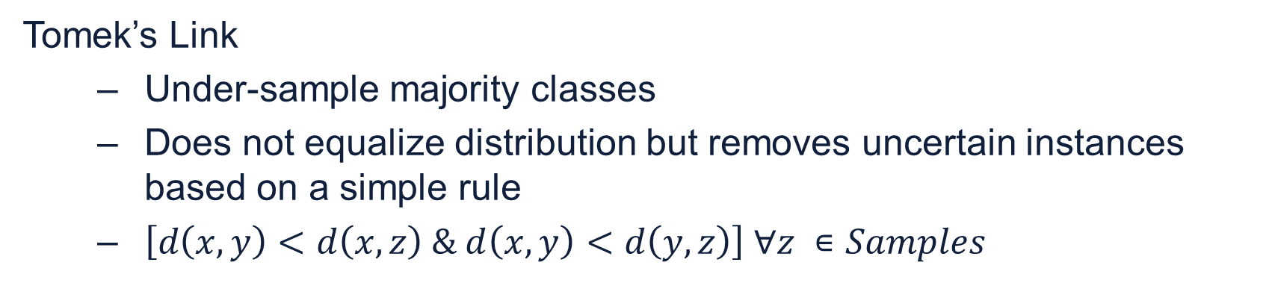
Our Proposed Method (6)
Tackling the Class Imbalance (3): Tomek’s Link under-sampling
Tomek’s Link
Under-sample majority classes
Does not equalize distribution but removes uncertain instances based on a simple rule
$\left[d\left(x,y\right)<d\left(x,z\right) \& d\left(x,y\right)<d\left(y,z\right)\right] ∀z ∊Samples$
[6] I. Tomek, “Two modifications of CNN,” IEEE Transactions on Systems, Man, and Cybernetics, vol. SMC-6, no. 11, pp. 769–772, 1976.
Notes:
Secondly, we used Tomek’s link under-sampling technique.
As shown in the figure, Tomek links are close in distance, pairs of instances that belong to opposite classes .
Removing the instances of the majority class of each pair increases the space between the two classes
which can subsequently facilitate the classification process.
**can potentially discard useful information**

Slide 9
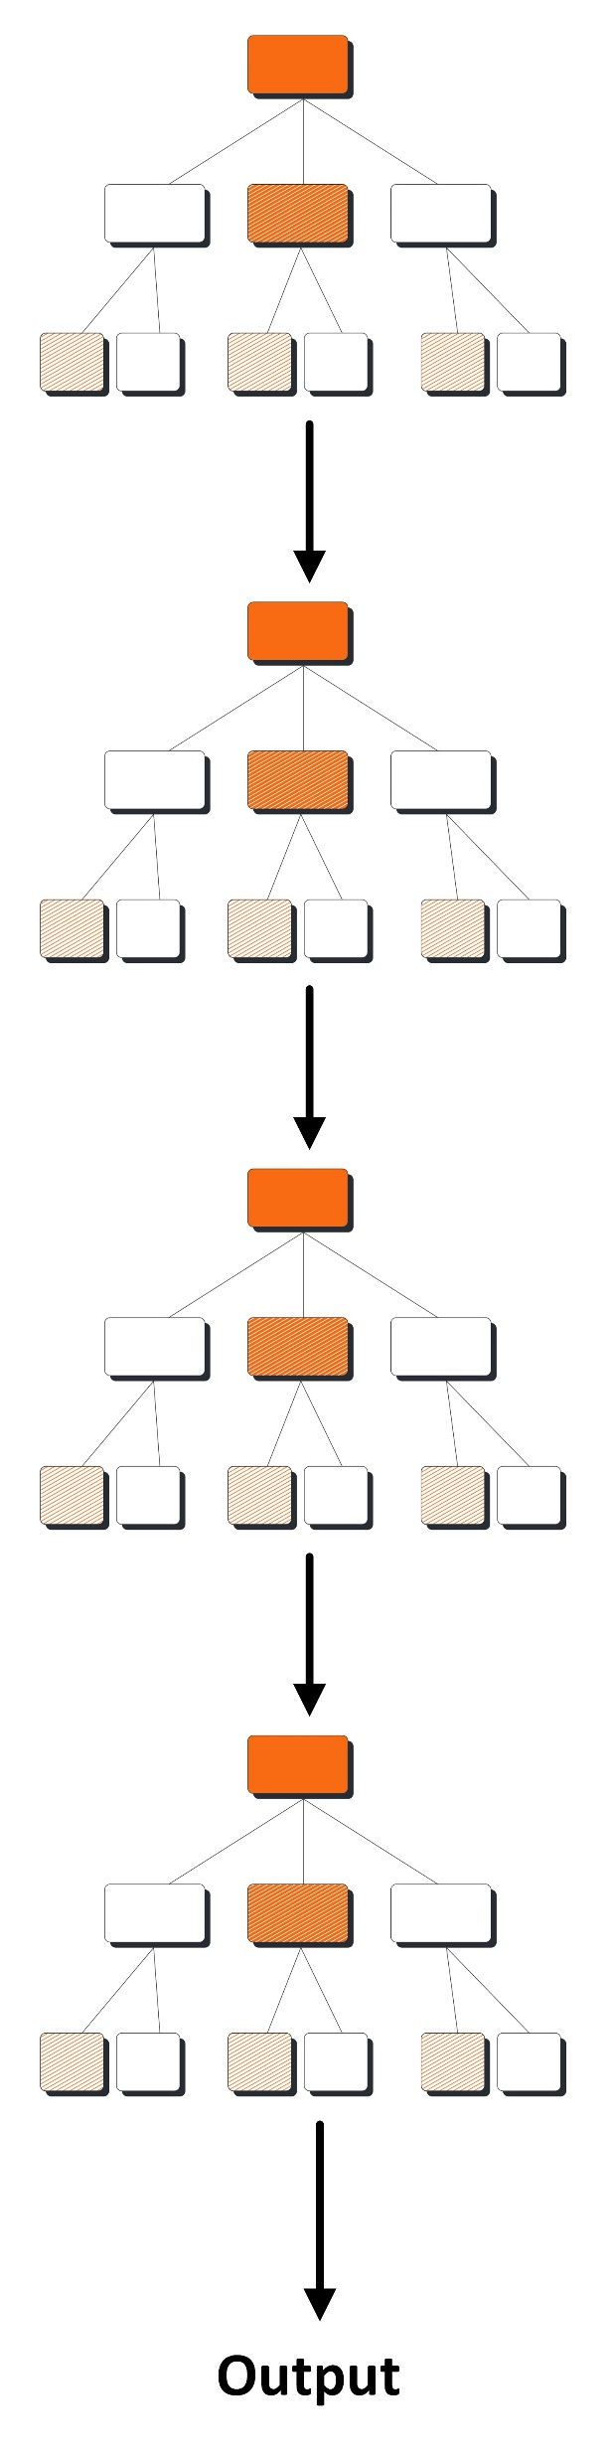
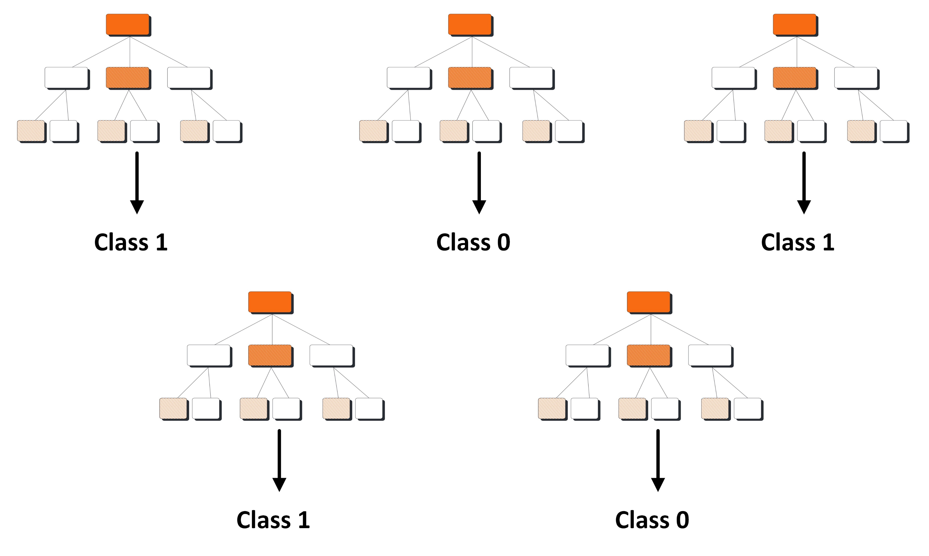
Our Proposed Method (7)
Classifier Models
XGBoost
Random Forest/ Bagging Algorithm
K-Nearest Neighbours
Decision Tree
Random Forest/Bagging
XGBoost
Notes:
Now, concerning the ML models used for this project, we decided to use mostly tree-based algorithms.
Since they have an extensive use in the deployment of IDSs, are easy to implement, fast to train and can provide interpretability if needed.
Our chosen models include K-Nearest Neighbors, Decision Trees, Bagging Classifiers such as Random Forest, and XGBoost.
Some of the models were used as benchmark models.

Slide 10
Results & Discussion (1)
Dataset Variations
Dataset | Explanation
1. Original Dataset | 70 Features, All instances
2. Feature Reduced Dataset | 34 Features, All instances
3. Resampled Dataset | 70 Features, Resampled instances
4. Feature Reduced and Resampled Dataset | 34 Features, Resampled instances
Notes:
Moving on to our results.
Training of models was performed using 4 variations of the initial dataset provided, to evaluate the fluctuation in performance.
Those datasets are first the original dataset, second the feature reduced dataset, third the resampled dataset and fourth the feature reduced and resampled dataset.

Slide 11
Results & Discussion (2)
Performance Evaluation for Test Set
Model/Dataset | Precision | Recall | F1-Score | Acc
KNN Original | 0.9968 | 0.9962 | 0.9966 | 0.9932
DT Original | 0.9989 | 0.9974 | 0.9981 | 0.9964
RF Original | 0.9990 | 0.9995 | 0.9990 | 0.9982
Bagging Original | 0.9990 | 0.9996 | 0.9995 | 0.9983
XGBoost Original | 0.9990 | 0.9996 | 0.9996 | 0.9986
KNN Feature Reduced | 0.9945 | 0.9876 | 0.9948 | 0.9915
DT Feature Reduced | 0.9989 | 0.9973 | 0.9981 | 0.9966
RF Feature Reduced | 0.9991 | 0.9996 | 0.9996 | 0.9988
Bagging Feature Reduced | 0.9990 | 0.9996 | 0.9990 | 0.9985
XGBoost Feature Reduced | 0.9990 | 0.9996 | 0.9996 | 0.9990
DT Resampled | 0.9988 | 0.9980 | 0.9986 | 0.9968
RF Resampled | 0.9989 | 0.9996 | 0.9995 | 0.9984
DT Feature Reduced and Resampled | 0.9988 | 0.9980 | 0.9986 | 0.9968
RF Feature Reduced and Resampled | 0.9989 | 0.9996 | 0.9995 | 0.9986
Notes:
The table shows the results obtained by applying different combinations of classifiers and datasets.
The best overall performance was obtained when XGBoost was trained with the reduced dataset achieving an accuracy of 99.9% and an F1-score score of 99.96.
Furthermore, the best per-class performance was achieved when the DT classifier was trained with the reduced resampled dataset.

Slide 12
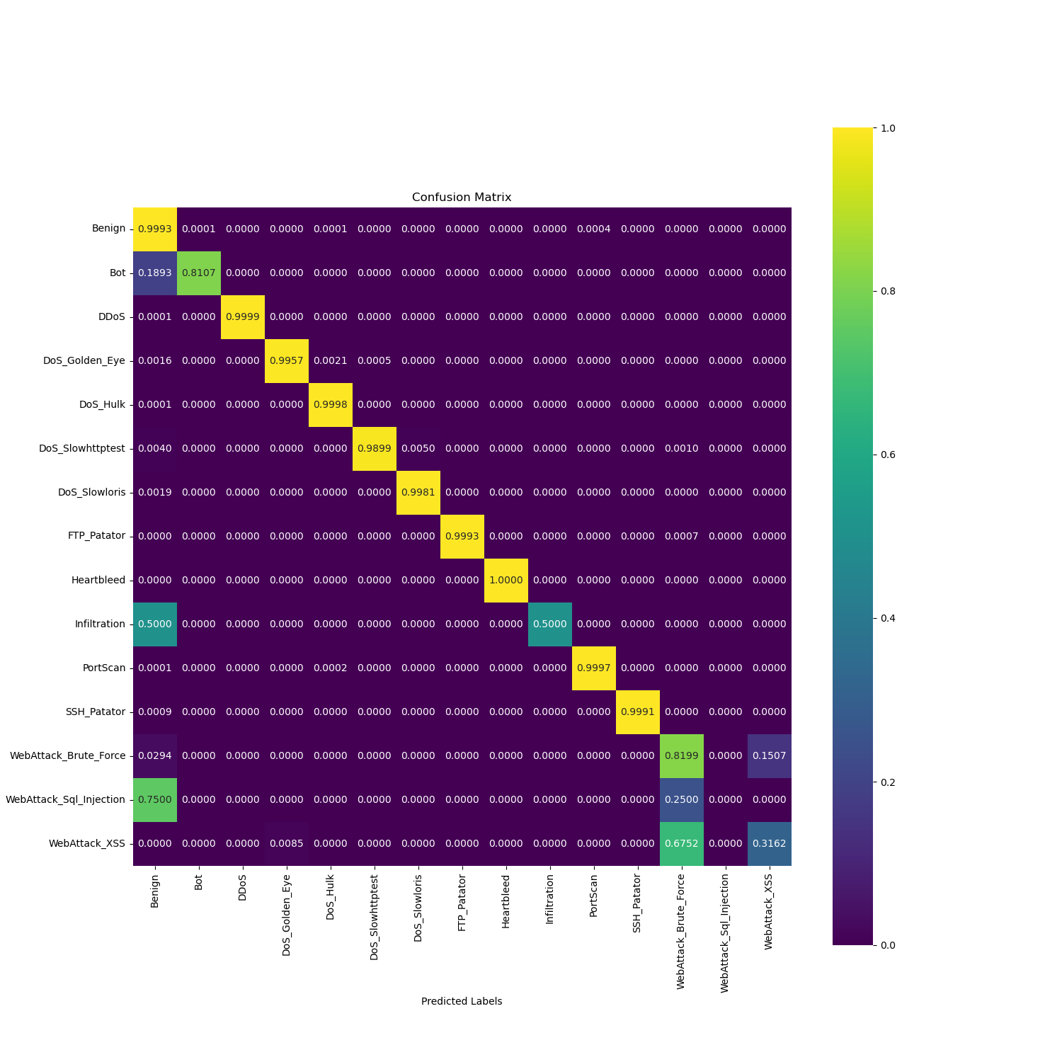
Results & Discussion (3)
Final Models Selected
XGBoost- Feature Reduced Dataset
Data Traffic | Precision | Recall | F1-Score | Accuracy | FPR | Support
Benign | 1.0000 | 1.0000 | 1.0000 | 0.9993 | 0.0010 | 410865
Bot | 0.8600 | 0.8100 | 0.8400 | 0.8107 | 0.0001 | 354
DDoS | 1.0000 | 1.0000 | 1.0000 | 0.9999 | 0.0000 | 23160
DoS Golden Eye | 1.0000 | 1.0000 | 1.0000 | 0.9957 | 0.0000 | 1861
DoS Hulk | 1.0000 | 1.0000 | 1.0000 | 0.9998 | 0.0001 | 41626
DoS Slowhttptest | 0.9900 | 0.9900 | 0.9900 | 0.9899 | 0.0000 | 994
DoS Slowloris | 1.0000 | 1.0000 | 1.0000 | 0.9981 | 0.0000 | 1048
FTP Patator | 1.0000 | 1.0000 | 1.0000 | 0.9993 | 0.0000 | 1436
Heartbleed | 1.0000 | 1.0000 | 1.0000 | 1.0000 | 0.0000 | 2
Infiltration | 1.0000 | 0.5000 | 0.6700 | 0.5000 | 0.0000 | 6
Portscan | 0.9900 | 1.0000 | 1.0000 | 0.9997 | 0.0003 | 28728
SSH Patator | 1.0000 | 1.0000 | 1.0000 | 0.9991 | 0.0000 | 1067
Web Attack Brute Force | 0.7300 | 0.8200 | 0.7700 | 0.8199 | 0.0010 | 272
Web Attack Sql Injection | 0.0000 | 0.0000 | 0.0000 | 0.0000 | 0.0000 | 4
Web Attack XSS | 0.4700 | 0.3200 | 0.3800 | 0.3162 | 0.0001 | 117
Notes:
Getting a more detailed look on the results of XGBoost.
We can see from the CM that the XGBoost classifier performs well on detecting most of the classes.
However, there are 5 classes that the classifier lacks in performance.
Those attacks belong to minority classes, that have insufficient training instances, leading in a difficulty to train the classifier to detect them.

Slide 13
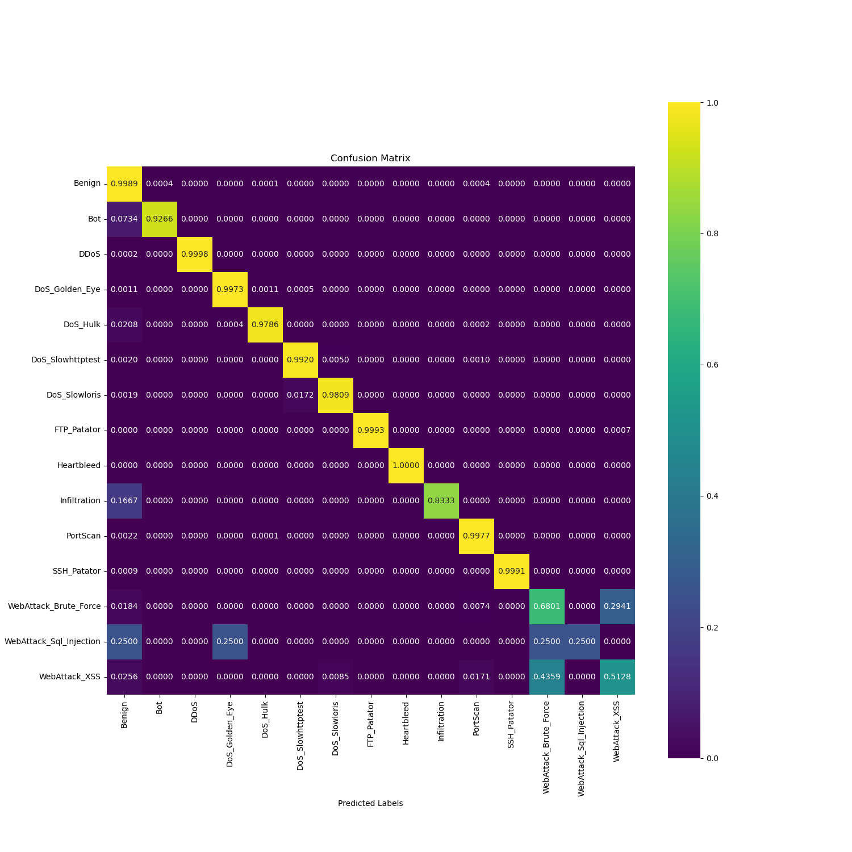
Results & Discussion (4)
Final Models Selected
Decision Trees Feature Reduced and Resampled
Data Traffic | Precision | Recall | F1-Score | Accuracy | FPR | Support
Benign | 1.0000 | 1.0000 | 1.0000 | 0.9989 | 0.0090 | 410865
Bot | 0.6800 | 0.9300 | 0.7800 | 0.9266 | 0.0003 | 354
DDoS | 1.0000 | 1.0000 | 1.0000 | 0.9998 | 0.0000 | 23160
DoS Golden Eye | 0.9990 | 1.0000 | 0.9900 | 0.9973 | 0.0001 | 1861
DoS Hulk | 1.0000 | 0.9800 | 0.9900 | 0.9786 | 0.0001 | 41626
DoS Slowhttptest | 0.9700 | 0.9900 | 0.9800 | 0.9920 | 0.0001 | 994
DoS Slowloris | 0.9900 | 0.9800 | 0.9800 | 0.9809 | 0.0000 | 1048
FTP Patator | 1.0000 | 1.0000 | 1.0000 | 0.9993 | 0.0000 | 1436
Heartbleed | 1.0000 | 1.0000 | 1.0000 | 1.0000 | 0.0000 | 2
Infiltration | 0.7100 | 0.8300 | 0.7700 | 0.8333 | 0.0000 | 6
Portscan | 0.9900 | 1.0000 | 1.0000 | 0.9977 | 0.0004 | 28728
SSH Patator | 1.0000 | 1.0000 | 1.0000 | 0.9991 | 0.0000 | 1067
Web Attack Brute Force | 0.7600 | 0.6800 | 0.7200 | 0.6801 | 0.0000 | 272
Web Attack Sql Injection | 1.0000 | 0.2500 | 0.4000 | 0.2500 | 0.0000 | 4
Web Attack XSS | 0.4000 | 0.5100 | 0.4500 | 0.5128 | 0.0001 | 117
Notes:
If we now observe the performance of the DT model trained with the feature reduced resampled dataset
We can see that the performance of the minority classes increased in most of the cases.

Slide 14
Results & Discussion (5)
Ablation Study: Classifier Effect
XGBoost & Feature Reduced Dataset
DT & Feature Reduced and Resampled Dataset
Notes:
A side-by-side comparison can give a clearer view of the per-class performance.
XGBoost shows a better performance on predicting benign data traffic.
However, for the performance of the 5 minority classes, we can see that the DT model performs better on 4 out of the 5.

Slide 15
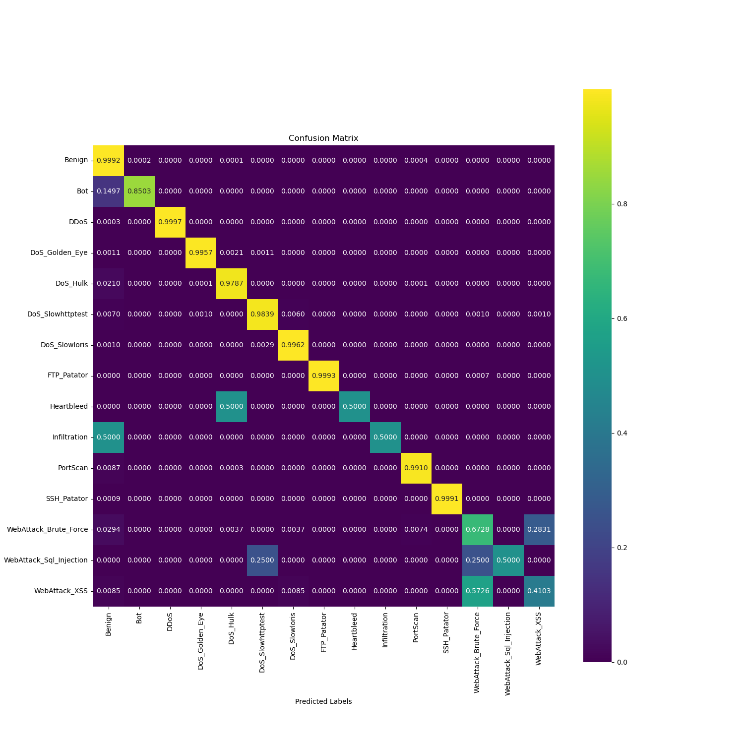
Results & Discussion (6)
Ablation Study: Resampling Effect
DT & Feature Reduced Dataset
DT & Feature Reduced and Resampled Dataset
Notes:
A final ablation study was then made to evaluate the effect that resampling can have in the performance of the model.
On the left we have the DT model trained on the feature reduced dataset.
And on the right, we have the DT model trained with the feature reduced resampled dataset.
We can observe that resampling improves the 5 out of the 6 minority classes.

Slide 16
Conclusion
Take-away Point
Feature Selection
Data Resampling
Appropriate ML model
Model | Accuracy | F1-Score | Training Time Complexity (CPU seconds) | Inference Time Complexity (CPU seconds)
XGBoost | 0.9990 | 0.9996 | 1755 sec | 1.44 sec
Decision Tree | 0.9968 | 0.9986 | 485 sec | 0.29 sec
Notes:
To conclude this presentation,
Our best model achieved an average overall accuracy of 99.9% and an F1-Score of 99.96.
Furthermore, the best per-class performance, and especially on minority classes, came from the DT model when trained on a reduced and resampled dataset.
The training times of those two models were roughly 29 and 8 CPU minutes respectively.
Finally, some take away points.
Firstly, reducing the number of features doesn’t always lead into a worse performing model, if the features are descriptive enough.
Secondly, data resampling can most of the times help boosting the performance of minority classes.
Thirdly , depending on the task to be carried out, the appropriate ML model must be chosen.
Finally, we believe that the conjunction of those three components is what can improve the performance of the final model, and not just a more sophisticated classifier.

Slide 18
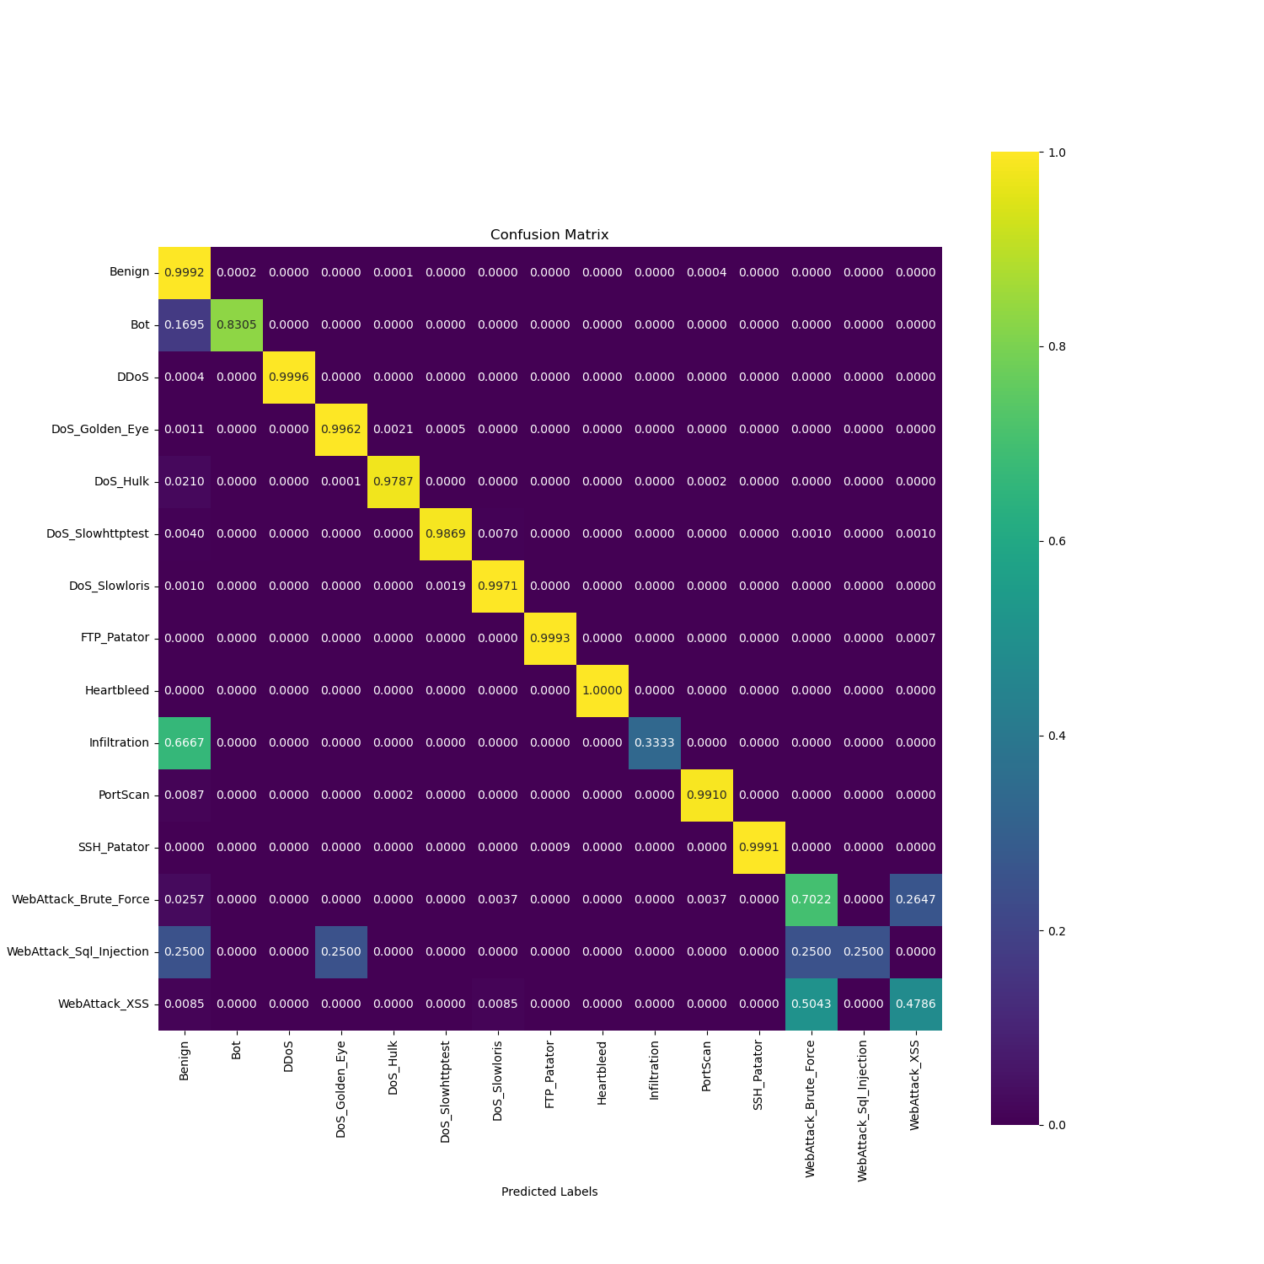
Results & Discussion (6)
Ablation Study: Resampling Effect
DT & Original Dataset
DT & Original Dataset
DT & Reduced Resampled Dataset
Notes:
Finally we wanted to make a final side-by-side comparison to tell about the effect that resampling can have in the performance of a model.
On the left we have the DT model trained on the original dataset and
On the right we have the DT model trained on the reduced resampled dataset.

Slide 19
Results
Performance Evaluation for 5-Fold Cross Validation
Model | Precision | Recall | F1-Score | Accuracy
DT | 0.9990 | 0.9990 | 0.9990 | 0.9973
RF | 0.9988 | 0.9996 | 0.9991 | 0.9977
K-NN | 0.9981 | 0.9986 | 0.9985 | 0.9958
Bagging | 0.9991 | 0.9991 | 0.9991 | 0.9982
XGBoost | 0.9992 | 0.9995 | 0.9993 | 0.9985
5-Fold Cross Validation Performance of baseline dataset
Model | Precision | Recall | F1-Score | Accuracy
DT | 0.9991 | 0.9991 | 0.9991 | 0.9978
RF | 0.9991 | 0.9992 | 0.9991 | 0.9976
K-NN | 0.9982 | 0.9987 | 0.9985 | 0.9969
Bagging | 0.9991 | 0.9991 | 0.9991 | 0.9984
XGBoost | 0.9992 | 0.9995 | 0.9993 | 0.9989
5-Fold Cross Validation Performance of reduced baseline dataset
Notes:
The tables shows the 5-fold cross validation performance using the baseline and the reduced baseline datasets.
The models were trained using 4 folds each time and were evaluated using the one-fold left.
The 5 evaluations obtained for each fold were then average and the performance is shows.

Slide 20
Results
Performance Evaluation for 5-Fold Cross Validation
Model | Precision | Recall | F1-Score | Accuracy
DT | 0.9983 | 0.9983 | 0.9987 | 0.9983
RF | 0.9838 | 0.9815 | 0.9815 | 0.9813
DT Reduced | 0.9896 | 0.9898 | 0.9899 | 0.9895
RF Reduced | 0.9650 | 0.9626 | 0.9619 | 0.9623
Bagging Reduced | 0.9959 | 0.9957 | 0.9960 | 0.9955
5-Fold Cross Validation Performance of resample and reduced resample dataset
Notes:
Furthermore, the table shows the average 5-fold cross validation performance on the resampled and reduced resampled dataset as well.
It can be concluded that we have a consistent performance across the different folds since results are good.
As well as we get the indication that the chosen models can generalize well from the training data to unseen data.

Slide 21
Conclusions & Future Work
Future Work
Explore more strategies to handle data imbalance
Hierarchical Classification
Multi-step binary classification
Create an ensemble of XGBoost and DT to improve results more
Apply more oversampling and under sampling techniques
Notes:
To conclude this presentation,
Our model achieved an average accuracy of 99.9% and an F1-Score of 99.96.
Furthermore, are DT trained with a dataset containing resampled instances performed better on minority classes.
The training times of those two models were 1755 and 485 seconds respectively.
Now since class imbalance on the dataset was the issue of the model not being able to predict minority attacks,
We want to explore ML models to handle data imbalances such as hierarchical classification and multi-step binary classification.
And also combining the two ML models can lead into improved results as well.

