Slide 1

IT & Sustainability
Notes on a myth
sebastian büttrich
sebastian@itu.dk

Slide 2

Sustainability – Attempts at a definition
Sustainability is the ability to exist constantly.
Development that
meets the needs of the present
without compromising the ability of
future generations to meet their own needs.
["Our Common Future, From One Earth to One World" -
UN - Brundtland Commission Report 1987]
Sources: https://en.wikipedia.org/wiki/Sustainability
http://www.un-documents.net/ocf-ov.htm#1.2
29-08-20
· <number>

Slide 3
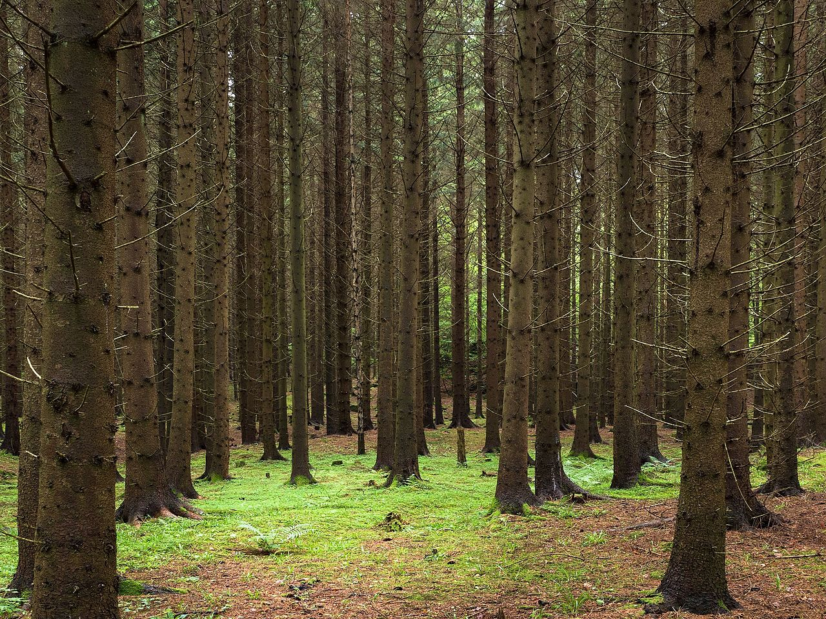
The concept of sustainability, or Nachhaltigkeit in German, can be traced back to Hans Carl von Carlowitz (1645–1714), and was applied to forestry.
The concept of sustainability - Hans Carl von Carlowitz (1645–1714), applied to forestry.[15]
Sources: http://www.environmentandsociety.org/tools/keywords/hans-carl-von-carlowitz-and-sustainability https://commons.wikimedia.org/wiki/File:Spruce_forest_at_Holma.jpg
29-08-20
· <number>

Slide 4
Sustainability – Domains or Pillars
largely agreed on:
environmental, economic and social
with subdomains
cultural, technological and political
Sources: https://en.wikipedia.org/wiki/Sustainability
29-08-20
· <number>

Slide 5
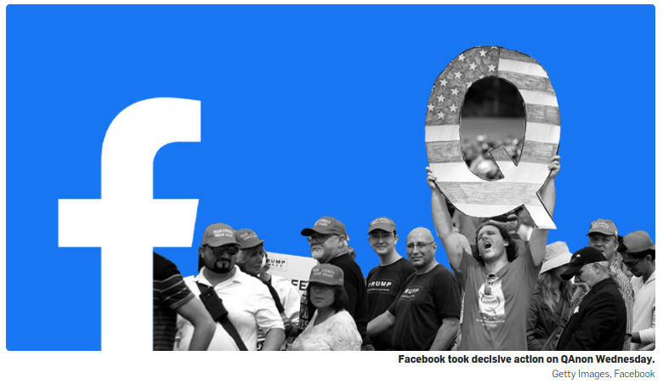
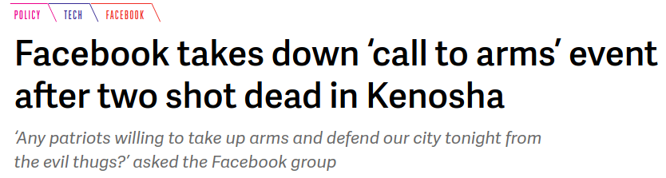
This talk focuses on
environmental – ecological aspects
and to some extent, the economic -
Social – political -
cultural
is another (long) talk …
”Social” media & society
Sources: Getty images
https://www.theverge.com/2020/8/26/21402571/kenosha-guard-shooting-facebook-deplatforming-militia-violence
29-08-20
· <number>

Slide 6
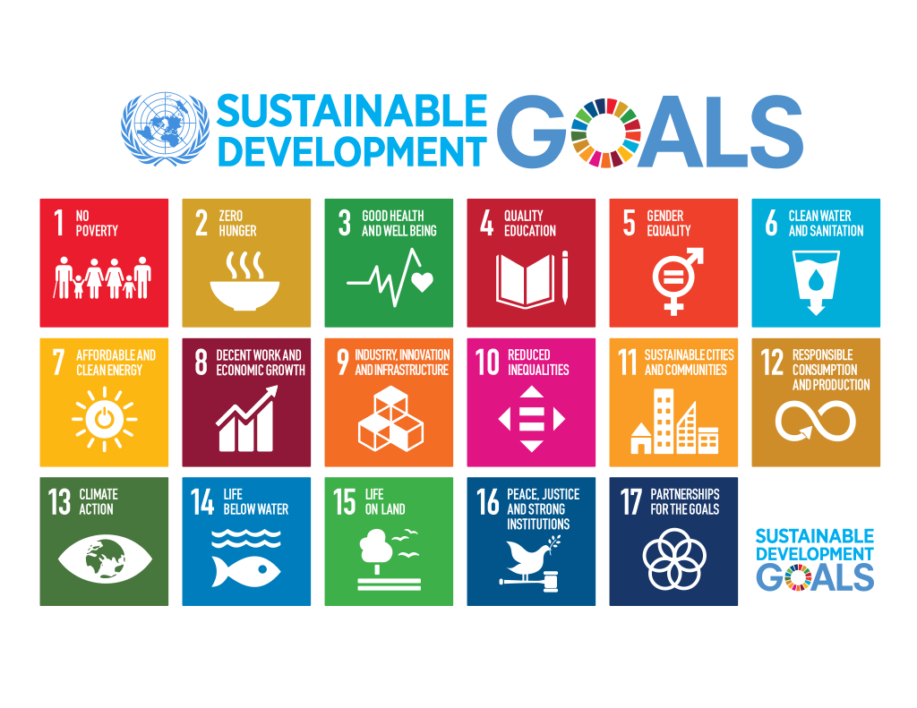
The Sustainable Development Goals,
adopted on 25 September 2015 as a part of the UN 2030 Agenda.
Sources: https://en.wikipedia.org/wiki/Sustainable_Development_Goals
29-08-20
· <number>

Slide 7
Sustainability – Contradictions
Already at this point – there is contradictions:
the ”ability to exist constantly” implies
lack of change, or at least a circle.
How does this concept relate to
”development” or ”growth”?
Constant growth per definition can not be sustainable.
29-08-20
· <number>

Slide 8
The issue
The IT sector is using energy and natural resources at a fast growing rate
The very tool we claim will help us tackle climate change is responsible for further driving it
29-08-20
· <number>

Slide 9
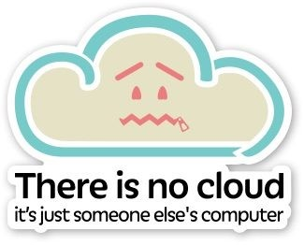
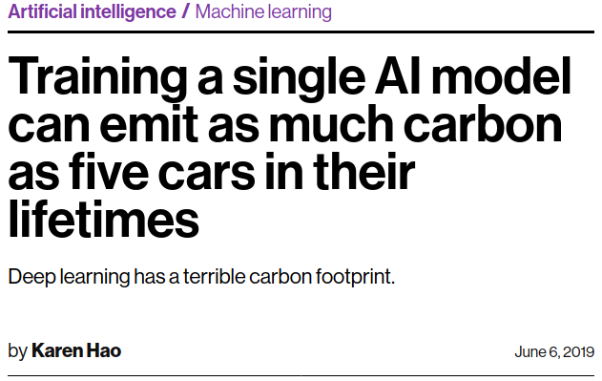
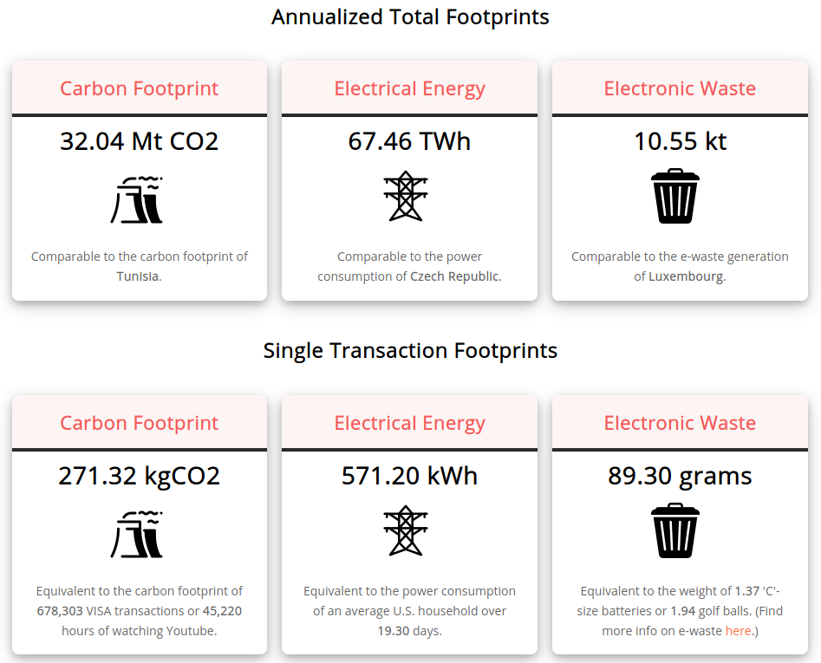
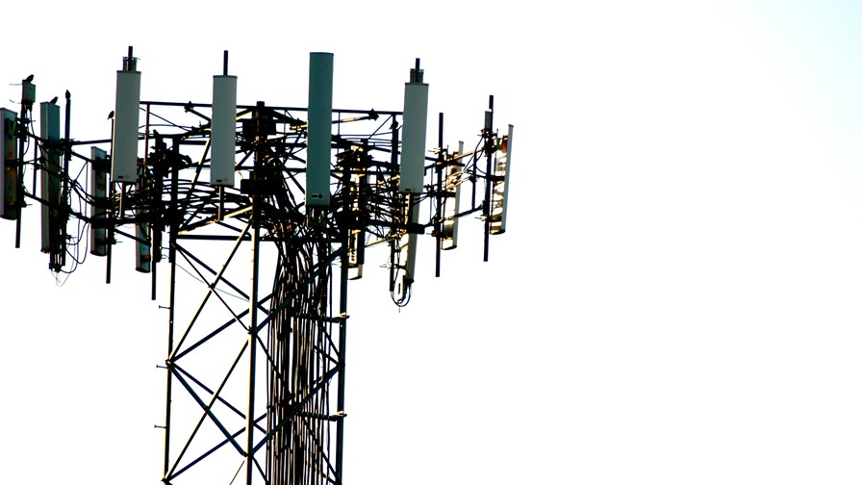
Drivers of IT energy hunger
Internet services at large, ”Cloud”
>>> data centers!
Video - 75% of all internet traffic
Cisco Annual Internet Report, 2018–2023
”AI”, machine learning
Blockchain & Cryptocurrencies
e.g. bitcoin >>>
Mobile, 5G
Sources: https://www.cisco.com/c/en/us/solutions/collateral/executive-perspectives/annual-internet-report/white-paper-c11-741490.html
https://digiconomist.net/bitcoin-energy-consumptionhttps://www.technologyreview.com/2019/06/06/239031/training-a-single-ai-model-can-emit-as-much-carbon-as-five-cars-in-their-lifetimeshttps://doi.org/10.1016/j.erss.2020.101721
29-08-20
· <number>

Slide 10
Exact description or estimation of the
IT environmental footprint is hard
A personal experience:
someone asked me about energy footprint of keeping their pictures and videos in the cloud -
Is it like a light bulb? A fridge? A car?
I couldn’t answer initially
and neither could my colleagues.
Can you?
29-08-20
· <number>

Slide 11
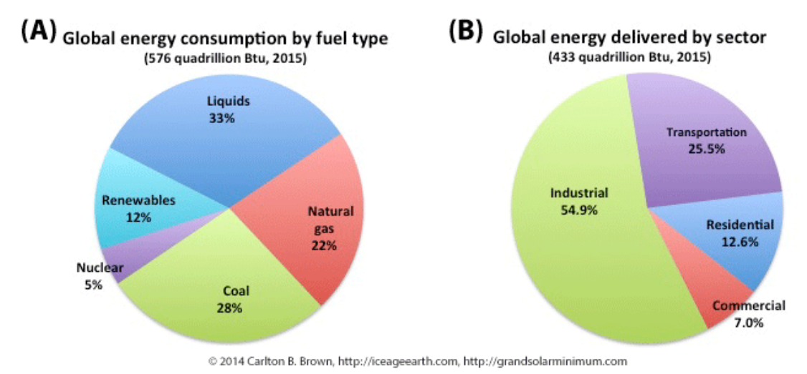
Exact description or estimation of the
IT environmental footprint is hard
What to include?
Traditonal view of sectors:
Industrial, commercial, residential, transport
==> IT is in all of these
IT Industry is secretive:
Those who know won’t tell
Data says what one wants it to say
Sources: https://www.bp.com/en/global/corporate/energy-economics/energy-outlook/demand-by-sector.html
29-08-20
· <number>

Slide 12
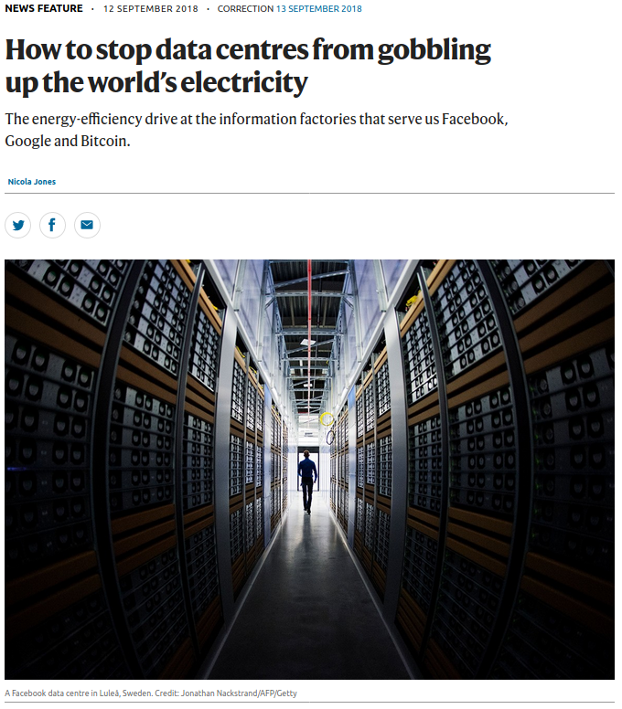
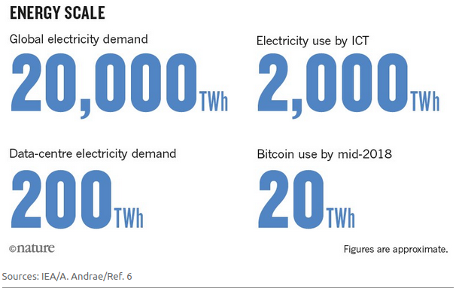
ICTs use ~10%* of global electricity
Excellent start point for reading: https://www.nature.com/articles/d41586-018-06610-y
* with huge uncertainty
Sources: https://www.iea.org/ https://eia.gov
https://yearbook.enerdata.net/electricity/electricity-domestic-consumption-data.html
https://ember-climate.org/wp-content/uploads/2020/03/Ember-2020GlobalElectricityReview-Web.pdf https://www.nature.com/articles/d41586-018-06610-y
29-08-20
· <number>

Slide 13
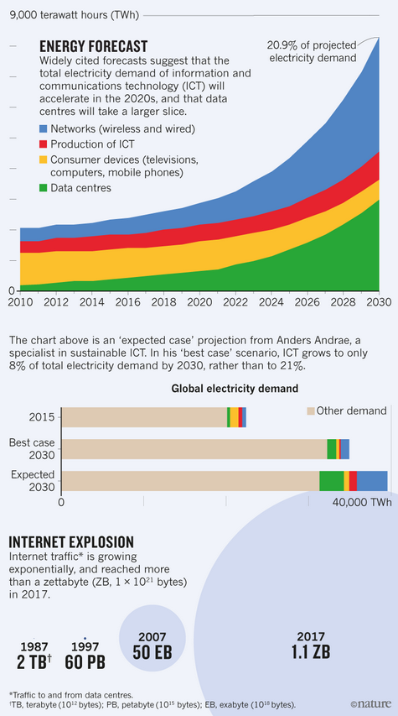
Some key sources
Andrae et al. (Huawei) have supplied
data which is widely used and discussed
Andrae, A.S.G.; Edler, T.
On Global Electricity Usage of Communication Technology
Trends to 2030.
Challenges 2015, 6, 117-157.
https://www.mdpi.com/2078-1547/6/1/117
Total Consumer Power Consumption Forecast
October 2017
Conference: Nordic Digital Business Summit
Project: Global Forecasting of ICT footprints
Anders S.G. Andrae
https://www.researchgate.net/publication/320225452_Total_Consumer_Power_Consumption_Forecast
key message:
centralized data & networks are drivers,
not consumer devices and production
29-08-20
· <number>

Slide 14
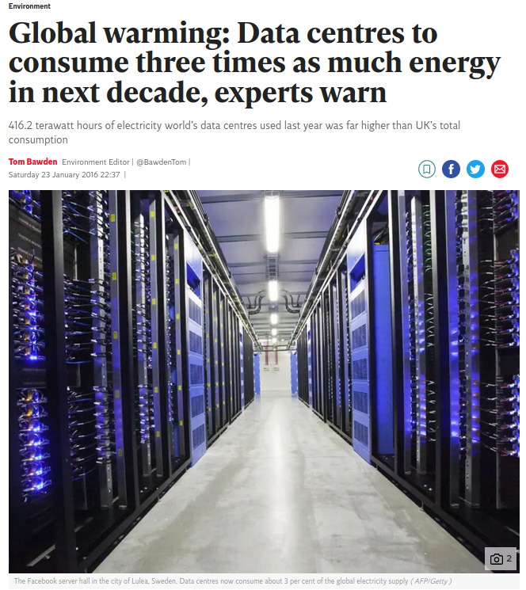
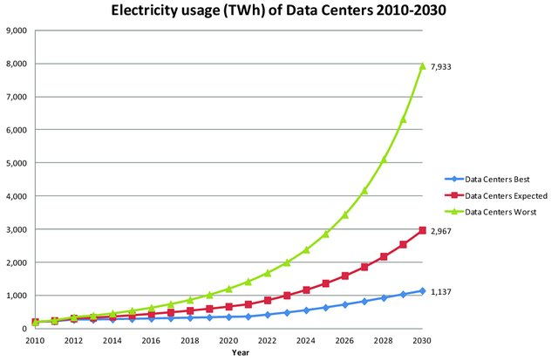
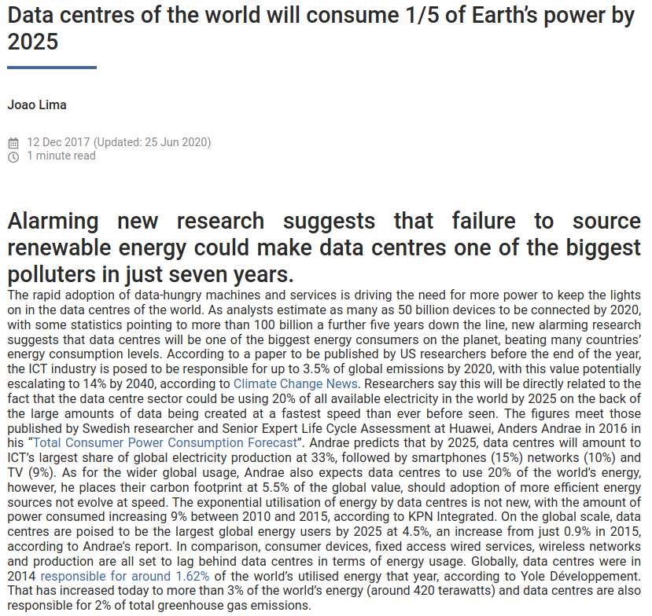
Central role of Data Centers:
growing 10% per year
Sources:https://www.independent.co.uk/environment/global-warming-data-centres-to-consume-three-times-as-much-energy-in-next-decade-experts-warn-a6830086.html
https://www.broad-group.com/data/news/documents/b1m2y6qlx5dv5t
https://www.researchgate.net/publication/320225452_Total_Consumer_Power_Consumption_Forecast
29-08-20
· <number>

Slide 15
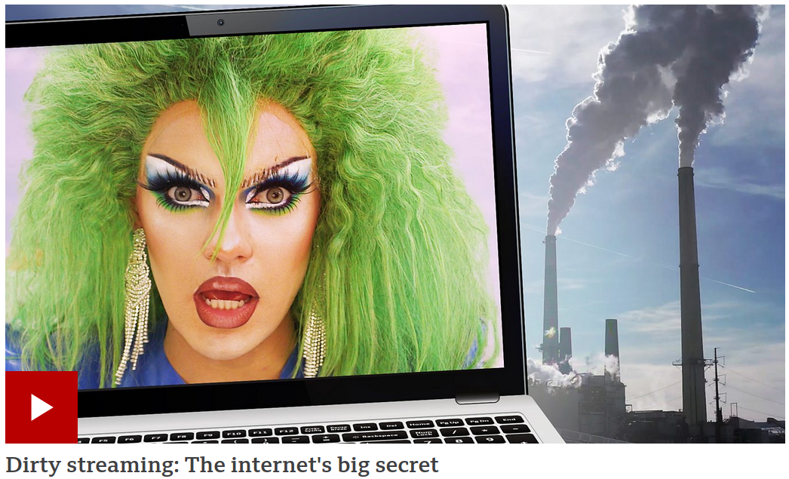
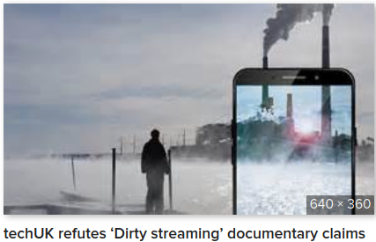
Popular video and rebuttal
Popular BBC video ..
and the rebuttal
Sources: https://www.bbc.com/news/av/stories-51742336
https://www.techuk.org/insights/opinions/item/17020-does-streaming-really-have-a-dirty-secret
29-08-20
· <number>

Slide 16
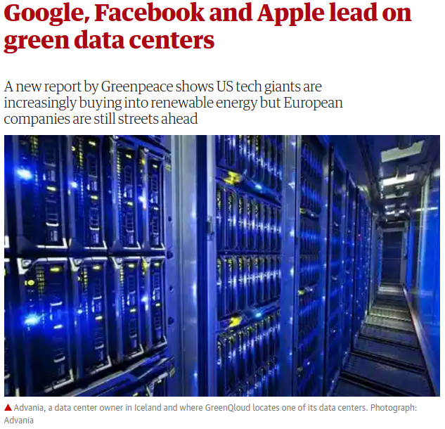


Arguments against the pessimistic forecast
1. Data Center efficiency (Power usage effectiveness, PUE) is improving fast: Google claims 1.1, global average around 1.7
Recalibrating global data center energy-use estimates
E Masanet, A Shehabi, N Lei, S Smith - Science, 2020
Lawrence Berkeley Labs
Science 28 Feb 2020:
Vol. 367, Issue 6481, pp. 984-986
DOI: 10.1126/science.aba3758
2. Data Center Industry
moving towards renewables
Sources: https://en.wikipedia.org/wiki/Power_usage_effectiveness
https://science.sciencemag.org/content/367/6481/984.full
29-08-20
· <number>

Slide 17
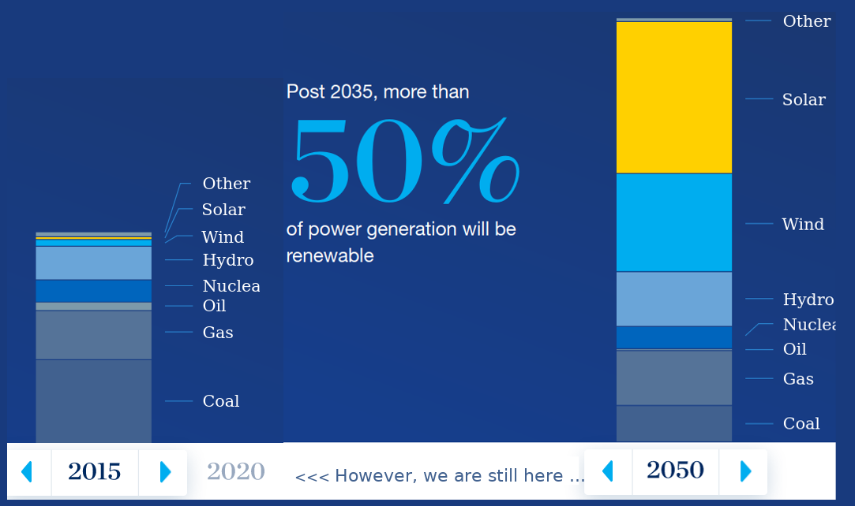
Some scepticism is due
1. If Data Center efficiency (PuE) is already optimized, then there is little room for further improvement
2. Efficiency is highest for Hyperscale Data Centers – arguing for these is in the interest of the industry, but not without implications for sustainability (see: social – political – cultural)
3. Vows regarding renewable energy are all very well, but hard to verify, and there is quite some greenwashing about.
4. The reality of renewable energy in 2020 is still: around 10% share in total electricity –
and 2030, 2040, 2050 might be too late
Sources: https://www.mckinsey.com/industries/oil-and-gas/our-insights/global-energy-perspective-2019
29-08-20
· <number>

Slide 18
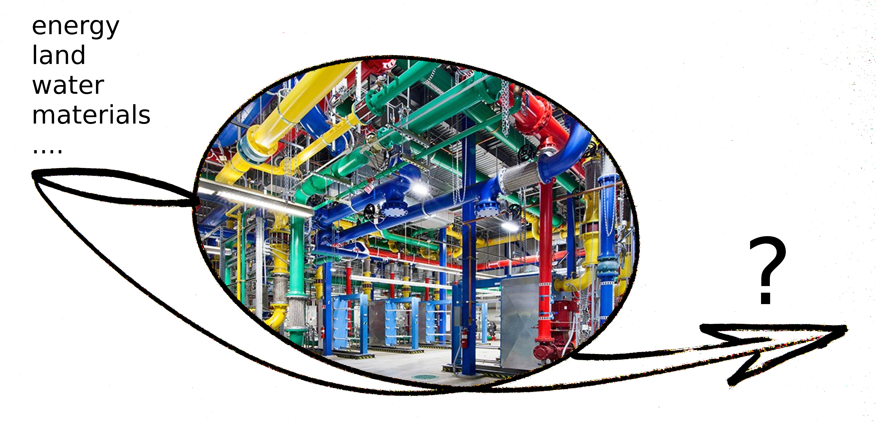
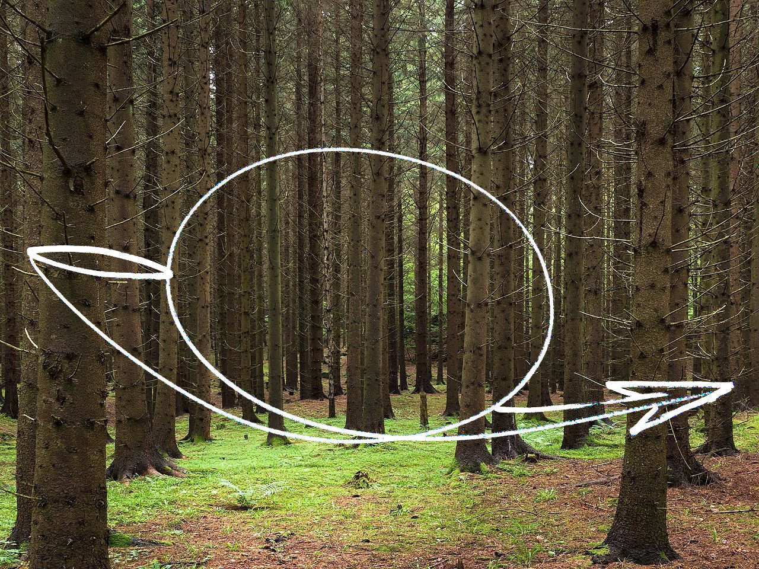
Perhaps the most fundamental problem
Unlike e.g. agriculture, forestry, energy sectors, IT can not produce any of its own input resources
Sources: https://en.wikipedia.org/wiki/Sustainability
http://www.un-documents.net/ocf-ov.htm#1.2
29-08-20
· <number>

Slide 19

Where to, from here?
1. Stop development of ICTs at current level?
2. Impose data taxes?
3. Go back to black and white images and video? ban video?
4. Envision a radically new form of ICTs that is not resource dependent?
(if all of ICTs outputs are virtual, certainly we should be able to run it on virtual inputs?
will quantum computing do that trick?)
5. Can we say goodbye to silicon, run ICTs on organic, renewable systems?
6. or can we _________________________________________________________________________________________ ?
All sources of this talk:
https://github.com/ITU-DASYALab/IT-sustainability/blob/master/IT-sustainability-sources.md
grateful for input! sebastian@itu.dk
29-08-20
· <number>

