Slide 1


Slide 2
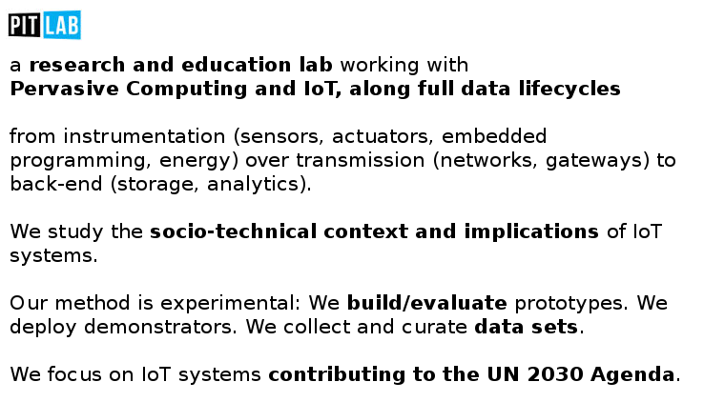

Slide 3
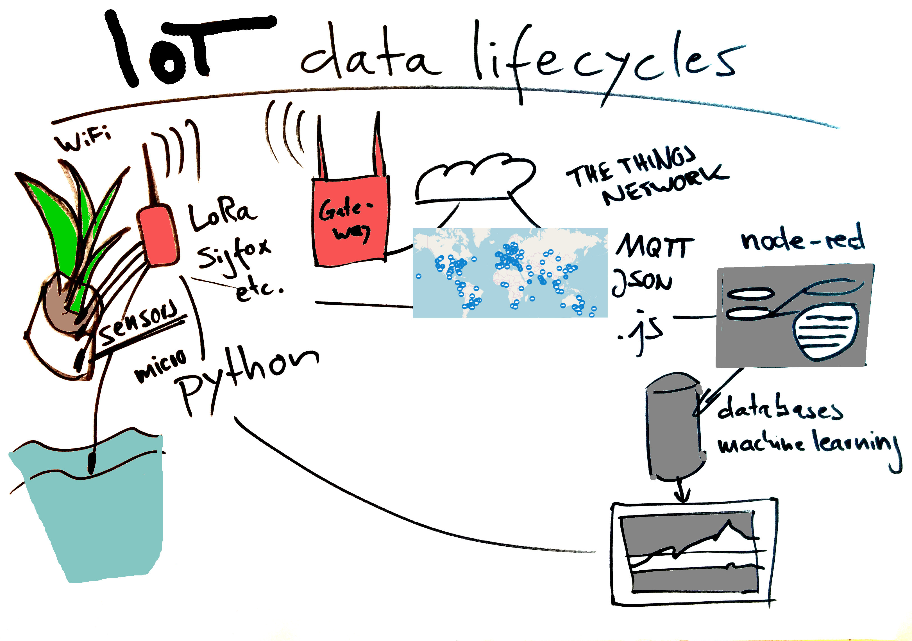

Slide 4
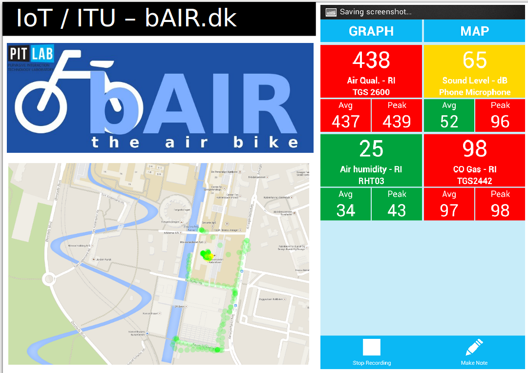

Slide 5
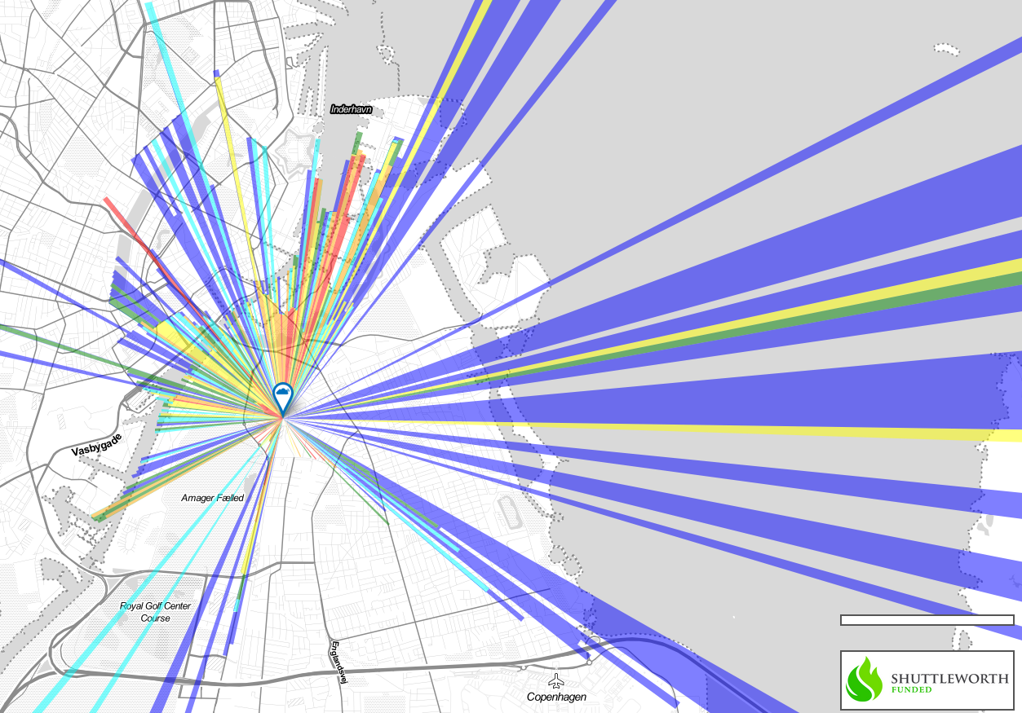
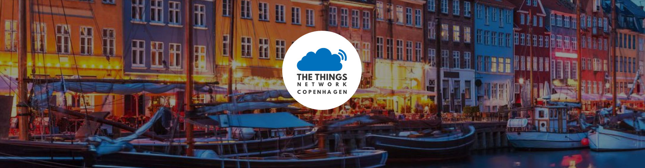

Slide 6
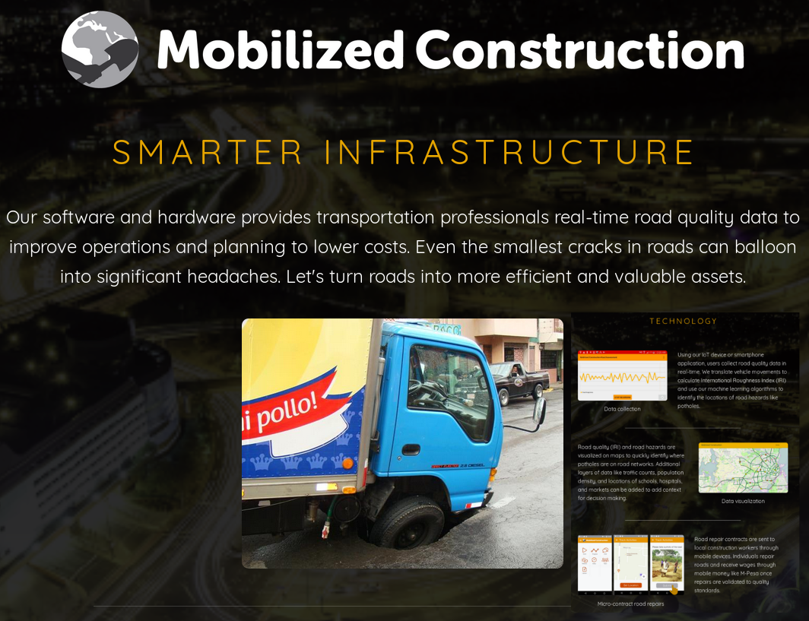
Example Course Project: Mobilized Construction

Slide 7
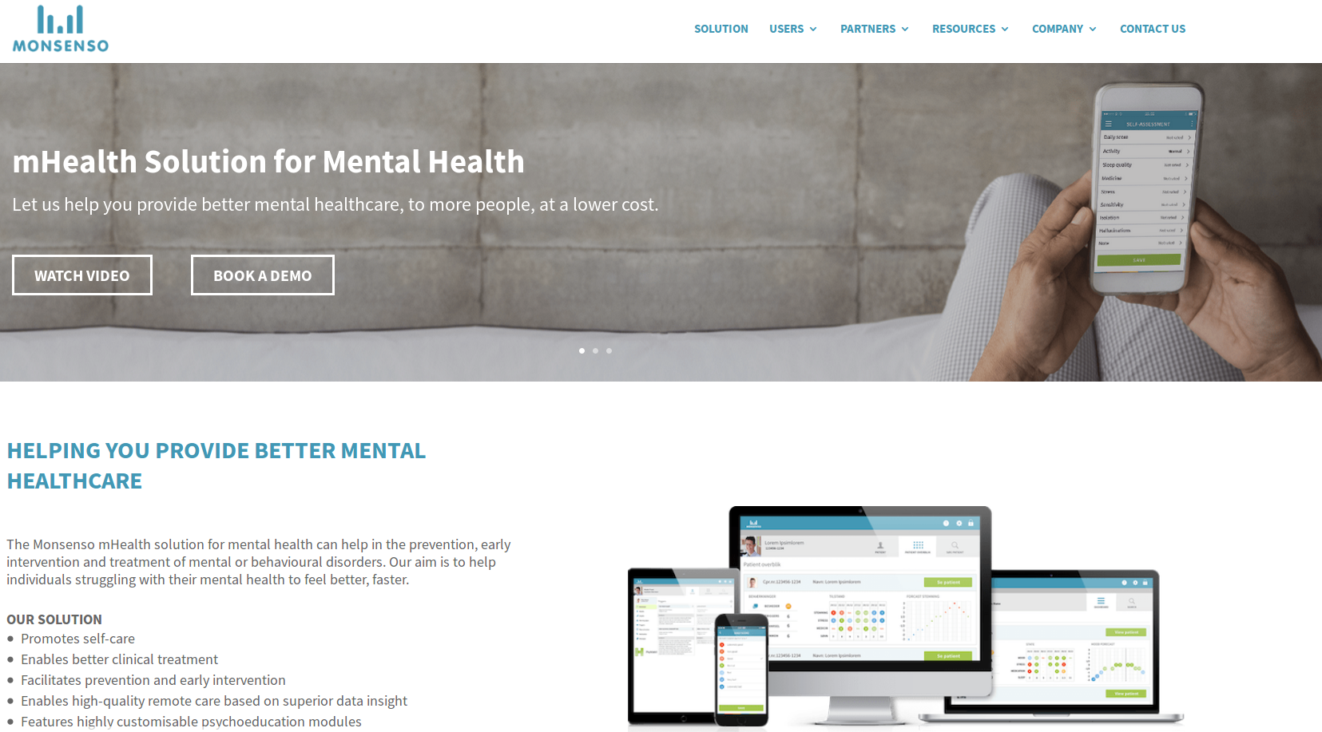
One of many startups: Monsenso

Slide 8
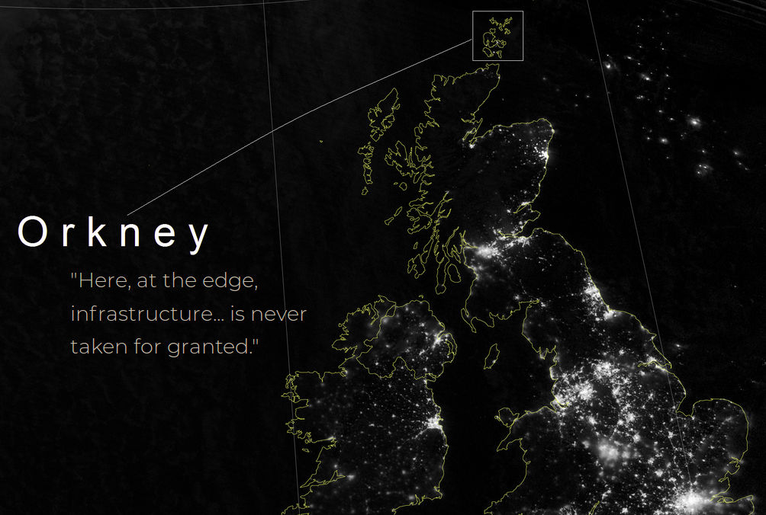
International projects: Orkney Cloud

Slide 9
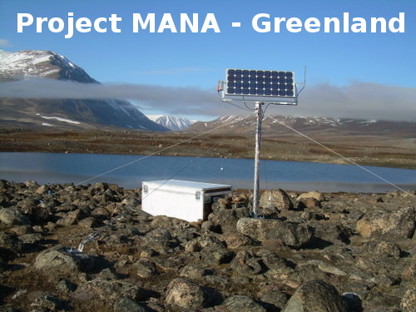
International projects: Greenland

Slide 10
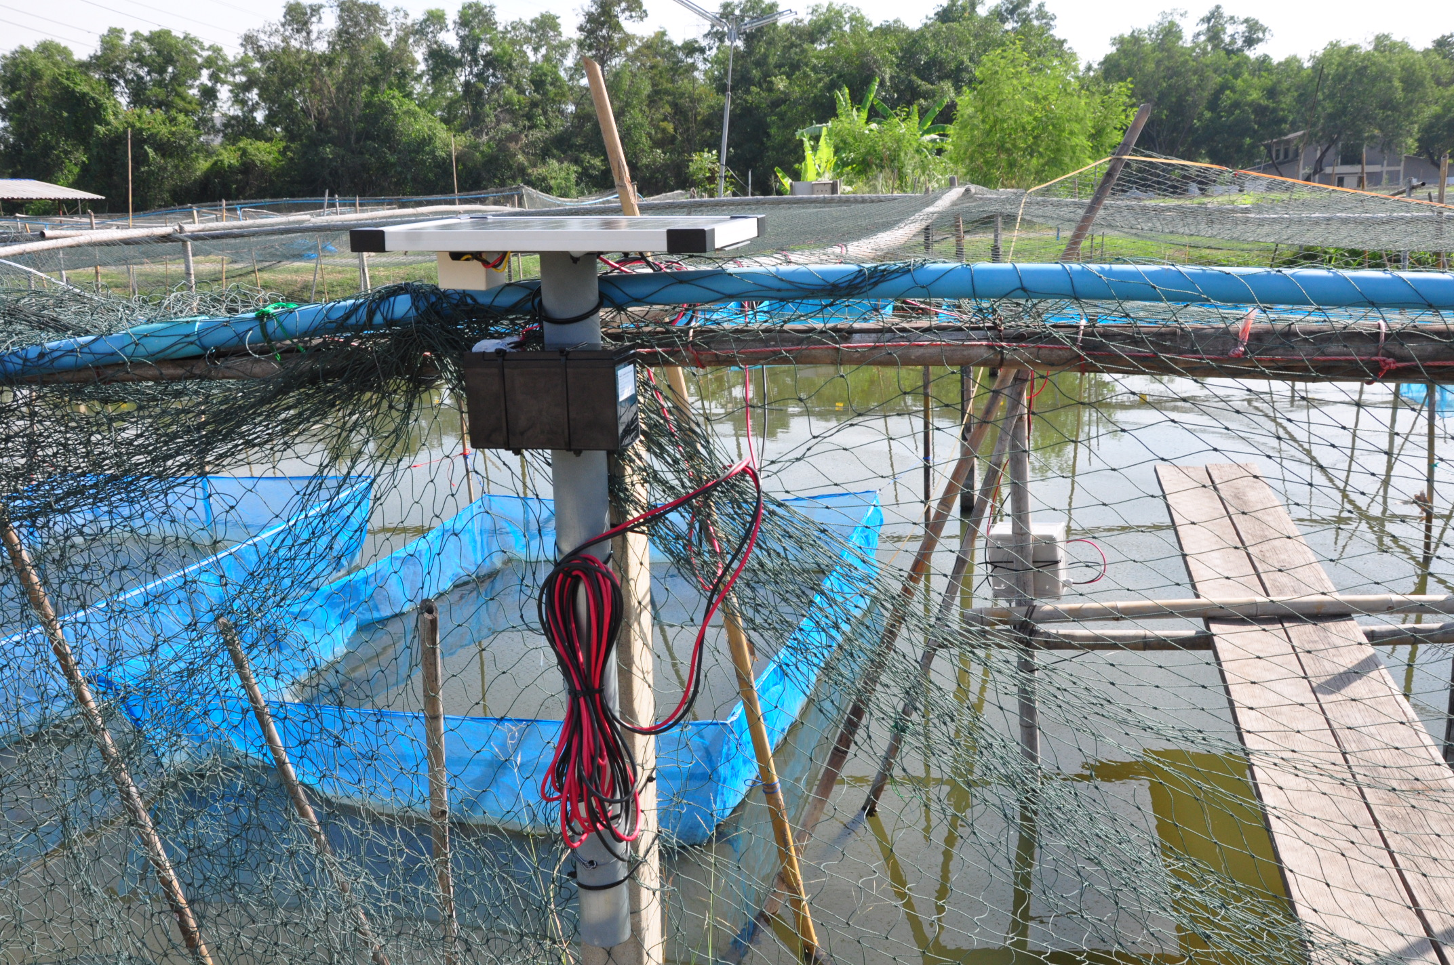
International projects: Thailand

Slide 11
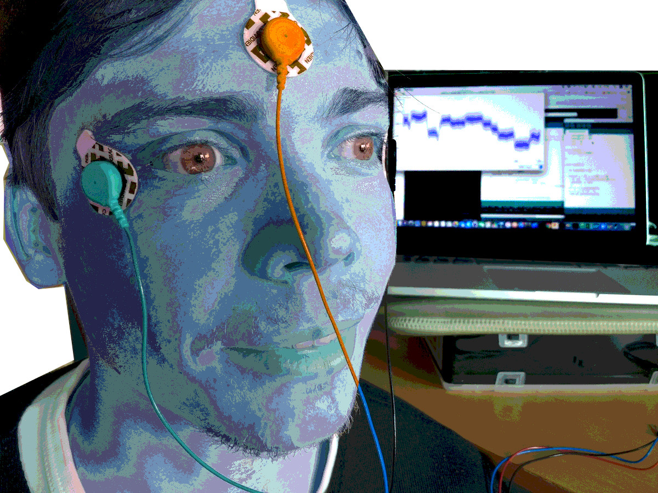
Bio sensors

Slide 12
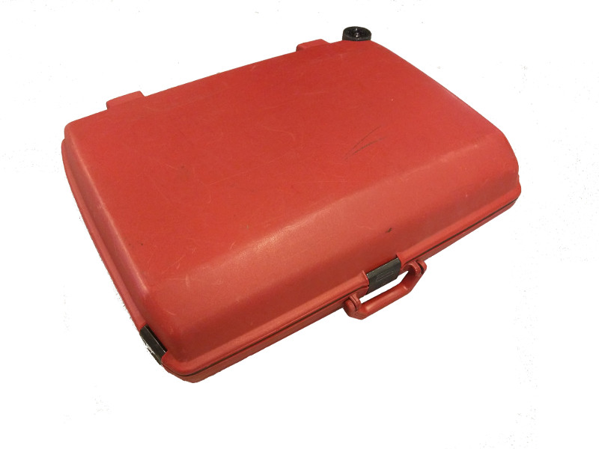
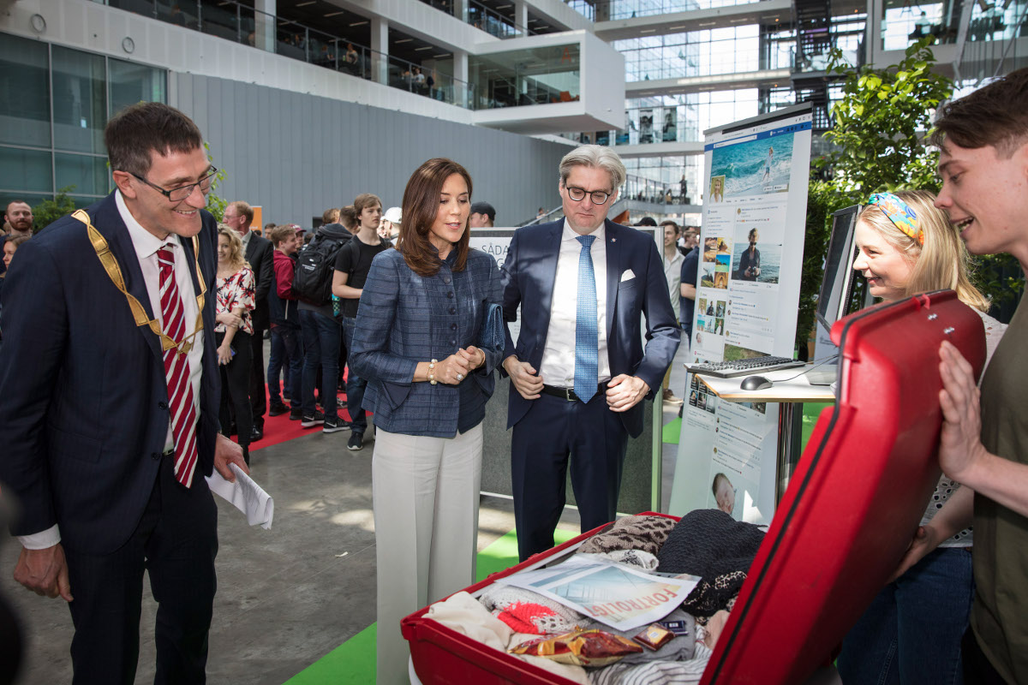
Famous red suitcase

Slide 13
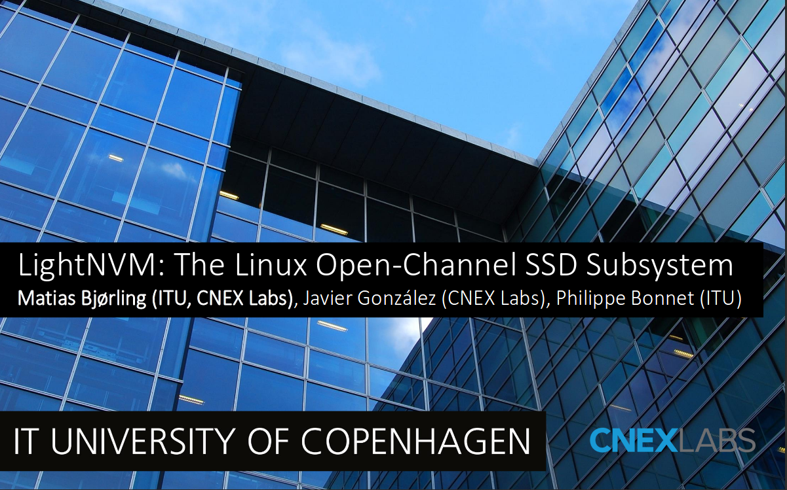
Edge Computing, Near Data Computing

Slide 14
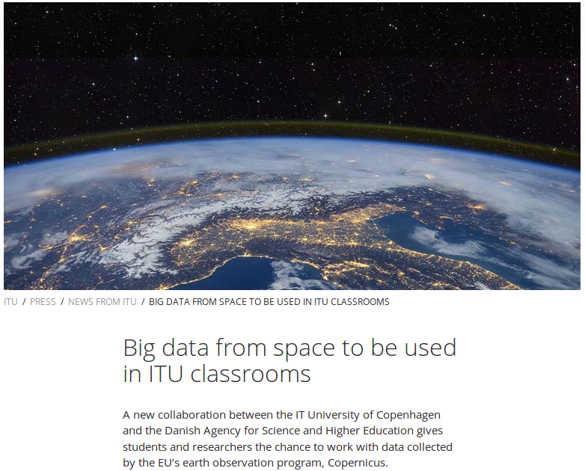
Big Data from Space

Slide 15
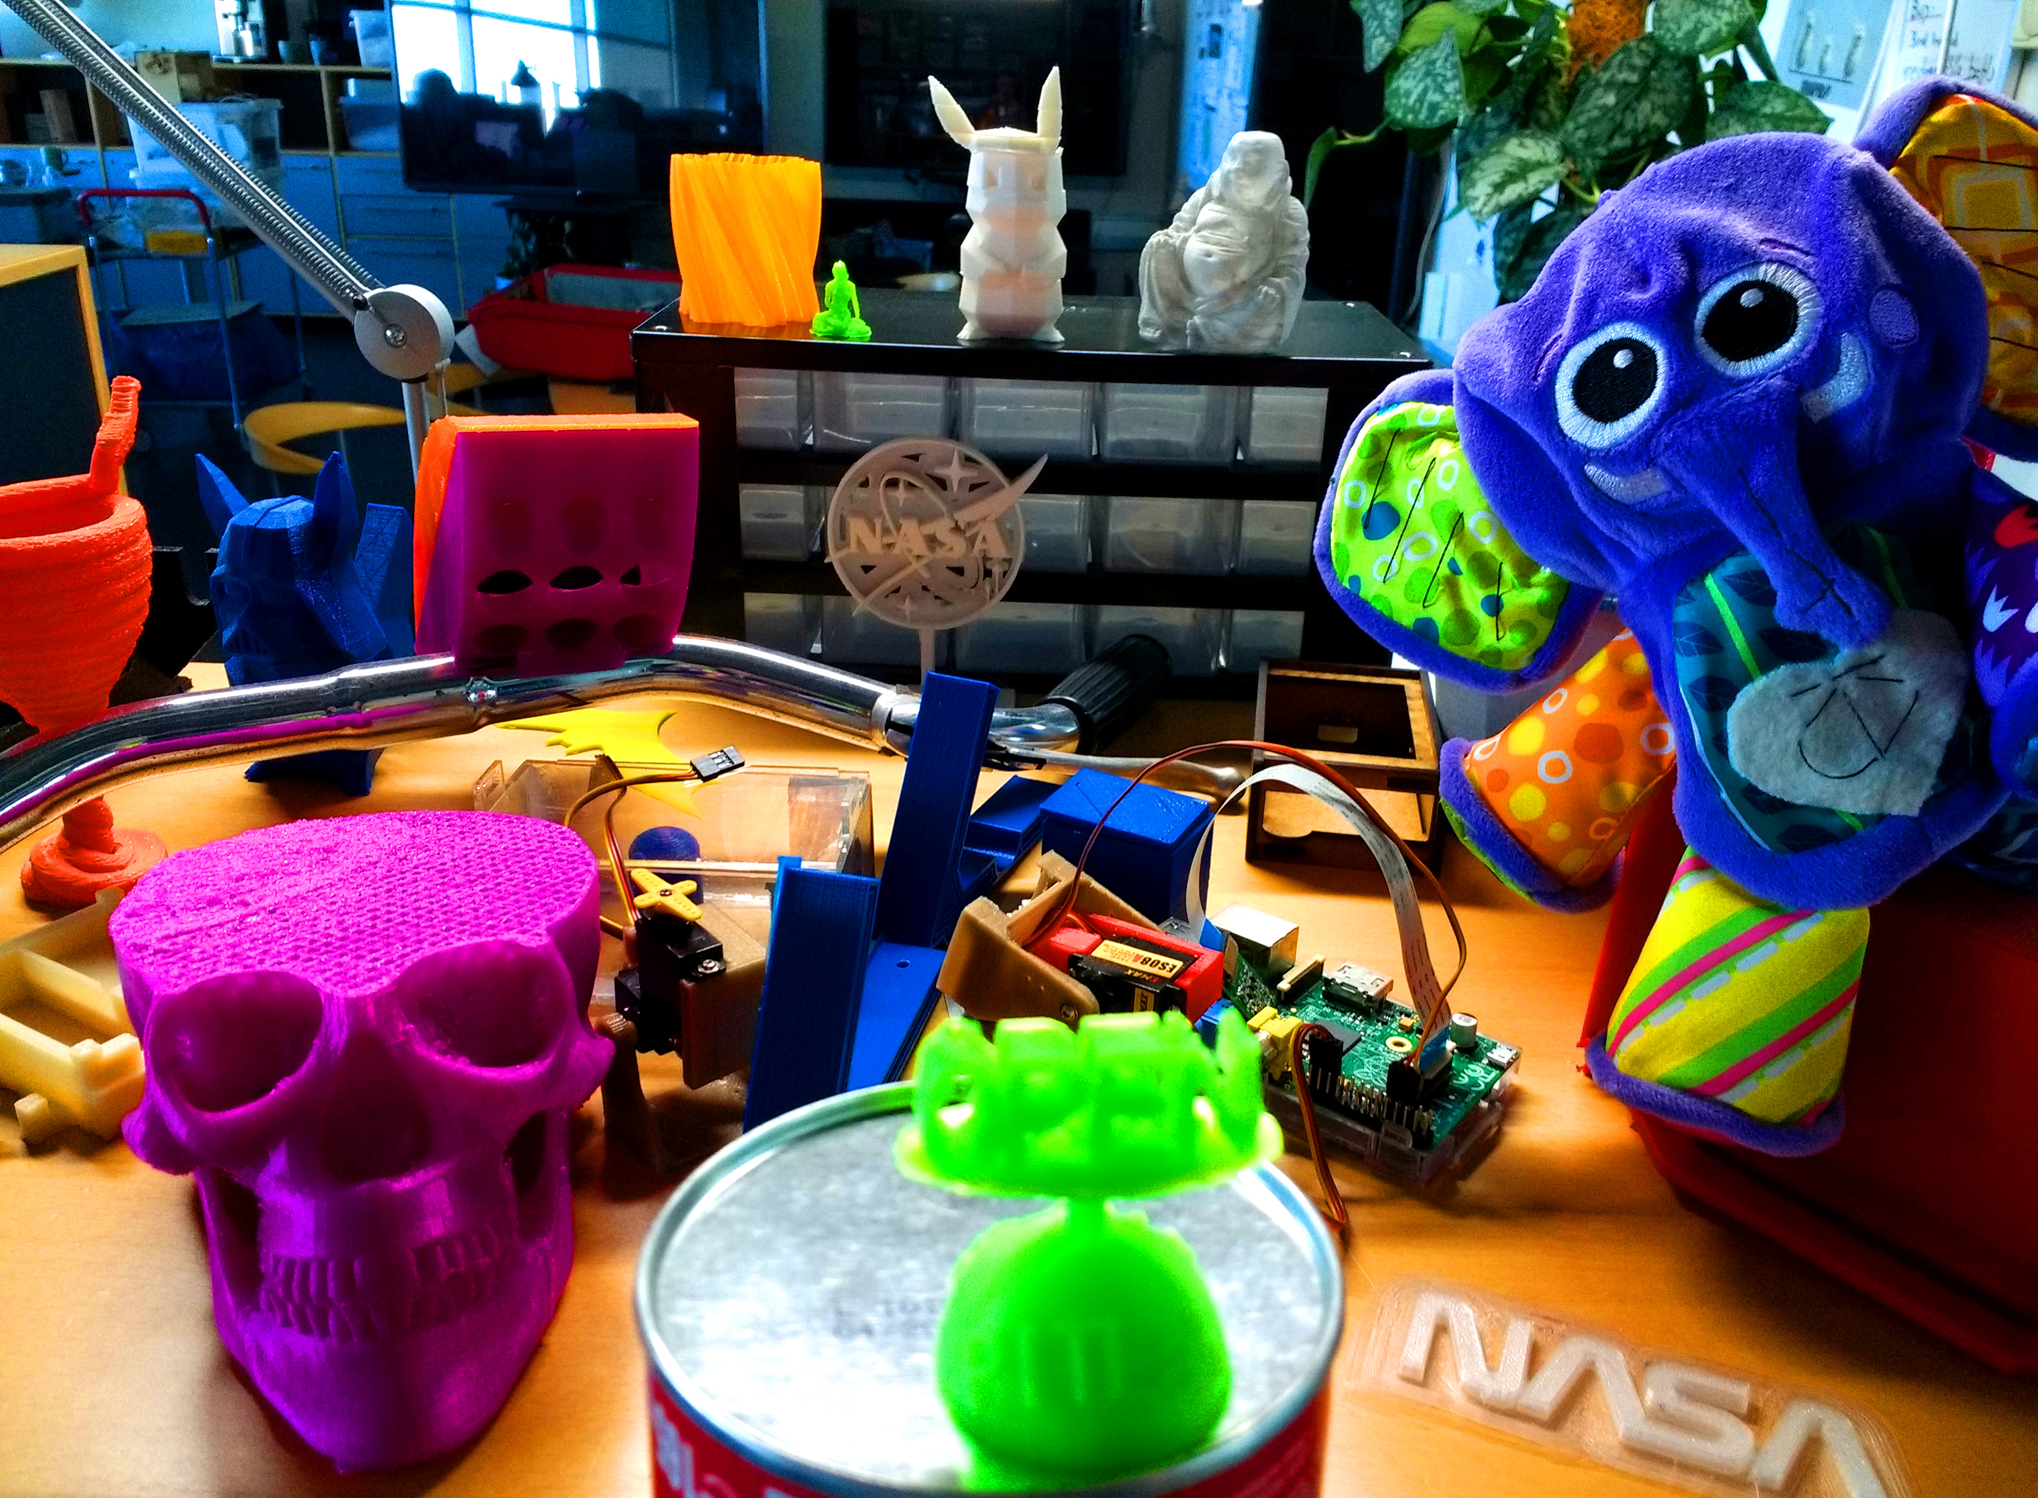

open
open

Slide 16
open
We are in 5A56
mail us at
sebastian@itu.dk
https://pitlab.itu.dk

