Slide 1





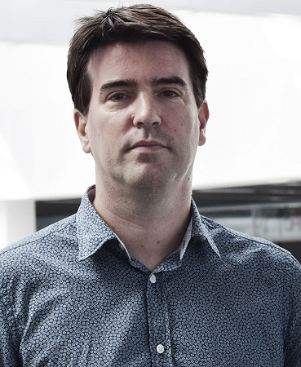


Björn Thòr Jònsson
Pınar Tözün
Large-Scale, Real-Time
Multimedia Analytics
Workload Characterization
Hybrid Transaction-Analytics systems
Databases on modern hardware
Our group focuses on improving the resource utilization
and scalability of data systems.
Ivan Luiz Picoli
Sebastian Bütrrich
Data system: The low-level software that supports the basic function of data-intensive applications
on modern hardware infrastructures, e.g., log-based storage or query processing.
Open-Channel SSDs
Sofware-Defined SSDs
Log-Based Storage Manager
Benchmarking
@ Microsoft Research
IoT, Wireless networking Energy efficient and secure systems
We design, build and evaluate prototype systems.
Philippe Bonnet
Jonathan Fürst
Decentralized Cloud Software-Defined SSDs
Database Tuning
IoT, Edge computing Software-Defined Buildings
@ NEC Labs

