Slide 1

GeoAI Challenge for Air Pollution Susceptibility Mapping by ITU
Presenter: Xiao Liu

Slide 2
About the presenter
PhD degree obtained in 2022
GNSS (Global Navigation Satellite System) industry
Software R&D
Interest in: Aerospace, AI, IOT

Slide 3
Introduction
Goal: Predict Air Quality Index (AQI)
Given information:
Coordinates and date
Meteorological data (meteo_spring_2022.csv, … for each season)
Digital terrain model (air_pollution_Milan_Comune_topo_only.csv)

Slide 4
Data Analysis
Meteorological data​
given for each season separately​
Digital terrain data​
geo-tagged on a 100m*100m grid​
Training data​
contains records of the above two data at different location and different dates​
Test data​
Only coordinates and season

Slide 5
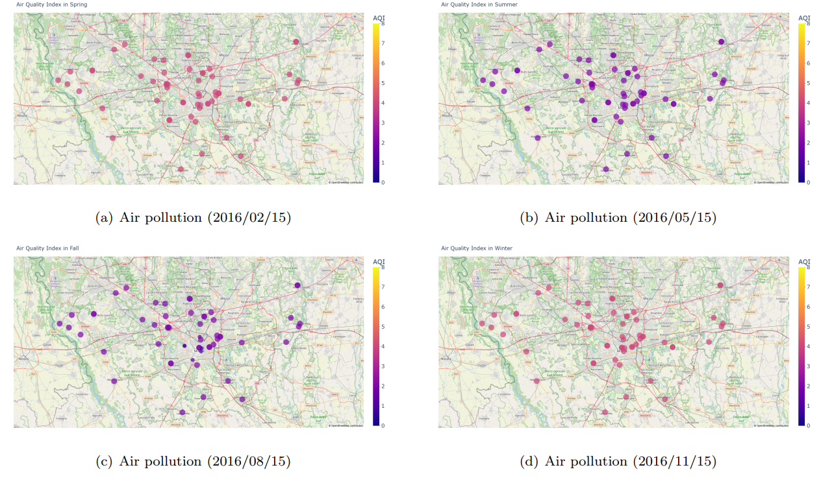

Slide 6
Data Analysis
Binding meteorological and terrain data to the test dataset
Total number of features: 60
# function to get the proper row of terrain data by
# finding the closest point to the input coordinates def get_terrain_data(lat, lng): # find the closest point to the input coordinates df_terrain['distance'] = df_terrain.apply(lambda row:
(row['lat'] - lat) ** 2 + (row['lng'] - lng) ** 2, axis=1) df_terrain.sort_values(by=['distance'], inplace=True) # get the closest point df_terrain_closest = df_terrain.iloc[0] # get the terrain data of the closest point df_terrain_data = df_terrain_closest.iloc[5:] return df_terrain_data

Slide 7
Proposed Methods and results
When using only minimal features (lat, lon, season)
Random Forest Regression (RFR): 44.6%
Naive Bayes (NB): 99.1%
Neural Network (NN): 26.8%

Slide 8
Proposed Methods and results
When using all features
Random Forest Regression (RFR): 25%
Naive Bayes (NB): 7.5%

Slide 9
Conclusions and future improvements
Seems simplest model with the minimal features already produced a near perfect prediction for the test data.
Geographically weighted regression (GWR) models can be a good direction for further investigation
Usage of meteorological and terrain data need to be explored more thoroughly.

Slide 10
Thank you

