Slide 1



SECTION I · PROBLEM
Problem statement
Measuring Universal Meaningful Connectivity in a hyper-connected city
Seoul — a hard case for testing UMC.
9.4M
25
Seoul ranks among the world's most connected cities by every conventional ITU benchmark — yet conventional threshold-based UMC frameworks cannot distinguish meaningful variation in a city where basic infrastructure is already saturated.
Any remaining gaps are structural and human, not infrastructural. Seoul is therefore the natural setting for asking how UMC should be defined and measured beyond infrastructure.
Population
Autonomous districts
99%+
100%
Broadband penetration
5G coverage
Q1 — MEASUREMENT
Q2 — MECHANISM
How should UMC be measured in high-connectivity urban contexts where threshold-based frameworks may not capture meaningful variation?
Are certain groups structurally excluded from connectivity benefits, and what methodology can separate individual vulnerability from district context?
SIX UMC DIMENSIONS
Connectivity
Available for Use
Affordability
Devices
Digital Skills
Safety
1 / 13

Slide 2
SECTION II · ETL APPROACH · 1 / 4
Data sources
Analysis 1 & 2
Dataset name | Source | Link | Coverage | Key variables | Format | Access method
Seoul Digital Competency Survey | Seoul AI Foundation | https://saif.or.kr/dataroom/2564 | Geographic: Seoul Time: 2023 used | devices, skills, safety; survey weights | CSV/XLSX | data provision upon official request
Cellular Base Station Data | Spectrum Resource Mgmt System | https://spectrummap.kr/gis/mobile_service.do?menuNo=300480 | Geographic: Seoul Time: 2023, 2024 | 4G/5G cell-site locations |  | Public Open Data
NIA Communication Quality (CQ) | Korean Public Data Portal | https://www.data.go.kr/data/15120591/fileData.do | Geographic: Seoul Time: 2023, 2024 | district-level download speed
Public Free Wi-Fi Installation Data | Local Admin WiFi License Data | https://www.localdata.go.kr/lif/lifeCtacDataView.do | Geographic: Seoul Time: 2023, 2024 | public Wi-Fi installation locations
Telecommunication Indicators | SKT Telecom Data | https://www.data.go.kr/data/15127168/fileData.do# | Geographic: Seoul Time: 2023, 2024 | mobile data use; online service days; fee delinquency rate
Average Monthly Household Income by District | Seoul Commercial Analysis Service | https://data.seoul.go.kr/dataList/OA-22167/S/1/datasetView.do | Geographic: Seoul Time: 2023, 2024 | average monthly household income
Seoul Survey | Seoul Open Data | https://data.seoul.go.kr/dataList/OA-15564/F/1/datasetView.do | Geographic: Seoul Time: 2023, 2024 | digital service use; demographics, income, housing, district/year
Analysis 3
Dataset name | Source | Link | Coverage | Key variables | Format | Access method
Daangn Community Post | Daangn Market | daangn.com/kr/community/s | Geographic: Seoul dong fields Time: 2024-2026 crawl period | post text; gu/location; createdAt; subject/category | CSV/XLSX | Web Scraping
Seoul Living/Floating Population | Seoul Open Data | data.seoul.go.kr OA-14991 | Geographic: Seoul Time: 2023-2026 used as available | hourly/dong population; daytime population; age shares; dong/district code |  | Public Open Data
2 / 13

Slide 3
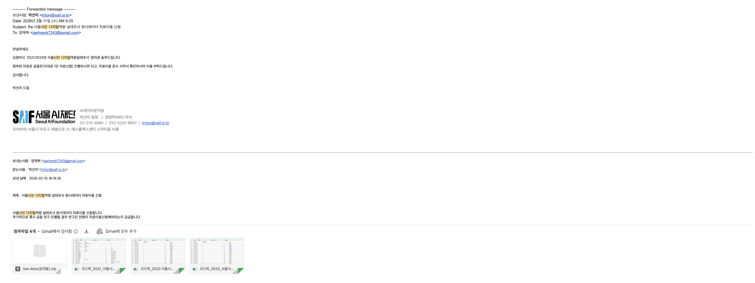

Data sources
About Seoul Digital Competency Survey
Requested raw data separately on Feb 11, 2026 Obtained via official channels

Slide 4
SECTION II · ETL APPROACH · 2 / 4
Stage 1 — UMC index construction
6 dimensions × 25 districts, equal-weighted composite
NORMALIZE
6 DIMENSIONS
COMPOSITE
→
→
Min-Max Scale
Per-District Scores
Equal-Weight Mean
0 — 1 across districts
Connectivity · AFU · Affordability
Devices · Skills · Safety
UMC score per district
KEY METHODOLOGICAL CHOICES
Daytime population as denominator
Reverse-coded burden indicators
Equal weights across dimensions
Connectivity indicators use daytime (floating) population rather than registered residents — captures where people actually access digital services.
Telecom bill arrears rate is reverse-coded so higher values consistently mean better outcomes across all six dimensions.
Composite UMC score uses equal weights across the six dimensions — no a priori prioritization, supporting reproducible cross-city application.
3 / 13

Slide 5
SECTION II · ETL APPROACH · 3 / 4
Stage 2 (HLM) & Stage 3 (Platform text)
Multilevel modeling and Bayesian text-evidence integration
STAGE 2 — HIERARCHICAL LINEAR MODEL
STAGE 3 — PLATFORM TEXT ANALYSIS
Dependent variable
Digital-service usage score (0–80) summed from 8 items: finance, e-commerce, public services, communication, leisure, education, mobile payment.
1,287,761 posts
Danggeun community board · 25 districts · May 2024 – Mar 2026
→
Level-1 predictors (individual)
Age · gender · education · income · occupation · housing type · disability · single-person household (following prior digital divide literature; van Dijk, 2020; Mossberger et al., 2006)
480,972 posts
after removing inaccessible body text
→
Level-2 predictors (district)
146,933 candidates
Connectivity · AFU · Affordability (from Stage 1).
matched 6-dimension UMC keyword
→
Sequential model estimation
M0
Null
→
M1
+ L1
→
M2
+ L2
→
M3
+ Inter.
7,136 relevant posts
few-shot classification
4 / 13

Slide 6
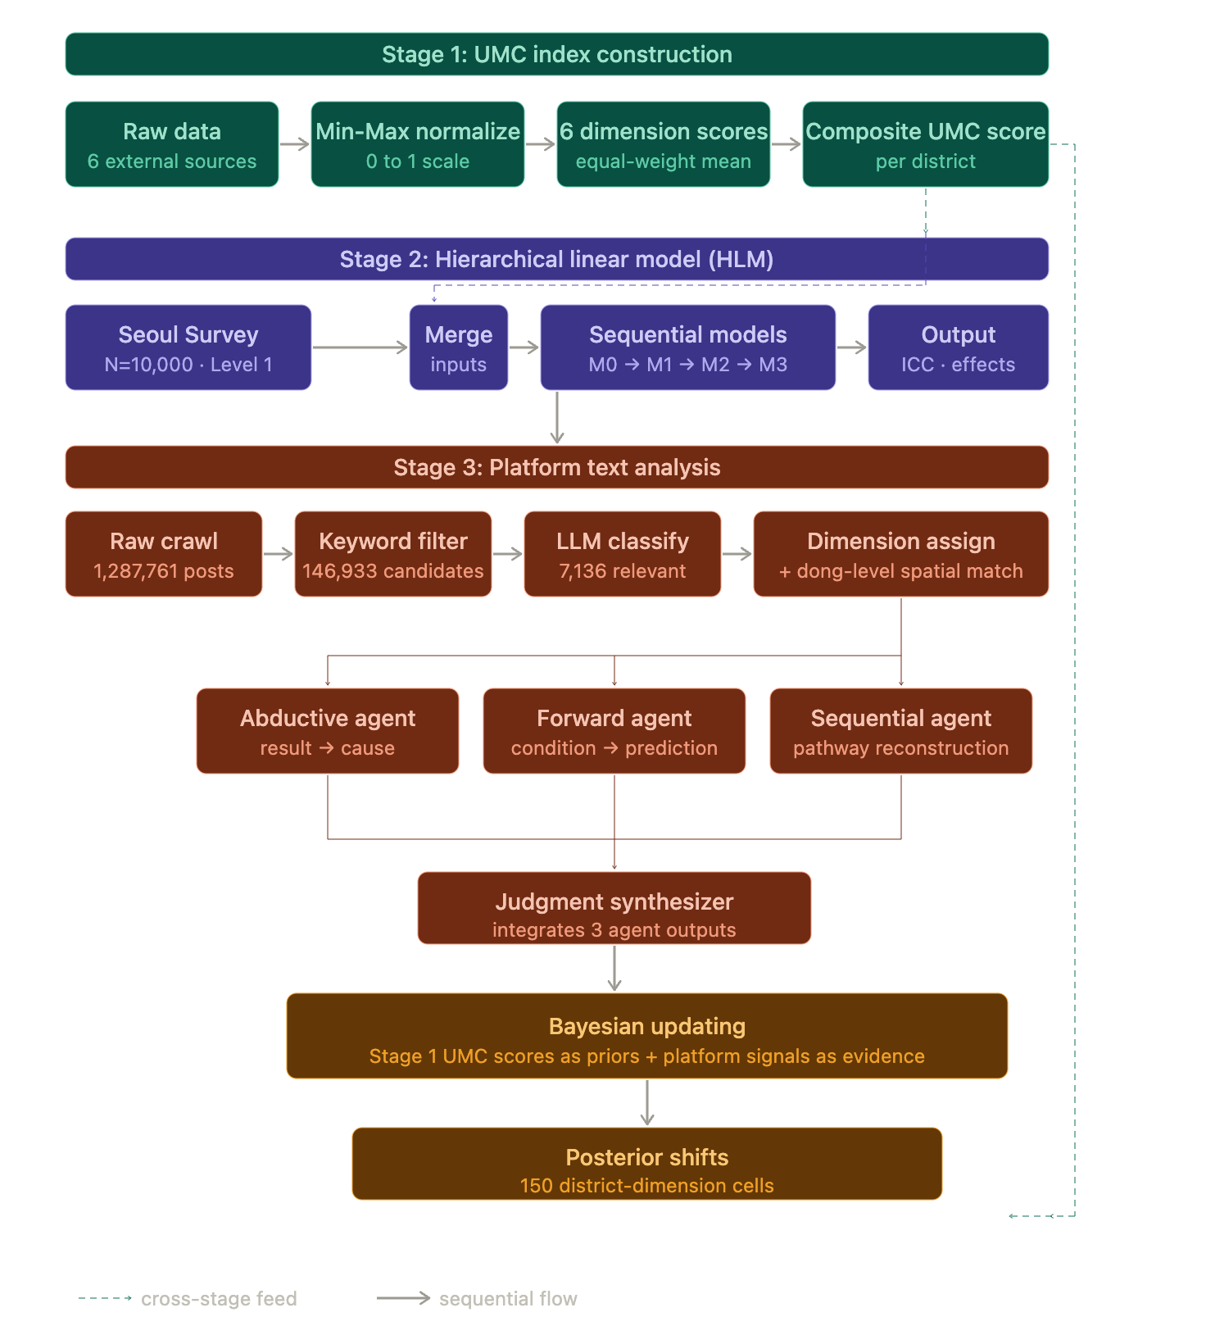
SECTION II · ETL APPROACH · 4 / 4
Integrated ETL pipeline
Three sequential stages with cross-stage feedback loop
STAGE INTEGRATION LOGIC
Stage 1 establishes where digital gaps exist
→ district-level structural baseline
Stage 2 explains who is affected and why
→ individual vulnerabilities tested against that baseline
Stage 3 reveals how residents experience those gaps
→ platform signals validate and nuance the quantitative picture
Closed loop: Stage 1 scores re-enter Stage 3 as Bayesian priors — measurement informs interpretation
5 / 13

Slide 7
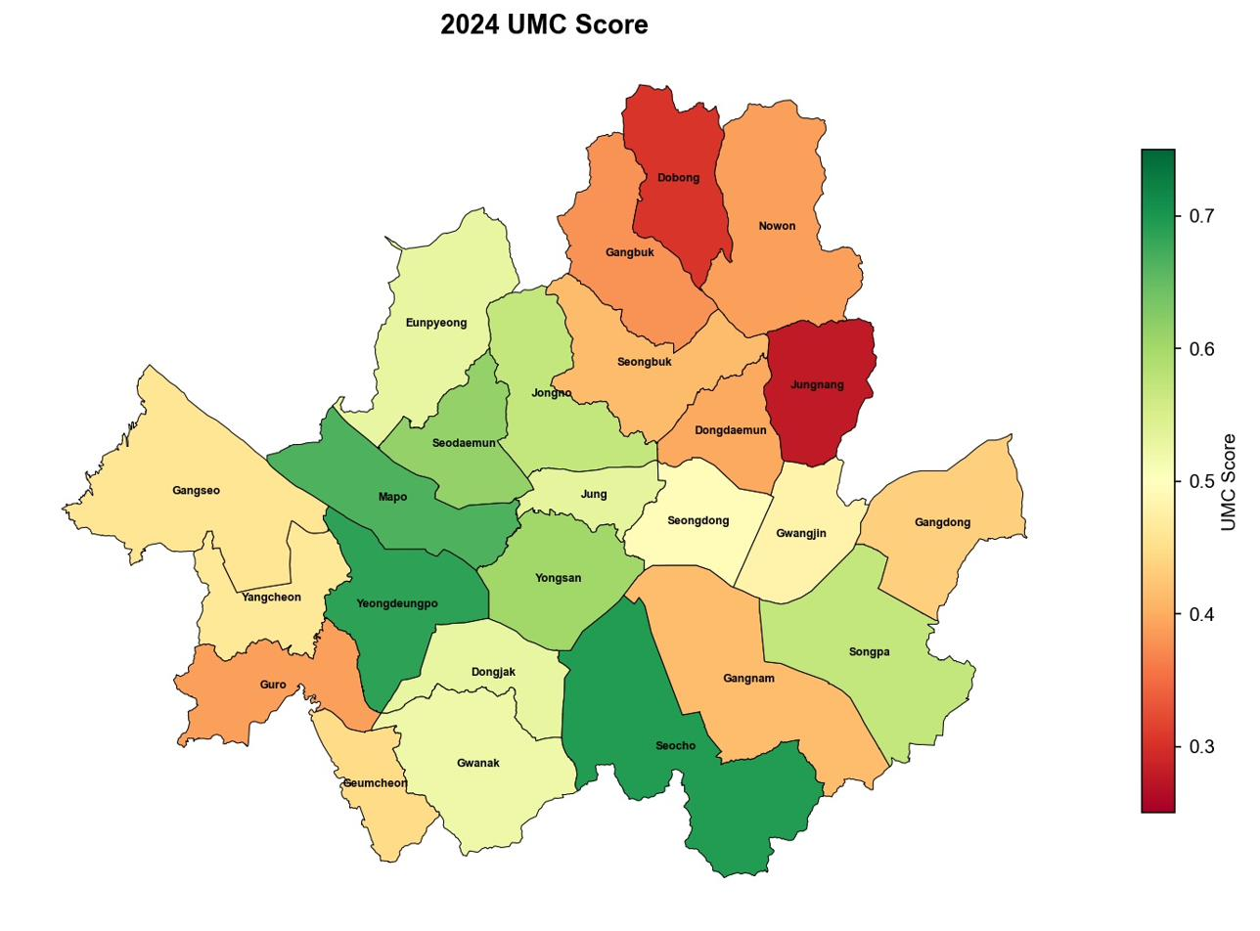
SECTION III · PRELIMINARY RESULTS · 1 / 6
Preliminary results — Where is the gap?
UMC Composite Index across 25 districts
TOP 5 DISTRICTS
1. Seocho-gu
0.695
2. Yeongdeungpo-gu
0.686
3. Mapo-gu
0.665
4. Seodaemun-gu
0.615
5. Yongsan-gu
0.603
BOTTOM 5 DISTRICTS
21. Nowon-gu
0.389
22. Guro-gu
0.389
23. Gangbuk-gu
0.380
24. Dobong-gu
0.303
25. Jungnang-gu
0.279
KEY FINDINGS
2.5× gap between top and bottom districts
Northern Seoul (Jungnang, Dobong, Gangbuk, Nowon) forms a Low-Low spatial cluster
Spatial autocorrelation confirms statistically significant clustering
UMC Composite Score by district, Seoul 2024.
6 / 13

Slide 8
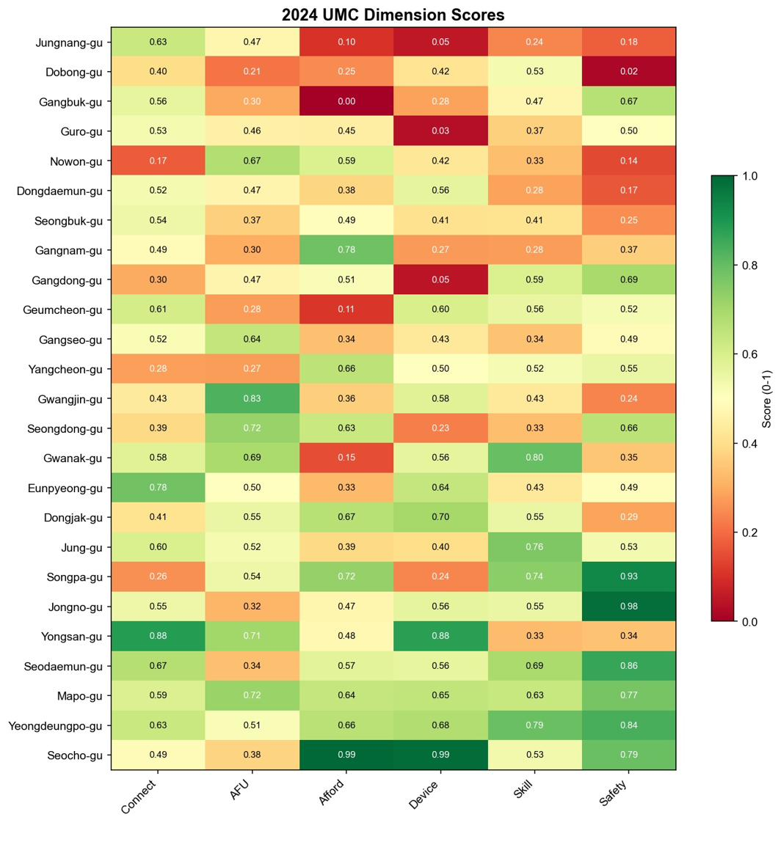
SECTION III · PRELIMINARY RESULTS · 2 / 6
Dimensional heterogeneity
No district excels in all dimensions
ILLUSTRATIVE CASES
Eunpyeong-gu
Connectivity
0.78
top tier
Affordability
0.33
bottom
Gwanak-gu
Digital Skills
0.80
#1 in Seoul
Affordability
0.15
last
KEY FINDINGS
Digital deserts have average connectivity but severe gaps in Devices and Safety
Physical infrastructure exists — what is missing is human and economic capacity
A single composite ranking hides policy-relevant, dimension-specific vulnerabilities
Implication: dimension-specific intervention, not uniform infrastructure investment
Heatmap of district × UMC dimension scores, Seoul 2024.
7 / 13

Slide 9
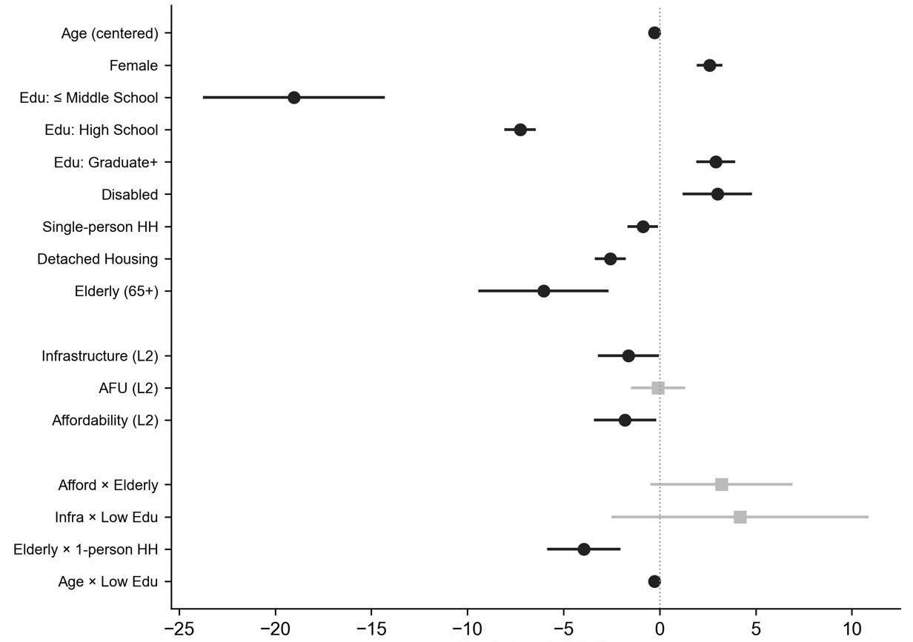
SECTION III · PRELIMINARY RESULTS · 3 / 6
Why does the gap exist? — Individual differences dominate
HLM: ICC and main effects
WHERE THE GAP LIVES
Almost all variation in digital use sits between people, not between districts.
Between districts 0.5%
Between individuals 99.5%
Model 3 main effects (refs: college, apartment, multi-person HH). Null-model ICC = 0.49%, design effect = 2.94.
STRONGEST PREDICTORS
Edu ≤ middle school
−18.4 pts
p<0.001
Age
−0.34 / yr
p<0.001
Single-person household
−1.7 pts
p<0.001
Disabled
+3.1 pts
p<0.001
Detached housing
−2.4 pts
p<0.001
Infrastructure main effect
≈ 0
n.s.
Model 3 key fixed effects (95% CI).
9 / 13

Slide 10
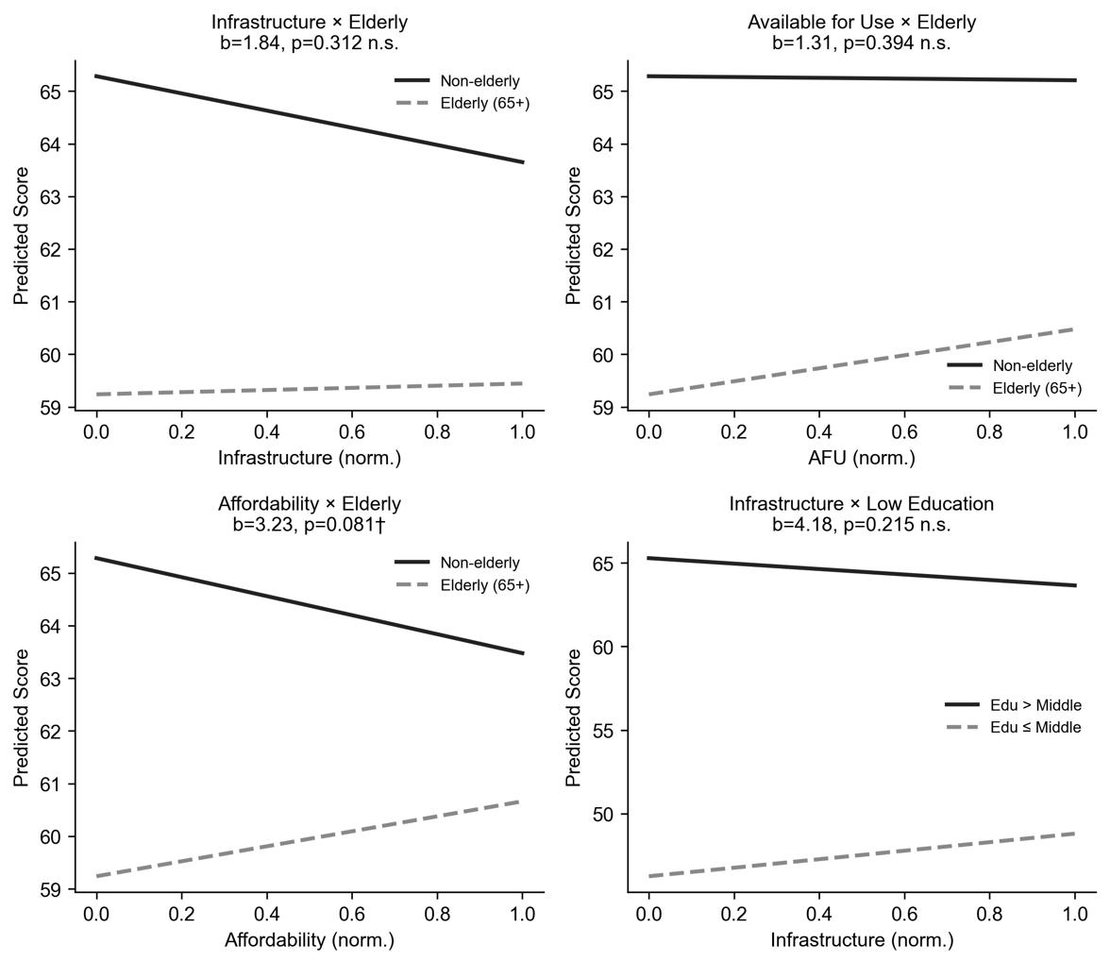
SECTION III · PRELIMINARY RESULTS · 4 / 6
Does infrastructure offset individual vulnerability?
HLM: cross-level interactions
MAIN EFFECT
District-level UMC dimensions show only weak, contextual associations with individual digital use.
CROSS-LEVEL INTERACTIONS
Connectivity × low education
+4.66 n.s. (M3)
Age × low education
−0.40 *** (M3)
Older (65+) × low education
−3.53 * (M4 supp.)
L2 Affordability (main)
−1.35 † (M3)
INTERPRETATION
Retained interactions are individual-level: the low-education penalty steepens with age (Age × low education −0.40***, M3) and with being 65+ (Older × low education −3.53*, M4 supplementary). District-level UMC dimensions show only weak, marginal main associations (Connectivity −1.34†, Affordability −1.35† in M3); the Connectivity × low-education term is positive but non-significant (+4.66, p=.16). District scores locate where vulnerable residents concentrate — supporting place-sensitive (not place-based) targeting.
District scores identify where vulnerable individuals are concentrated — supporting place-sensitive (not place-based) targeting.
Cross-level interactions: how district-level UMC dimensions interact with vulnerable groups.
10 / 13

Slide 11
SECTION III · PRELIMINARY RESULTS · 5 / 6
Where infrastructure indicators may miss the problem
Bayesian posterior shifts: Stage 1 priors updated by platform text evidence
1.29M
~520k
25
METHOD
UMC dimension scores serve as Bayesian priors; classified Danggeun posts update them. The resulting posterior shifts reveal where measured indicators may overstate or understate lived deprivation.
Posts crawled
(2024–2026)
Analyzed after
dedup & filtering
Districts covered
(all of Seoul)
PRELIMINARY POSTERIOR SHIFTS
INTERPRETATION
POSITIVE shift → measurement misses deprivation that residents actually express on the platform
NEGATIVE shift → measurement overstates deprivation relative to lived signals
Across 150 cells, the dominant pattern (preliminary): Skills and Safety show hidden deprivation in northern districts; AFU and Affordability tend to be overstated by measurement.
Jungnang · Devices
+4.77 pp
measured score understates device-access deprivation
Jungnang · Skills
+4.69 pp
platform signals stronger skill-related struggles
Gwanak · Skills
−4.52 pp
measured score overstates skill deprivation
Yongsan · Devices
−4.18 pp
platform signals fewer device-related issues
11 / 13

Slide 12
SECTION III · PRELIMINARY RESULTS · 6 / 6
How is the gap experienced?
Platform text analysis — deprivation patterns from ~520k community posts.
REPRESENTATIVE CASES
Sinsa-dong, Eunpyeong-gu
“Is there really no place...?”
INFO ABSENCE · DIGITAL SKILLS
Bongcheon-dong, Gwanak-gu
“Where can I print legal documents? Regular print shops can't do it.”
PUBLIC ACCESS GAP · AVAILABILITY FOR USE
Sillim-dong, Gwanak-gu
“Looking for a PC-bang that can do document scanning.”
DEVICE ACCESS GAP · DEVICES + AVAILABILITY
Deprivation Types (n=100) — 88% of posts overlap 2 or more types.
12 / 13

Slide 13
SECTION IV · PROGRESS
Progress status & next steps
Three analyses underway; Phase 2 of platform text validation in progress
✓ ANALYSIS COMPLETE
◐ MAIN RESULTS DRAFTED
◑ PHASE 2 IN PROGRESS
Analysis 1 · UMC Index
Analysis 2 · HLM
Analysis 3 · Multi agent + Bayesian
25 districts × 6 dimensions (2023, 2024)
Composite + dimensional scores finalized
Spatial autocorrelation validated
Models M0–M3 estimated
ICC, fixed effects, cross-level interactions complete
Sensitivity checks pending finalization
Phase 0 – 1 complete: classification, hypothesis generation (n=100)
Initial posterior shifts computed on validation sample
Phase 2 (judge-agent triangulation on full corpus) running
Validated against external benchmarks.
Preliminary — final sensitivity & dong-level robustness in progress.
Preliminary — values may shift after Phase 2 validation.
NEXT STEPS BEFORE FINAL DELIVERABLE
Phase 2 judge-agent triangulation on the full corpus of LLM-relevant posts
Final policy implications: refine the four preliminary directions with validated evidence
13 / 13

