Slide 1



Intermediate deliverable:
Data Preparation and ETL Methods
High-Five

Slide 2
Data sources
Analysis 1 & 2
Dataset nameㅌ | Source | Link | Coverage | Key variables | Format | Access method
Seoul Digital Competency Survey | Seoul AI Foundation | https://saif.or.kr/dataroom/2564 | Geographic: Seoul Time: 2023 used | devices, skills, safety; survey weights | CSV/XLSX | data provision upon official request
Seoul Survey | Seoul Open Data | https://data.seoul.go.kr/dataList/OA-15564/F/1/datasetView.do | Geographic: Seoul Time: 2023, 2024 | digital service use; demographics, income, housing, district/year |  | Public Open Data

Slide 3
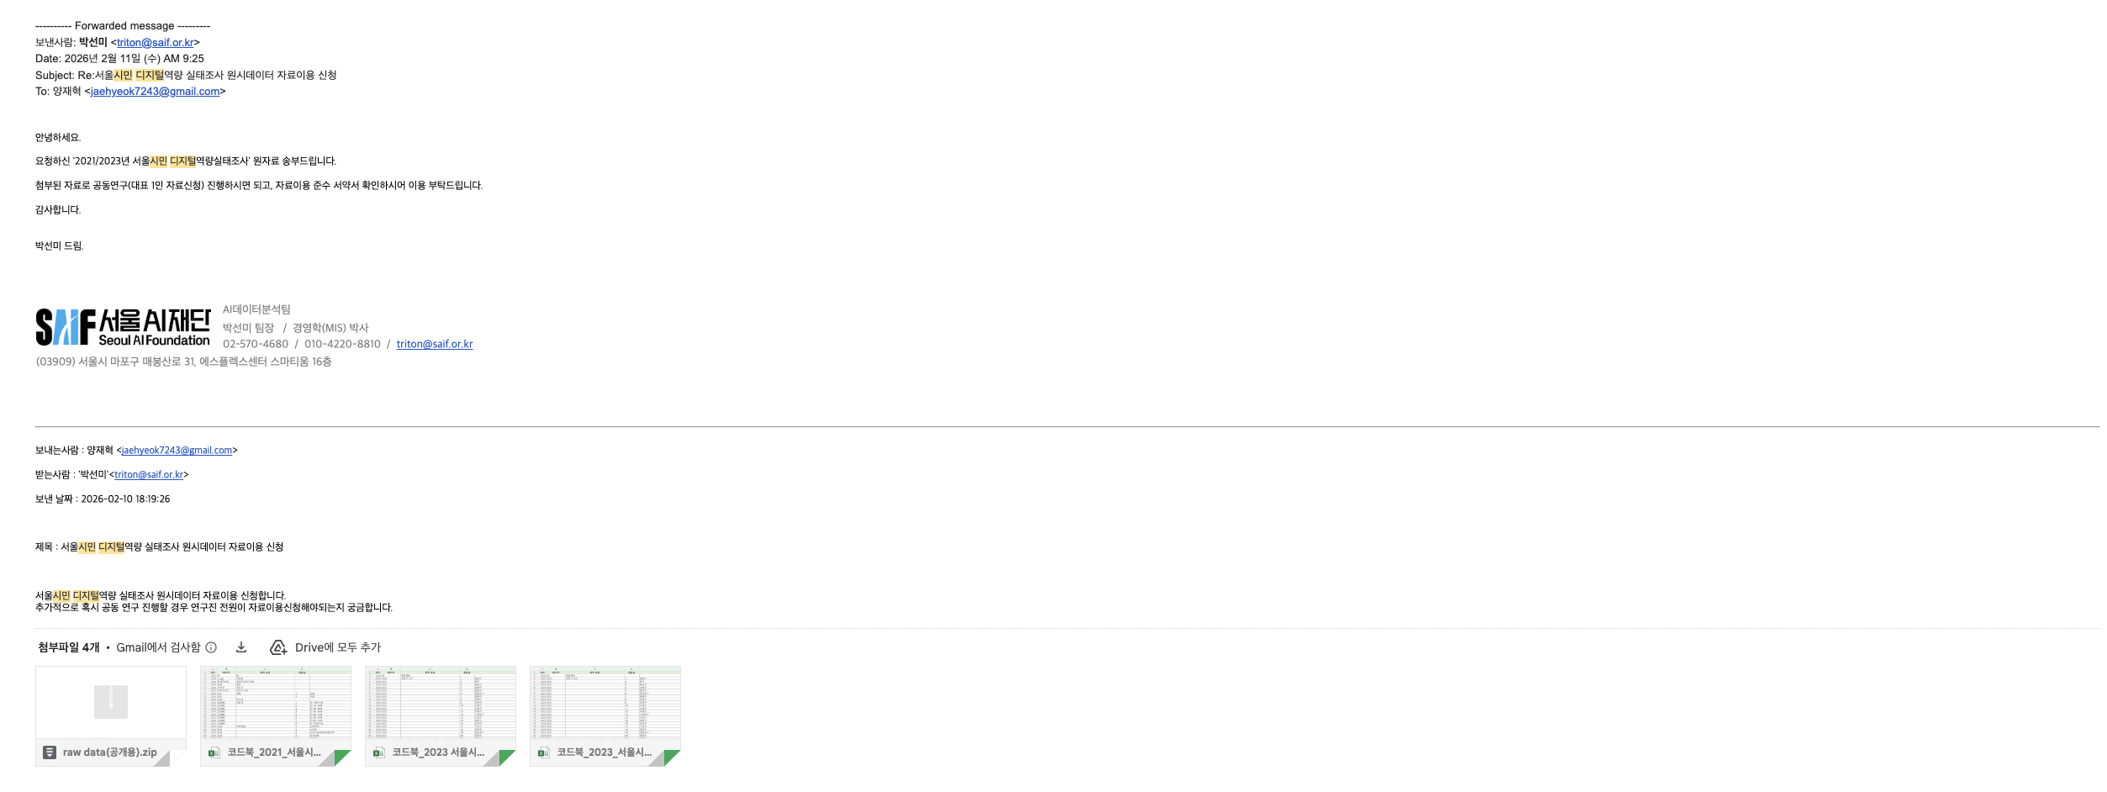
Data sources
About Seoul Digital Competency Survey
Requested raw data separately on Feb 11, 2026 Obtained via official channels

Slide 4
Data sources
Analysis 1 & 2
Dataset name | Source | Link | Coverage | Key variables | Format | Access method
Cellular Base Station Data | Spectrum Resource Mgmt System | https://spectrummap.kr/gis/mobile_service.do?menuNo=300480 | Geographic: Seoul Time: 2023, 2024 | 4G/5G cell-site locations | CSV/XLSX | Public Open Data
NIA Communication Quality (CQ) | Korean Public Data Portal | https://www.data.go.kr/data/15120591/fileData.do | Geographic: Seoul Time: 2023, 2024 | district-level download speed
Public Free Wi-Fi Installation Data | Local Admin WiFi License Data | https://www.localdata.go.kr/lif/lifeCtacDataView.do | Geographic: Seoul Time: 2023, 2024 | public Wi-Fi installation locations
Telecommunication Indicators | SKT Telecom Data | https://www.data.go.kr/data/15127168/fileData.do# | Geographic: Seoul Time: 2023, 2024 | mobile data use; online service days; fee delinquency rate
Average Monthly Household Income by District | Seoul Commercial Analysis Service | https://data.seoul.go.kr/dataList/OA-22167/S/1/datasetView.do | Geographic: Seoul Time: 2023, 2024 | average monthly household income

Slide 5
Data sources
Analysis 3
Dataset name | Source | Link | Coverage | Key variables | Format | Access method
Daangn Community Post | Daangn Market | daangn.com/kr/community/s | Geographic: Seoul dong fields Time: 2024-2026 crawl period | post text; gu/location; createdAt; subject/category | CSV/XLSX | Web Scraping
Seoul Living/Floating Population | Seoul Open Data | data.seoul.go.kr OA-14991 | Geographic: Seoul Time: 2023-2026 used as available | hourly/dong population; daytime population; age shares; dong/district code |  | Public Open Data

Slide 6
Data Preparation Methods
Analysis 1: UMC Index
Connectivity: turning network infrastructure into comparable district measures
Unit of comparison: each Seoul district in each study year.
Data used: Cellular Base Station Data locations, measured download speed, district boundaries, and daytime population.
Preparation steps
Count each physical base-station site only once.
Match all records to the same Seoul district code system.
Convert station counts into population-adjusted density measures.
Average measured download speed at the district-year level.
Place all connectivity indicators on a common scale before combining them.

Slide 7
Data Preparation Methods
Analysis 1: UMC Index
Availability for Use: measuring whether digital services are practically usable
Unit of comparison: each Seoul district in each study year.
Data used: telecom usage(SKT Telecom Data), online service days, public Wi-Fi installations, population denominators, and district codes.
Preparation steps
Aggregate neighborhood-level telecom data to district level using daytime floating population weights.
Convert public Wi-Fi installations into resident-adjusted density.
Usage, service-day, and Wi-Fi indicators on a common scale before combining them.

Slide 8
Data Preparation Methods
Analysis 1: UMC Index
Affordability: separating ability to pay from payment burden
Unit of comparison: each Seoul district in each study year.
Data used: district household income and telecom fee delinquency.
Preparation steps
Use income as the positive resource side of affordability.
Use telecom fee delinquency as the burden side of affordability.
Aggregate delinquency from neighborhood to district level with population weights.
Reverse the burden indicator so that higher final values consistently mean better conditions.
Combine the resource and burden sides after standardization.

Slide 9
Data Preparation Methods
Analysis 1: UMC Index
Devices, Skills, and Safety: converting survey answers into district-level conditions
Data used: Seoul Digital Competency Survey with official survey weights.
Constructed dimensions
Devices: whether residents have and use core digital devices.
Digital skills: task-based ability items grouped into a skills score.
Safety and security: safe-use behavior and security-awareness items.
Preparation steps
Remove invalid and nonresponse codes before scoring.
Apply survey weights so district averages represent the sampled population.
Use the available survey wave as a time-invariant district input for both study years.

Slide 10
Data Preparation Methods
Analysis 2: Multilevel Survey Dataset
Goal: connect individual digital-use behavior with district-level UMC context.
Survey pooling
Combine the two Seoul Survey years into one respondent-level analysis frame.
Link each respondent to the correct district-year UMC context using district and year keys.
Outcome construction
Convert digital service-use responses to a common score range and sum them into one digital-use measure.
Assign zero use only when the respondent is identified as a non-user.
Variable harmonization
Standardize field names that changed between survey years before pooling.
Create demographic and household controls needed for the multilevel model.
Keep selected binary outcomes for robustness checks.
Scaling and centering
Place district-level predictors on comparable scales; reverse cost-burden indicators.
Center age and income using constants saved with the processed dataset.
Document every transformation in the analysis codebook.

Slide 11
Data Preparation Methods
Analysis 3: Daangn Community Posts
Goal: translate local community text into district-level UMC evidence.
Corpus cleaning
Remove deleted, blocked, and empty-text posts before analysis.
Standardize text, time, category, and location fields when available.
Candidate screening
Use UMC keyword dictionaries to identify potentially relevant posts.
Keep all matched UMC dimensions at the screening stage instead of forcing one label.
Scoring and aggregation
Score selected posts for UMC relevance, dimension, confidence, and problem type.
Aggregate scored evidence by district and dimension for Bayesian updating.

Slide 12
Missing Data Rules
Analysis 1: UMC Index
Principle: clean each source before constructing composite scores.
Indicator-level rules
Convert blanks and nonresponse codes to missing before calculation.
Use official population denominators for density and per-capita measures when available.
Keep fallback denominator logic only for reproducibility, not as the main rule.
Survey-derived dimensions
Exclude invalid survey responses before constructing devices, skills, and safety measures.
Use survey weights only when both response and weight are valid.
Composite construction
Apply the same normalization and dimension formula after source-specific cleaning.

Slide 13
Missing Data Rules
Analysis 2: Survey Dataset
Principle: use rule-based handling that matches the survey meaning.
Standardization
Read blank and null-like survey entries as missing values before pooling.
Harmonize variables that changed names or coding between survey years.
Rule-based handling
Assign zero digital use only to respondents identified as non-users.
Apply the documented income nonresponse rule before centering.
Modeling file
Remove unresolved missing values in the dependent variable or required model controls.
Leave robustness-only gaps in robustness variables rather than imputing them into the main model.

Slide 14
Missing Data Rules
Analysis 3: Daangn Community Posts
Principle: keep uncertainty visible instead of filling text-derived gaps artificially.
Invalid-resource filtering
Remove unusable posts before keyword screening.
Keep posts with usable text and available location information for downstream matching.
Location context gaps
Do not impute unmatched official-dong or living-population context.
Use district labels for aggregation when finer neighborhood context is unavailable.
Uncertainty handling
Keep unassigned dimensions as zero-probability fields.
Use Bayesian aggregation so sparse text evidence is represented with uncertainty.

Slide 15
Data Management
Analysis 1: UMC Index
Goal: make every index value traceable back to its source and transformation rule.
Storage structure
Separate raw sources, cleaned indicators, normalized dimensions, and final index tables.
Store each study year separately to support year-by-year review.
Audit trail
Keep source-specific files before joining so transformations remain traceable.
Store codebook, descriptives, and summaries beside the processed outputs.
Documentation
Record source role, aggregation rule, scaling direction, and dimension formula in the codebook.

Slide 16
Data Management
Analysis 2: Multilevel Survey Dataset
Goal: preserve a clean path from raw survey responses to the modeling file.
Storage structure
Save the processed model frame in both efficient and inspection-friendly formats.
Store centering constants and panel metadata separately from the model frame.
Audit trail
Keep raw survey files separate from processed analysis files.
Maintain district-year UMC predictors as external contextual inputs before merging.
Documentation
Use the analysis codebook to document variable definitions, transformations, scales, and source roles.

Slide 17
Data Management
Analysis 3: Daangn Community Posts
Goal: keep the text-processing and Bayesian-model stages auditable.
Storage structure
Save cleaned posts, screened candidates, scored posts, aggregates, posterior tables, and figures separately.
Keep scoring outputs separate from Bayesian posterior outputs.
Audit trail
Preserve raw, candidate, and scored stages so each post-level decision can be traced.
Use district-dimension aggregates as the bridge from text scoring to posterior estimation.
Documentation
Version posterior outputs by model setting so sensitivity checks remain transparent.

Slide 18
ETL Workflow
Analysis 1: UMC Index
EXTRACT
Collect infrastructure, service-use, affordability, competency, and population-context sources.
TRANSFORM
Align district codes and remove duplicate infrastructure records.
Convert counts and rates into comparable district-year indicators.
Use population weights where neighborhood data are aggregated upward.
Standardize indicators and combine them into the six UMC dimensions.
LOAD
Save versioned UMC tables and documentation for downstream analyses.

Slide 19
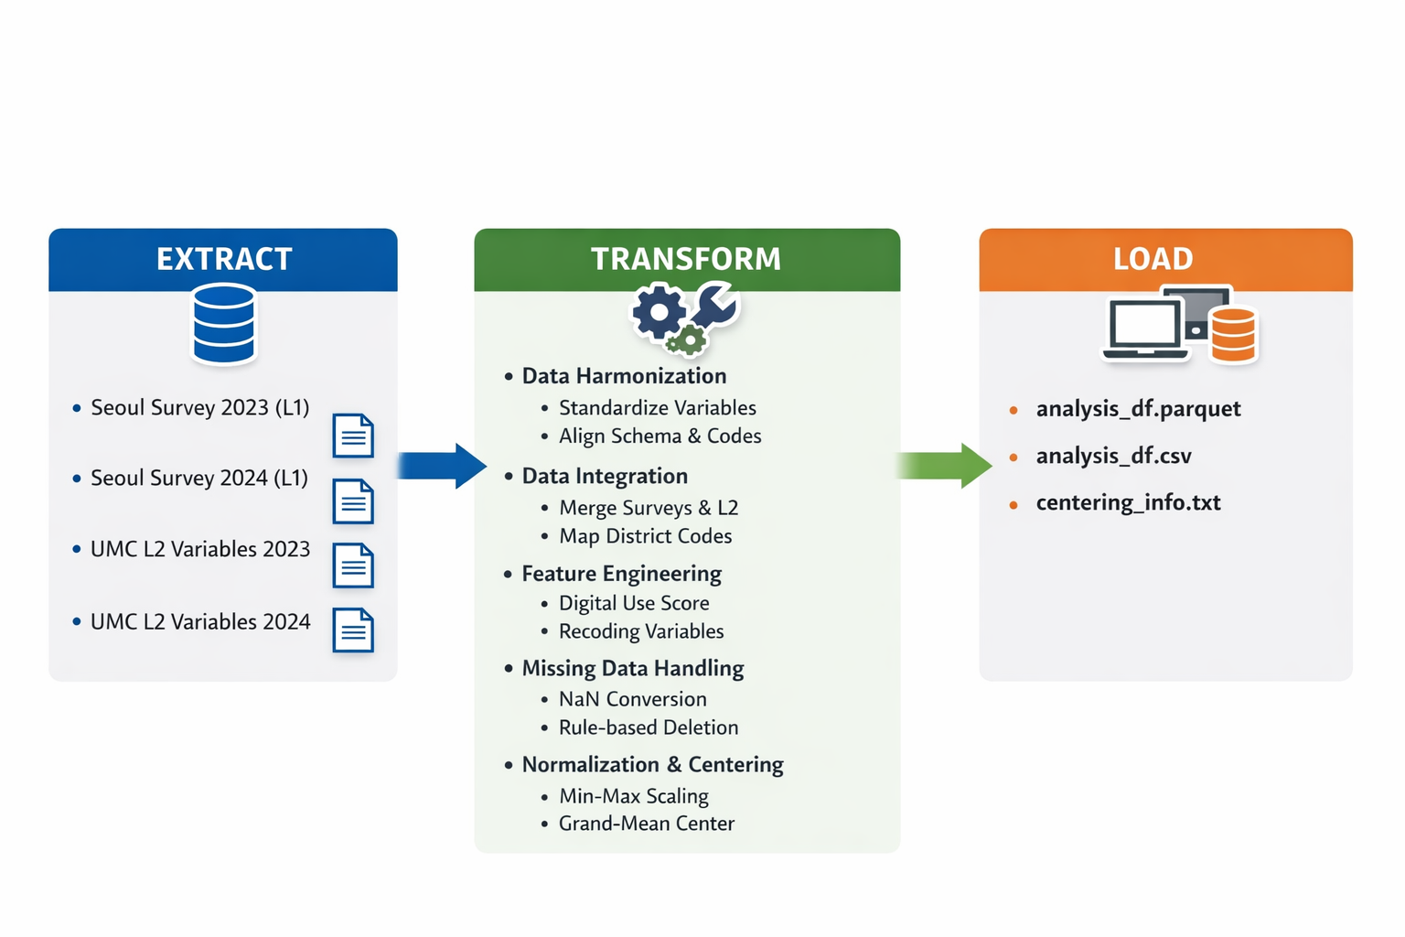
ETL Workflow
Analysis 2

Slide 20
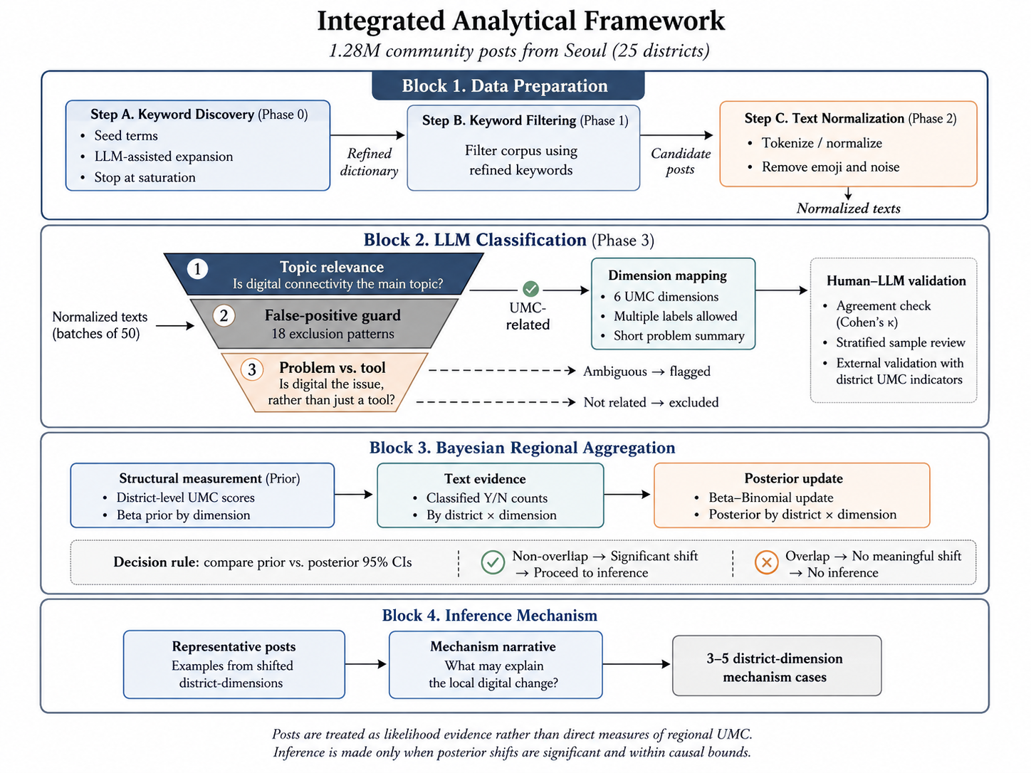
ETL Workflow
Analysis 3: Daangn Community Posts
EXTRACT
Collect clean community posts, district UMC priors, neighborhood mapping, and population context.
TRANSFORM
Screen posts with UMC keywords and score selected posts with UMC probabilities.
Map neighborhood context when available and aggregate labels to district-dimension counts.
Update measured UMC priors with text evidence using the Bayesian model setting.
LOAD
Save scored-post data, summary tables, posterior tables, and figures.

Slide 21
Others
Team Notion Page: https://www.notion.so/ITU-Data-Hackathon-2e9594c68227801ca869dab7e2428f3f?source=copy_link
Github: Will address this soon
Report_draft: Attatched File

