Slide 1

Fuzzy Controlled Adaptive Follow the Gap Obstacle Avoidance Algorithm
Bilal Yucel, Abdurrahman Yilmaz, Osman Ervan, Prof. Dr. Hakan Temeltas
19.11.2021

Slide 2

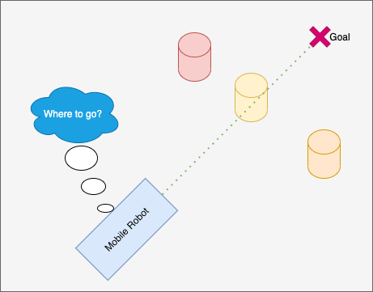

MOTIVATION
Obstacle avoidance is critical for robots
To develop a method that allows robots operate in any environment
Method shall be operatable with slow processors

Slide 3
OUTLINE
Simulation Tools
Robot Operating System(ROS)
ROS-Gazebo Environment
ROS-Rviz Monitoring Environment
Fuzzy Controlled Adaptive Follow the Gap Obstacle Avoidance Algorithm
Follow the Gap(FGM)
Improved Follow the Gap(I-FGM)
Adaptive Follow the Gap(A-FGM)
Experimental Results
Success Rate Increment
Efficiency Improvement
Outdoor Performance Test
Conclusion and Future Works

Slide 4
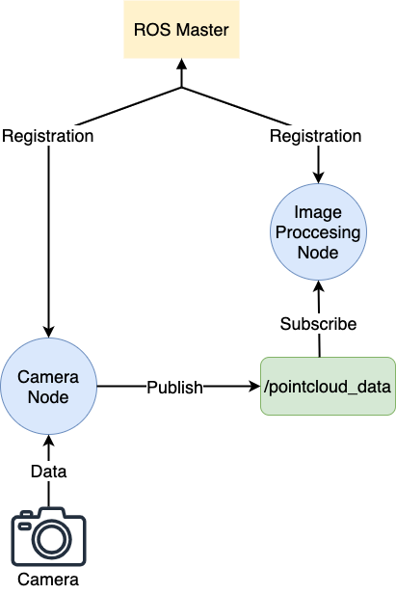
BASICS of ROS
Nodes
Executable processors
Perform tasks(Capture video, Image processings)
Architecture
Topic
Output of nodes that is published and can be subscribed
Consist of message
Message
Contains variable values
Has various types such as integer, float and boolean
Ros message types such as geometry_msgs/Twist, sensor_msgs/PointCloud

Slide 5

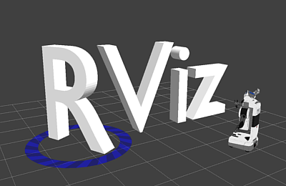

SIMULATION TOOLS
Gazebo
Rviz
Package
Modelling environments, robots and sensors
Physics Engine
Sensor data monitoring
Control and commands
Pre-build libraries

Slide 6
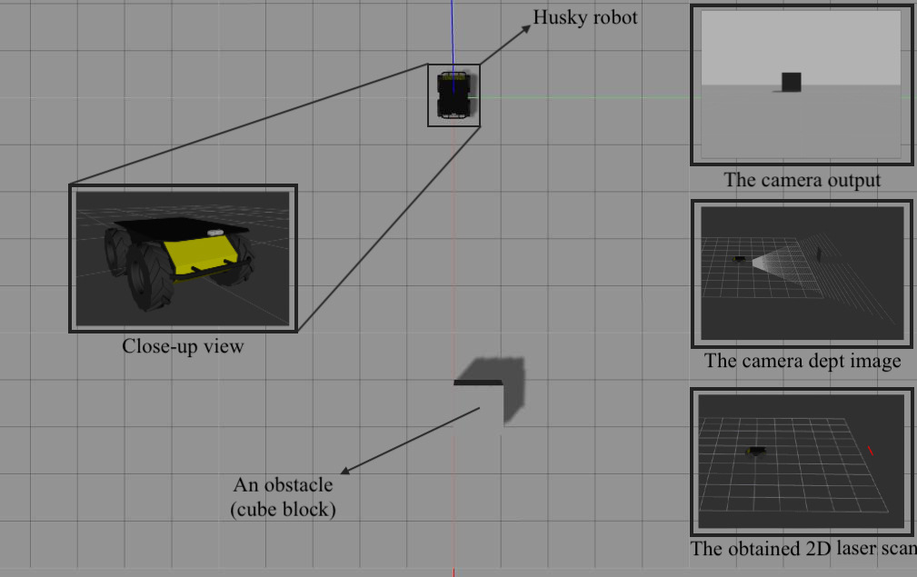
SIMULATION ENVIRONMENT
Gazebo and Rviz View
Image Processing
Camera
Dept Image
Deptimage_to_laserscan package
2D Laser Scan
Processing
Obstacle Position
Avoidance algorithm

Slide 7
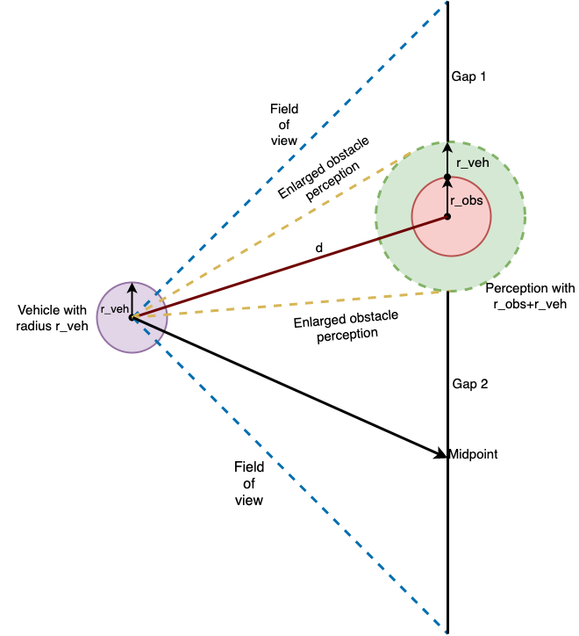
FUZZY CONTROLLED A-FGM OBSTACLE AVOIDANCE ALGORITHM
Follow the Gap Method
Priorities
Gap size
Safety
Advantages
Easy to tune
Dynamic response
No local minimum problem
Low computational Load
Disadvantages
Long trajectories
Failure of reaching goal in some cases

Slide 8
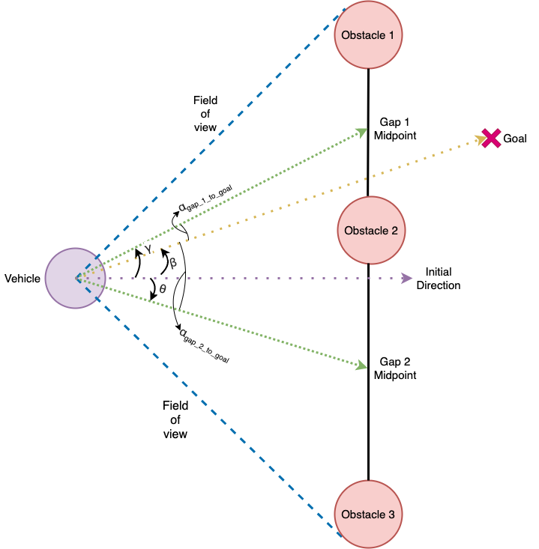


FUZZY CONTROLLED A-FGM OBSTACLE AVOIDANCE ALGORITHM
Improved Follow the Gap Method
Advantages
Shorten trajectories for some cases
Where $d_{n}$ is the minimum distance to obstacle and $θ_{gap_to_goal}$ is the angle between midpoint and goal point
Disadvantages
The average safety metric drops

Slide 9
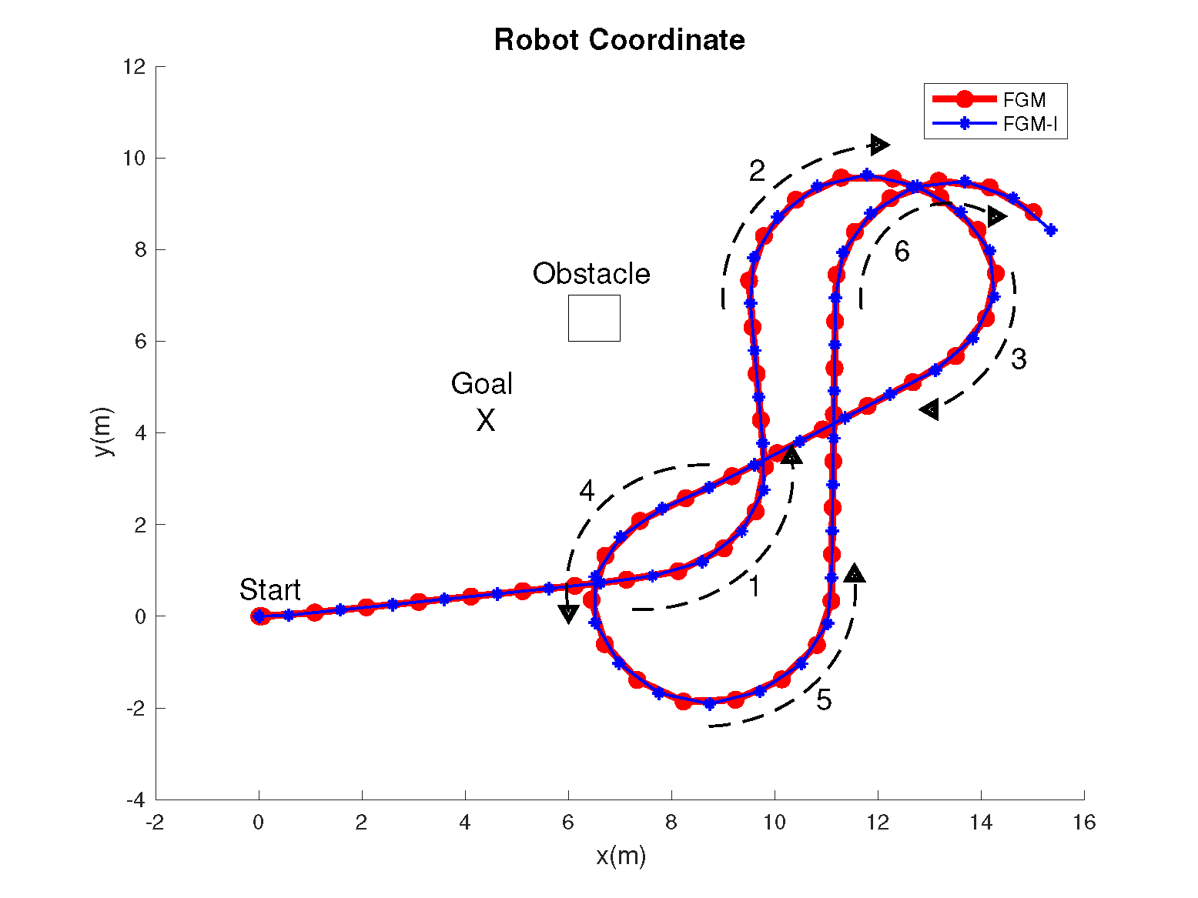
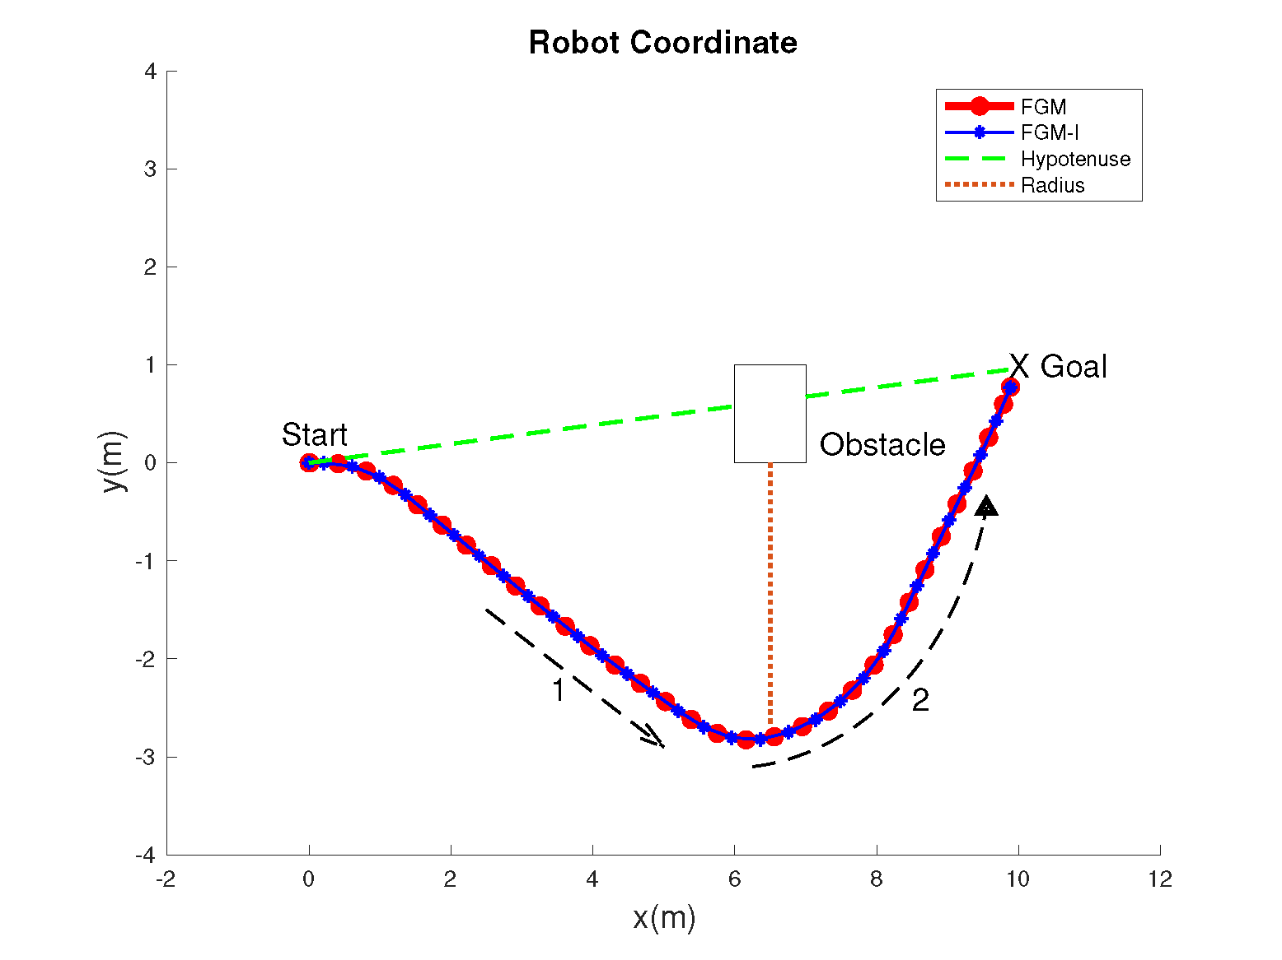
FUZZY CONTROLLED A-FGM OBSTACLE AVOIDANCE ALGORITHM
Failure of Reaching Goal
Longer Turn Radius

Slide 10
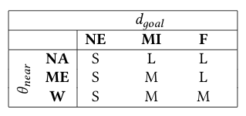
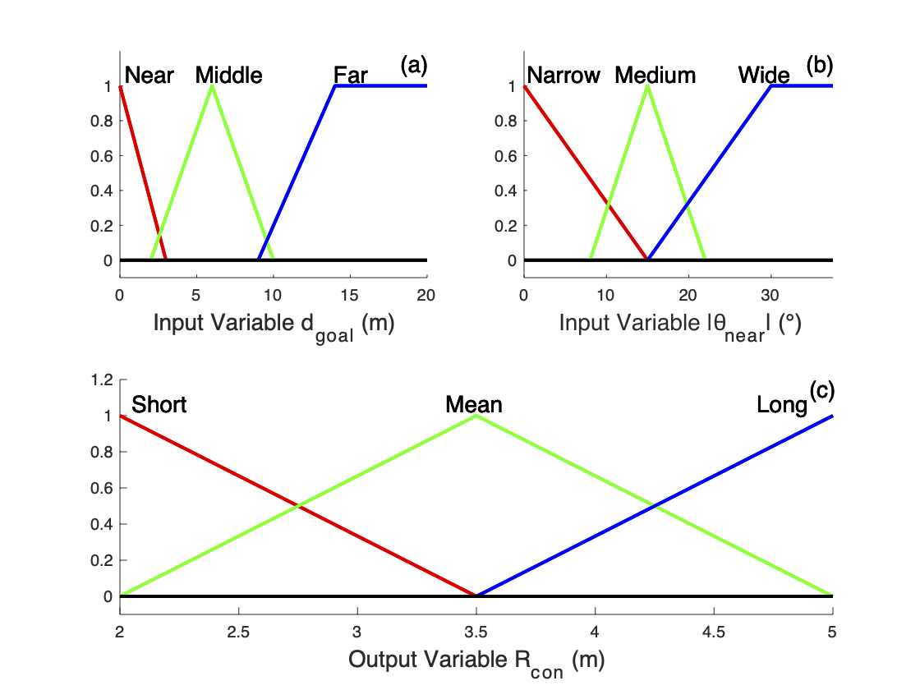

FUZZY CONTROLLED A-FGM OBSTACLE AVOIDANCE ALGORITHM
Problems
Algorithm fails when there is an obstacle near to the goal point
Early consideration of obstacles causes longer trajectories
Fuzzy Logic Rule Table and Membership Functions
NE: Near, MI: Middle, F: Far, NA: Narrow, ME: Medium, W: Wide, S: Short, M: Mean, L: Long
Solution
Tuning a consideration radius($R_{con}$) based on distance to the goal point($d_{goal}$) and angle to the nearest obstacle($θ_{near}$)

Slide 11
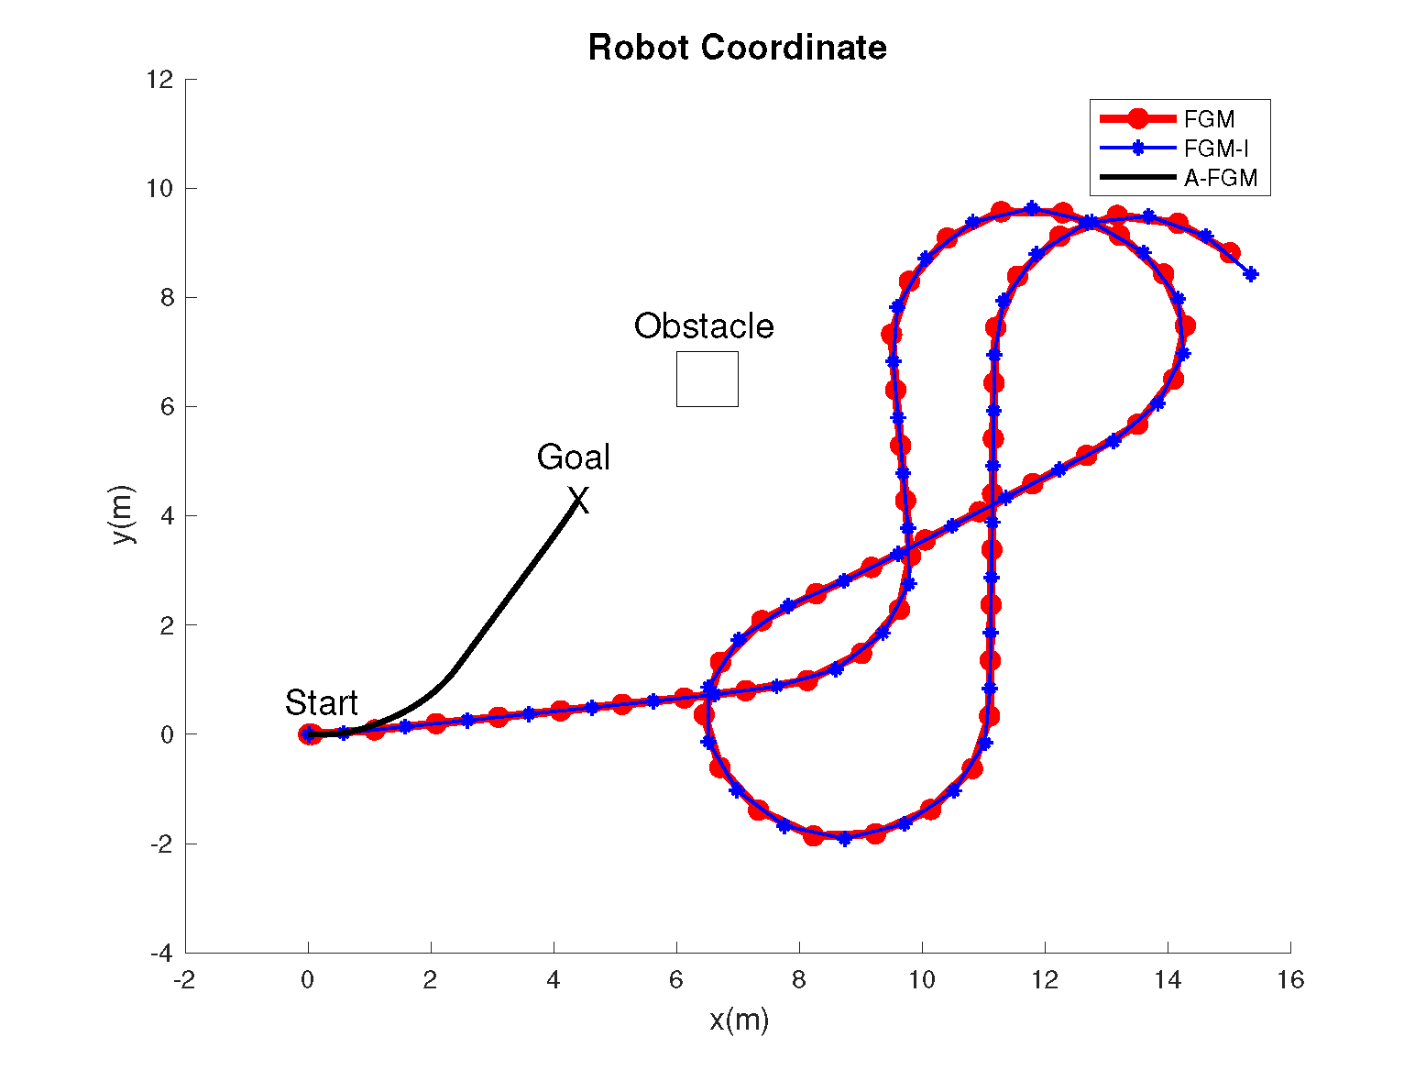
SIMULATION RESULTS
Failure of Reaching Goal
A-FGM

Slide 12
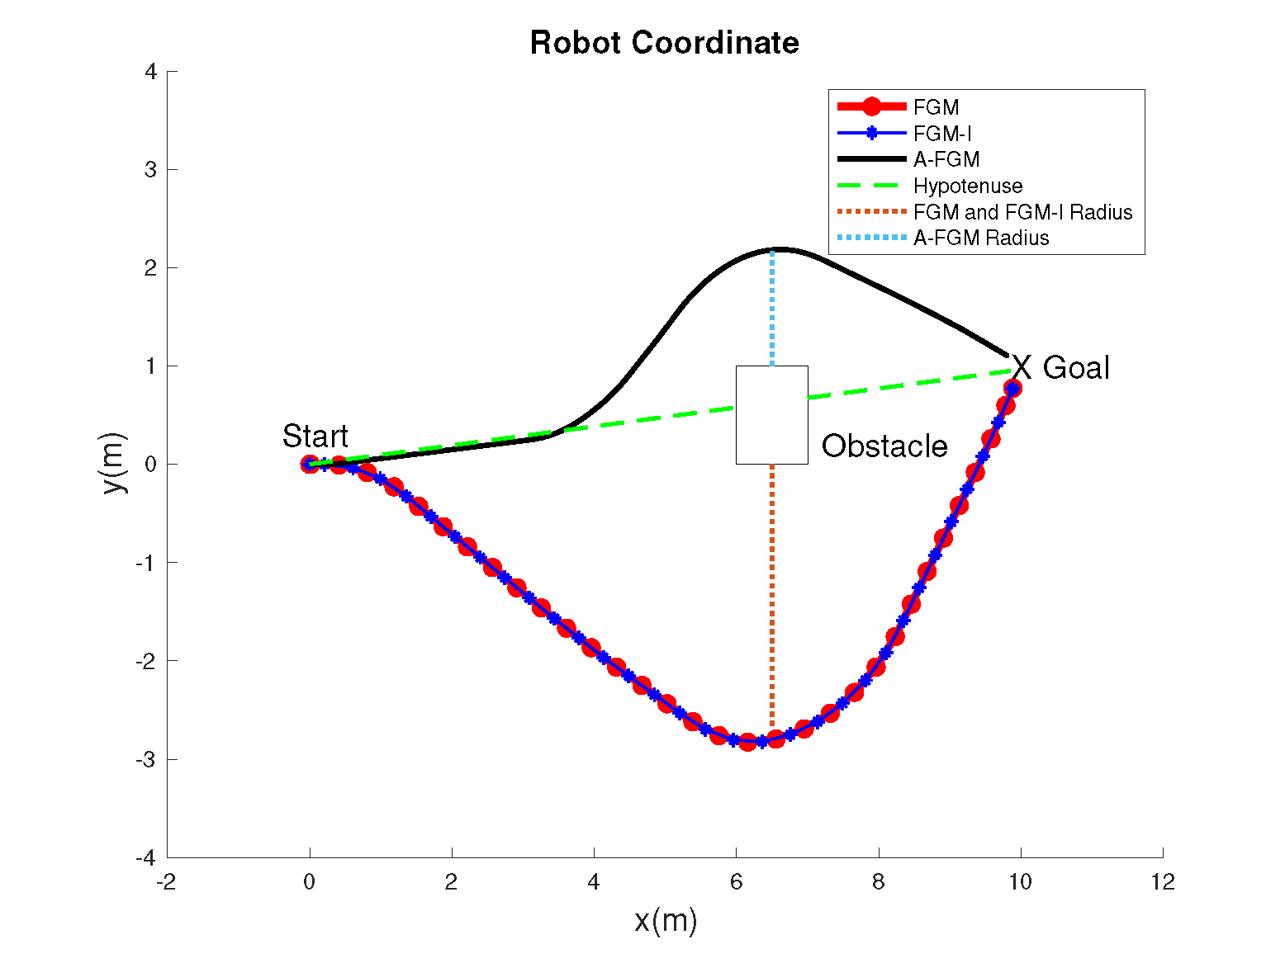
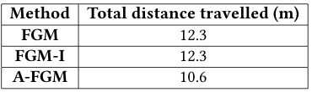

SIMULATION RESULTS
Longer Turn Radius
$$D=D+\sqrt{{(x_{c}−x_{p})}^{2}+{(y_{c}−y_{p})}^{2}}$$

Slide 13
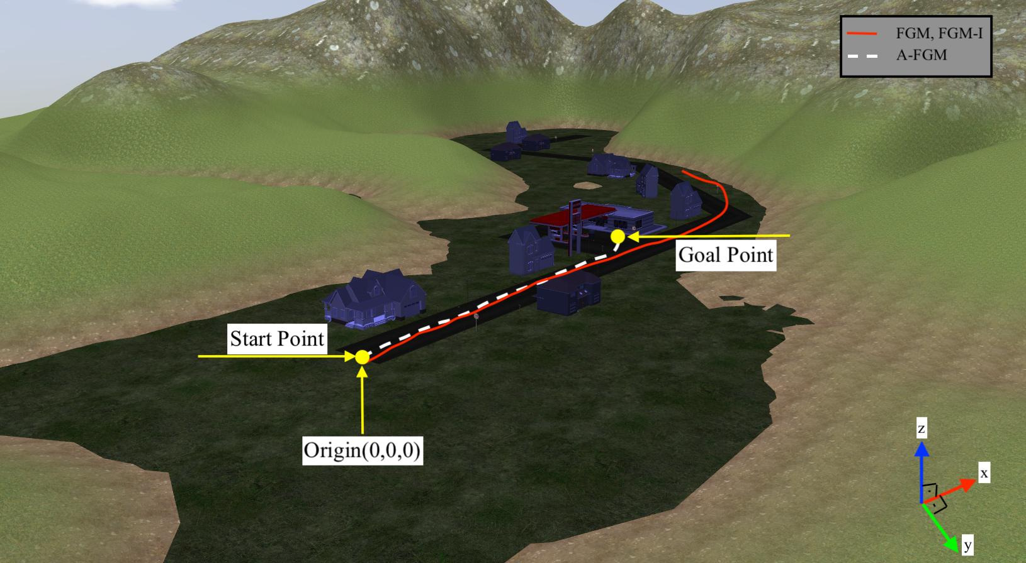
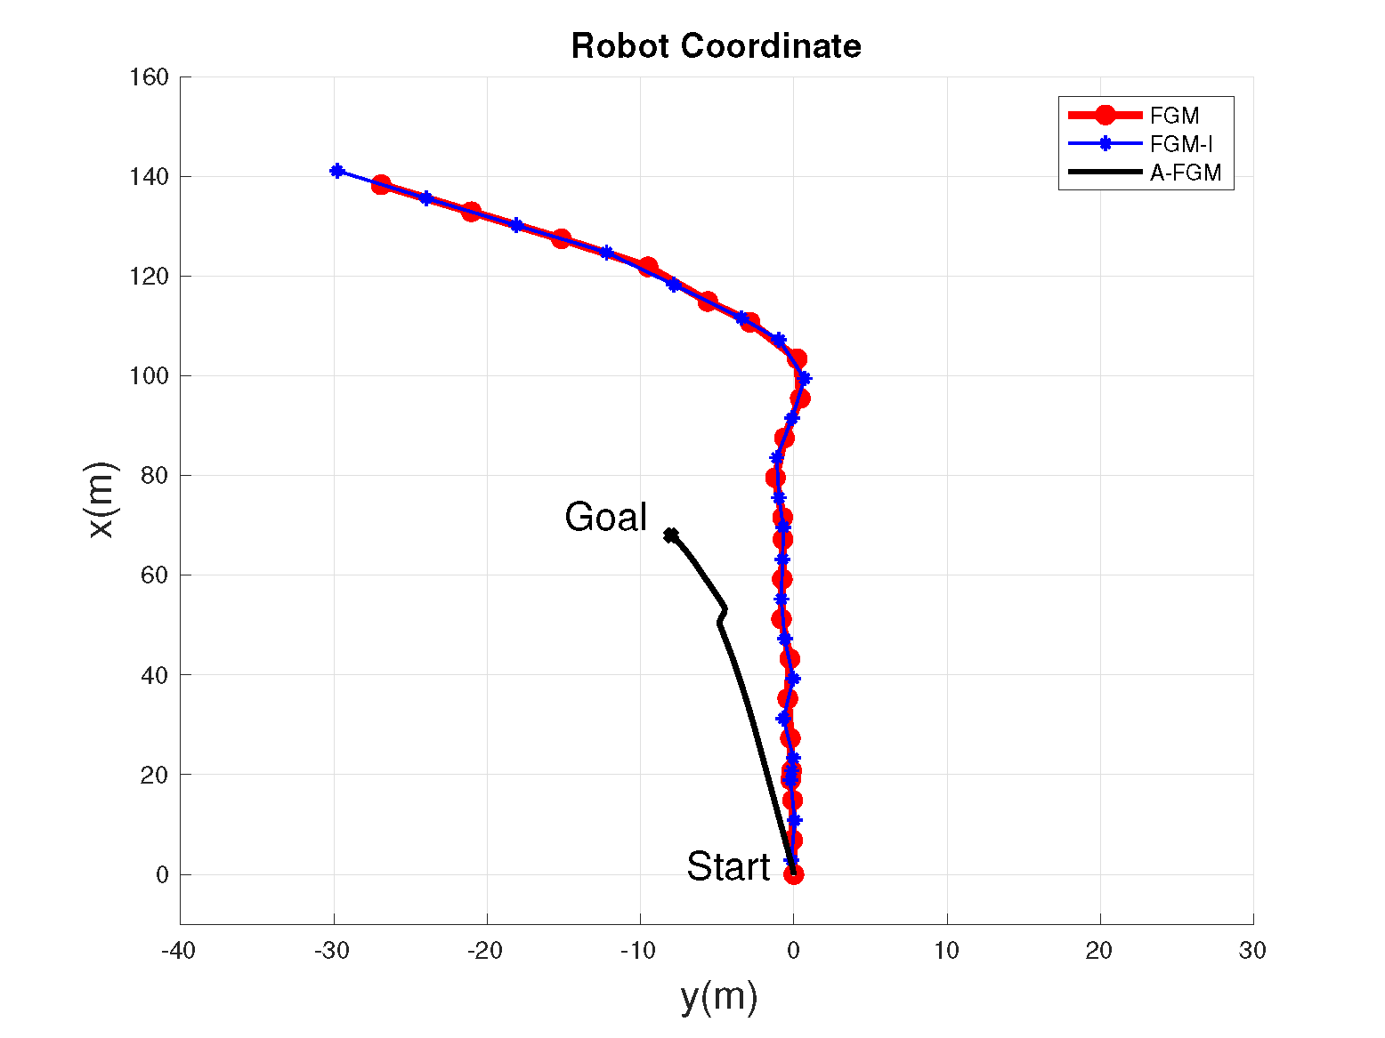
SIMULATION ENVIRONMENT
Outdoor Environment
Detailed Plot of Movement

Slide 14
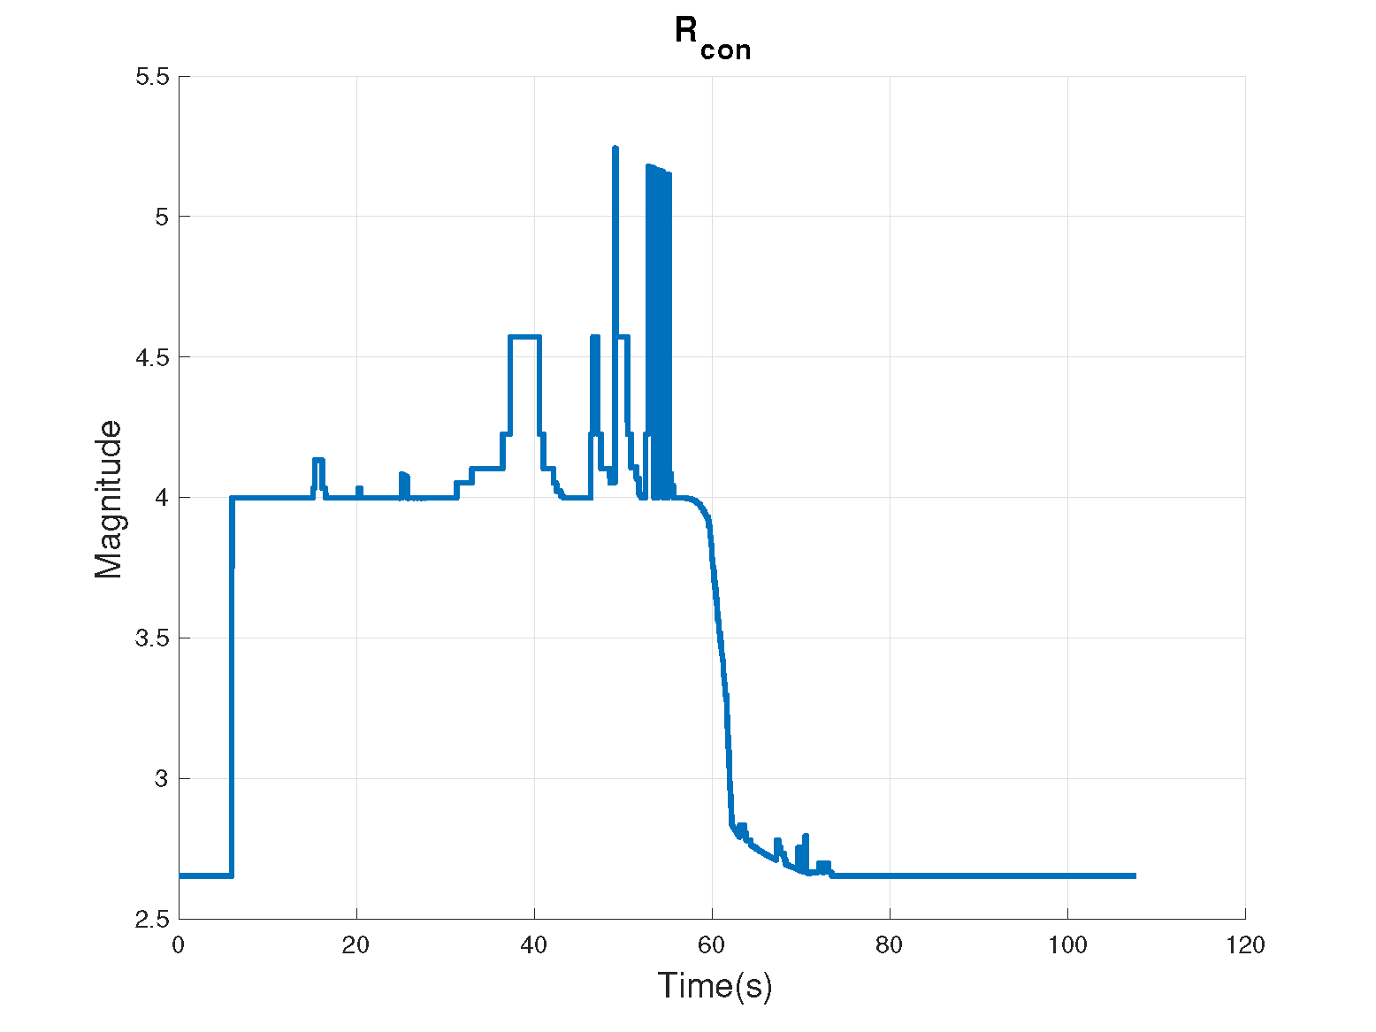
SIMULATION ENVIRONMENT
Detailed Plot of Movement
Alternation of Consideration Radius

Slide 15
CONCLUSION AND FUTURE WORK
Conclusion
The failure problem of reaching to goal when a near obstacle exists is solved
Efficiency is increased by reducing the turning radius
Outdoor success rate is improved
Future Work
Verification with simulation algorithms
Obstacle tracking can improve overall efficiency

Slide 16
Thank you for your attention!
Questions, Comments and Discussions
19.11.2021

