Slide 1
Computer Security: Principles and Practice
Chapter 8: Intrusion Detection
EECS710: Information Security
Professor Hossein Saiedian
Fall 2014
Notes:
Lecture slides prepared by Dr Lawrie Brown (UNSW@ADFA) for “Computer Security: Principles and Practice”, 1/e, by William Stallings and Lawrie Brown, Chapter 1 “Overview”.

Slide 2
Classes of intruders: criminals
Individuals or members of an organized crime group with a goal of financial reward
  Identity theft
  Theft of financial credentials
  Corporate espionage
  Data theft
  Data ransoming
Typically young, often Eastern European, Russian, or southeast Asian hackers, who do business on the Web
Meet in underground forums to trade tips and data and coordinate attacks

Slide 3
Classes of intruders: activitists
Are either individuals, usually working as insiders, or members of a larger group of outsider attackers, who are motivated by social or political causes
Also know as hacktivists
  Skill level is often quite low
Aim of their attacks is often to promote and publicize their cause typically through:
  Website defacement
  Denial of service attacks
  Theft and distribution of data that results in negative publicity or compromise of their targets

Slide 4
Intruders: state-sponsored
Groups of hackers sponsored by governments to conduct espionage or sabotage activities
Also known as Advanced Persistent Threats (APTs) due to the covert nature and persistence over extended periods involved with any attacks in this class
Widespread nature and scope of these activities by a wide range of countries from China to the USA, UK, and their intelligence allies

Slide 5
Intruders: others
Hackers with motivations other than those previously listed
Include classic hackers or crackers who are motivated by technical challenge or by peer-group esteem and reputation
Many of those responsible for discovering new categories of buffer overflow vulnerabilities could be regarded as members of this class
Given the wide availability of attack toolkits, there is a pool of “hobby hackers” using them to explore system and network security

Slide 6
Skill level: apprentice
Hackers with minimal technical skill who primarily use existing attack toolkits
They likely comprise the largest number of attackers, including many criminal and activist attackers
Given their use of existing known tools, these attackers are the easiest to defend against
Also known as “script-kiddies” due to their use of existing scripts (tools)

Slide 7
Skill level: journeyman
Hackers with sufficient technical skills to modify and extend attack toolkits to use newly discovered, or purchased, vulnerabilities
They may be able to locate new vulnerabilities to exploit that are similar to some already known
Hackers with such skills are likely found in all intruder classes
Adapt tools for use by others

Slide 8
Skill level: master
Hackers with high-level technical skills capable of discovering brand new categories of vulnerabilities
Write new powerful attack toolkits
Some of the better known classical hackers are of this level
Some are employed by state-sponsored organizations
Defending against these attacks is of the highest difficulty

Slide 9
Intruders: another classification
Masquerader: unauthorized individuals who penetrates a system
Misfeasor: legit user who accesses unauthorized data
Clandestine: seizes supervisory control

Slide 10
User and software trespass
User trespass: unauthorized logon, privilege abuse
Software trespass: virus, worm, or Trojan horse

Slide 11
Example of intrusion
Remote root compromise
Web server defacement
Guessing/cracking passwords
Copying databases containing credit card numbers
Viewing sensitive data without authorization
Running a packet sniffer
Distributing pirated software
Using an unsecured modem to access internal network
Impersonating an executive to get information
Using an unattended workstation

Slide 12
Intruder behavior
Target acquisition and information gathering
Initial access
Privilege escalation
Information gathering or system exploit
Maintaining access
Covering tracks

Slide 13
Hacker behavior example
Select target using IP lookup tools
Map network for accessible services
  study physical connectivity (via NMAP)
Identify potentially vulnerable services
Brute force (guess) passwords
Install remote administration tool
Wait for admin to log on and capture password
Use password to access remainder of network
Notes:
The techniques and behavior patterns of intruders are constantly shifting, to exploit newly discovered weaknesses and to evade detection and countermeasures. Even so, intruders typically follow one of a number of recognizable behavior patterns, and these patterns typically differ from those of ordinary users. Table 6.1a, based on [RADC04] summarizes an example of the behavior of hackers. This example is a break-in at a large financial institution. The intruder took advantage of the fact that the corporate network was running unprotected services, some of which were not even needed. In this case, the key to the break-in was the pcAnywhere application. The manufacturer, Symantec, advertises this program as a remote control solution that enables secure connection to remote devices. But the attacker had an easy time gaining access to pcAnywhere; the administrator used the same three-letter username and password for the program. In this case, there was no intrusion detection system on the 700-node corporate network. The intruder was only discovered when a vice president walked into her office and saw the cursor moving files around on her Windows workstation.

Slide 14
Criminal intruder behavior
Act quickly and precisely to make their activities harder to detect
Exploit perimeter via vulnerable ports
Use Trojan horses (hidden software) to leave back doors for re-entry
Use sniffers to capture passwords
Do not stick around until noticed
Make few or no mistakes
Notes:
Table 6.1b, based on [RADC04] summarizes examples of criminal enterprise behavior.

Slide 15
Insider intruder behavior
Create network accounts for themselves and their friends
Access accounts and applications they wouldn't normally use for their daily jobs
E-mail former and prospective employers
Conduct furtive (covert) instant-messaging chats
Visit web sites that cater to disgruntled employees, such as f*dcompany.com
Perform large downloads and file copying
Access the network during off hours
Notes:
Table 6.1c, based on [RADC04] summarizes examples of insider behavior.

Slide 16
Insider attacks
Among most difficult to detect and prevent
Employees have access & systems knowledge
May be motivated by revenge/entitlement
  When employment terminated
  Taking customer data when move to competitor
IDS/IPS may help but also need
  Least privilege, monitor logs, strong authentication, termination process to block access & take mirror image of employee’s HD (for future purposes)
Notes:
Insider attacks are among the most difficult to detect and prevent. Employees already have access and knowledge about the structure and content of corporate databases. Insider attacks can be motivated by revenge of simply a feeling of entitlement. An example of the former is the case of Kenneth Patterson, fired from his position as data communications manager for American Eagle Outfitters. Patterson disabled the company's ability to process credit card purchases during five days of the holiday season of 2002. As for a sense of entitlement, there have always been many employees who felt entitled to take extra office supplies for home use, but this now extends to corporate data. An example is that of a vice president of sales for a stock analysis firm who quit to go to a competitor. Before she left, she copied the customer database to take with her. The offender reported feeling no animus toward her former employee; she simply wanted the data because it would be useful to her.
Although IDS and IPS facilities can be useful in countering insider attacks, other more direct approaches are of higher priority. Examples include: enforcing least privilege, monitor logs, protect sensitive resources with strong authentication, on termination delete employee's computer and network access and make a mirror image of employee's hard drive before reissuing it.

Slide 17
Security intrusion & detection (RFC 2828)
Security intrusion: a security event, or combination of multiple security events, that constitutes a security incident in which an intruder gains, or attempts to gain, access to a system (or system resource) without having authorization to do so.
Intrusion detection: a security service that monitors and analyzes system events for the purpose of finding, and providing real-time or near real-time warning of attempts to access system resources in an unauthorized manner.
Notes:
The definitions shown from RFC 2828 (Internet Security Glossary) summarize the issues we are discussing.

Slide 18
Intrusion techniques
Objective to gain access or increase privileges
Initial attacks often exploit system or software vulnerabilities to execute code to get backdoor
  e.g. buffer overflow
Or to gain protected information
  Password guessing or acquisition (or via social engineering)
Notes:
The objective of the intruder is to gain access to a system or to increase the range of privileges accessible on a system. Most initial attacks use system or software vulnerabilities that allow a user to execute code that opens a back door into the system. Intruders can get access to a system by exploiting attacks such as buffer overflows on a program that runs with certain privileges. We examine such software vulnerabilities in Chapters 11 and 12.
Alternatively, the intruder attempts to acquire information that should have been protected. In some cases, this information is in the form of a user password. With knowledge of some other user's password, an intruder can log in to a system and exercise all the privileges accorded to the legitimate user. Password guessing and password acquisition techniques are discussed in Chapter 3.

Slide 19
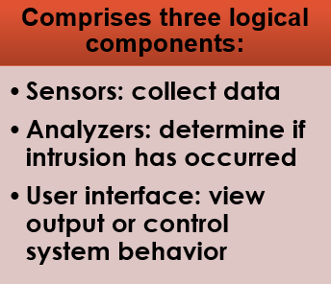
Intrusion detection systems
Host-based IDS: monitor single host activity
Network-based IDS: monitor network traffic
  Distributed or hybrid: Combines information from a number of sensors, often both host and network based, in a central analyzer that is able to better identify and respond to intrusion activity
Notes:
Intrusion detection systems (IDSs) can be classified as follows:
• Host-based IDS: monitors the characteristics of a single host and the events occurring within that host for suspicious activity
• Network-based IDS: monitors network traffic for particular network segments or devices and analyzes network, transport, and application protocols to identify suspicious activity
An IDS comprises three logical components:
• Sensors: Sensors are responsible for collecting data. The input for a sensor may be any part of a system that could contain evidence of an intrusion. Example types of input to a sensor are network packets, log files, and system call traces. Sensors collect and forward this information to the analyzer.
• Analyzers: Analyzers receive input from one or more sensors or from other analyzers. The analyzer is responsible for determining if an intrusion has occurred. The output of this component is an indication that an intrusion has occurred. The output may include evidence supporting the conclusion that an intrusion occurred. The analyzer may provide guidance about what actions to take as a result of the intrusion.
• User interface: The user interface to an IDS enables a user to view output from the system or control the behavior of the system. In some systems, the user interface may equate to a manager, director, or console component.

Slide 20
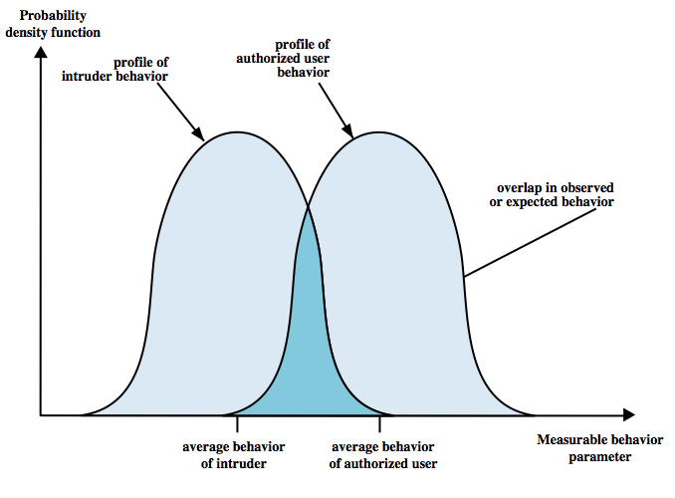
IDS principles
Assumption: intruder behavior differs from legitimate users
  Expect overlap as shown
  for legit users:
  Observe major deviations
  from past history
  Problems of:
    false positives
    false negatives
    must compromise
loose vs tight interpretation:
catch more (false +) or catch less (false -)
valid user identified as intruder
intruder not identified
Notes:
Intrusion detection is based on the assumption that the behavior of the intruder differs from that of a legitimate user in ways that can be quantified. Of course, we cannot expect that there will be a crisp, exact distinction between an attack by an intruder and the normal use of resources by an authorized user. Rather, we must expect that there will be some overlap, as shown by Figure 6.1. Patterns of legitimate user behavior can be established by observing past history, and significant deviation from such patterns can possibly be detected. Although the typical behavior of an intruder differs from the typical behavior of an authorized user, there is an overlap in these behaviors. Thus, a loose interpretation of intruder behavior, which will catch more intruders, will also lead to a number of false positives, or authorized users identified as intruders. On the other hand, an attempt to limit false positives by a tight interpretation of intruder behavior will lead to an increase in false negatives, or intruders not identified as intruders. Thus, there is an element of compromise and art in the practice of intrusion detection.

Slide 21

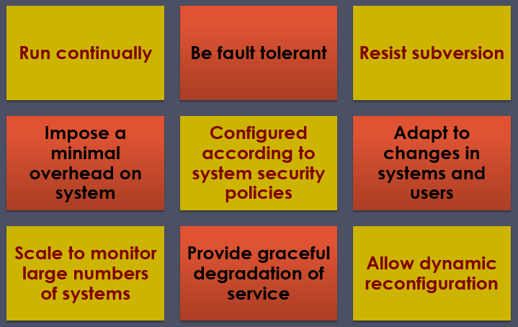
IDS requirements

Slide 22
IDS requirements
Run continually with minimal human supervision
Be fault tolerant: recover from crashes
Resist subversion: monitor itself from change by intruder
Impose a minimal overhead on system
Configured according to system security policies
Adapt to changes in systems and users
Scale to monitor large numbers of systems
Provide graceful degradation of service: if one component fails, others should continue to work
Allow dynamic reconfiguration
Notes:
[BALU98] lists the following as desirable for an IDS. It must:
• run continually with minimal human supervision.
• be fault tolerant in the sense that it must be able to recover from system crashes and reinitializations.
• resist subversion. The IDS must be able to monitor itself and detect if it has been modified by an attacker.
• impose a minimal overhead on the system where it is running.
• be able to be configured according to the security policies of the system that is being monitored.
• be able to adapt to changes in system and user behavior over time.
• be able to scale to monitor a large number of hosts.
• provide graceful degradation of service in the sense that if some components of the IDS stop working for any reason, the rest of them should be affected as little as possible.
• allow dynamic reconfiguration; that is, the ability to reconfigure the IDS without having to restart it.

Slide 23
Detection techniques
Anomaly (behavior) detection
Signature/heuristic detection

Slide 24
IDS: anomaly (behavior) detection
Involves the collection of data relating to the behavior of legitimate users over a period of time
Current observed behavior is analyzed to determine whether this behavior is that of a legitimate user or that of an intruder

Slide 25
Anomaly detection
Threshold detection
  checks excessive event occurrences over time
  alone a crude and ineffective intruder detector
  must determine both thresholds and time intervals
  lots of false positive/false negative may be possible
Profile based
  characterize past behavior of users/groups
  then detect significant deviations
  based on analysis of audit records: gather metrics
Notes:
Threshold detection involves counting the number of occurrences of a specific event type over an interval of time. If the count surpasses what is considered a reasonable number that one might expect to occur, then intrusion is assumed. Threshold analysis, by itself, is a crude and ineffective detector of even moderately sophisticated attacks. Both the threshold and the time interval must be determined. Because of the variability across users, such thresholds are likely to generate either a lot of false positives or a lot of false negatives. However, simple threshold detectors may be useful in conjunction with more sophisticated techniques.
Profile-based anomaly detection focuses on characterizing the past behavior of individual users or related groups of users and then detecting significant deviations. A profile may consist of a set of parameters, so that deviation on just a single parameter may not be sufficient in itself to signal an alert. The foundation of this approach is an analysis of audit records. The audit records provide input to the intrusion detection function in two ways. First, the designer must decide on a number of quantitative metrics that can be used to measure user behavior. Examples incude: counter, guage, interval timer, resource utilization. An analysis of audit records over a period of time can be used to determine the activity profile of the average user. Thus, the audit records serve to define typical behavior. Second, current audit records are the input used to detect intrusion. That is, the intrusion detection model analyzes incoming audit records to determine deviation from average behavior. Various tests can be performed to determine whether current activity fits within acceptable limits, such as: mean and standard deviation, multivariate model, markov process model, time series model, operational model.

Slide 26
Example of metrics
Counters: e.g., number of logins during an hour, number of times a cmd executed
Gauge: e.g., the number of outgoing messages [pkts]
Interval time: the length of time between two events, e.g., two successive logins
Resource utilization: quantity of resources used (e.g., number of pages printed)
Mean and standard deviations

Slide 27
Signature/heuristic detection
Uses a set of known malicious data patterns or attack rules that are compared with current behavior
Also known as misuse detection
Can only identify known attacks for which it has patterns or rules (signature)
  Very similar to anti-virus (requires frequent updates)
  Rule-based penetration identification
    rules identify known penetrations/weaknesses
    often by analyzing attack scripts from Internet (CERTs)

Slide 28
Example of rules in a signature detection IDS
Users should not be logged in more than one session
Users do not make copies of system, password files
Users should not read in other users’ directories
Users must not write other users’ files
Users who log after hours often access the same files they used earlier
Users do not generally open disk devices but rely on high-level OS utils

Slide 29
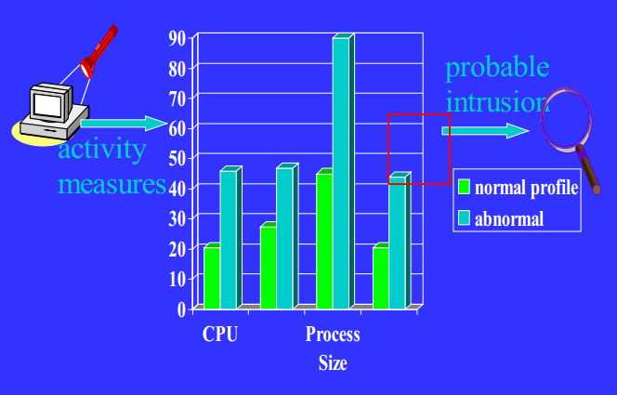
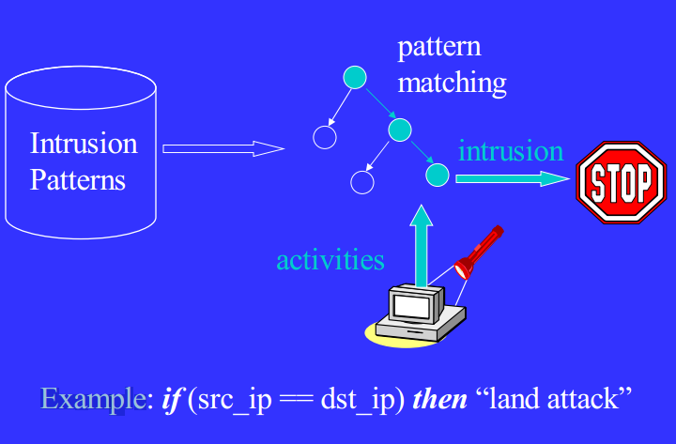
Host-based IDS: signature vs anomaly detection
Connection attempt from a reserved IP address
Attempt to copy the password file
Email containing a particular virus
File access attack on an FTP server by issuing file and directory commands to it without first logging in
drop tcp $EXTERNAL_NET any -> $HOME_NET $HTTP_PORTS (msg:"Block Baidu Spider
Notes:
Host-based IDSs add a specialized layer of security software to vulnerable or sensitive systems, that monitors activity on the system in a variety of ways to detect suspicious behavior. An IDS may be able to halt an attack before any damage is done, but its primary purpose is to detect intrusions, log suspicious events, and send alerts. The primary benefit of a host-based IDS is that it can detect both external and internal intrusions, something that is not possible either with network-based IDSs or firewalls. Host-based IDSs follow one of two general approaches to intrusion detection, though in practice, a system may employ a combination of both approaches:
Anomaly detection: Involves the collection of data relating to the behavior of legitimate users over a period of time. Then statistical tests are applied to observed behavior to determine with a high level of confidence whether that behavior is not legitimate user behavior. In essence, anomaly approaches attempt to define normal, or expected, behavior. This approach is effective against masqueraders, who are unlikely to mimic the behavior patterns of the accounts they appropriate. On the other hand, such techniques may be unable to deal with misfeasors. The following are two approaches to statistical anomaly detection:
a. Threshold detection: involves defining thresholds, independent of user, for the frequency of occurrence of various events.
b. Profile based: of activity of each user used to detect changes in user behavior.
2. Signature detection: defines a set of rules or attack patterns used to decide that a given behavior is that of an intruder. It attempts to define proper behavior and may be able to recognize events and sequences that, in context, reveal penetration.

Slide 30
Host-based IDS
Specialized software to monitor system activity to detect suspicious behavior
  primary purpose is to detect intrusions, log suspicious events, and send alerts
  can detect both external and internal intrusions
Two approaches, often used in combination:
  Anomaly detection: consider normal/expected behavior over a period of time; apply statistical tests to detect intruder
    threshold detection: for various events (#/volume of copying)
    profile based (time/duration of login)
  Signature detection: defines proper (or bad) behavior (rules)
Notes:
Host-based IDSs add a specialized layer of security software to vulnerable or sensitive systems, that monitors activity on the system in a variety of ways to detect suspicious behavior. An IDS may be able to halt an attack before any damage is done, but its primary purpose is to detect intrusions, log suspicious events, and send alerts. The primary benefit of a host-based IDS is that it can detect both external and internal intrusions, something that is not possible either with network-based IDSs or firewalls. Host-based IDSs follow one of two general approaches to intrusion detection, though in practice, a system may employ a combination of both approaches:
Anomaly detection: Involves the collection of data relating to the behavior of legitimate users over a period of time. Then statistical tests are applied to observed behavior to determine with a high level of confidence whether that behavior is not legitimate user behavior. In essence, anomaly approaches attempt to define normal, or expected, behavior. This approach is effective against masqueraders, who are unlikely to mimic the behavior patterns of the accounts they appropriate. On the other hand, such techniques may be unable to deal with misfeasors. The following are two approaches to statistical anomaly detection:
a. Threshold detection: involves defining thresholds, independent of user, for the frequency of occurrence of various events.
b. Profile based: of activity of each user used to detect changes in user behavior.
2. Signature detection: defines a set of rules or attack patterns used to decide that a given behavior is that of an intruder. It attempts to define proper behavior and may be able to recognize events and sequences that, in context, reveal penetration.

Slide 31
Audit records
A fundamental tool for intrusion detection
Two variants:
  Native audit records: provided by O/S
    always available but may not be optimum
  Detection-specific audit records: IDS specific
    additional overhead but specific to IDS task
    often log individual elementary actions
    e.g. may contain fields for: subject, action, object, exception-condition, resource-usage, time-stamp
    possible overhead (two such utilities)
Notes:
A fundamental tool for intrusion detection is the audit record. Some record of ongoing activity by users must be maintained as input to an IDS. Basically, two plans are used:
• Native audit records: Virtually all multi-user operating systems include accounting software that collects information on user activity. The advantage of using this information is that no additional collection software is needed. The disadvantage is that the native audit records may not contain the needed information or may not contain it in a convenient form.
• Detection-specific audit records: A collection facility can be implemented that generates audit records containing only that information required by the IDS. One advantage of such an approach is that it could be made vendor independent and ported to a variety of systems. The disadvantage is the extra overhead involved in having, in effect, two accounting packages running on a machine.
A good example of detection-specific audit records is one developed by Dorothy Denning [DENN87]. Each audit record contains the fields shown (see text). Most user operations are made up of a number of elementary actions. The decomposition of a user operation into elementary actions has several advantages in simplifying the tracking of activity on the system.

Slide 32
Common data sources
Common data sources include:
  System call traces
  Audit (log file) records
  File integrity checksums
  Registry access

Slide 33
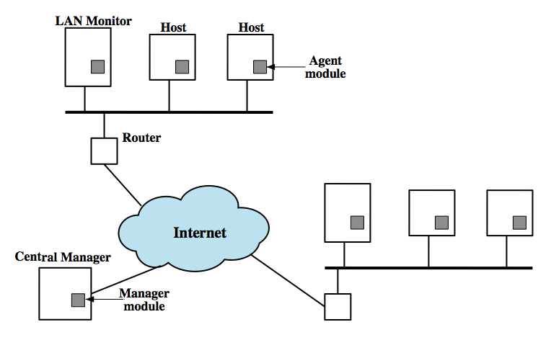
Distributed host-based IDS
* Host agent
* LAN agent (analyzes LAN traffic)
* Central manager
Notes:
Traditionally, work on host-based IDSs focused on single-system stand-alone facilities. A more effective defense of a distributed collection of hosts supported by a LAN or internetwork can be achieved by coordination and cooperation among IDSs across the network. A good example of a distributed IDS is one developed at the University of California at Davis. The scheme is designed to be independent of any operating system or system auditing implementation. Figure 6.2 here shows the overall architecture, which consists of three main components:
• Host agent module: An audit collection module operating as a background process on a monitored system. Its purpose is to collect data on security-related events on the host and transmit these to the central manager.
• LAN monitor agent module: Operates in the same fashion as a host agent module except that it analyzes LAN traffic and reports the results to the central manager.
• Central manager module: Receives reports from LAN monitor and host agents and processes and correlates these reports to detect intrusion.

Slide 34
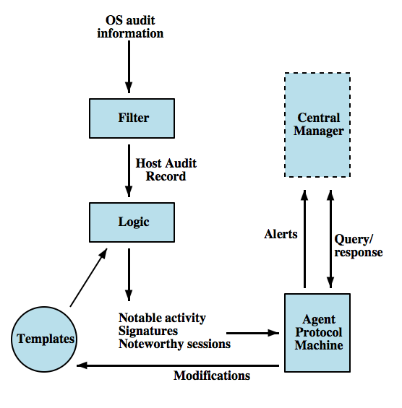
Distributed host-based IDS: agent architecture
retain only sec data,
use a std format,
host audit record
analyze for failed file access,
change to AC matrix
Analysis module:
Suspicious activity?
Send to central mgr
Notes:
Figure 6.3 shows the general approach that is taken. The agent captures each audit record produced by the native audit collection system. A filter is applied that retains only those records that are of security interest. These records are then reformatted into a standardized format referred to as the host audit record (HAR). Next, a template-driven logic module analyzes the records for suspicious activity. At the lowest level, the agent scans for notable events that are of interest independent of any past events. Examples include failed file accesses, accessing system files, and changing a file's access control. At the next higher level, the agent looks for sequences of events, such as known attack patterns (signatures). Finally, the agent looks for anomalous behavior of an individual user based on a historical profile of that user, such as number of programs executed, number of files accessed, and the like.
When suspicious activity is detected, an alert is sent to the central manager. The central manager includes an expert system that can draw inferences from received data. The manager may also query individual systems for copies of HARs to correlate with those from other agents.
The LAN monitor agent also supplies information to the central manager. The LAN monitor agent audits host-host connections, services used, and volume of traffic. It searches for significant events, such as sudden changes in network load, the use of security-related services, and network activities such as rlogin.
The architecture depicted in Figures 6.2 and 6.3 is quite general and flexible. It offers a foundation for a machine-independent approach that can expand from stand-alone intrusion detection to a system that is able to correlate activity from a number of sites and networks to detect suspicious activity that would otherwise remain undetected.

Slide 35
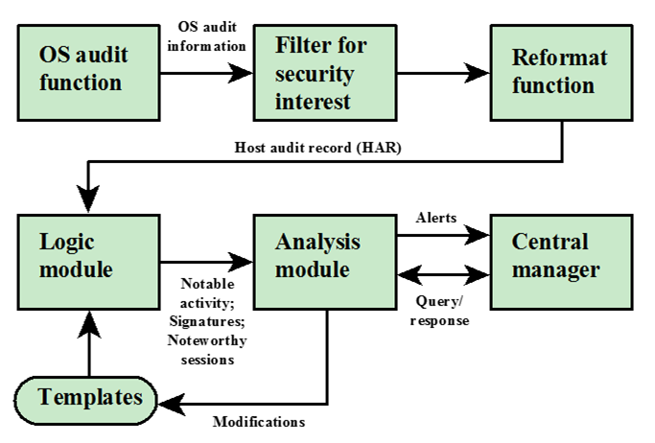
Distributed host-based IDS: agent architecture
retain only sec data,
use a std format,
host audit record
analyze for failed file access,
change to AC matrix
Analysis module:
Suspicious activity?
Send to central mgr
Notes:
Figure 6.3 shows the general approach that is taken. The agent captures each audit record produced by the native audit collection system. A filter is applied that retains only those records that are of security interest. These records are then reformatted into a standardized format referred to as the host audit record (HAR). Next, a template-driven logic module analyzes the records for suspicious activity. At the lowest level, the agent scans for notable events that are of interest independent of any past events. Examples include failed file accesses, accessing system files, and changing a file's access control. At the next higher level, the agent looks for sequences of events, such as known attack patterns (signatures). Finally, the agent looks for anomalous behavior of an individual user based on a historical profile of that user, such as number of programs executed, number of files accessed, and the like.
When suspicious activity is detected, an alert is sent to the central manager. The central manager includes an expert system that can draw inferences from received data. The manager may also query individual systems for copies of HARs to correlate with those from other agents.
The LAN monitor agent also supplies information to the central manager. The LAN monitor agent audits host-host connections, services used, and volume of traffic. It searches for significant events, such as sudden changes in network load, the use of security-related services, and network activities such as rlogin.
The architecture depicted in Figures 6.2 and 6.3 is quite general and flexible. It offers a foundation for a machine-independent approach that can expand from stand-alone intrusion detection to a system that is able to correlate activity from a number of sites and networks to detect suspicious activity that would otherwise remain undetected.

Slide 36
Network-Based IDS
Network-based IDS (NIDS)
  Monitor traffic at selected points on a network (e.g., rlogins to disabled accounts)
  In (near) real time to detect intrusion patterns
  May examine network, transport and/or application level protocol activity directed toward systems
Comprises a number of sensors
  Inline (possibly as part of other net device) – traffic passes thru it
  Passive (monitors copy of traffic)
Notes:
A network-based IDS (NIDS) monitors traffic at selected points on a network or interconnected set of networks. The NIDS examines the traffic packet by packet in real time, or close to real time, to attempt to detect intrusion patterns. The NIDS may examine network, transport and/or application level protocol activity. Note the contrast with a host-based IDS. A NIDS examined packet traffic directed toward potentially vulnerable computer systems on a network. A host-based system examines user and software activity on a host.
A typical NIDS facility includes a number of sensors to monitor packet traffic, one or more servers for NIDS management functions, and one or more management consoles for the human interface. The analysis of traffic patterns to detect intrusions may be done at the sensor, at the management server, or some combination of the two. Sensors can be deployed in one of two modes: inline and passive. An inline sensor is inserted into a network segment so that the traffic that it is monitoring must pass through the sensor, possibly by combining NIDS sensor logic with another network device (e.g. firewall, LAN switch). A passive sensor monitors a copy of network traffic; the actual traffic does not pass through the device. From the point of view of traffic flow, the passive sensor is more efficient than the inline sensor, because it does not add an extra handling step that contributes to packet delay. The sensor connects to the network transmission medium by a direct physical tap that provides the sensor with a copy of all network traffic. The network interface card (NIC) for this tap usually does not have an IP address. All traffic into this NIC is simply collected with no protocol interaction with the network. The sensor has a second NIC that connects to the network with an IP address and enables the sensor to communicate with a NIDS management server.

Slide 37
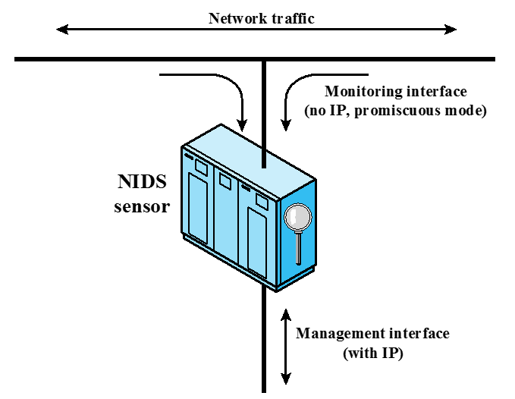
Passive sensors

Slide 38
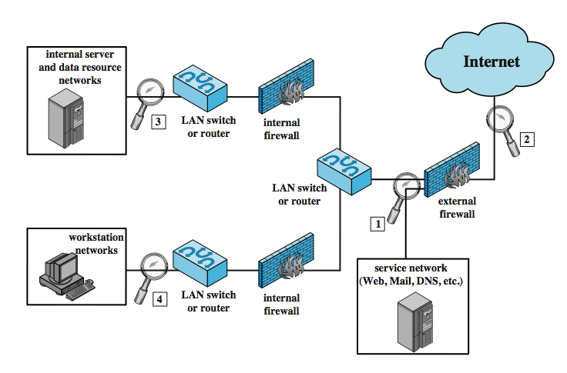
NIDS Sensor Deployment
2. monitor and documents
unfiltered packets;
more work to do
3. protect major backbones;
monitor internal/external attacks
1. monitor attacks from outside
(see attacks to servers)
4. Special IDS to provide additional protection
for critical systems (e.g., bank accounts)
Notes:
Within a single site, a key decision for the security administrator is the placement of the sensors. Figure 6.5 illustrates a number of possibilities. In general terms, this configuration is typical of larger organizations. All Internet traffic passes through an external firewall that protects the entire facility. Internal firewalls may also be used to provide more specific protection to certain parts of the network.
A common location for a NIDS sensor is just inside the external firewall (location 1 in the figure), where it can attacks, originating from the outside world. Instead of placing a NIDS sensor inside the external firewall, the security administrator may choose to place a NIDS sensor between the external firewall and the Internet or WAN (location 2). In this position, the sensor can monitor all network traffic, unfiltered. A sensor at location 2 has a higher processing burden than any sensor located elsewhere on the site network. In addition to a sensor at the boundary of the network, on either side of the external firewall, the administrator may configure a firewall and one or more sensors to protect major backbone networks, such as those that support internal servers and database resources (location 3). Thus, a sensor at location 3 is able to monitor for both internal and external attacks. Because the sensor monitors traffic to only a subset of devices at the site, it can be tuned to specific protocols and attack types, reducing the processing burden. Finally, the network facilities at a site may include separate LANs that support user workstations and servers specific to a single department. The administrator could configure a firewall and NIDS sensor to provide additional protection for all of these networks or target the protection to critical subsystems, such as personnel and financial networks (location 4). As with a sensor at location 3, a sensor at location 4 can be tuned to specific protocols and attack types, reducing the processing burden.

Slide 39
NIDS intrusion detection techniques
Signature detection
  at application (FTP), transport (port scans), network layers (ICMP); unexpected application services (host running unexpected app), policy violations (website use)
Anomaly detection
  of denial of service attacks, scanning, worms (significant traffic increase)
When potential violation detected, sensor sends an alert and logs information
  Used by analysis module to refine intrusion detection parameters and algorithms
  by security admin to improve protection
Notes:
As with host-based intrusion detection, network-based intrusion detection makes use of signature detection and anomaly detection.
Some examples suitable for signature detection include:
• Application layer reconnaissance and attacks: analyze several dozen application protocols looking for attack patterns identified as targeting these protocols.
• Transport layer reconnaissance and attacks: analyze TCP / UDP / other transport-layer protocols for unusual packet fragmentation, port scans, TCP-specific attacks etc
• Network layer reconnaissance and attacks: typically analyze IPv4, ICMP, and IGMP for spoofed IP addresses, illegal IP header values, etc
• Unexpected application services: to determine if activity consistent with protocol
• Policy violations: such as use of inappropriate Web sites,use forbidden protocols etc
Some examples of types of attacks suitable for anomaly detection are:
• Denial of service (DoS) attacks: involve either significantly increased packet traffic or significantly increase connection attempts, to overwhelm the target system.
• Scanning: occurs when an attacker probes a target network or system by sending different kinds of packets to learn many of the system’s characteristics/vulnerabilities.
• Worms: detected because of use of large amounts of bandwidth, or because they can cause hosts to communicate with other hosts/ports not typically seen.
When a sensor detects a potential violation it sends an alert and logs information related to the event. The NIDS analysis module uses this to refine intrusion detection parameters and algorithms, and by the security admin to design prevention techniques.

Slide 40
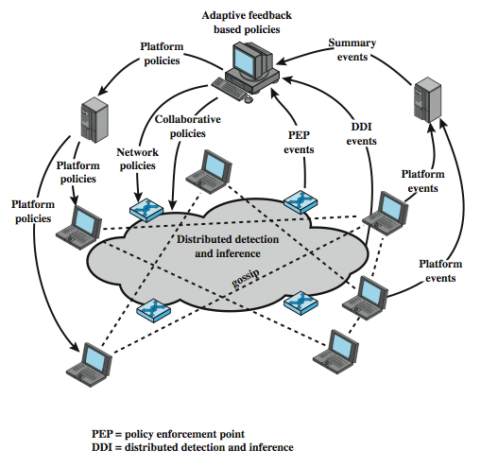
Distributed hybrid intrusion detection (host-based, NIDS, distributed host-based)
Issues:
1. Tools may not recognize new threats
2. Difficult to deal with rapidly spreading attacks
Solution:
Distributed Adaptive IDS thru
Peer-to-peer gossip and cooperation
One developed by Intel
Notes:
In recent years, the concept of communicating IDSs has evolved to schemes that involve distributed systems that cooperate to identify intrusions and to adapt to changing attack profiles. Two key problems have always confronted systems such as IDSs, firewalls, virus and worm detectors etc. First,these tools may not recognize new threats or radical modifications of existing threats. And second, it is difficult to update schemes rapidly enough to deal with rapidly spreading attacks. Attackers have exploited these problems. A way to counter such attacks is to develop cooperated systems that can recognize attacks based on more subtle clues and then adapt quickly. In this approach, anomaly detectors at local nodes look for evidence of unusual activity. The local node then uses a peer-to-peer “gossip” protocols to inform other machines of its suspicion, in the form of a probability that the network is under attack. If a machine receives enough of these messages so that a threshold is exceeded, the machine assumes an attack is under way and responds. The machine may respond locally to defend itself and also send an alert to a central system.
An example of this approach is a scheme developed by Intel and referred to as autonomic enterprise security, as shown in Figure 6.6. In this approach each end host and network device is a potential sensor and may have the sensor software module installed. The sensors can exchange information to corroborate the state of the network (i.e. whether an attack is under way). A central system is configured with a default set of security policies. Based on input from distributed sensors, these policies are adapted and specific actions are communicated to the various platforms in the distributed system. The device-specific policies may include immediate actions to take or parameter settings to be adjusted. The central system also communicates policies to platforms that adjust the timing/content of collaborative gossip messages.

Slide 41
Logging of alerts (for all types)
Typical information logged by a NIDS sensor includes:
  Timestamp
  Connection or session ID
  Event or alert type
  Rating
  Network, transport, and application layer protocols
  Source and destination IP addresses
  Source and destination TCP or UDP ports, or ICMP types and codes
  Number of bytes transmitted over the connection
  Decoded payload data, such as application requests and responses
  State-related information

Slide 42
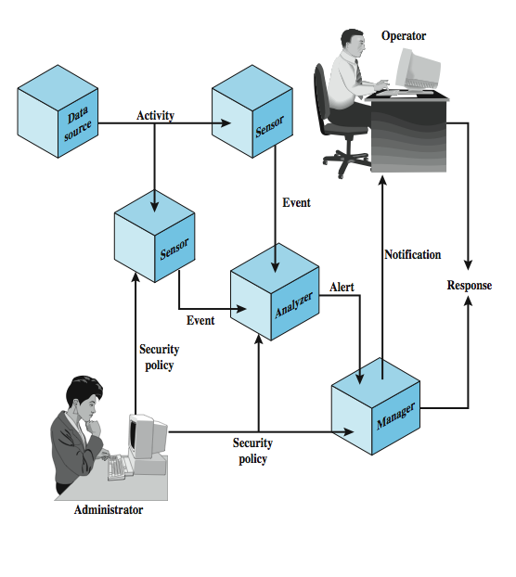
Intrusion detection exchange format
To facilitate development
of a distributed IDS
Not a product, but a proposed
IETF standard
Key elements
Data source: raw data from an IDS
Sensor: collect and forward events
Analyzer: process data
Administrator defines sec policy
Manager: a process for operator to
manage the IDS system
Operator: the user of the Manager
Example of a response:
log an activity
Notes:
To facilitate the development of distributed IDSs that can function across a wide range of platforms and environments, standards are needed to support interoperability. Such standards are the focus of the IETF Intrusion Detection Working Group. Figure 6.7 illustrates the key elements of the model on which the intrusion detection message exchange approach is based. This model does not correspond to any particular product or implementation, but its functional components are the key elements of any IDS. The specification defines formats for event and alter messages, message types, and exchange protocols for communication of intrusion detection information. The functional components are as follows:
Data source: raw data an IDS uses to detect unauthorized or undesired activity
Sensor: collects data from the data source & forwards events to the analyzer
Analyzer: process analyzing data collected for unauthorized/undesired activity
Administrator: human with overall responsibility for setting security policy of org
Manager: process from which operator manages components of ID system
Operator: human that is the primary user of the IDS manager
The sensor monitors data sources looking for suspicious activity. The sensor communicates suspicious activity to the analyzer as an event. If the analyzer determines that the event is of interest, it sends an alert to the manager component. The manager component issues a notification to the human operator. A response can be initiated automatically by the manager component or by the human operator. The security policy is the predefined, formally documented statement that defines what activities are allowed to take place.

Slide 43
Honeypots
Decoy systems
  Filled with fabricated info and instrumented with monitors/event loggers
  Lure a potential attacker away from critical systems
  Collect information about the attacker’s activity
  Encourage the attacker to stay on the system long enough for administrators to respond
  Divert and hold attacker to collect activity info without exposing production systems
Initially were single systems
More recently are/emulate entire networks
Notes:
A relatively recent innovation in intrusion detection technology is the honeypot. Honeypots are decoy systems that are designed to lure a potential attacker away from critical systems. Honeypots are designed to divert an attacker from accessing critical systems, collect information about the attacker’s activity, and to encourage the attacker to stay on the system long enough for administrators to respond. These systems are filled with fabricated information designed to appear valuable but that a legitimate user of the system wouldn’t access. Thus, any access to the honeypot is suspect. The system is instrumented with sensitive monitors and event loggers that detect these accesses and collect information about the attacker’s activities. Because any attack against the honeypot is made to seem successful, administrators have time to mobilize and log and track the attacker without ever exposing productive systems. Initial efforts involved a single honeypot computer with IP addresses designed to attract hackers. More recent research has focused on building entire honeypot networks that emulate an enterprise, possibly with actual or simulated traffic and data. Once hackers are within the network, administrators can observe their behavior in detail and figure out defenses.

Slide 44
Honeypot classification
Low interaction honeypot
  Consists of a software package that emulates particular IT services or systems well enough to provide a realistic initial interaction, but does not execute a full version of those services or systems
  Provides a less realistic target
  Often sufficient for use as a component of a distributed IDS to warn of imminent attack
High interaction honeypot
  A real system, with a full operating system, services and applications, which are instrumented and deployed where they can be accessed by attackers

Slide 45
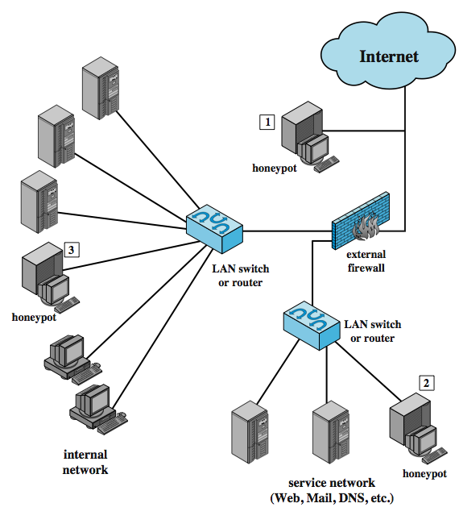
Honeypot deployment
1. Tracks attempts to connect
to an unused IP address; can’t help with inside attackers
3. Full internal honeypot; can detect internal attacks
2. In DMZ; must make sure the other
systems in the DMZ are secure; firewalls
may block traffic to the honeypot
Notes:
Honeypots can be deployed in a variety of locations, as shown in Figure 6.6. The location depends on a number of factors, such as the type of information the organization is interested in gathering and the level of risk that organizations can tolerate to obtain the maximum amount of data. A honeypot outside the external firewall (location 1) is useful for tracking attempts to connect to unused IP addresses within the scope of the network. A honeypot at this location does not increase the risk for the internal network. The disadvantage of an external honeypot is that it has little or no ability to trap internal attackers, especially if the external firewall filters traffic in both directions. The DMZ is another candidate for locating a honeypot (location 2). The security administrator must assure that the other systems in the DMZ are secure against any activity generated by the honeypot. A disadvantage of this location is that a typical DMZ is not fully accessible, and the firewall typically blocks traffic to the DMZ the attempts to access unneeded services. Thus, the firewall either has to open up the traffic beyond what is permissible, which is risky, or limit the effectiveness of the honeypot. A fully internal honeypot (location 3) has several advantages in that it can catch internal attacks, and can also detect a misconfigured firewall that forwards impermissible traffic from the Internet to the internal network. There are several disadvantages. The most serious of these is if the honeypot is compromised so that it can attack other internal systems. Any further traffic from the Internet to the attacker is not blocked by the firewall because it is regarded as traffic to the honeypot only. Another difficult for this honeypot location is, as with location 2, the firewall must adjust its filtering to allow traffic to the honeypot, complicating firewall configuration and potentially compromising the internal network.

Slide 46
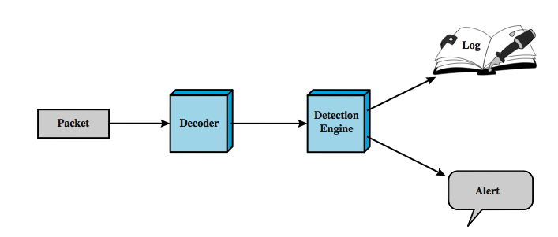
Snort IDS
Lightweight IDS
  Open source (rule-based)
  Real-time packet capture and rule analysis
  Passive or inline
  Components: decoder, detector, logger, alerter
processes captured
packets to identify
and isolate
intrusion
detection
work
Notes:
Snort is an open source, highly configurable and portable host-based or network-based IDS. Snort is referred to as a lightweight IDS. Snort can perform real-time packet capture, protocol analysis, and content searching and matching. Snort can detect a variety of attacks and probes, based on a set of rules configured by a system administrator. A Snort implementation can be configured as a passive sensor, which monitors traffic but is not in the main transmission path of the traffic, or an inline sensor. In the latter case, Snort can perform intrusion prevention as well as intrusion detection.
A Snort installation consists of four logical components, shown here in Figure 6.7:
• Packet Decoder: efficiently processes each captured packet to identify and isolate protocol headers at the data link, network, transport, and application layers.
• Detection Engine: does actual work of intrusion detection, analyzing each packet using rules defined for this configuration of Snort by the security administrator.
• Logger: of each packet that matches a rule, if specified. The security administrator can then use the log file for later analysis.
• Alerter: can be sent for each detected packet to a file, a UNIX socket, or a database.

Slide 47
SNORT Rules
Use a simple, flexible rule definition language
Fixed header and zero or more options
Deader includes: action, protocol, source IP, source port, direction, dest IP, dest port
Many options
Example rule to detect TCP SYN-FIN attack:
  alert tcp $EXTERNAL_NET any -> $HOME_NET any \
  (msg: "SCAN SYN FIN"; flags: SF, 12; \
  reference: arachnids, 198; classtype: attempted-recon;)
  detects an attack at the TCP level; $strings are variables with defined values; any source or dest port is considered; checks to see if SYN and FIN bits are set
Notes:
Snort uses a simple, flexible rule definition language that generates the rules used by the detection engine. Although the rules are simple and straightforward to write, they are powerful enough to detect a wide variety of hostile or suspicious traffic. Each rule consists of a fixed header and zero or more options. The header includes:
• Action: tells Snort what to do when it finds a packet that matches the rule criteria (alert, log, pass, activate, dynamic, drop, reject, sdrop)
• Protocol: if packet protocol matches this field then analysis proceeds
• Source IP address: source of packet
• Source port: for the specified protocol (e.g.,a TCP port).
• Direction: unidirectional (->) or bidirectional (<->).
• Destination IP address: destination of packet.
• Destination port
Following the rule header may be one or more rule options. Each option consists of an option keyword, which defines the option; followed by arguments, which specify the details of the option. Table 6.5 in the text gives examples of options in each category.
The example shown of a Snort rule checks detects a type of attack at the TCP level known as a SYN-FIN attack. It has specified source and destination networks, and checks if the SYN and the FIN bits are set, ignoring reserved bit 1 and reserved bit 2 in the flags octet. The reference option refers to an external definition of this attack, which is of type attempted-recon.

Slide 48
Summary
Introduced intruders & intrusion detection
  Hackers, criminals, insiders
Intrusion detection approaches
  Host-based (single and distributed)
  Network
  Distributed adaptive
Honeypots
Snort example
Notes:
Chapter 6 summary.

