Slide 1
Simple Weather
Reply time:2017.12 Members:Wei He,Hongyang Chen

Slide 2
CONTENTS
1.Overview
4.Test
Introduction of the application
How we test this application
2.Complex Part
5.Extra
About the most complex part in the application
About extra points
3.Difficult
6.Future
Development difficulties encountered
How to optimize this app and add more features

Slide 3
01
Overview
This app mainly divided into these few parts:
WeatherScreen, SelectCityScreen, SettingScreen, AboutScreen

Slide 4

Overview
Brief Introduction
Simple weather, a weather information query software,
user-friendly design, easy to use,
support for more than 3,000 cities and regions in China weather inquiries, forecast every three hours.
Provide 7-day weather forecast,air quality live,8 life index.
Help users make better life decisions, calmly deal with all kinds of weather conditions.

Slide 5
Overview
WeatherScreen
WeatherScreen is Weather main interface, There are 4 main points:
Show 24 hours of the day weather, and the next seven days weather
Show real-time air quality
Show some weather suggestions
Can be done manually refresh

Slide 6
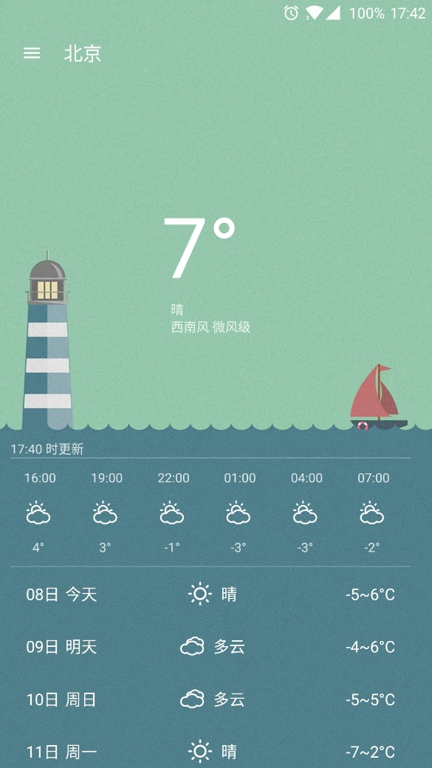
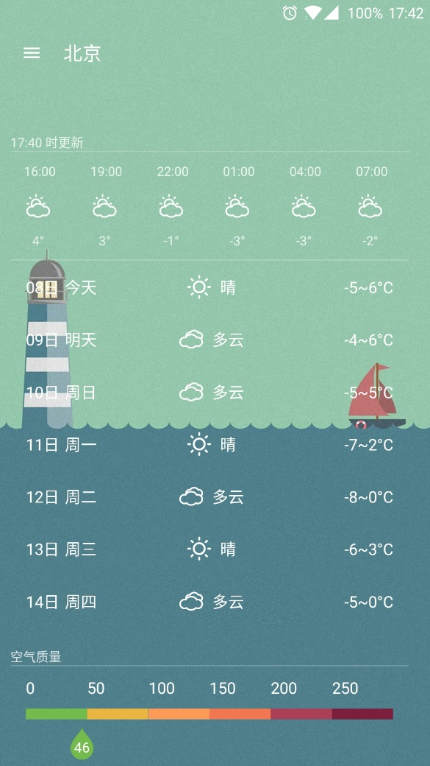
Overview
WeatherScreen
The first part is
real-time weather and
the next 7 days weather forecast

Slide 7
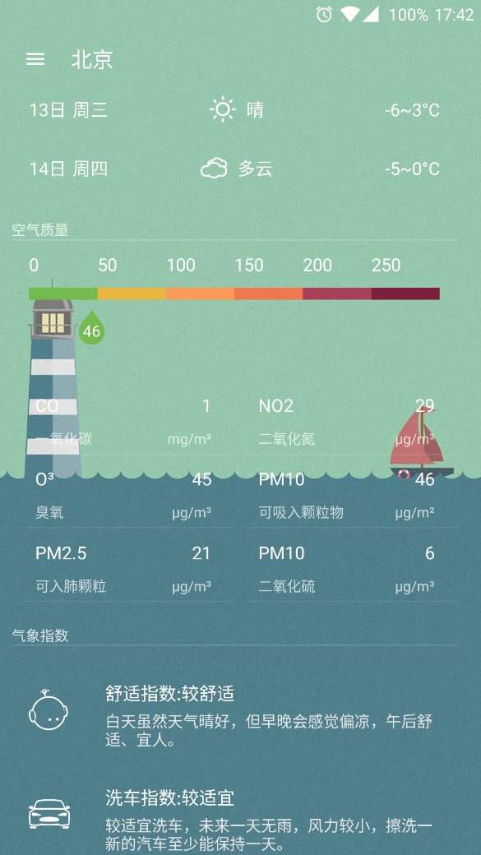
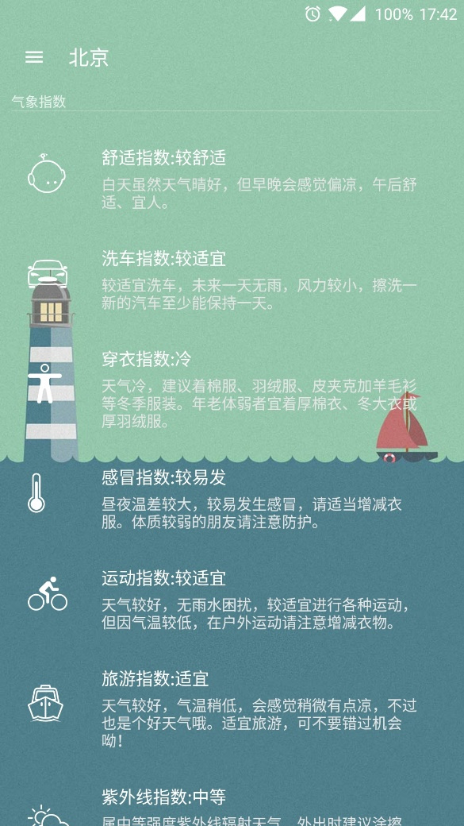
Overview
WeatherScreen
The second part is
the air quality report
The third part is
the life index and
some life suggestions

Slide 8
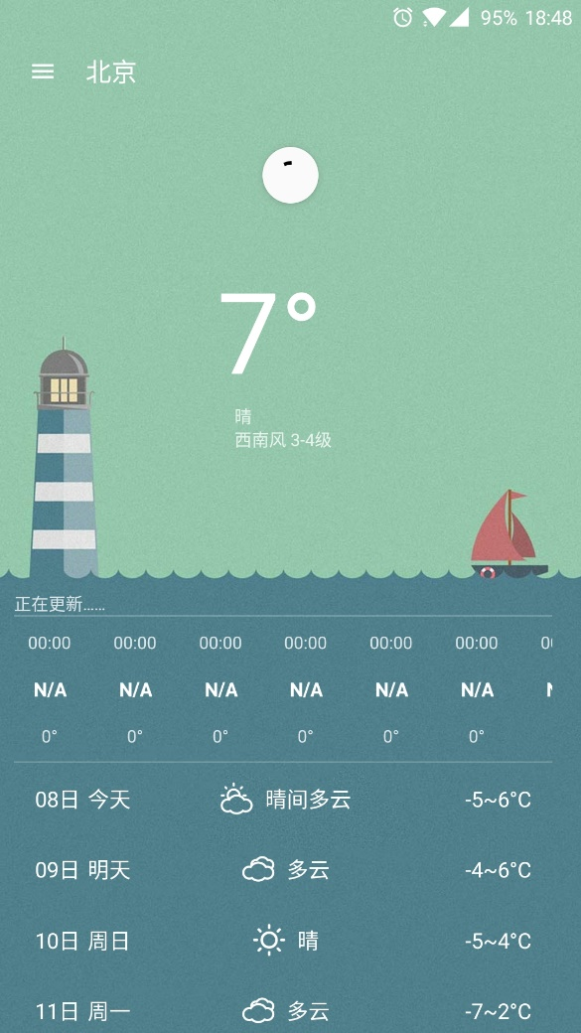
Overview
WeatherScreen
When you slide down at the top, you can refresh the weather data manually.

Slide 9
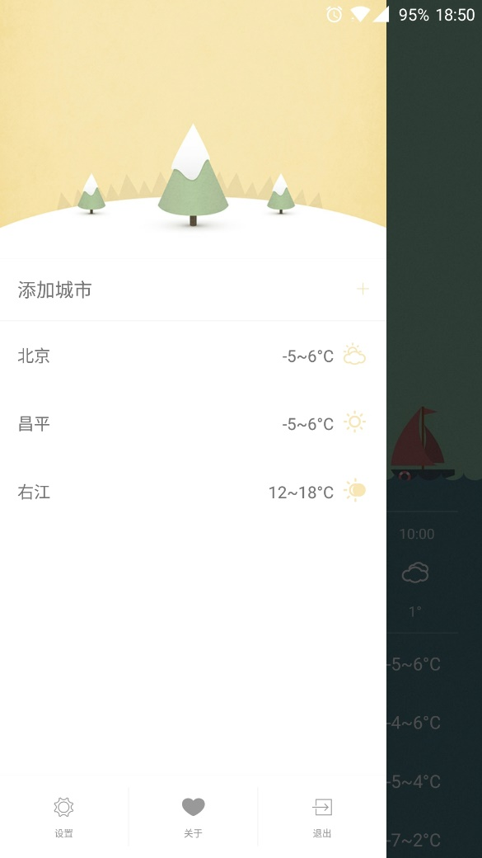
Overview
SelectCityScreen
Swipe to the right in the main interface to open the sidebar and enter the city selection screen. In this interface, you can switch to any added city

Slide 10
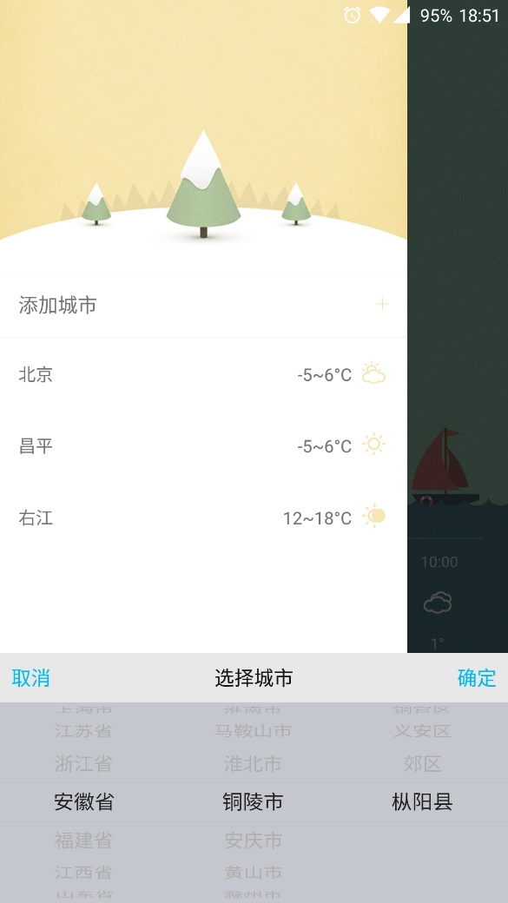
Overview
SelectCityScreen
Touch the 'Add City' button
to add any city supported by the software into the city list
add city

Slide 11
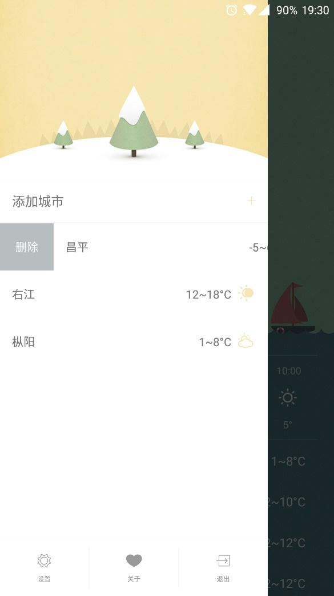
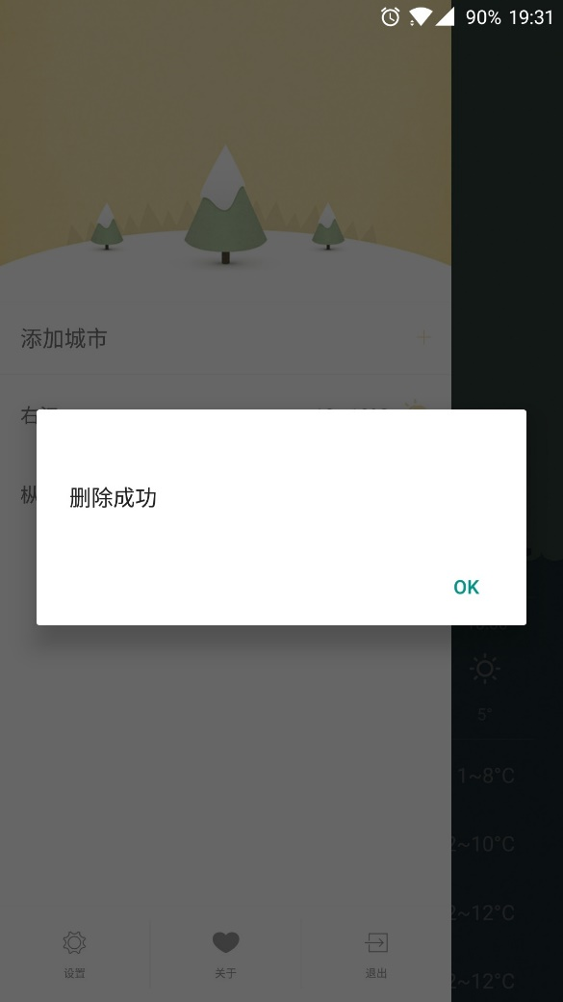
Overview
SelectCityScreen
Swipe to the right on the city name to display the delete button.
Press the delete button to delete the city item.

Slide 12
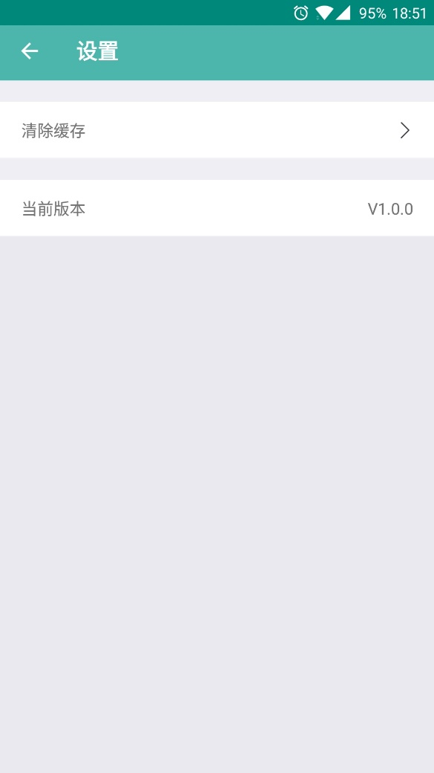
Overview
SettingScreen
In the sidebar, press 'Settings' to enter the settings page.
The Settings page has two functions:
Clear the cache
View the current version of the app and check for updates

Slide 13
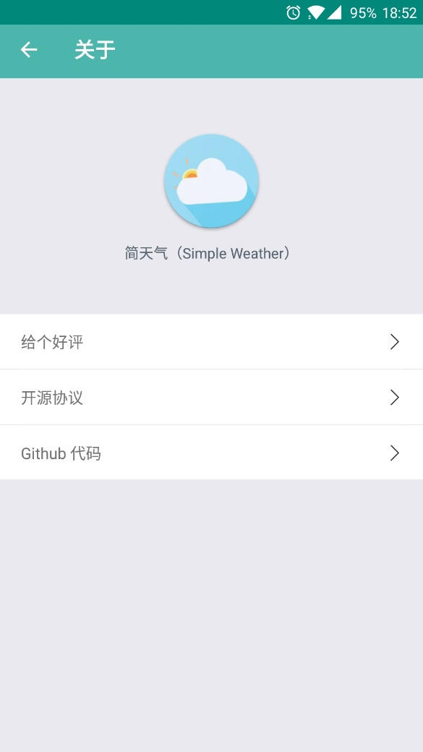
Overview
AboutScreen
Press 'About' in the sidebar to get to the about page,
In the about page, you can
Praise the app in the app market
See the open source agreement
See the github code

Slide 14
02
Complex Part
We think the most complicated part of this application

Slide 15
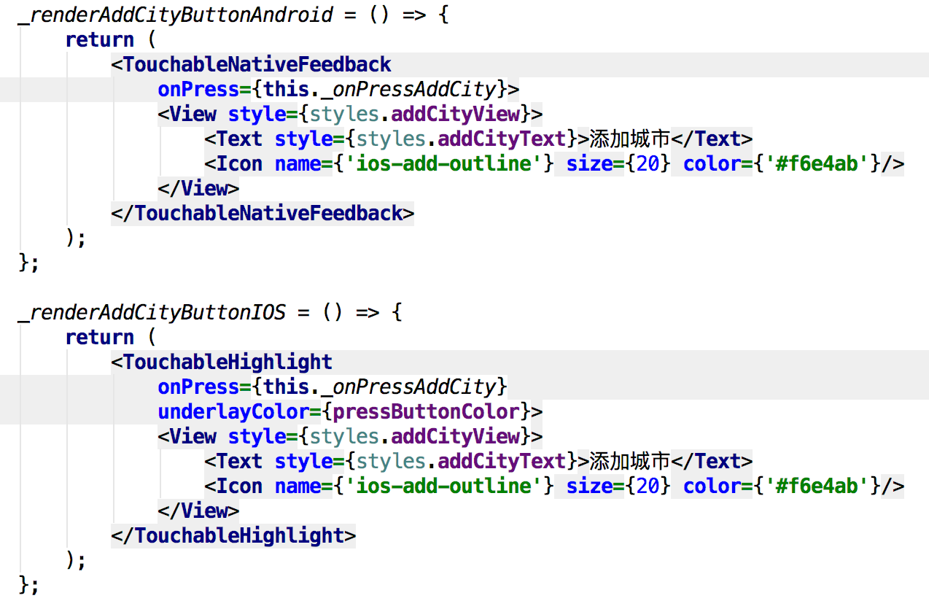
Complex Part
Fit click effect in Android and iOS
Fit Android and iOS button click effect:
Android Settings Use TouchableNativeFeedback for the best click feedback experience;
iOS only uses TouchableHighlight components;
So some code needs to write two copies of Android and IOS platform.
On the left is an example of Android and iOS click effects,
the first part is click effect in Android,
and second part is click effect in iOS.

Slide 16
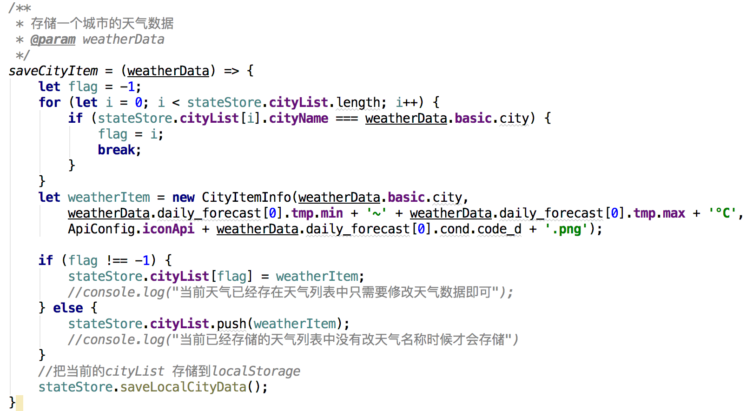
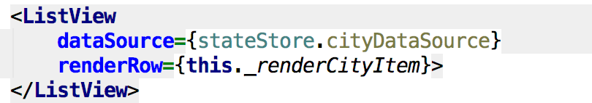
Complex Part
Interface data exchange
Interface data exchange.
Use mobx open source library observer mode, when the observed data changes, the observer's interface will be re-rendered,
On the left code,the fisrt part set ‘citylist[]’ as the observed element,the second add a new element into the citylist[], the interface observes citylist [] has changed, it has been re-rendered(in the third part of the code).

Slide 17
03
Difficult
The difficulties we encountered in the development process

Slide 18
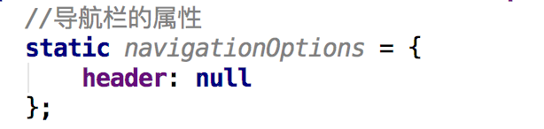
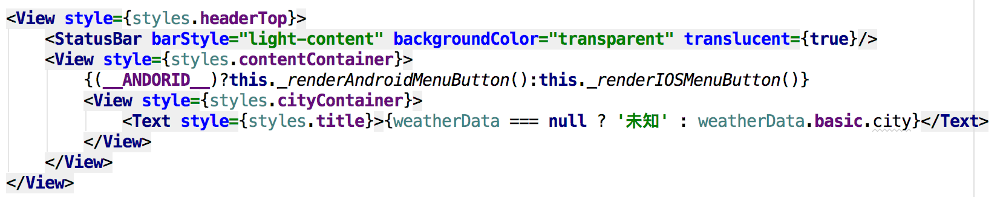
Difficult
Toolbar
In the process of developing the interface, the color of the toobar is white but not transparent.
We solved this problem by disable the top bar and new a view to overriding toolbar's function.

Slide 19
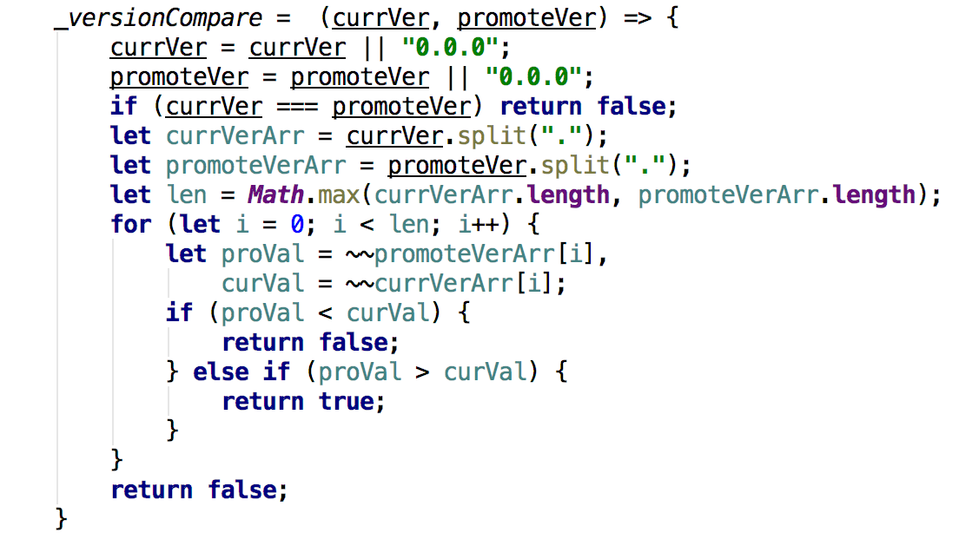
Difficult
Check updates
Check the APP update,
prompting the user to update.
We use code as follow to get it.

Slide 20
Difficult
Other
APP is too large, we do this things to reduce the package size:
Compress Pictures:use https://tinypng.com, PS and other means to reduce the picture size;
Obfuscate code:change ‘def enableProguardInReleaseBuilds’ to true and
modify the configuration of Android Confusion Tool ‘Progruard’
Hardly to design interface:
We visit https://dribbble.com/ and other design sites to see a lot of design resources.

Slide 21
04
Test
For this application, we did the following test

Slide 22
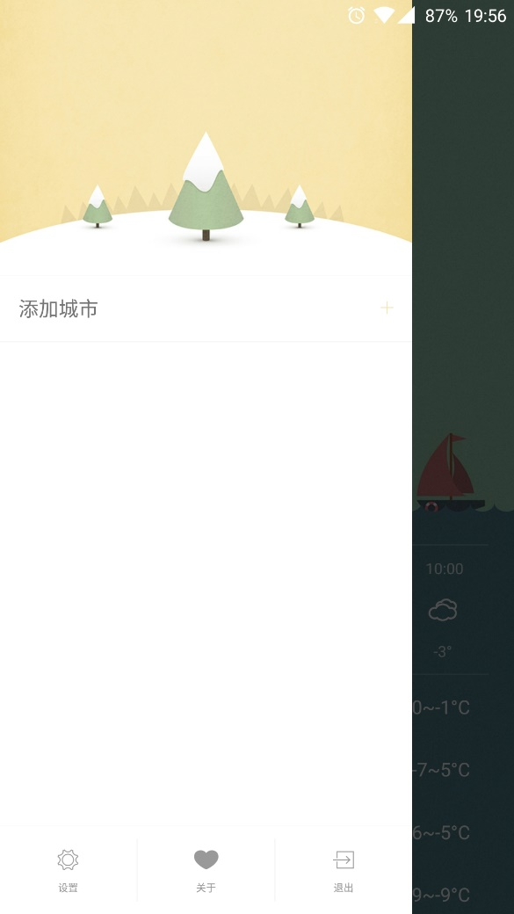

Test
Delete all city in the list and then refresh in the weather screen:It auto add the last city in the list.
Add two same city:The second add operation is invalid.

Slide 23
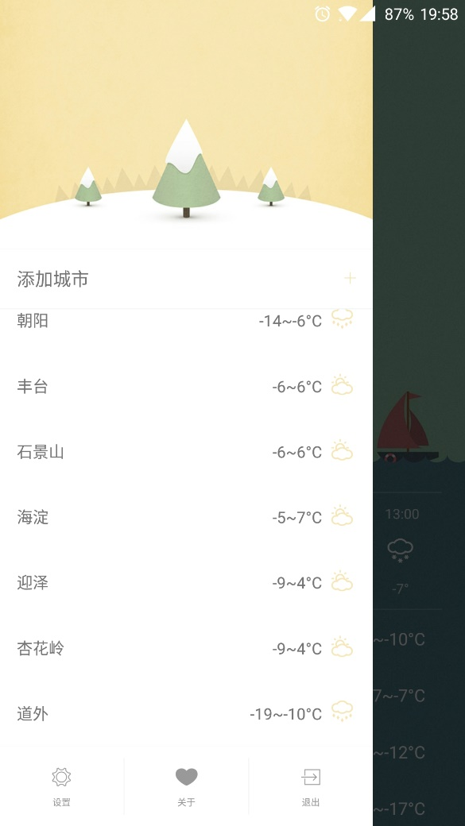
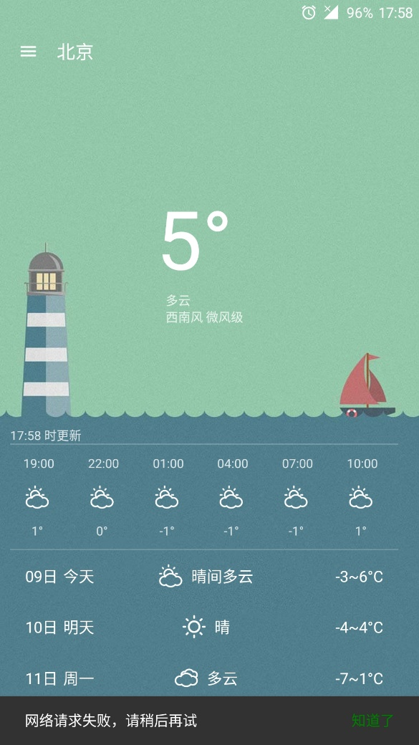
Test
Add a large number of cities: The app is working fine.
Refresh without network:The application returns an timeout error message and stop refreshing.

Slide 24
05
Extra
Something we can get extra credit

Slide 25
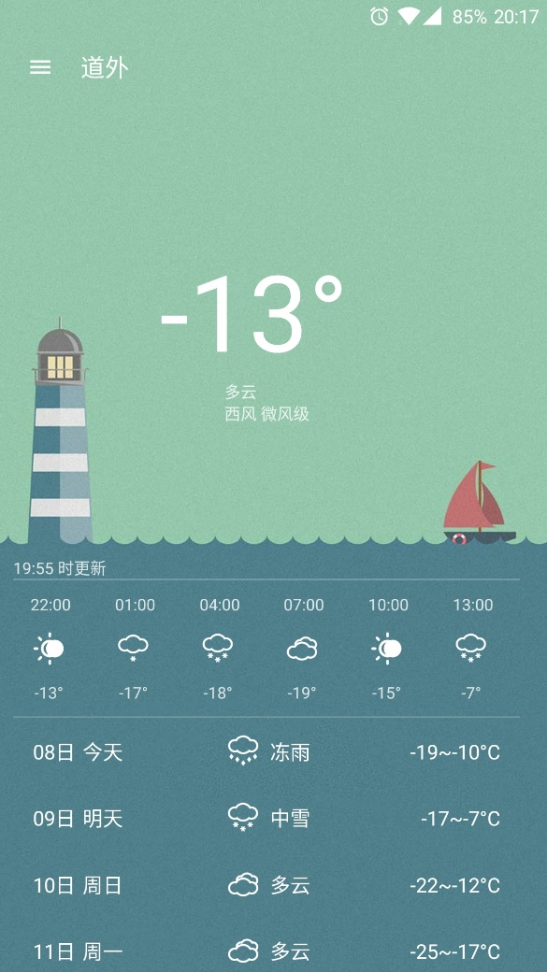
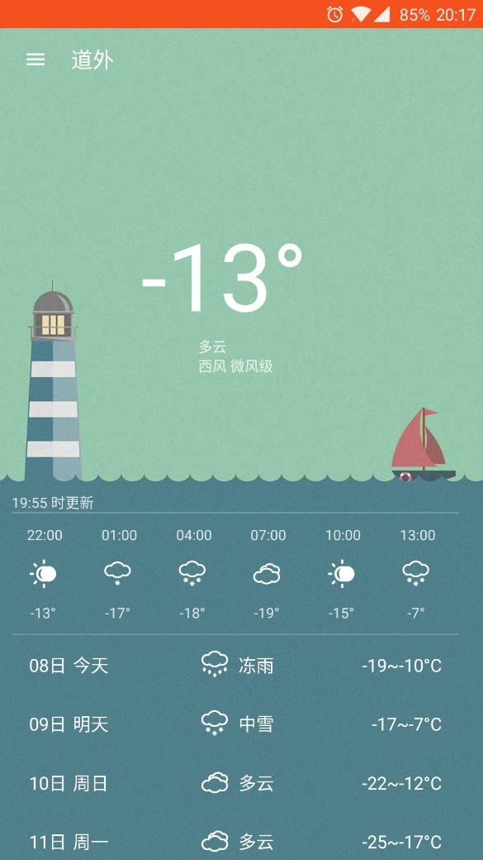
Extra
Immersive status bar
For this application, we have added the status bar immersion,
the left picture shows the normal mode, the status bar is transparent and merges with the background;
the right shows the disabled status bar immersed, the status bar is red.
Immersive status bar
Non-immersive status bar

Slide 26
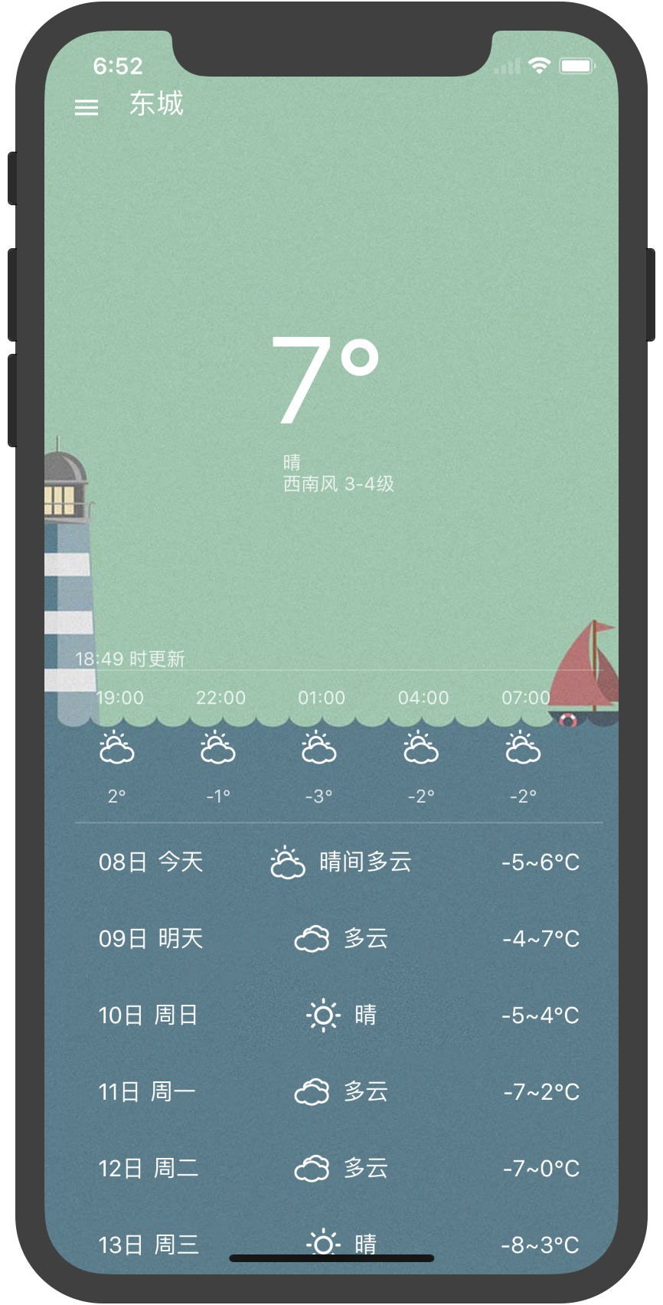
Extra
iOS adaption
We made this application iOS adaptation,
it can run smoothly on Apple devices.
iOS operating interface

Slide 27
Extra
Others
We also provide the following additional features in this application:
Local data store
Manage list of cities that users have added
Supplied clear the cache

Slide 28
06
Future
What we intend to do

Slide 29
Future
We will do the following things in the future:
Further reduce the application volume
Provide direct update within the app
Add the automatic positioning function
Random switch wallpaper
Optimize performance

Slide 30
Thanks for listening
Reply time:2017.12 Members:Wei He,Hongyang Chen

