Slide 1
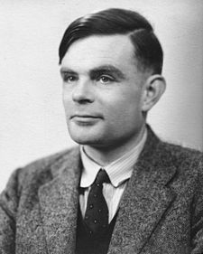
Turing Machine Simulator
Wang Kun
September 10, 2014
Notes:
This template can be used as a starter file for presenting training materials in a group setting.
Sections
Right-click on a slide to add sections. Sections can help to organize your slides or facilitate collaboration between multiple authors.
Notes
Use the Notes section for delivery notes or to provide additional details for the audience. View these notes in Presentation View during your presentation.
Keep in mind the font size (important for accessibility, visibility, videotaping, and online production)
Coordinated colors
Pay particular attention to the graphs, charts, and text boxes.
Consider that attendees will print in black and white or grayscale. Run a test print to make sure your colors work when printed in pure black and white and grayscale.
Graphics, tables, and graphs
Keep it simple: If possible, use consistent, non-distracting styles and colors.
Label all graphs and tables.

Slide 2
Outline
Requirements Specification
Design
Implementation
Summary
Demo

Slide 3
Requirements
Turing machine simulator
The syntax is based on Introduction to Models of Computation, Song Fangmin, Higher Education Press
Program can be defined by users
Transition of states should be vividly, and real-time

Slide 4
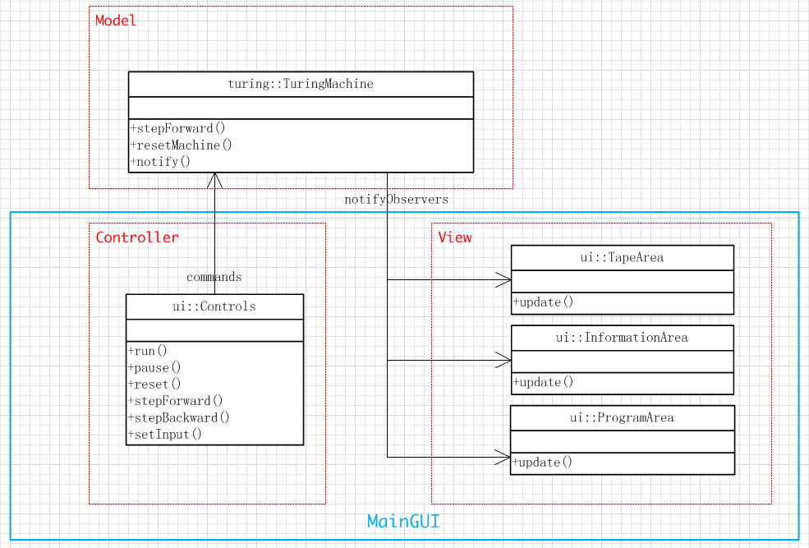
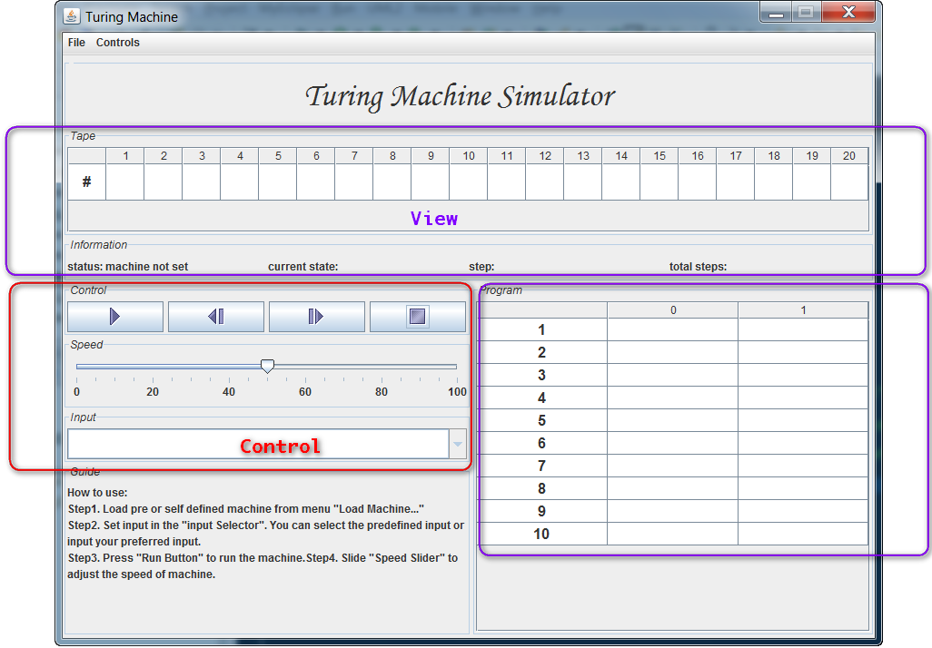
MVC View

Slide 5
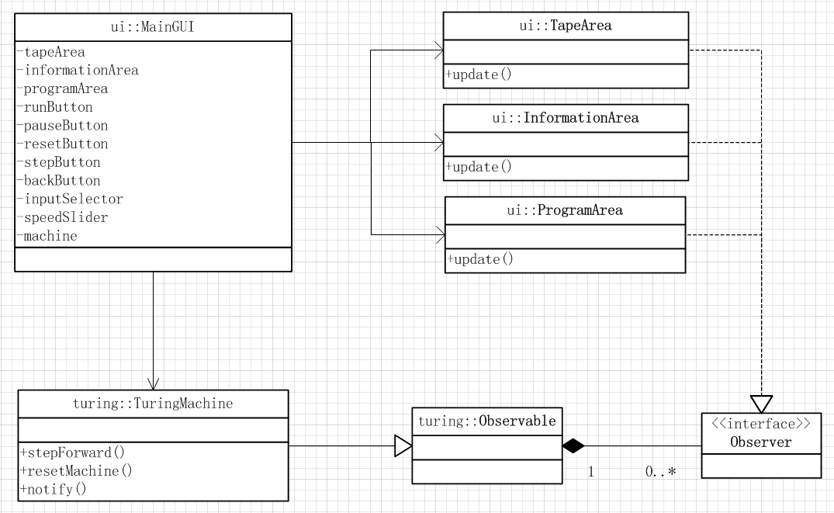
Class Dependency

Slide 6
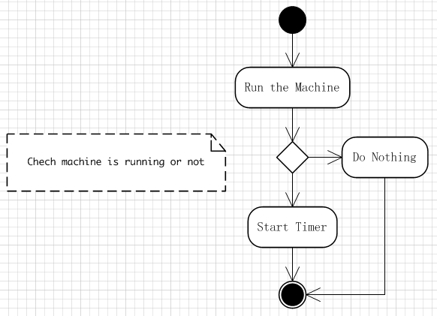
Activity Modeling
Start Event Activity Modeling

Slide 7
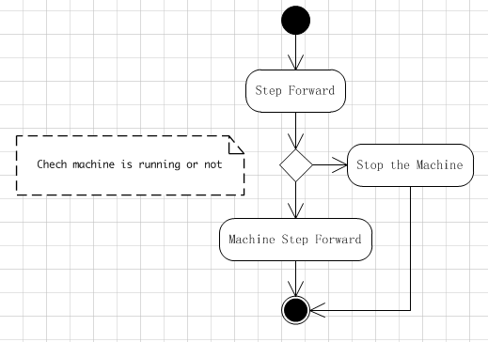
Activity Modeling ( Cont.)
StepForward Event Activity Modeling
Notes:
Java’s mantra: “write once, run anywhere”

Slide 8
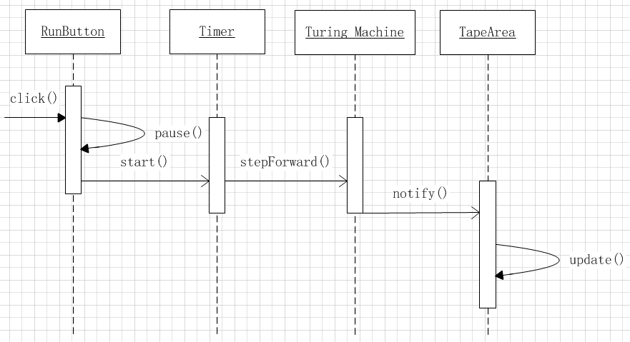
Sequence Diagram
Run Button Sequence Diagram

Slide 9
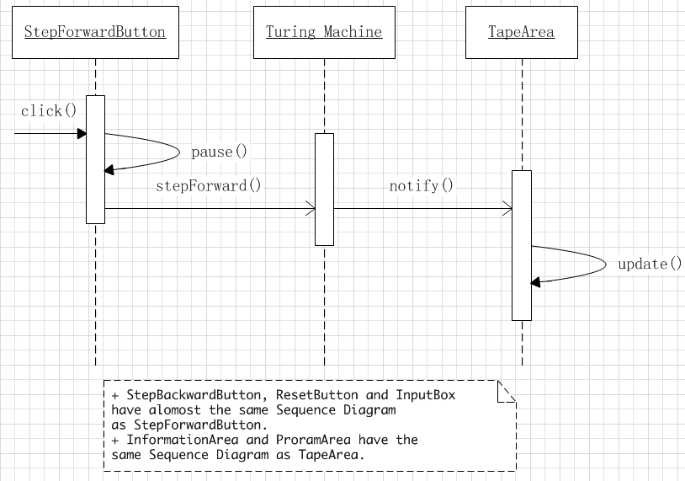
Sequence Diagram (Cont.)
StepForward Button Sequence Diagram

Slide 10
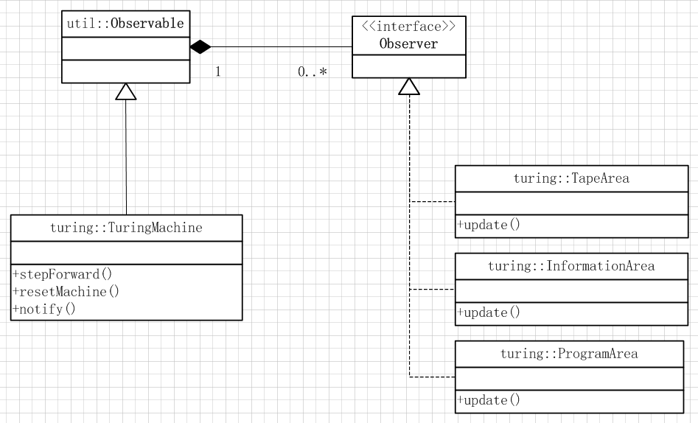
Observer Pattern
Notes:
Java’s mantra: “write once, run anywhere”

Slide 11
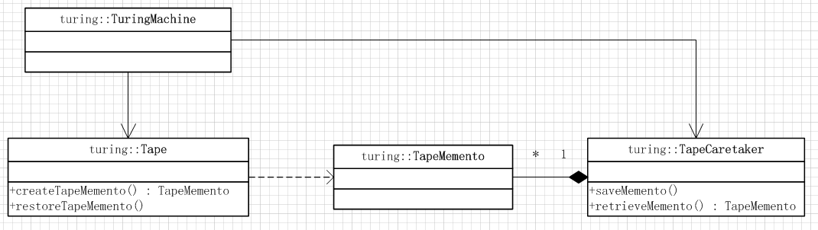
Memento Pattern
Memento of the initial tape
Intended for resetting the machine
Notes:
Java’s mantra: “write once, run anywhere”

Slide 12
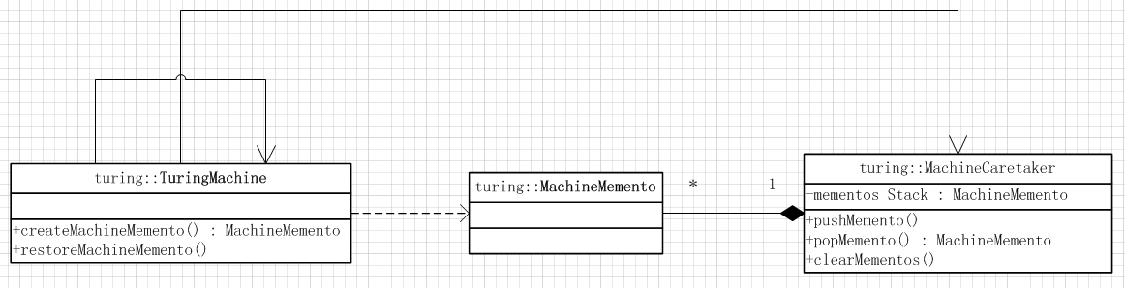
Memento Pattern (Cont.)
Memento of the machine changes
Intended for stepping back of the machine
Notes:
Java’s mantra: “write once, run anywhere”

Slide 13
Other Patterns
Facade Pattern
All panels have the same appearance
Static Factory
Some of useful methods cannot be aggregated to any of current classes
Put them into static factory and serve all
Design patterns used by swing components
Notes:
Java’s mantra: “write once, run anywhere”

Slide 14
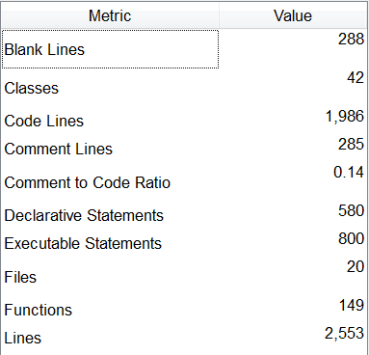
Implementation
Metrics of the project

Slide 15
Summary
Design Patterns make the project’s architecture easy to understand
More skilled to solving problem in a sequential processing procedure
Not used to consider the problem from an OO engineer’s prospective
What I have done is to fit my project to design patterns

Slide 16
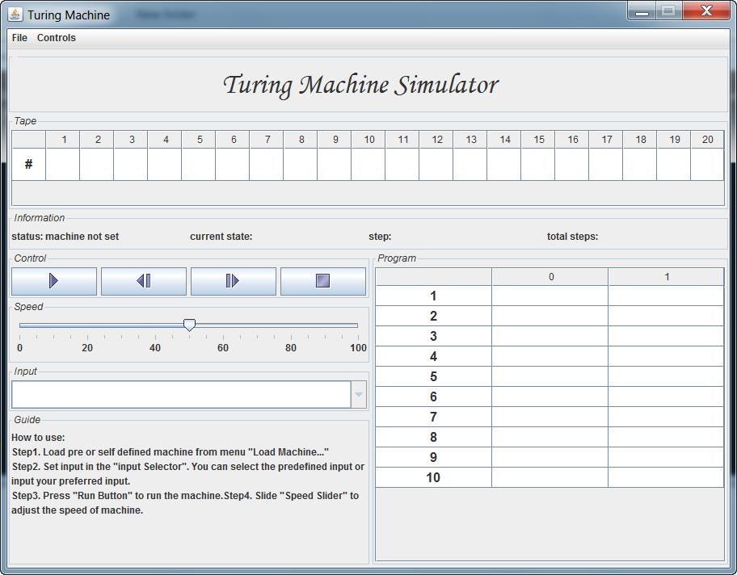
Demo
Main GUI. The menu is used to load machine.

Slide 17
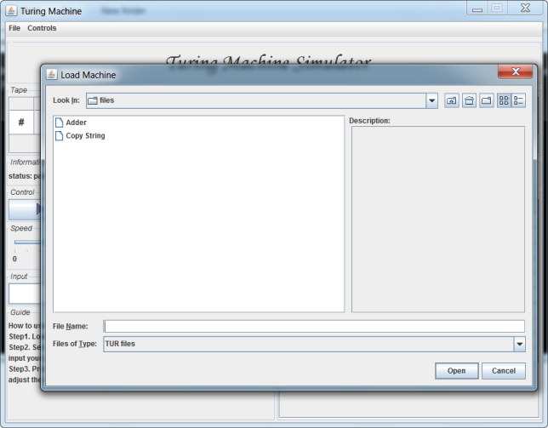
Demo (Cont.)
Loading machine from file.

Slide 18
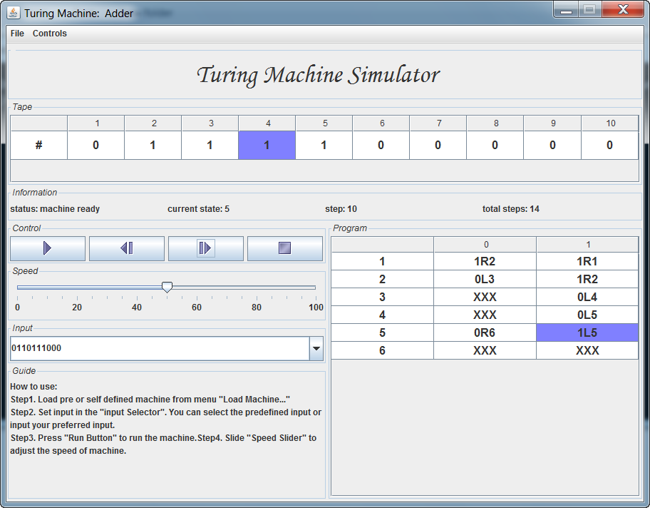
Demo (Cont.)
The program “Adder” is running.

Slide 19
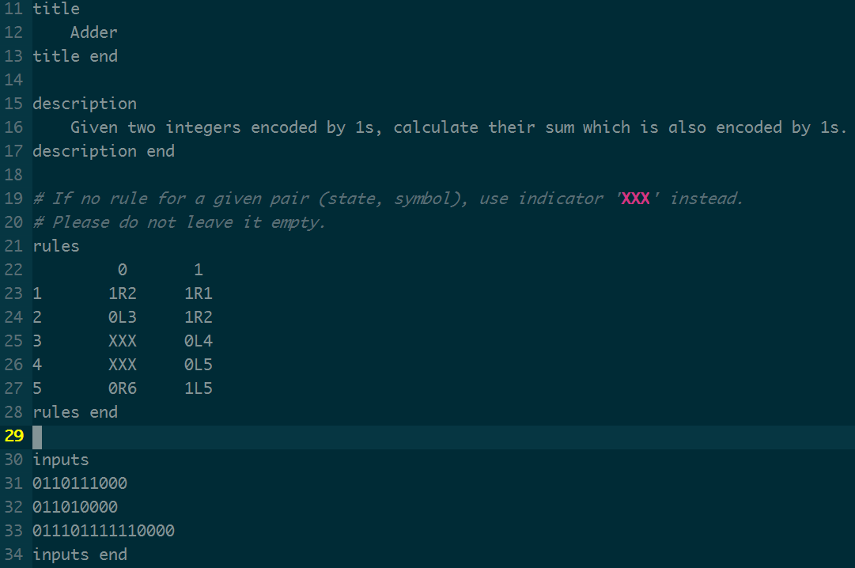
Demo (Cont.)
The description of program “Adder”

Slide 20
Ack.
Thank
You！
Notes:
This is another option for an Overview slide.

