Slide 1





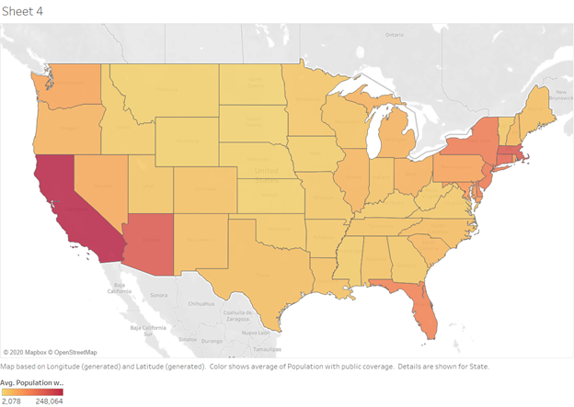
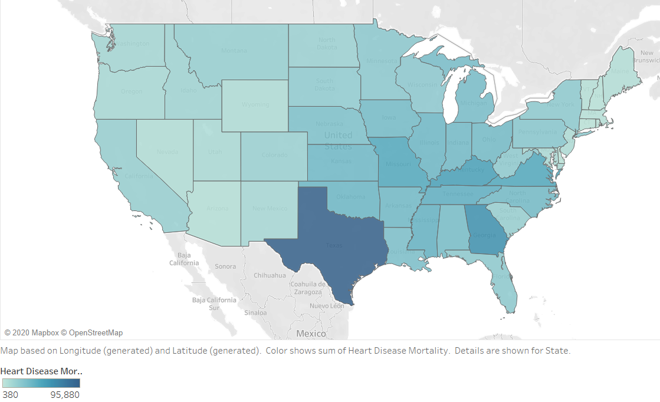
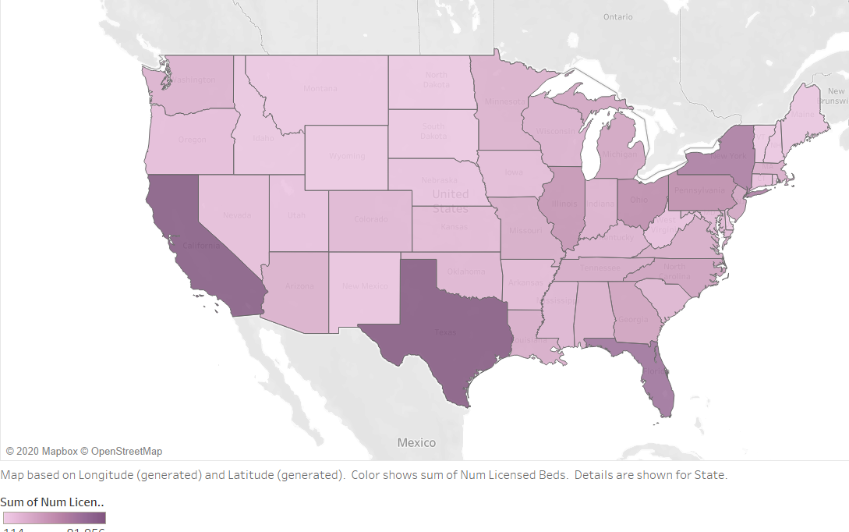
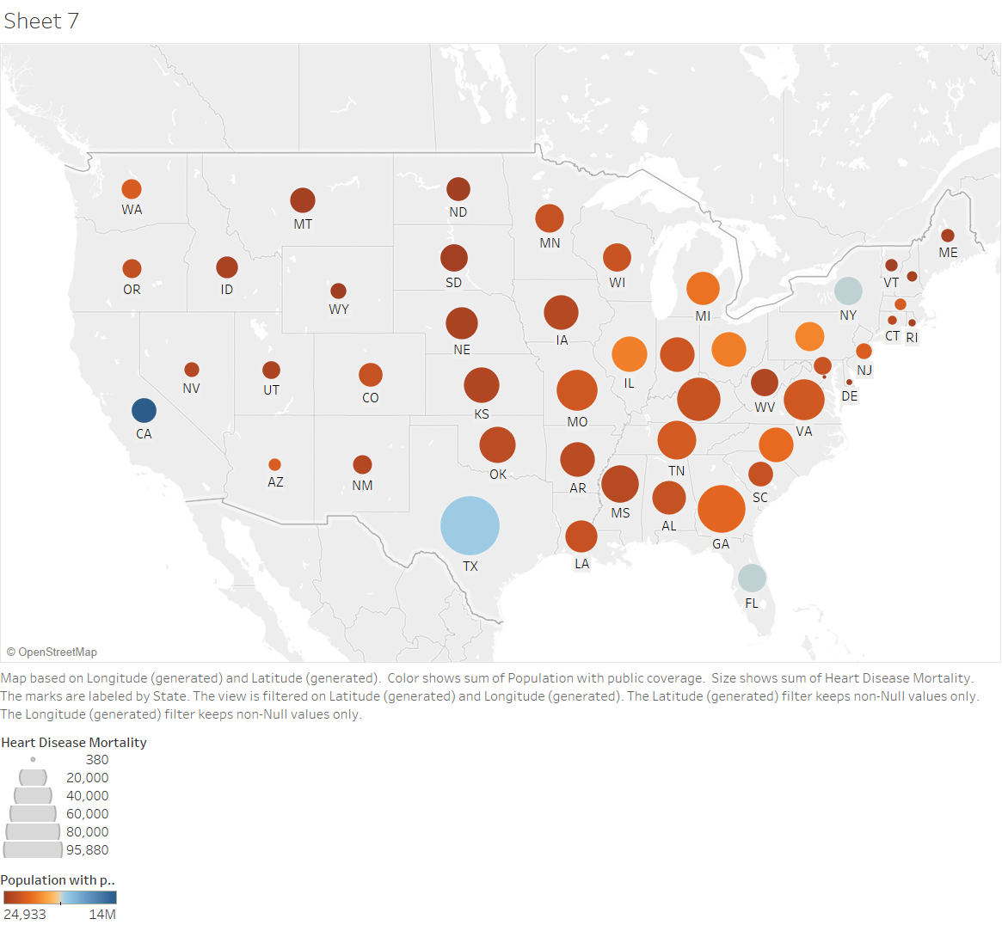
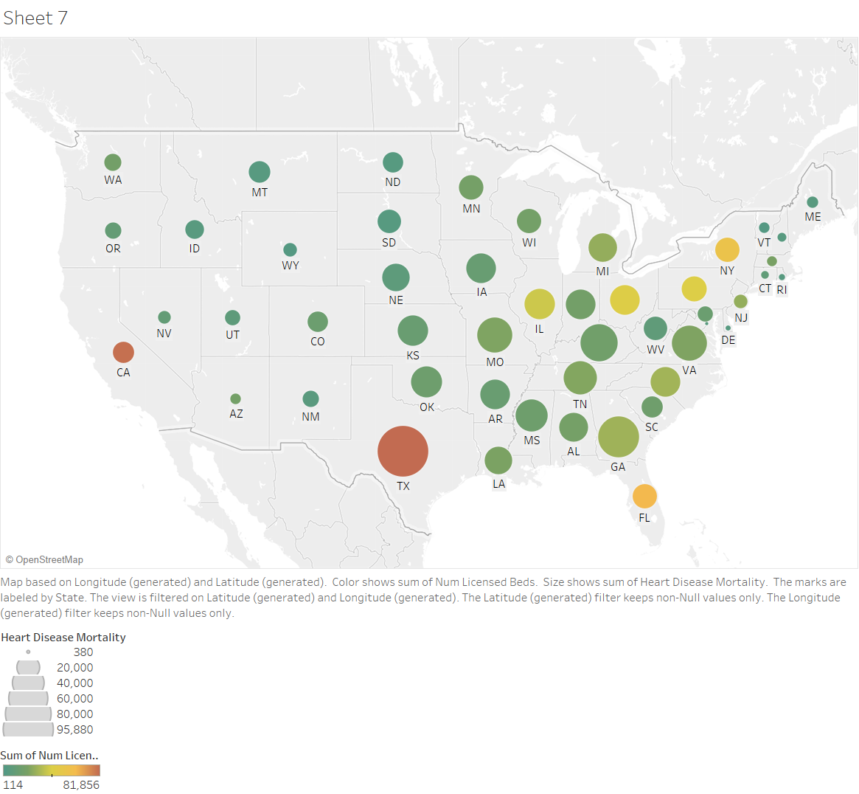
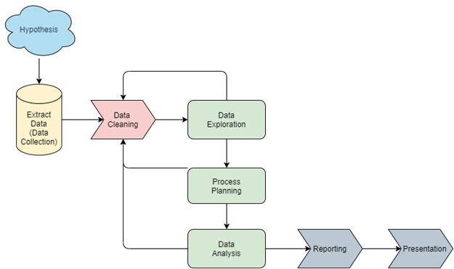
Are We Prepared For Heart Disease?
Angelina Martineau ^{(martia13@rpi.edu)}, Andrew Updegrove ^{(updega3@rpi.edu)}, Vaishnavi Neema ^{(neemav@rpi.edu)}
(¹Rensselaer Polytechnic Institute 110 8th St., Troy, NY, 12180 United States)
Abstract
Maintenance and Preservation
Data Analysis
Heart Disease, also known as Cardiovascular Disease, is the leading cause of death in the United States. According to the CDC, someone in the United States dies every 36 seconds from heart disease (cdc.gov, 2020). The cost of heart disease reaches hundreds of billions of dollars every year.
Due to the prevalence of heart disease in the United States, it is important that healthcare and health insurance companies be prepared to handle the amount of treatment required. It is of particular importance to understand where healthcare and health insurance are lacking, especially if these locations correlate with high levels of heart disease.
This project aims to highlight the areas where heart disease is more prevalent and health insurance or healthcare is not as prevalent.
The contents of this project have been uploaded to the following GitHub repository:
https://github.com/ITWSDataScience/Team2_2020
The project will remain on GitHub so that it will be available to the public, though only those who are granted access through GitHub will be permitted to edit and advance the project. The original datasets and their metadata will be present, as well as the newly created data and its metadata. The project’s GitHub repository also includes the visualizations and reports produced from the analysis.
(a) (b) (c)
Image 2 : Visualisations representing the population with public coverage, heart disease mortality rate and number of licensed beds per state respectively. Ideally, the shades for all three cases should be similar which would mean that each state has a balance between these three attributes.
1. Health Insurance and Heart Disease
Tools and Methods
To achieve the purpose of this project, the data exploration step led to the comparison of population with health insurance coverage and the mortality rate of heart disease in each state. This graphic helps us to visualize the discrepancy in our healthcare system. This graphic, if plotted on a linear scale should ideally be a straight line but there are many states that have a very low population with health insurance but the mortality rate for heart disease is pretty high.
Three main tools were used to complete the project: GitHub, RStudio, and Tableau. GitHub was primarily used to create a public repository for the project. RStudio was used to develop and run an R script for the analysis portion of the project. Finally, once the new data had been generated by the R script, Tableau was used to create visualizations explaining the results of the analysis.
The main method used in the R script was linear regression. The first model compared heart disease and the percentage of people without health insurance, and the second compared heart disease and the number of hospital beds available.
Motivation
The motivation for this project primarily comes from the 3rd goal for sustainable development: “Ensure healthy lives and promote well-being for all ages,” (un.org, 2020). Determining where hospital bed counts and insurance are low and heart disease is highly prevalent can elude to where medical funding needs to be allocated. Providing the necessary medical care and coverage will promote well-being for individuals with heart disease, and it will help ensure that those with heart disease lives as long and healthy a life as possible. The motivation for this project was enhanced by the fact that heart disease is the leading cause of death in the United States. This demonstrates how urgent the need to be prepared for heart disease is.
Analysis Design
Image 2: USA Map graphic that shows comparison between different states based on heart disease mortality rates (size) and population with public coverage health insurance (color). The legend is shown on right of the graphic.
Image 1 describes the data analysis workflow. The beginning of the project focused on developing a research topic. Next, questions and hypotheses were developed. Using the hypotheses, datasets were found on the web and were saved to a project repository. Then, data cleaning was performed on each of the data files until they were ready for analysis. The data analysis for both questions was performed concurrently. This produced new data describing the relationships between heart disease, insurance, and hospital availability. This data was then reported on and visualizations were created.
2. Hospital Beds and Heart Disease
Another comparison was done between the number of licensed beds and the mortality rate of heart disease in each state. This graphic helps us to visualize whether a state, especially with high heart disease mortality rate would be able to handle that pressure given the number of licensed beds in the state. Ideally, this relationship should also be a straight line - or the bigger dots should be more red than green.
Data
Five data sets were used to complete this project:
Heart Disease Dataset
Hospital Bed Availability Dataset
Health Insurance Dataset
Population by County Dataset
State Code Dataset
The heart disease, hospital bed availability, and health insurance datasets are all broken down by county. This led to the inclusion of the population by county dataset, which allowed the results of the analysis to be normalized by population. Finally, the state code dataset was used, which contains the 2-digit state FIPS code. All datasets were obtained in CSV format, and the metadata collected for each dataset was maintained in the GitHub repository for this project. The newly created data is also included in this repository, with the appropriate provenance and metadata information.
Image 3: USA Map graphic that shows comparison between different states based on heart disease mortality rates (size) and number of licensed beds (color). The legend is shown on right of the graphic.
Conclusion
As seen from the above scenarios, most of the states, where the heart diseases are prevalent, are clearly not ready to take on its impact given their ratio of population with health insurance and the current healthcare system.
Image 1: Data Analysis Workflow
Poster: Team 2
Glossary:
RPI – Rensselaer Polytechnic Institute
TWC – Tetherless World Constellation at Rensselaer Polytechnic Institute
Heart/Cardiovascular Disease – disease that involves a narrowed or blocked blood vessel, which can lead to other health complications such as heart attack or stroke.
Acknowledgments:
Professor Thilanka Munasinghe
Teaching Assistant Aradhya Kasat
Sponsors:
Rensselaer Polytechnic Institute, Tetherless World, Information Technology and Web Science Department, Rensselaer Institute for Data Exploration and Applications, DSRC
Resources:
Rstudio - https://www.RStudio.com
Heart Disease Dataset - https://chronicdata.cdc.gov/Heart-Disease-Stroke-Prevention/Heart-Disease-Mortality-Data-Among-US-Adults-35-by/6x7h-usvx
Hospital Bed Dataset - https://opendata.dc.gov/datasets/1044bb19da8d4dbfb6a96eb1b4ebf629_0
Health Insurance Dataset - https://covid19.census.gov/datasets/b69c7076eaa8433eab8f7fa077bac3b6/data
County Population Dataset –
https://www2.census.gov/programs-surveys/popest/datasets/2010-2018/counties/totals/

