Slide 1




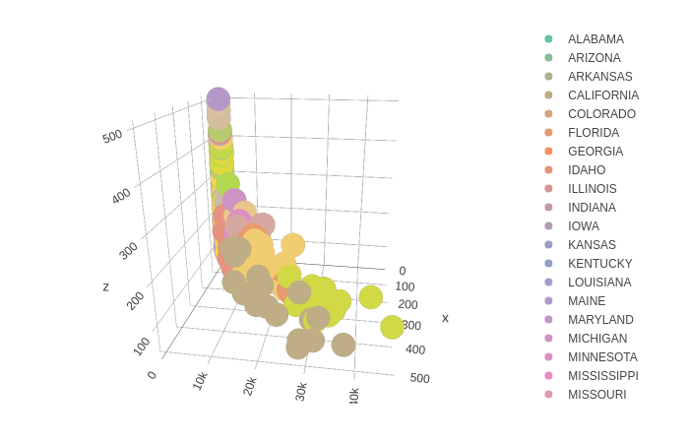
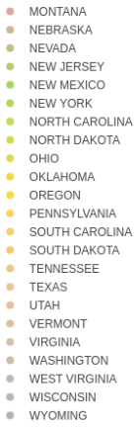
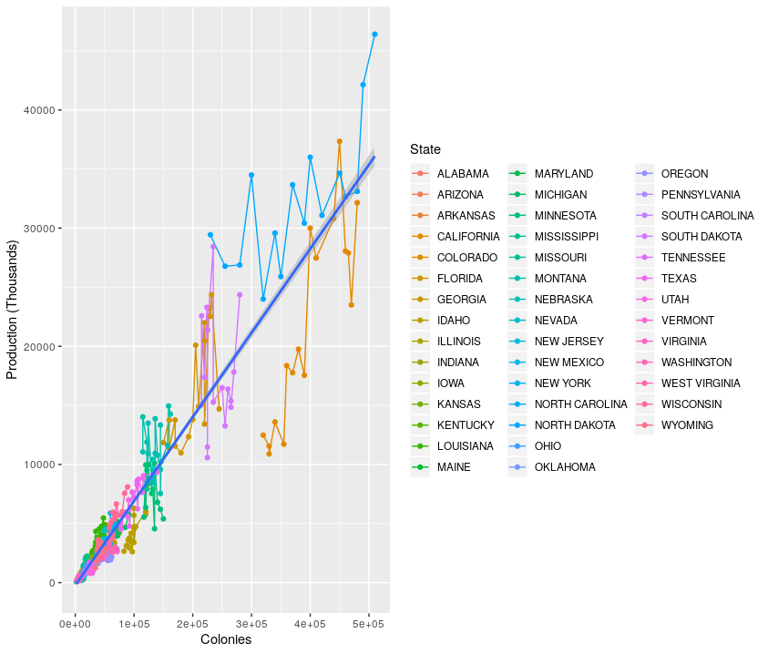
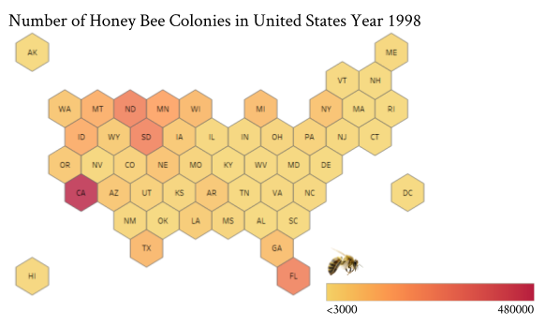
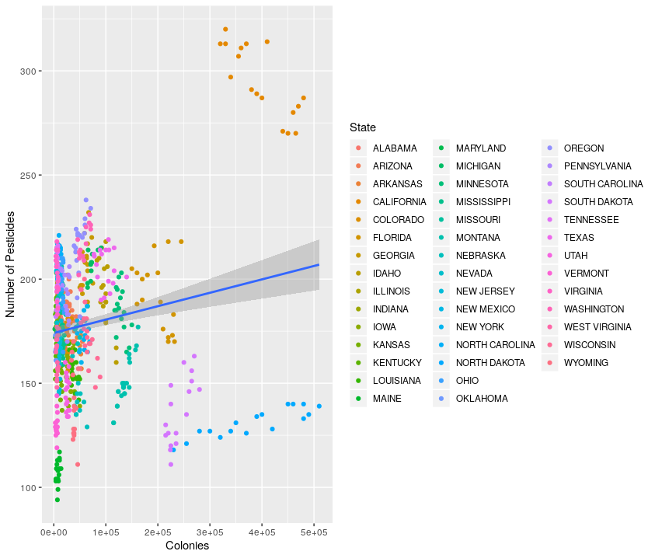
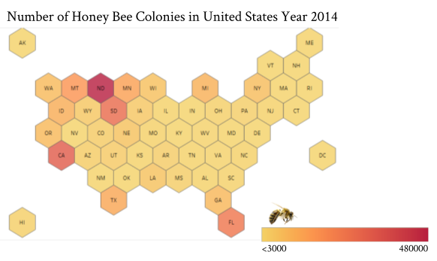
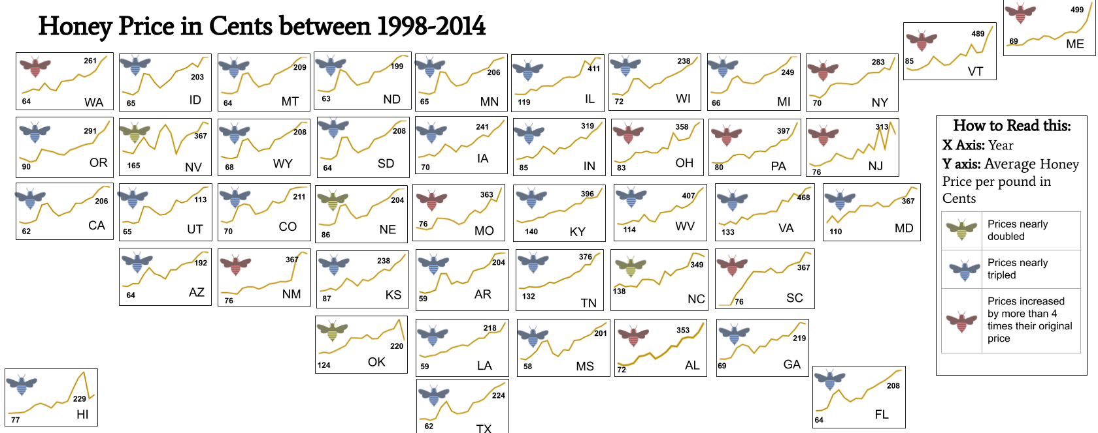

Analyzing Honey Bees in the United States
Charly Huang, Josephine Lyons, Pragati Pant, Meenu Ravi
Rensselaer Polytechnic Institute, Troy, NY, United States
github.com/ITWSDataScience/HoneyBeeColoniesInUSA2019
Abstract
Analyzing Datasets and Deriving Conclusions
Honey bees are a significant contributors to ecology and agriculture within the United States. Since the early 2000s, the slogan “Save the Bees” has been spreading rapidly across America, and it has been evident that bees are dying at a swift pace. Many of these campaigns focus on harmful pesticides that kill much of the bee populations. There is also a huge astigmatism against honey as it is their main production. This project aims to determine the correlation, if at all, between the population of bees in the United States, the use of bee-killing pesticides, and the sale of honey.
To make an informed analysis, multiple datasets have been derived from different sources. The first dataset looks at the number of bee colonies in different states, and was found on the website for the U.S. Department of Agriculture National Agricultural Statistics Service Quick Stats Dataset. The second dataset looks at the pounds of honey and the prices of honey for different states, and was retrieved from the website of the National Agricultural Statistics Service (NASS) of the U.S. Department of Agriculture. Finally, the third dataset, created by the Department of the Interior’s US Geological Surveyor Nancy T Baker, looks into the use of pesticides in the United States.
This poster focuses on the various aspects of the project itself. We begin by stating our hypotheses about the given topics of bees population, honey production sales, and pesticide usage sales. We, then, highlight our process for analyzing the datasets for potential patterns as well as initial analysis. Furthermore, a deeper analysis is provided through given code and data visualization. Finally, our conclusion summarizes the findings of this project as well as whether our hypotheses were supported or not.
Workflow for Data Analysis
Analysis
Question 1
Hypothesize:
Retrieved datasets from sources
Stated project questions
Formed our own hypotheses
Analyze:
Cleaned datasets
Found initial data patterns
Performed thorough data analysis
Honey price
Number of colonies
Visualize:
Graphed initial data patterns
Aggregated and graphed multiple datasets
Honey production
Figure 4 shows honey production and number of colonies against price of honey. These variables were used in the linear model (not pictured), and as seen above, it is clear why no “good” linear model could be made.
Conclude:
Analyzed trendlines and r values
Found data analysis to be inconclusive
Exploratory Data Analysis
Figure 5 demonstrates the correlation between honey production and bee colony population for all states from 1998 to 2014.
Figure 1 reflects the bee colony populations in 1998. The darker states have a higher bee population, like California.
Question 2
Questions and Hypotheses
The following states the two questions that drove this project.
What is the relationship between the national honey production and the honey bee colony population in the United States between the years of 1998 and 2014 and how does this relationship affect the average honey production prices? We hypothesize that the declining bee population has lowered honey production sales.
How has the use of harmful bee killing pesticides correlated with the number of honey bee colonies in the United States between the years 1998 and 2014? We hypothesize that the number of honey bee colonies will increase as the amount of harmful bee killing pesticides decreases and vice versa.
Figure 2 reflects the bee colony populations in 2014. This highlights the changes in populations over the 16 year time span from Figure 1.
Figure 6 shows that there is not a correlation between bee colony population and pesticide usage for all states from 1998 to 2014. Our model is the blue line.
Figure 3 (below) demonstrates the change in the price of honey from 1998 to 2014 for each state.
Scan this QR code to see more visuals created for this presentation.
Figure 3
Resources:
Bee colony population dataset: https://quickstats.nass.usda.gov/
Honey production sales dataset: https://www.nass.usda.gov/About_NASS/index.php
Pesticide usage sales dataset: https://catalog.data.gov/dataset/agricultural-pesticide-use-estimates-for-the-usgs-national-water-
quality-network-1992-2014-vers
Tableau: https://www.tableau.com/
plotly package in R: https://plot.ly/r/
ggplot2 package in R: https://ggplot2.tidyverse.org/
Pandas package in Python: https://pandas.pydata.org/
PyYAML package in Python: https://pypi.org/project/PyYAML/
Conclusion
We found the data analysis to be inconclusive. There is a relationship between bee colony population and honey production, however, there is no direct linear relationship with the price of honey. Additionally, the number of unique types of pesticides used within a given state does not correlate with the bee colony population within that state.
Notes:
<number>

