Slide 1
Application: Internship Finder
Team Name : BYTE
Team Members:
Nazneen Desawalla
David Steiner
Daniel Girma
Arshad Ahamed Syed
Frempong Patrick

Slide 2
Goal:
To help students search for an internship and apply.
To help employers find right interns for their internships.
Objectives:
An employer will be able to register and login.
Employer will be able to enter all the internships on offer with pre-requisites and skills required for each internship.
An employer will be able to view all the registered student profiles and then accept or decline the applications.

Slide 3
Objectives(contd..):
Students at a university will be able to register and login.
Students will be able to browse through current internships based on discipline category & skill sets .
Students can view details of a particular internship , select and apply.
Students will be able to track the status of past applications.
A successful application will be notified by an email to the student.

Slide 4
Wireframe: Homepage

Slide 5
Wireframe: Student Registration Page

Slide 6
Wireframe: Single Internship

Slide 7
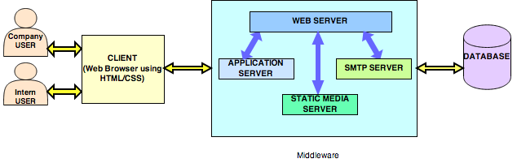
Architecture
MIDDLEWARE

Slide 8
Technology
Client: Web browser on a mobile device, using HTML/CSS/JS
Middleware: Apache Web Server, with an Application Server built using Django
Database: SqlLite3

Slide 9
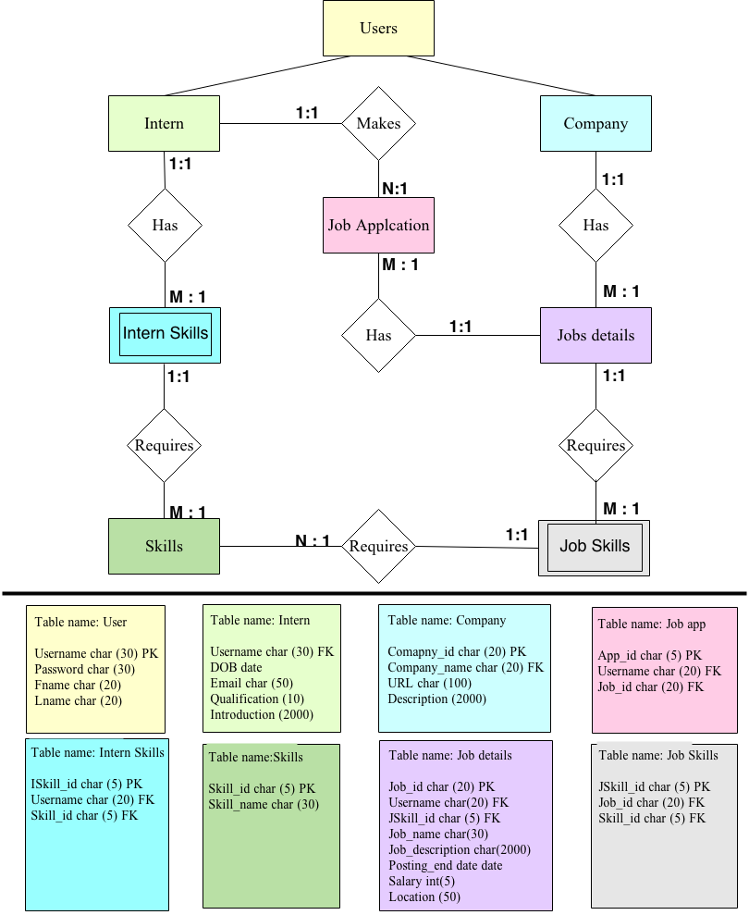
ER DIAGRAM

Slide 10
Standout Features
The website is user friendly and easy to use
This website provides the users to see job vacancies without logging in.

Slide 11
Specification List MoSCoW
M:- Must Interns should be able to add profile and view ,apply internships offered. Companies must be able to view intern profiles | S:- Should The intern should be able to sign up for more than one intership
C:- Could Interns could receive mails about internships offered | W:- Wont At present the Interns wont be able send mails

Slide 12
User Needs matrix : Student
 | Overall Project Priority | Student | Employer
Login | 1 | 1 | 1
Create profile | 1 | 1 | 1
Apply for internships | 1 | 1 | n/a
Parameter based search | 2 | 2 | 3
Tracking application | 1 | 1 | 2
View attributes (eg CV etc) | 2 | 3 | 1
Communication (ie email) | 1 | 1 | 1
File upload | 2 | 1 | 2
* Priority based on a 1 – 5 ranking system (1-highest priority, 5-Lowest Priority)

Slide 13
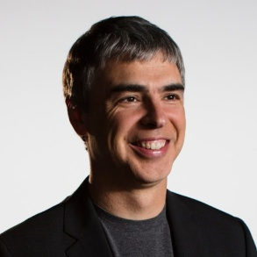
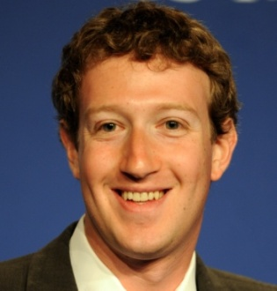
User Personas
David Gottajob (Employer)
HR Manager at RBS
David Gottajob is an HR manager at RBS and he is in charge of managing recruitment within the company. His tasks include creating job posts, shortlisting applications and interviewing potential candidates. David is regularly seeking to find new talent and attract the latest influx of new students.
Masood Nidajob (Student)
3rd year IT Student
Masood is a busy 3rd year IT student from Glasgow and has a lot of exams to study for. He is looking to utilize his newly acquired skills and gain experience over the summer holidays. He has been looking for local internships but has not yet had any success. Masood is beginning to lose his patience with filling out numerous application forms.

Slide 14
URLs Site Map
/home/
/internship/
Register/
Login/
Search/
Results/
Details/
/Employers/
Register/
Login/
Add/
/Contact/

Slide 15
Any questions???

