Slide 1


CAPM
The Capital Asset Pricing Model (CAPM) is a financial model that calculates the expected return on an investment based on its risk.
By Sagar Patel

Slide 2
Definition of CAPM
The Capital Asset Pricing Model (CAPM) is a financial model that determines the expected return on an investment by considering the risk-free rate, the market risk premium, and the systematic risk of the investment.

Slide 3
Assumptions of CAPM
1
Efficient Markets
2
Risk-Free Rate
Assumes that markets are efficient and all relevant information is already reflected in the price of the investment.
Assumes the existence of a risk-free rate of return, such as the yield on a government bond.
3
Diversification
4
Perfect Information
Assumes investors can hold fully diversified portfolios, reducing unsystematic risk.
Assumes investors have perfect information and can accurately assess the expected returns and risks of various investments.

Slide 4
CAPM Formula
ri = rf + βi(rm - rf)
The CAPM formula calculates the expected return (ri) of an investment by adding the risk-free rate (rf) to the product of the investment's beta (βi) and the market risk premium (rm - rf).

Slide 5

Risk-Free Rate
Definition
Importance
Examples
The risk-free rate is the theoretical rate of return on an investment with no risk.
It serves as a baseline for evaluating the expected return of other investments.
Examples of risk-free rates include the yield on government bonds or the interest rate on a savings account.

Slide 6



Beta Coefficient
Definition
Interpretation
Risk
Beta coefficient measures the sensitivity of an investment's returns to market movements.
A beta of 1 implies that the investment's returns move in line with the market, while a beta greater than 1 indicates greater volatility.
Beta helps investors assess the systematic risk, or non-diversifiable risk, associated with an investment.

Slide 7

Capital Asset Pricing Model in Practice
1
Step 1: Data Gathering
Collect necessary data, including historical prices of the investment and the market, risk-free rate, and market risk premium.
2
Step 2: Beta Calculation
Determine the beta coefficient of the investment by regression analysis or using available financial data.
3
Step 3: Expected Return Calculation
Apply the CAPM formula to calculate the expected return of the investment based on the risk-free rate, beta, and market risk premium.

Slide 8

Limitations of CAPM
Relies on various assumptions that may not hold in reality.
Cannot fully account for unpredictable events or changes in market conditions.
Does not consider other factors that may influence an investment's return.
Requires accurate estimation of beta, which can be challenging in practice.

Slide 9

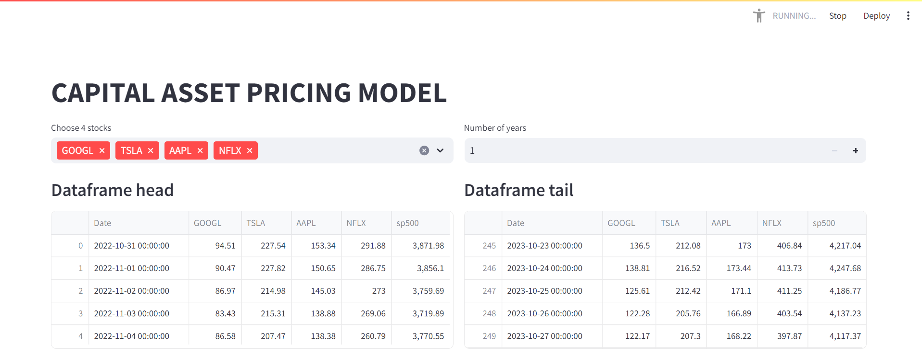

Slide 10
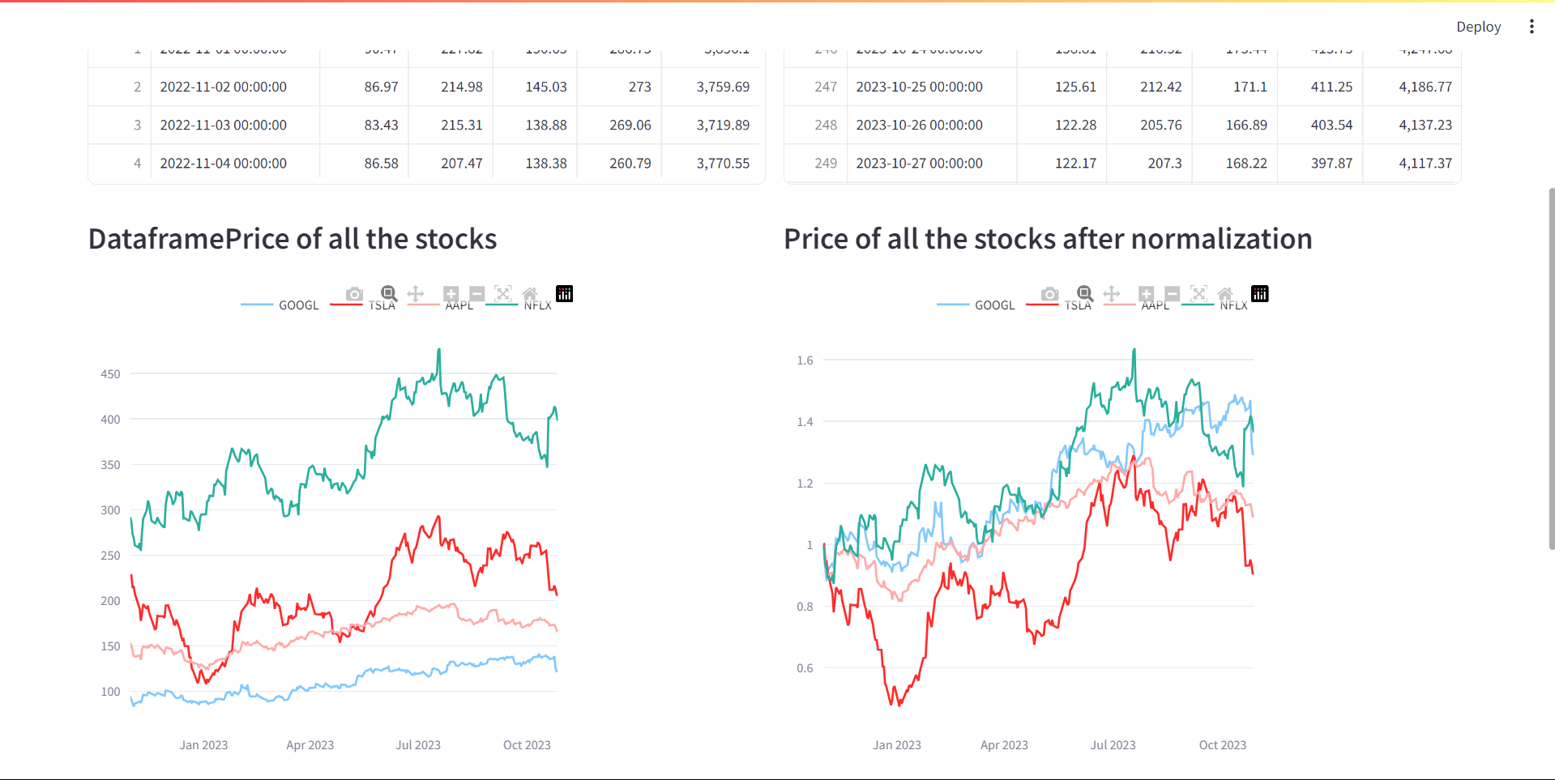

Slide 11
