Slide 1
Introduction to JDBC
David Vers

Slide 2
What is JDBC?
Java DataBase Connectivity
Standard Java API
DB-independent connectivity between a Java program and a DB

Slide 3
What does the API provide?
Connect to DB
Creating SQL statements
Executing queries
View and modify the resulting records

Slide 4
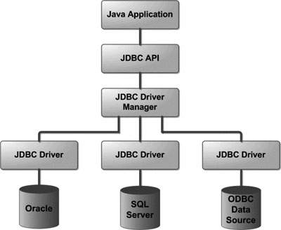
JDBC architecture
2 main layer
JDBC API
App – JDBC manager
JDBC Driver API
JDBC manager - Driver

Slide 5
The most important JDBC components
DriverManager
Driver
Connection
Statement
ResultSet
SQLException

Slide 6
JDBC application flow
We have a database somewhere
Get a driver, import necessary packages
Open a connection
Execute some query
Process the ResultSet
Cleanup – close the resources

Slide 7
H2 database
Lightweight Java database
Open source
Ideal for testing
Supports different modes
Embedded
In-memory
Server
https://www.h2database.com/

Slide 8
Let’s create a demo app!
New Maven project
Get the H2 driver
https://mvnrepository.com/artifact/com.h2database/h2
Connect to H2 database with JDBC URL
Embedded mode
Server mode
Try out some queries

Slide 9
Thank you for your attention!

