Slide 1
Database Management System
Delivery Database
Presenter: 洪翊庭、陳彥彣
Notes:
起源於動物的學習行為

Slide 2
Introduction
Class Diagram / Refactoring
Git Screenshot
Conclusion

Slide 3
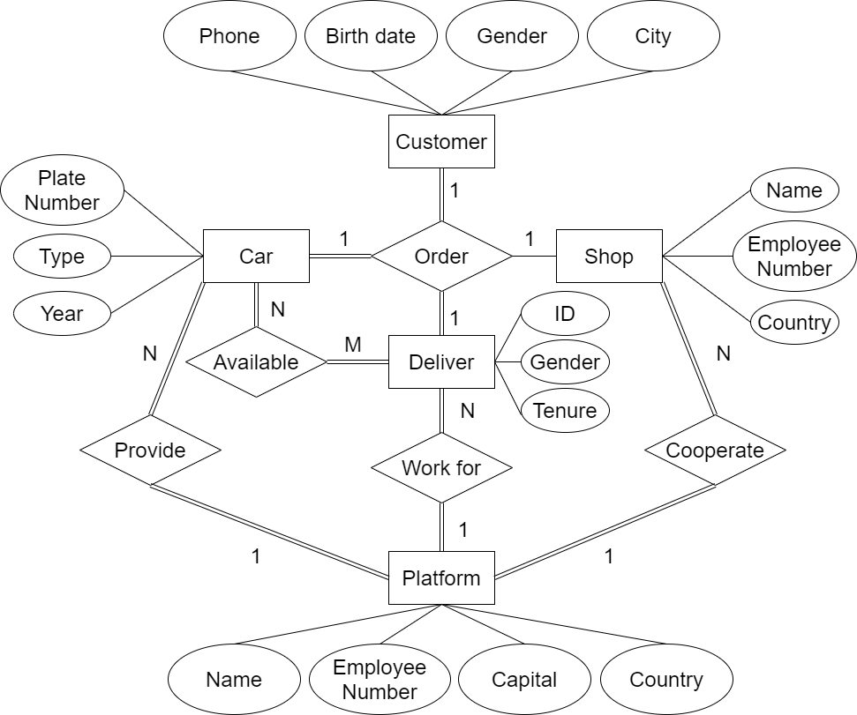
ER Diagram
Introduction

Slide 4
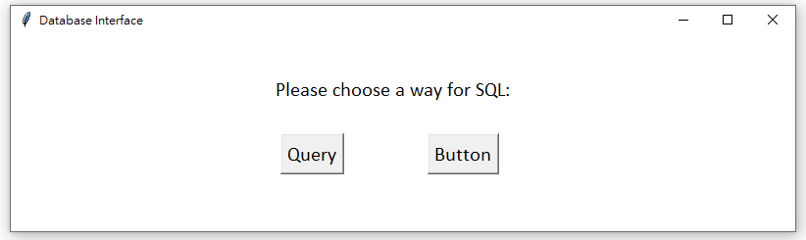
Screenshot
Introduction

Slide 5
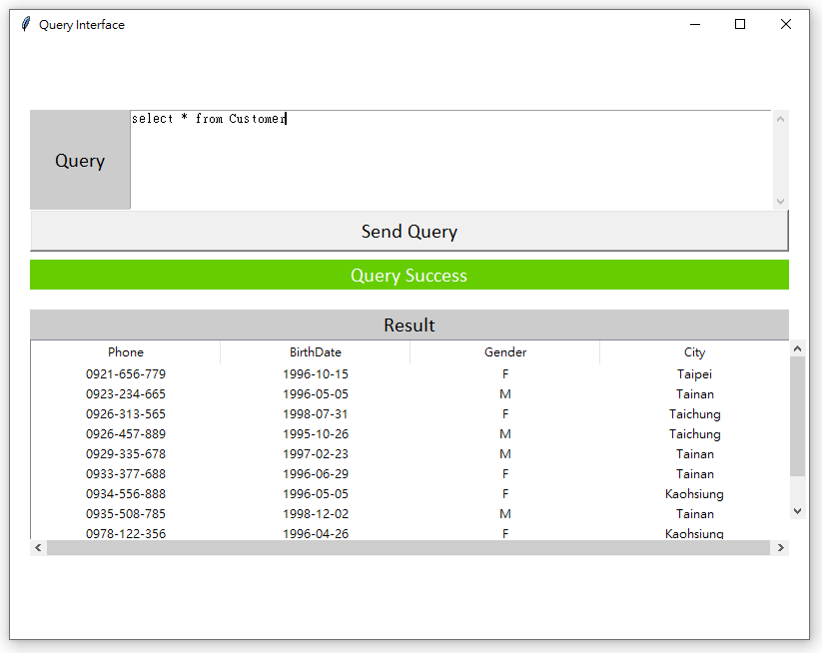
Screenshot
Introduction
Press

Slide 6
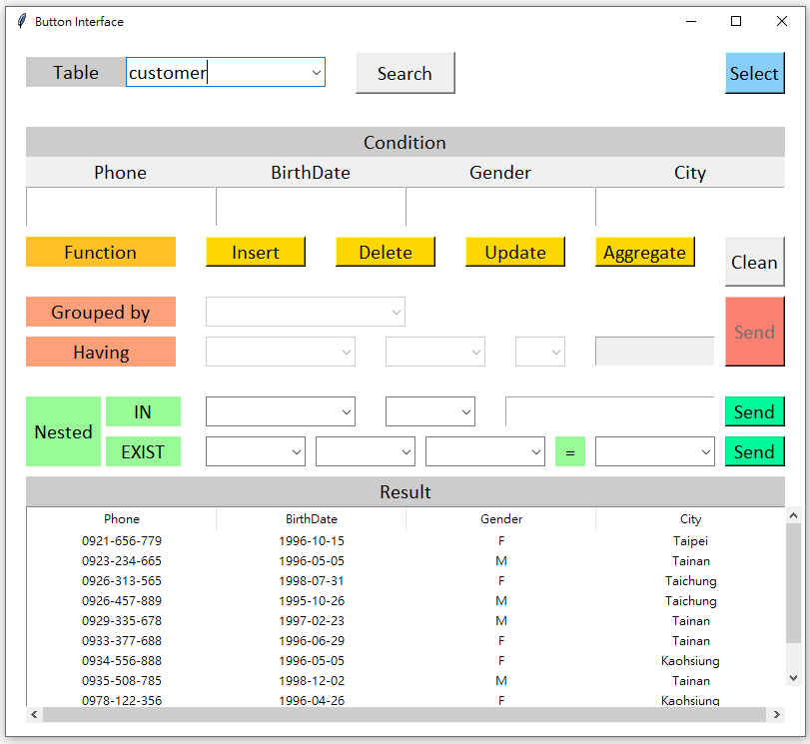
Screenshot
Introduction
Press

Slide 7
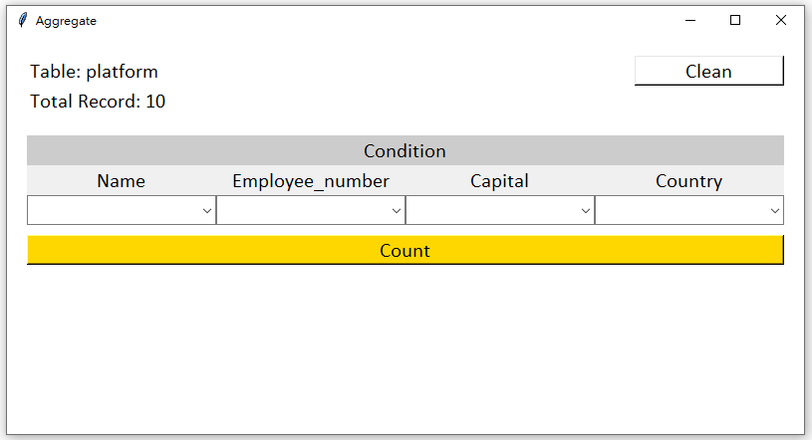
Screenshot
Introduction
Press

Slide 8
Problem
Introduction
Inconsistent naming policy
Ambiguous comments
Duplicate code
Few large classes rather than many small classes

Slide 9
Problem
Introduction
Inconsistent naming policy: google python style
Ambiguous comments
Duplicate code
Few large classes rather than many small classes

Slide 10
Class Diagram (Before)
Class Diagram / Refactoring
DatabaseInterface
QueryInterface
ButtonInterface
AggregateInterface

Slide 11
Class Diagram (After)
Class Diagram / Refactoring

Slide 12
Git Screenshot

Slide 13
Conclusion

