Slide 1
Database Management System
Delivery Database
Presenter: 洪翊庭、陳彥彣
Notes:
起源於動物的學習行為

Slide 2
Background
Motivation
Scale
Language

Slide 3
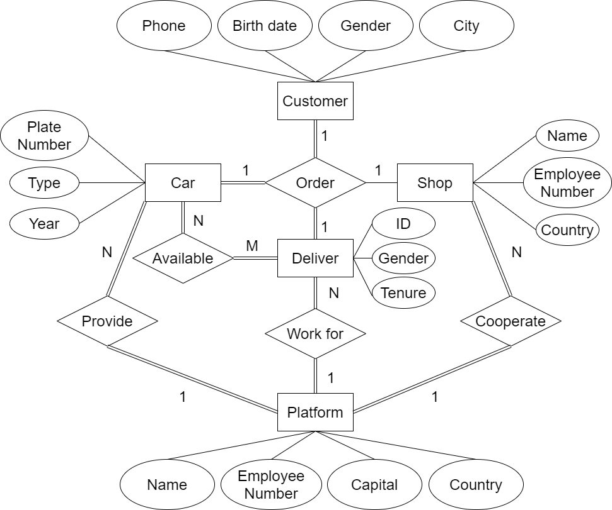
ER Diagram
Background

Slide 4
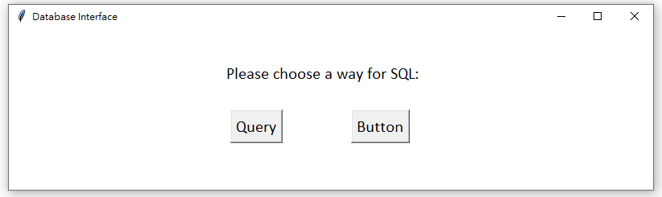
Screenshot
Background

Slide 5
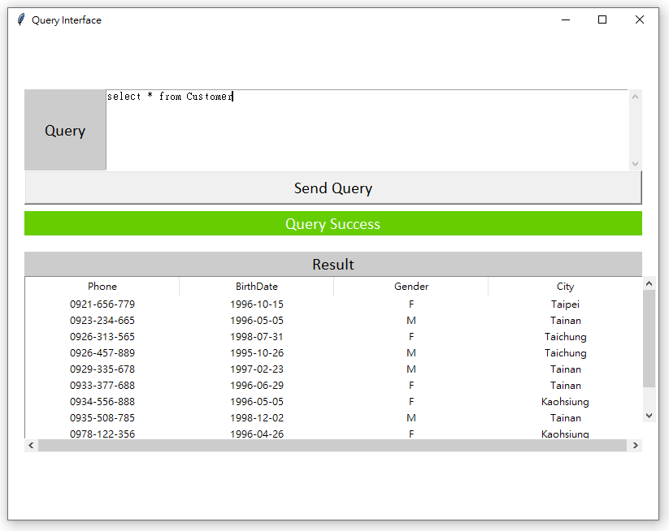
Screenshot
Background
Press

Slide 6
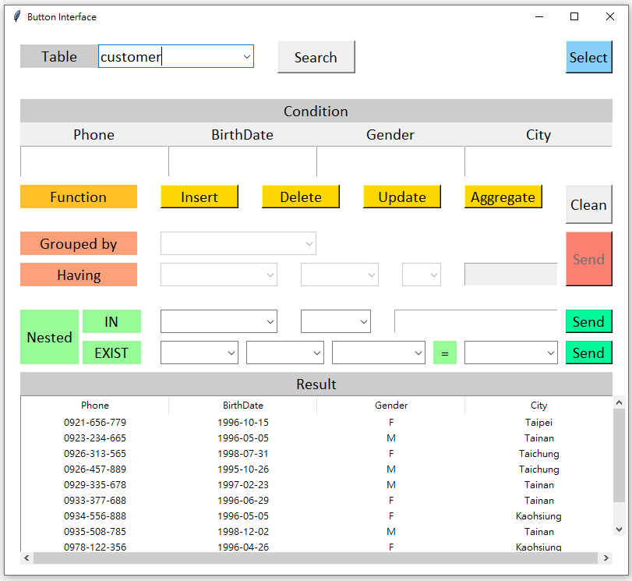
Screenshot
Background
Press

Slide 7
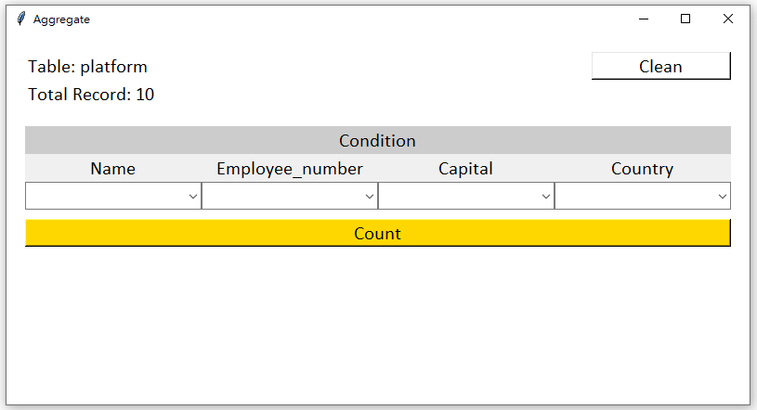
Screenshot
Background
Press

Slide 8
Motivation
Focus more on re-factor problem, rather than understanding how the project works
Interface has expandability

Slide 9
Scale
4 classes

Slide 10
Potential Problem
Motivation
Naming
Comments
Error Handling

Slide 11
Language
Python (100.0%)

