Slide 1






TAO People Architecture
Authentication
Authorization Black Box
LinkedIn Facebook
FirebaseUI Auth
ID Token
Certificates
Frontend
GET Request
Credentials, User Data
User Data
App Engine
Cloud Datastore
Verified Claims
Fetched User Data

Slide 2

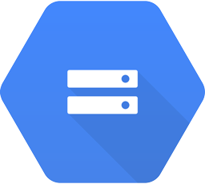


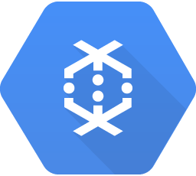

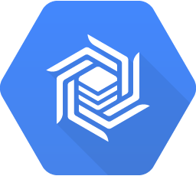
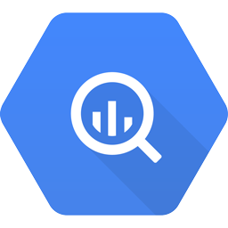

TAO People Architecture
Data ingestion and clean-up
1. External Data provider upload JSON profiles to Cloud Storage. Profiles are grouped in GZIPED files, each file contains 500k lines, each line a JSON profile. Total size ~300 millions lines
2. Optional: Raw data is preprocessed and moved to ingestion bucket. Potential processing steps here depends on clean-up processing capabilities
3. Data from ingestion bucket is also imported to BigQuery for analytics and Data Studio
4. Data from ingestion bucket is processed using specific tools for clean-up.
5. During clean-up, matching provider lists are used to ensure compatibility to matching algorithm
6. Result of data processing are also loaded to BigQuery
7. Results are loaded to operational storage – most probably Datastore. Initial estimated size tens of millions records.
Data Provider
1
Raw Data Cloud Storage
5
Matching Provider
2
One Time Tasks
Processing
Operational Storage
Hadoop/Spark Cloud Dataproc
Cloud Storage
Stage 1 Cloud Storage
4
Dataflow/Beam Cloud Dataflow
7
Cloud Datastore
Bespoke Apps Compute Engine
Cloud Bigtable
Recruitment for data scientist can start immediately.
He will have to:
- Read data from a bucket, preferably in actual format, or in a rather similar format
- Read data from matching provider or backend
- Import to specific Google services
- Process according to specifications
- Upload to operational storage and BigQuery – operational storage probably will be datastore.
6
3
BigQuery
BI Interface Data Studio 360

Slide 3

TAO People Architecture
Operations
1. Scheduled task process updates and upload the modifications to BigQuery for analytics
2. Scheduled task process updates and upload the modifications to external matching provider.
3. User request matching profiles for a job description
4. Back end creates a task to perform matching
5. The task inquire external matching provider. The answer will contain at most 1k-2k profiles ids
6. The task store the id list in database.
7. The App Engine retrieve the profiles and send them to front-end.
LinkedIn Facebook
BI Interface Data Studio 360
FirebaseUI Auth
BigQuery
1
Scheduled Tasks
2
Frontend
3
App Engine
Operational Cloud Datastore
7
6
4
Task Queues
5
Matching Provider

Slide 4
TAO People Architecture - Questions
Data size: The main data challenge is managing candidate profiles: we expect to work with 300-700 millions profiles.
Profile operations:
initial uploading
individual profile upload based on unique
retrieval of batches of 1000-2000 profiles by id. These batches need further filtering by name, location, and other fields.
Questions:
Is Datastore the right choice here? Would other options like Spanner or Bigtable be more appropriate?
If Datastore is the right choice here, what would be a good way to manage retrieval of set of 2k ids, considering there is no classical SQL “IN” operator?
Tasks: The API reference page for Task Queue mention it is Alpha release and we should apply for Cloud Tasks (also alpha). This apply only to REST API or to entire service? Is the regular use of Python libraries covered by SLA?
Cloud Functions: We consider using them for example to perform the upload to external matching provider each time when Cloud Storage changes.
According to product page, they are still in beta stage. Any possibility to learn more about roadmap?

