Slide 1
Covid data visualization website

Slide 2
content
data (include place and confirmed case)
map (provide a zoom in and out map to visualize the confirmed case in each place

Slide 3
language and framework
python
flask, bootstrap, panda, jupyter notebook, folium

Slide 4
data source
https://github.com/CSSEGISandData/COVID-19/blob/master/csse_covid_19_data/csse_covid_19_daily_reports/12-29-2020.csv

Slide 5
data source (tech we used)
panda
folium (map)

Slide 6
timeline
get data on jupyter notebook
make a sample for visualization map
write flask template
apply bootstrap and css to make the page look nicer
final styling

Slide 7
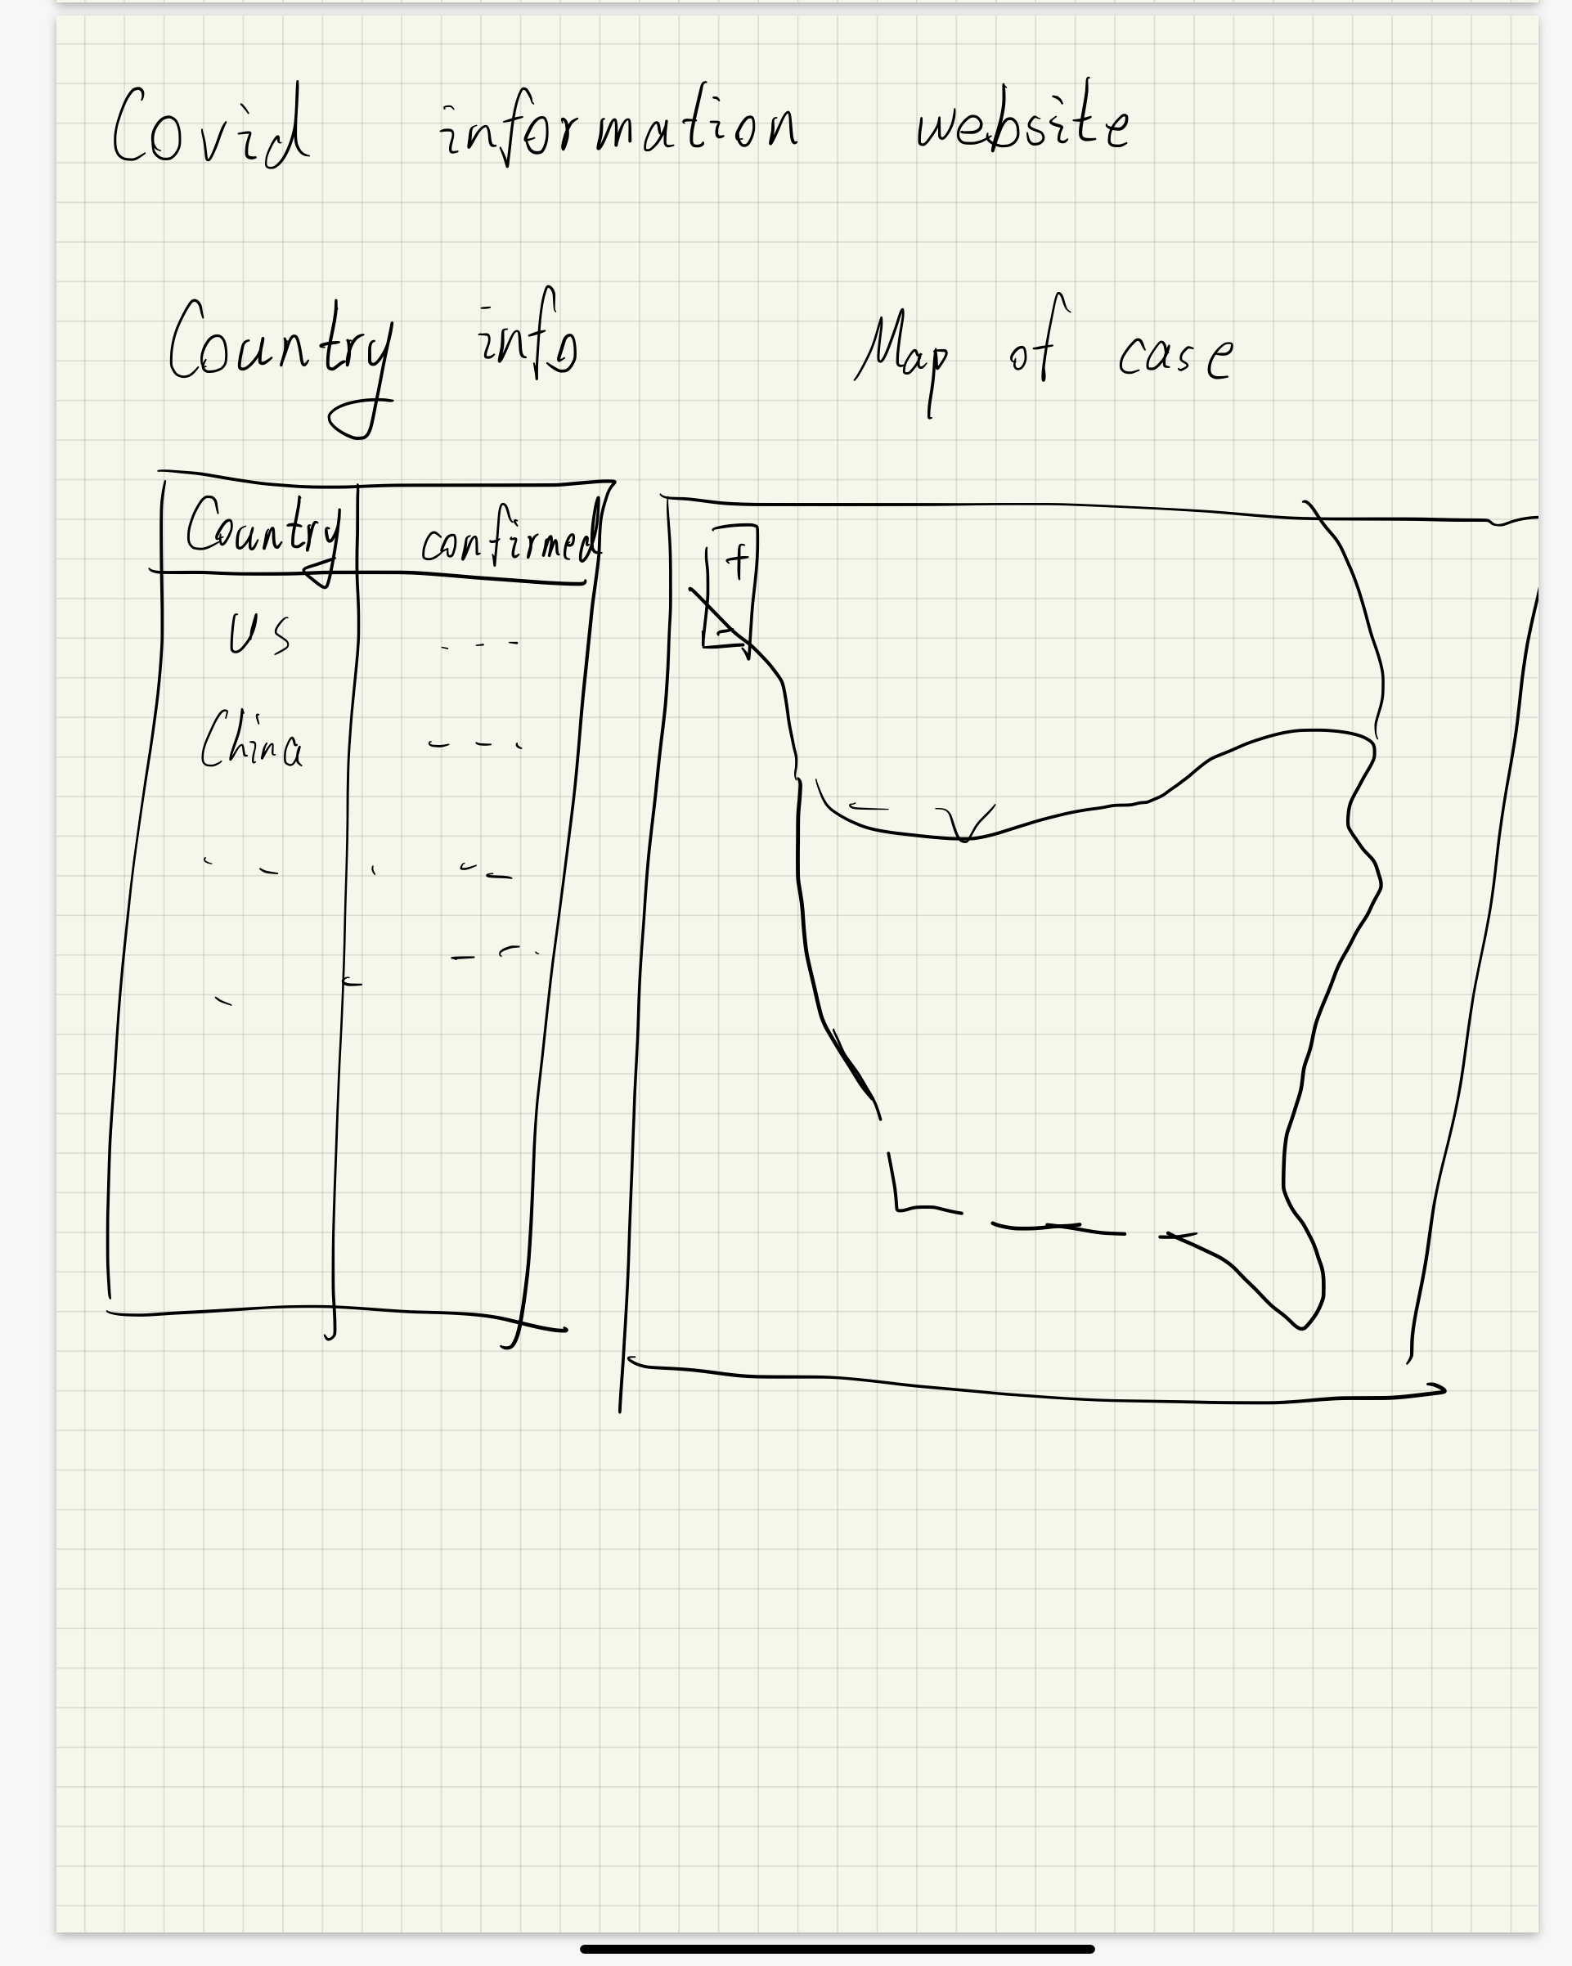
Demo

Slide 8
responsibility
get data on jupyter notebook (jie)(1-2 days)
make a sample for visualization map (jie and Fei) (1-2 days)
write flask template (jie and Fei)(3-4 days)
apply bootstrap and css to make the page look nicer (Fei)(2-3 days)
final styling (jie and Fei) (1-2 days)

Slide 9
Future work
add a dynamic page with updated dataset
add a database to store the data

