Slide 1
PDM PROJECT presentation

Slide 2

Sentiment analysis for product rating
Trịnh Quang Anh - ITITIU19002 Lê Trần Phong - ITITIU19180 Nguyễn Ngọc Minh Nhật - ITITIU19172 Phạm Duy Thịnh - ITITIU19215 Lê Việt Khôi - ITITIU18300

Slide 3
1. Introduction
a. Technologies Utilization
b. E-commerce Website API
2. Body
a. MSC Architecture
b. Database Design
c. Sentiment analysis for product rating system
d. Relational Models
3. Conclusion
a. Advantages
b. Disadvantages
c. Demo

Slide 4



Slide 5
INTRODUCTION

Slide 6
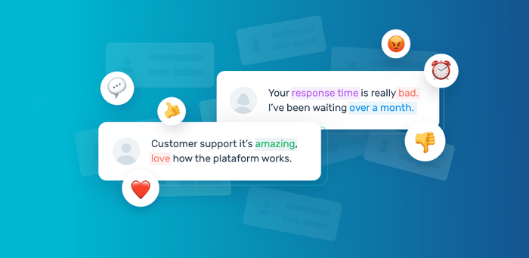
What is sentiment analysis for product rating system?

Slide 7
Technologies Utilization

Slide 8




Slide 9
E-commerce Website API

Slide 10
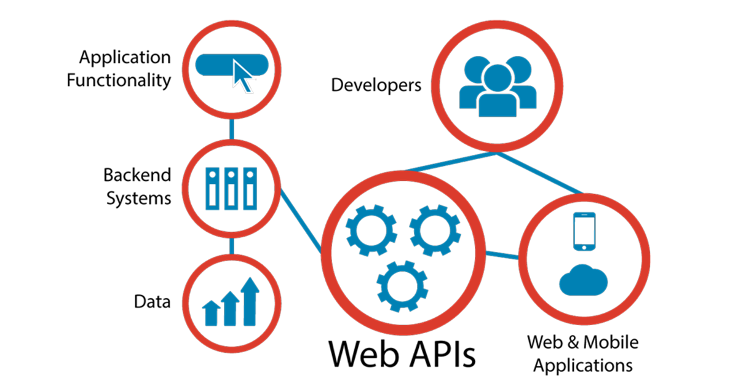
Necessary features:
☞ User Authentication  Product Review  Product Searching and Filter  Shopping Cart and Order  Advertisement and Promotion

Slide 11
Body

Slide 12
MSC Architecture

Slide 13
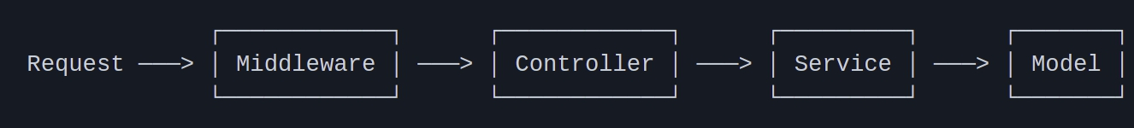
MCS diagram

Slide 14
MCS
Model layer
Responsible for defining how is defined the data model
Service layer
Get the data and logically handle it before being called by the Controller
Controller layer
Handling and contains the flow of logic for the application and determines what response to send back

Slide 15

DaTABASE DESIGN

Slide 16
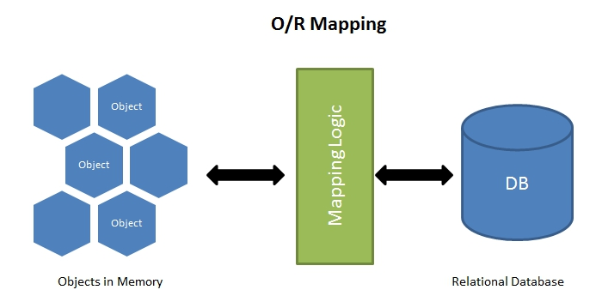
Object-Relational Mapping

Slide 17


Manage database

Slide 18
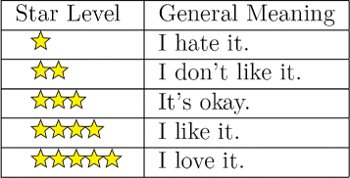
Sentiment Analysis for product rating

Slide 19
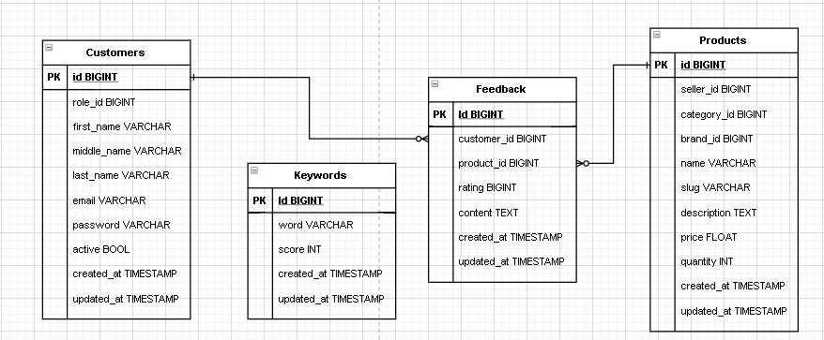

Slide 20


Slide 21
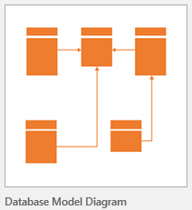
ENTITY-RELATIONSHIP MODELS

Slide 22
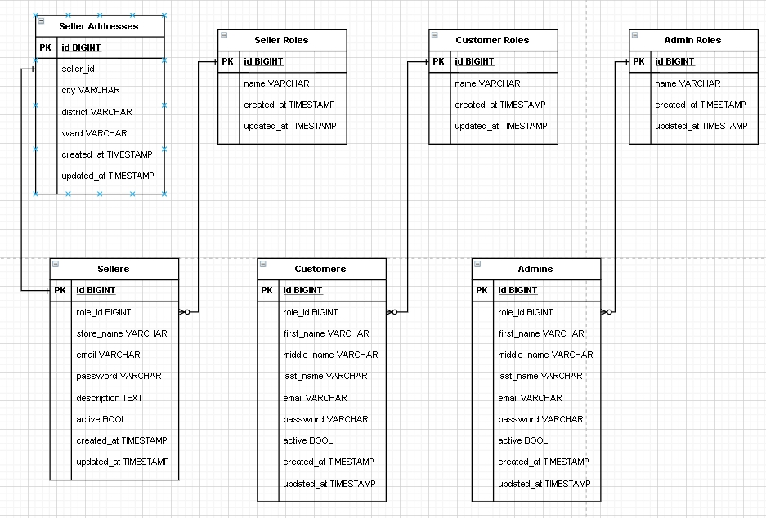
Users Relational MODELS

Slide 23
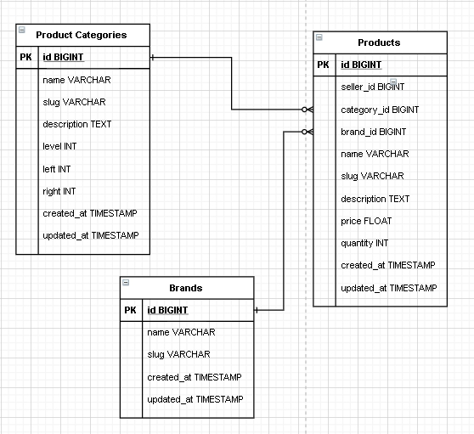
PRODUCT RELATIONAL MODELS

Slide 24
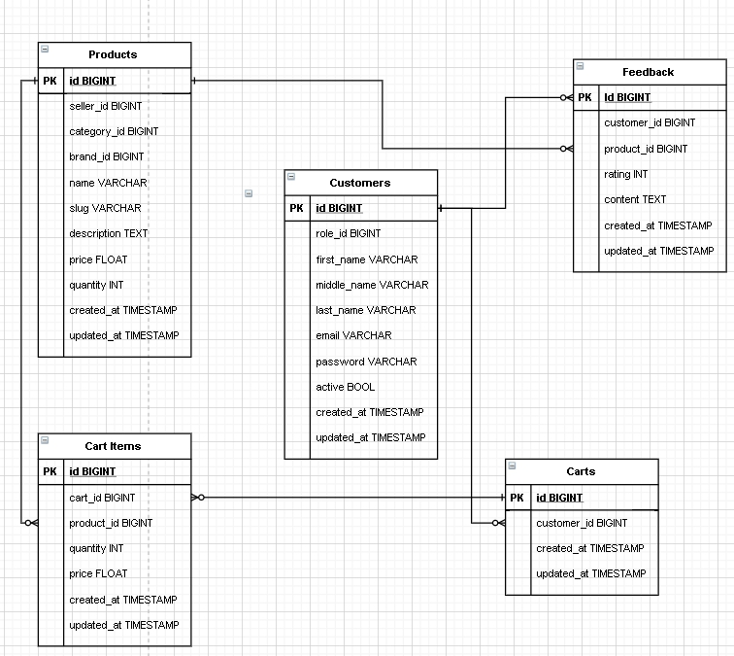
CART RELATIONAL MODELS

Slide 25
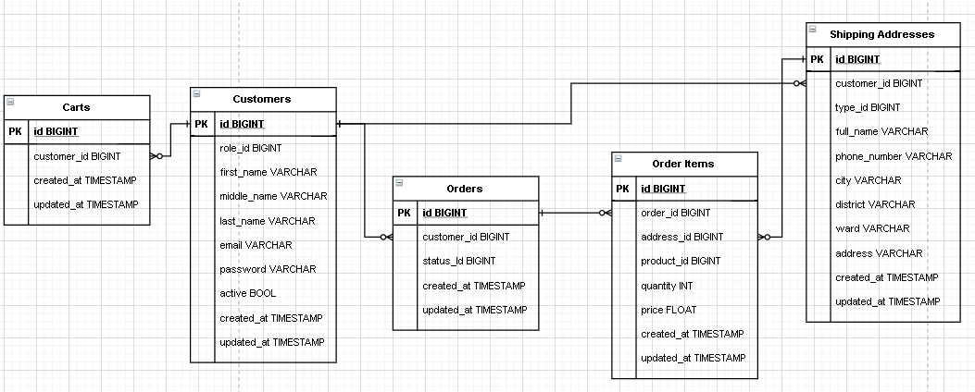
ORDER RELATIONAL MODELS

Slide 26
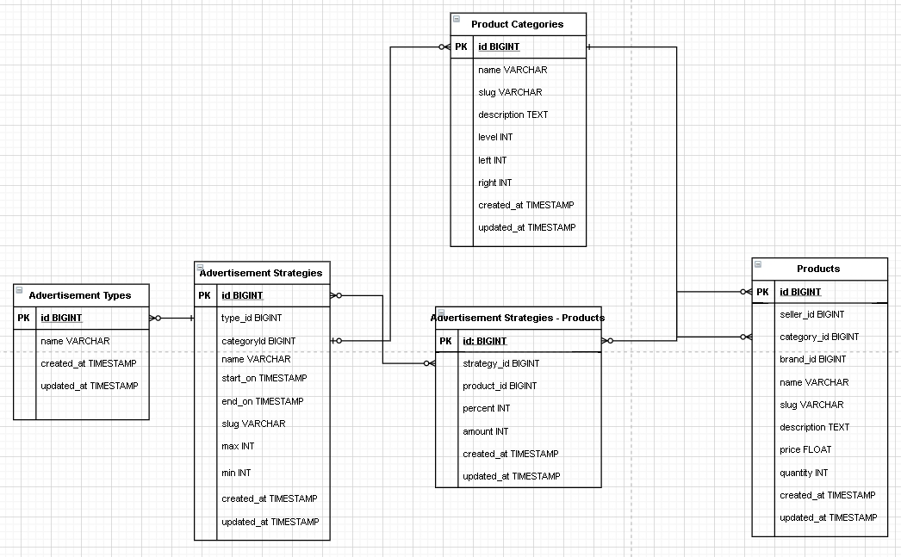
ADVERTISEMENT RELATIONAL MODELS

Slide 27
CONCLUSION

Slide 28
ADVANTAGES
Enhace product viewpoint sharing
Improve user evaluation of product quality
DISADVANTAGES
keywords limitation in database
the rest of the words are ignored
⇨ difficulty in analyzing and evaluating complex feedbacks

Slide 29




REFERENCES
https://resources.fabric.inc/blog/ecommerce-data-model
E-commerce Data model
http://mikehillyer.com/articles/managing-hierarchical-data-in-mysql/
https://nodejs.org/en/
https://expressjs.com/
https://www.docker.com/
https://www.typescriptlang.org/

Slide 30


Slide 31
Thanks!
Any questions?

