Slide 1
CSE303 Project Presentation
BY: Md. Golam Quaiyum - 1530281
Sheikh Anandee Hasan - 1730700
Shibriat Hossain - 1831099

Slide 2
Introduction Objectives of the project
To analyse the enrolment procedure and enrolment status of a student.
To help the higher authorities such as VC, Dean or department head to understand and assess student progress.
To provide insight into what students are learning in relation to the big ideas of the courses and the program they aim to complete.
To automate the process of monitoring student performance so as to reduce the manual processing involved in it.
To analyse how student populations are learning inside of their programs so that the departments can focus more strategically on equity and success.

Slide 3
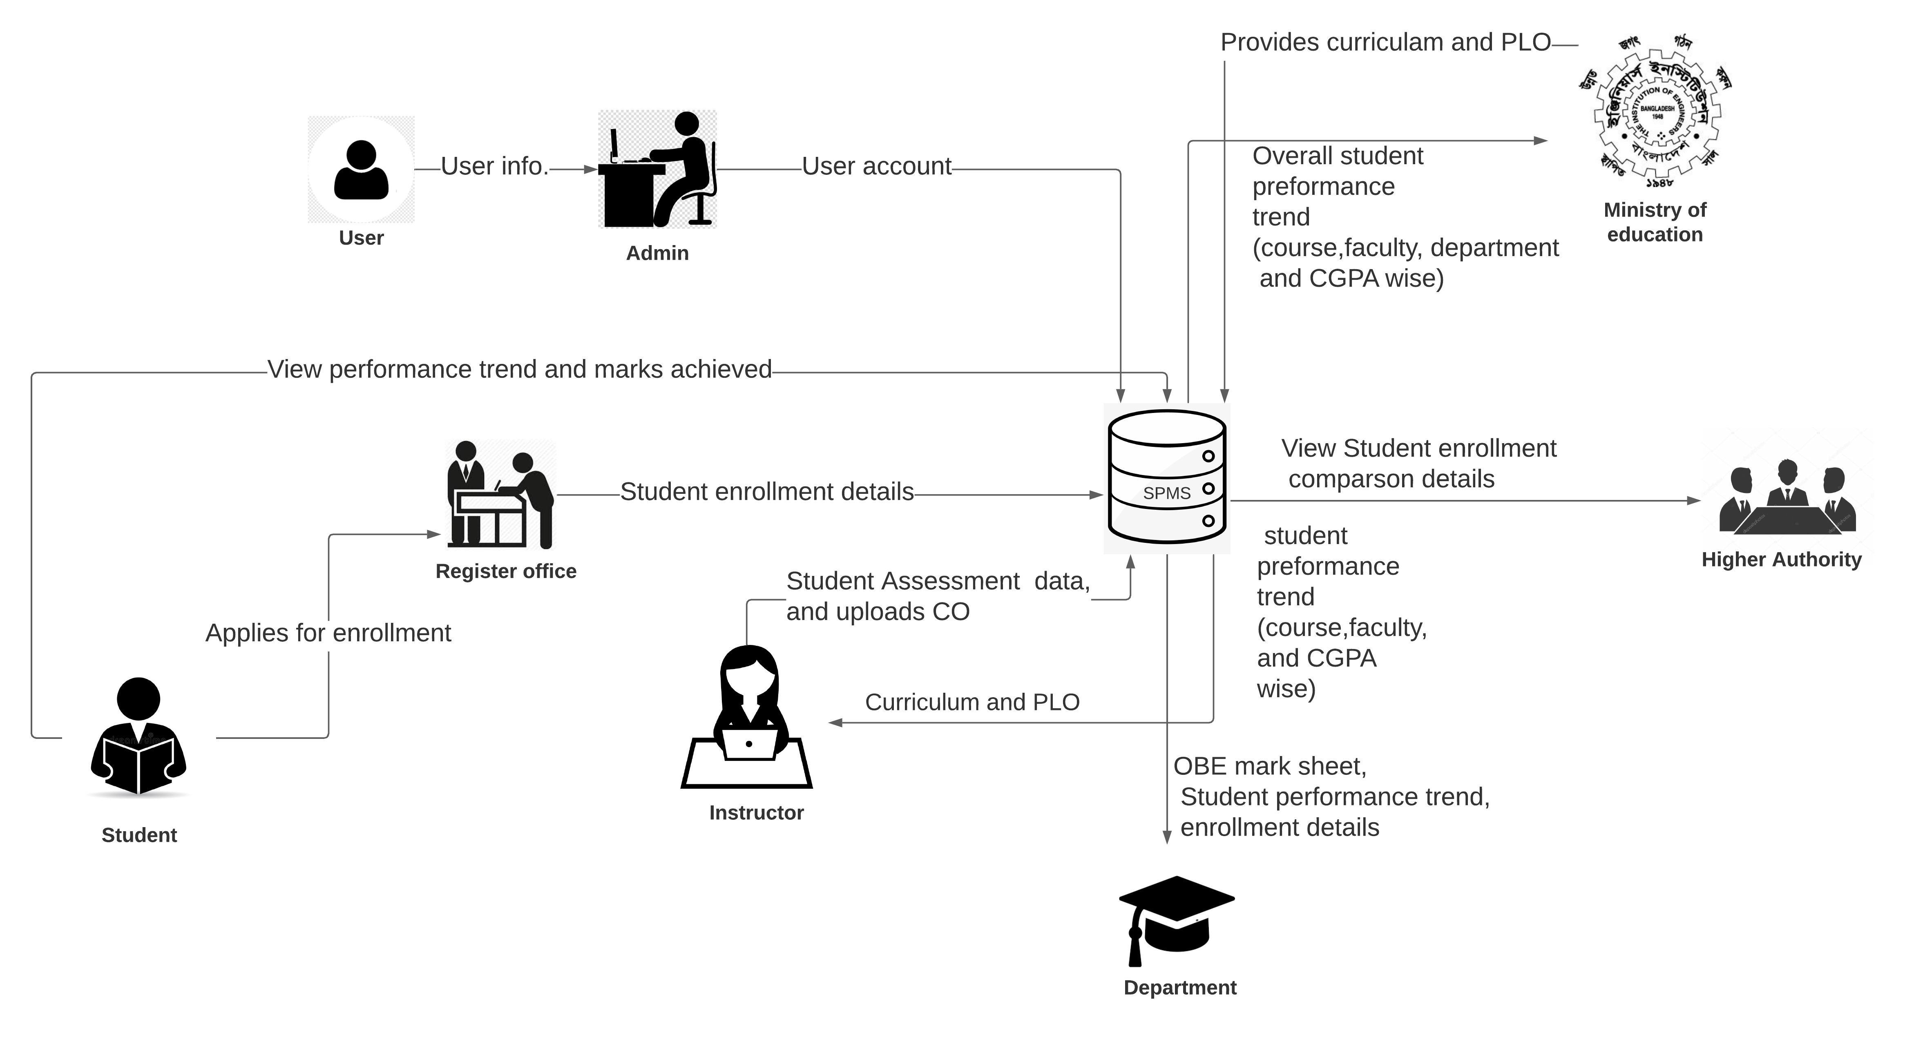
Student Performance Monitoring System Rich Picture

Slide 4
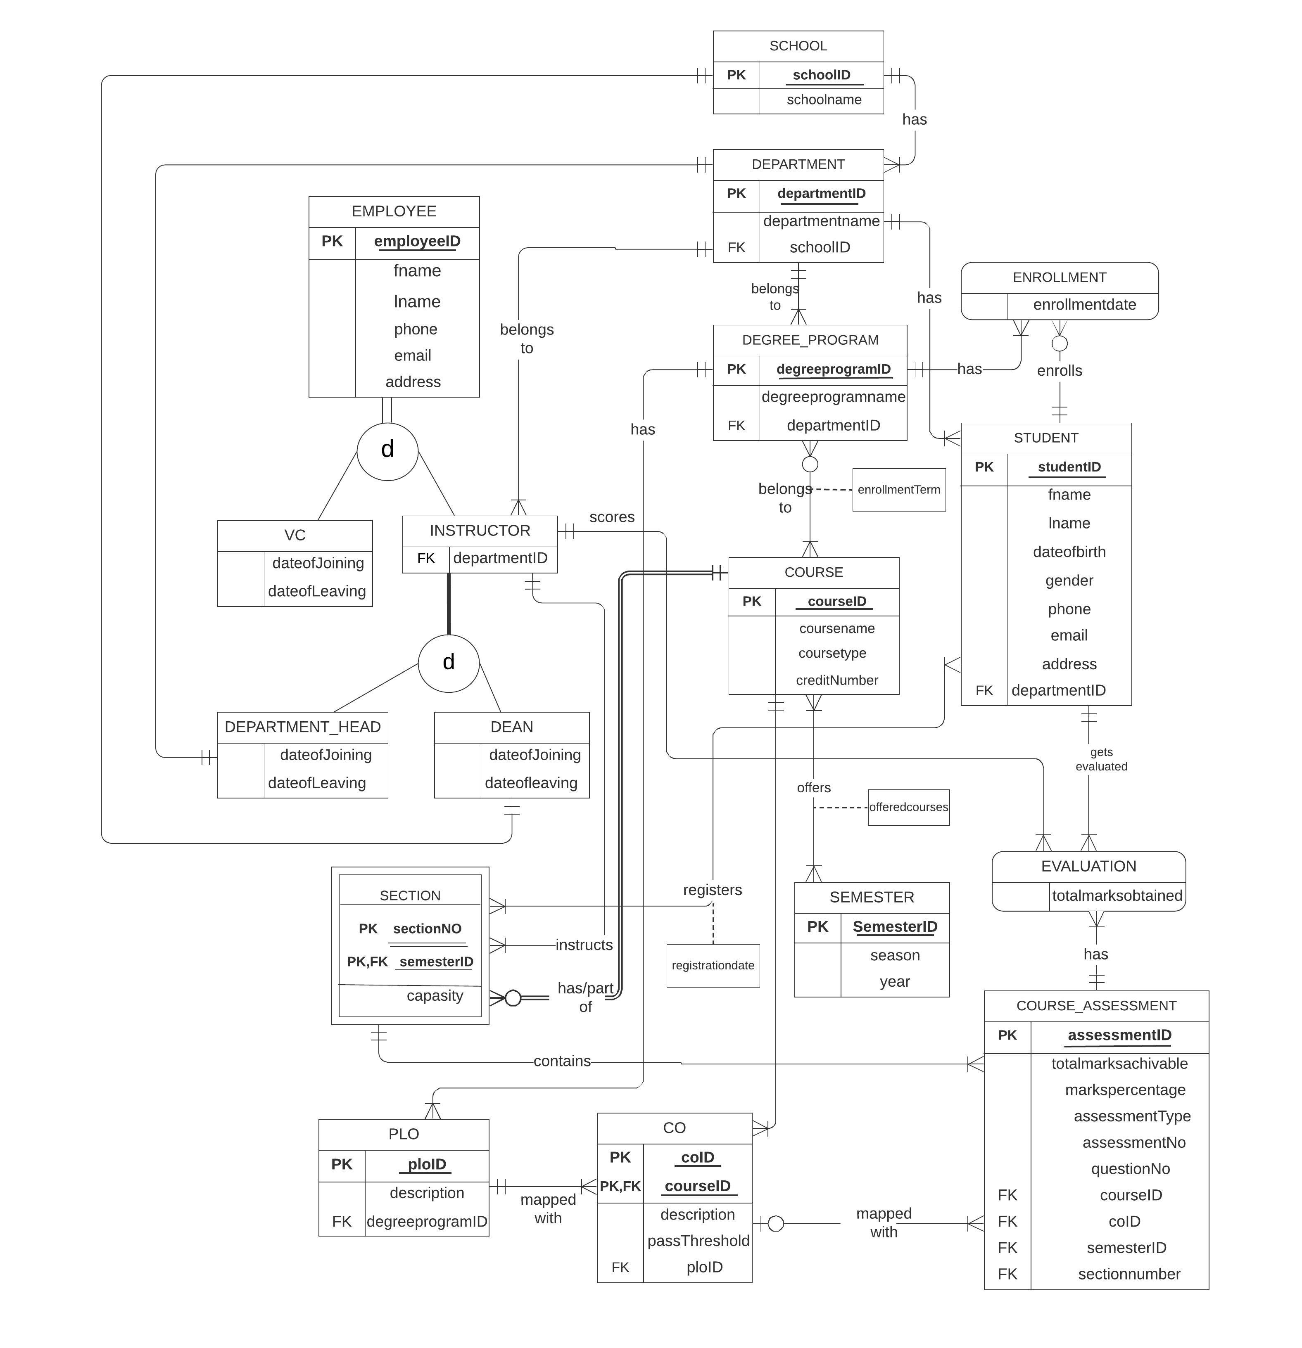
Enhanced Entity Relationship Diagram

Slide 5
Input Forms
Assessment Data Entry
Enrollment Data Entry

Slide 6
Output Reports
PLO/CO Achievement Comparison View
Assessment Data View
Student Result View
Enrollment Data View
Enrollment Comparison View

Slide 7
Conclusion
The system that we have created can automatically store and retrieve data that were previously done manually.
It is more effective and user friendly as gathering and collecting data manually was a tiresome task.
Primarily we have focused on IUB as the organization for this project but with some modification this can be useful to other universities as well.

Slide 8
Thank you

