Slide 1
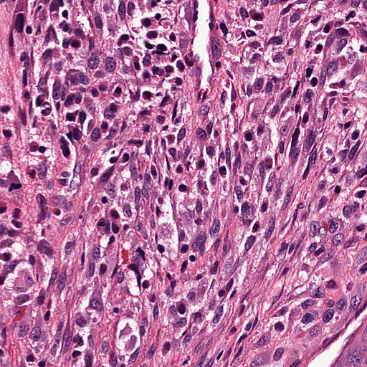
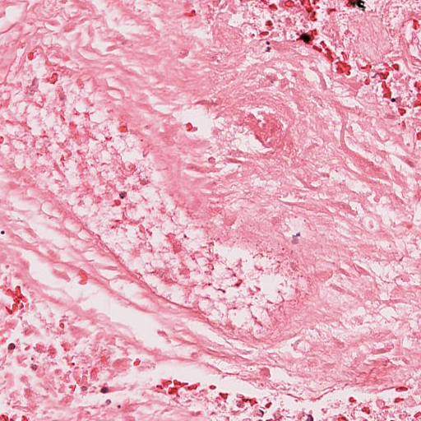
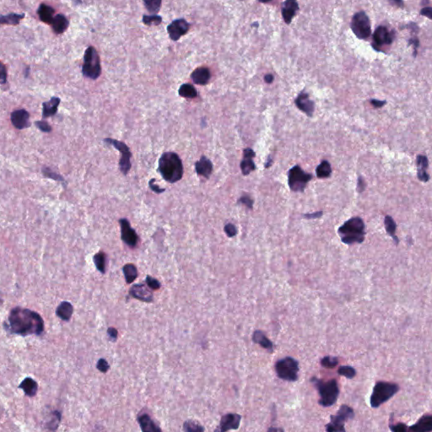
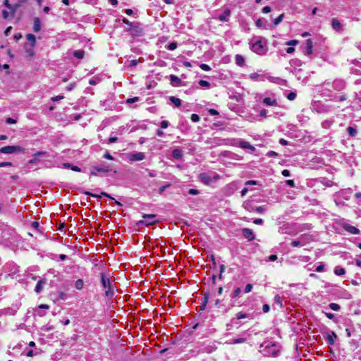
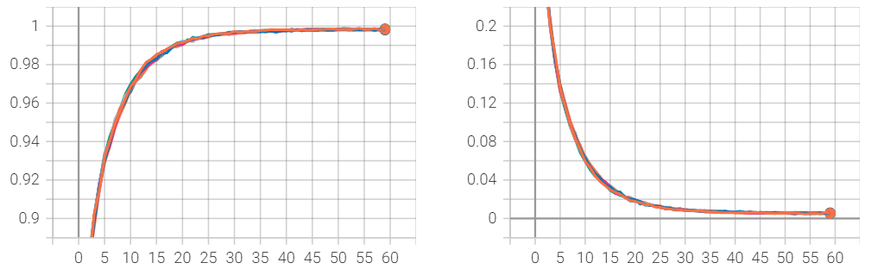
Classifying Histopathologic Glioblastoma Sub-regions with EfficientNet
Sanyukta Adap, Ujjwal Baid, Spyridon Bakas
Division of Computational Pathology, Department of Pathology and Laboratory Medicine, Indiana University School of Medicine
Glioblastoma (GBM) is the most common aggressive fast-growing brain tumor, with a grim prognosis.
Histopathological assessment of excised tumors is the first line of clinical diagnostic routine.
We hypothesize that automated, robust, and accurate identification of histological sub-regions within GBM could contribute to morphological understanding of this disease at scale.
Methodology
Training Set: BraTS-Path training set (96,485 GBM patches)
Validation Set: BraTS-Path validation set (36,401 GBM patches)
Preprocessing: Deconvolution, augmentation, pixel intensity scaling
Model: EfficientNet (ENet) B1
Training: 5-fold cross validation
Prediction: Ensembled outputs from 5 folds
Prediction
Data/Input
(BraTS-Path: GBM patches)
0
Cellular Tumor
Preprocessing
Model Training
1
Pseudopolisading Necrosis
Deconvolution
5-fold
Cross Validation
+
Ensembling
2
Microvascular Proliferation
Scaling
Augmentation
3
Geographic Necrosis
4
Infiltration into cortex
5
Penetration into White Matter
Results
Table 1: Initial model screening without cross validation
Cross Validation: Training curves on top-2 models
Table 3. Cross Validation results on challenge validation data
Model | Val F1 | Val MCC
ENet-B0 | 0.288 | 0.242
ENet-B1 | 0.462 | 0.374
ENet-B2 | 0.345 | 0.262
ENet-B3 | 0.274 | 0.214
ENet-B4 | 0.43 | 0.336
Model | Epoch | Val F1 | Val MCC
ENet-B1 | 20 | 0.491 | 0.388
ENet-B1 | 25 | 0.509 | 0.401
ENet-B1 | 30 | 0.546 | 0.436
ENet-B1 | 35 | 0.535 | 0.427
ENet-B4 | 20 | 0.403 | 0.311
ENet-B4 | 25 | 0.438 | 0.337
ENet-B4 | 30 | 0.393 | 0.307
ENet-B4 | 35 | 0.390 | 0.301
F1
Table 2. Hyperparameters used for inference
ENet-B1 Fold-1
ENet-B1 Fold-2
ENet-B1 Fold-3
ENet-B1 Fold-4
ENet-B1 Fold-5
ENet-B4 Fold-1
ENet-B4 Fold-2
ENet-B4 Fold-3
ENet-B4 Fold-4
ENet-B4 Fold-5
Hyperparameter | Value
Batch Size | 16
# Epochs | 60
Loss Function | Cross Entropy
Optimizer | Adam
Momentum | 0.0001
Learning Rate (LR) | 0.001
LR Scheduler | Exponential
LR Decay Rate | 0.9
Loss
Epoch No.
Conclusion
The results from each (5-fold) “weak” models form one “strong” (ensembled) model, that can classify the images much better than individual models
Ensembling might also avoid systematic biases that might be caused by individual models.
Simpler models may generalize better to new data; more complex models may be overfitting on training set.
The importance of a balance between model complexity and generalization, especially in medical applications.
References
Kanderi, T., Munakomi, S. and Gupta, V., 2024. Glioblastoma multiforme. In StatPearls [Internet]. StatPearls Publishing.
Bakas, S., Thakur, S.P., Faghani, S., Moassefi, M., Baid, U., Chung, V., Pati, S., Innani, S., Baheti, B., Albrecht, J. and Karargyris, A., 2024. BraTS-Path Challenge: Assessing Heterogeneous Histopathologic Brain Tumor Sub-regions. arXiv preprint arXiv:2405.10871.
Tan, M. and Le, Q., 2019, May. EfficientNet: Rethinking model scaling for convolutional neural networks. In International conference on machine learning (pp. 6105-6114). PMLR.
??

