Slide 1
Semantic Web for Life Sciences Workshop
Session VII:
Semantic Aggregation,
Integration, and Inference
Moderator: Joanne Luciano
October, 28 2004
Cambridge, MA USA

Slide 2
Semantic Web for Life Sciences Workshop
Session VII:
Pedantic Aggravation,
Irritation, and Interference
Moderator: Joanne Luciano
October, 28 2004
Cambridge, MA USA

Slide 3
BioPAX
BioPAX: Biological PAthway eXchange
A data exchange ontology and format for semantic integration, aggregation and inference of biological pathway data
Open source community effort – the community agreed upon and built this!
www.biopax.org
Notes:
BioPAX will provide a consistent format for pathway data so it will be easier for consumers of pathway data (e.g. tool developers, DB curators) to integrate data from multiple sources. More than just a data format standard, it is a data *content* standard

Slide 4
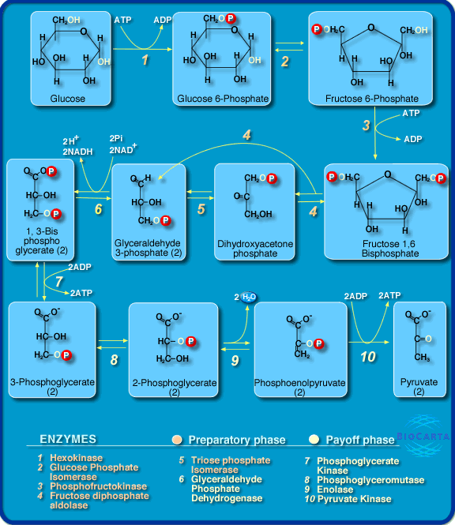
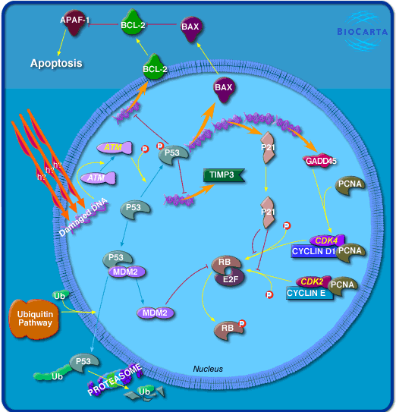
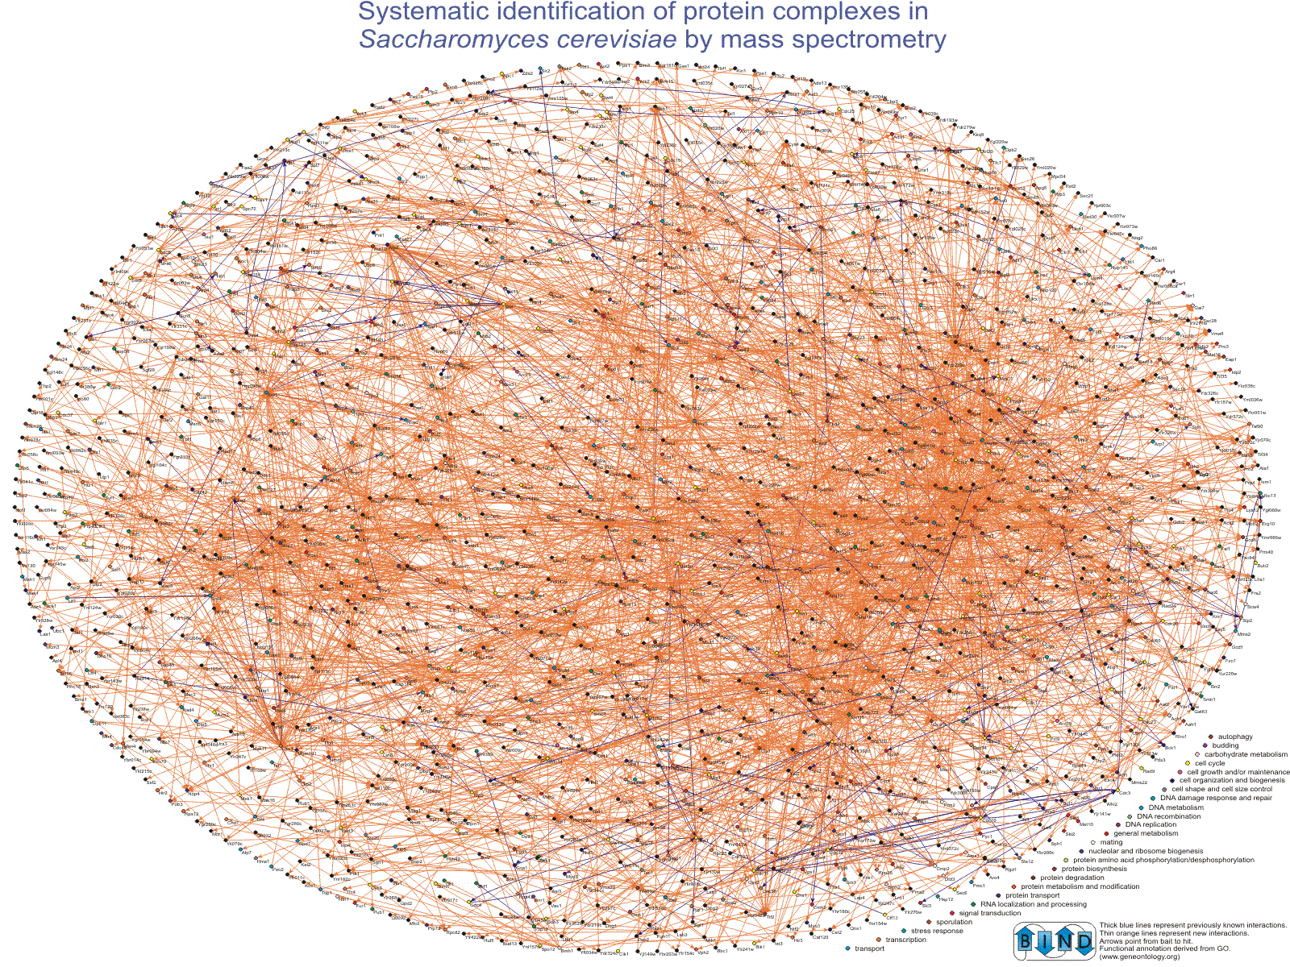
The domain: Biological pathways
Main categories:
Metabolic
Pathways
Molecular
Interaction
Networks
Signaling
Pathways
Notes:
Also include gene regulation

Slide 5
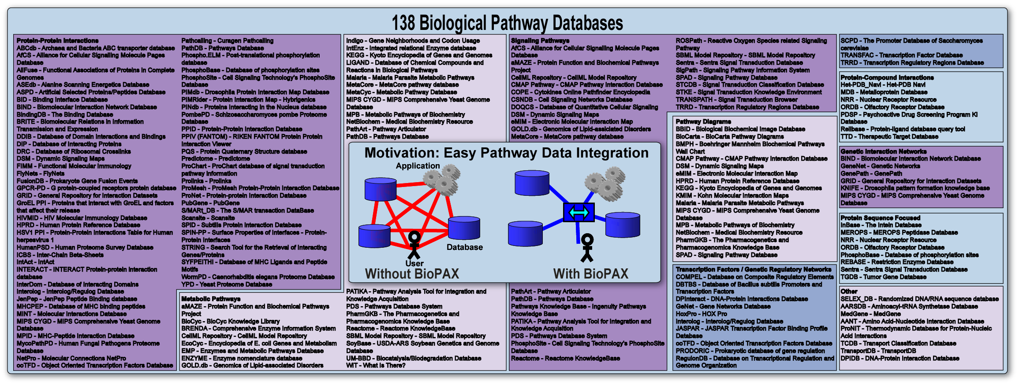
The Problem
So many pathway databases, all with their own data models, formats, and data access methods.
Source: Pathway Resource List (http://cbio.mskcc.org/prl/)
Notes:
Include the number 138 in larger font

Slide 6
BioPAX Motivation
>150 DBs and tools
Application
Database
User
Before BioPAX
With BioPAX
Common format will make data more accessible, promoting data sharing and distributed curation efforts
Notes:
Designed by the databases for themselves (DB-DB exchange) and for users. Umm… not really for users, yet. Unless you integrate into SBML

Slide 7
Exchange Formats in the Pathway Data Space
Database Exchange
Formats
Simulation Model
Exchange Formats
BioPAX
Genetic
Interactions
SBML,
CellML
PSI-MI 2
Interaction Networks
Molecular Non-molecular
Pro:Pro TF:Gene Genetic
Regulatory Pathways
Low Detail High Detail
Rate
Formulas
Molecular Interactions
Pro:Pro All:All
Biochemical
Reactions
Metabolic Pathways
Low Detail High Detail
Small Molecules
Low Detail High Detail
Notes:
This slide shows the difference between exchange formats in the pathway data space. Pathway databases and tools are not considered here, although each one is important and addresses specific use cases. I would use the other slide which shows the scope of BioPAX level 1. You can always point out that BioPAX intends to cover the whole space. It is important not to overstate the current state of things.
BioPAX level 1 is broad and shallow allowing us to quickly build a format that can represent most the existing data types in databases today. Details will be added in subsequent levels. This is a practical approach.

Slide 8
Aggregation, Integration, Inference
Multiple kinds of pathway databases
  metabolic
  molecular interactions
  signal transduction
  gene regulatory
Constructs designed for integration
  DB References
  XRefs (Publication, Unification, Relationship)
  Synonyms
  Provenance (not yet implemented)
OWL DL – to enable reasoning
Notes:
Be careful when using the word provenance. It turns out that there is an official way to do provenance in RDF, and we need to think more deeply about how to do this in BioPAX. Larry Hunter talks about this quite knowledgably.

Slide 9
BioPAX uses other ontologies
Conceptual framework based upon existing DB schemas:
    aMAZE, BIND, EcoCyc, WIT, KEGG, Reactome, etc.
    Allows wide range of detail, multiple levels of abstraction
Uses pointers to existing ontologies to provide supplemental annotation where appropriate
  Cellular location → GO Component
  Cell type → Cell.obo
  Organism → NCBI taxon DB
Incorporate other standards where appropriate
  Chemical structure → SMILES, CML, INCHI
Interoperate with existing standards (RDF/OWL, LSID, SBML, PSI, CellML Metadata Standard)

Slide 10
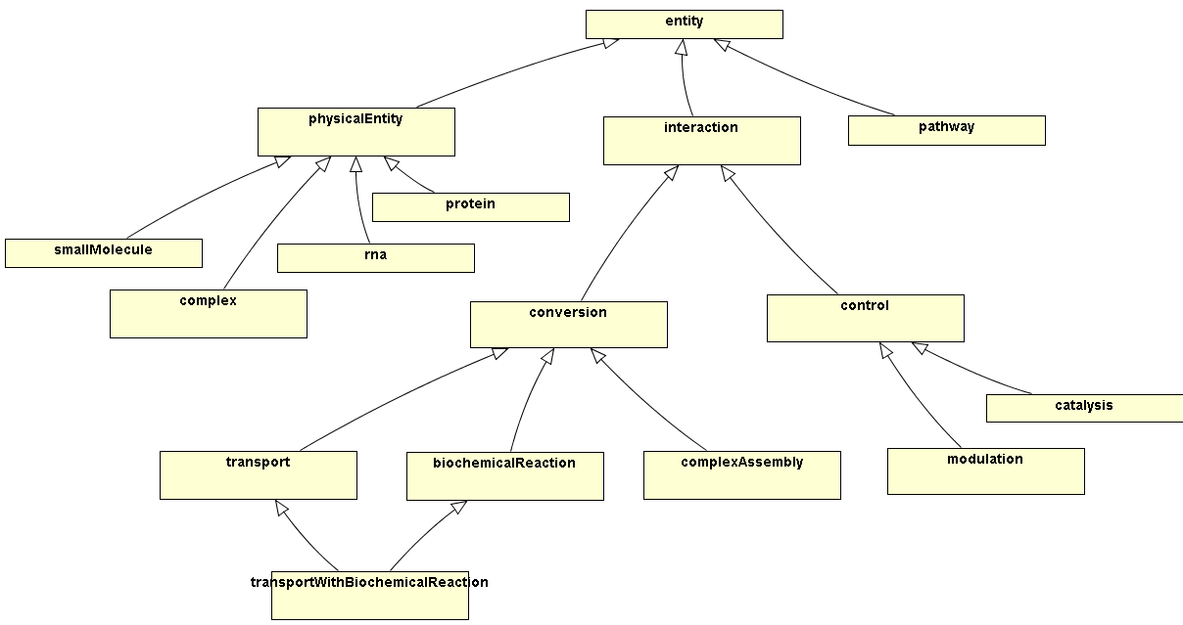
BioPAX Ontology: Overview
Level 1 v1.0 (July 7th, 2004)
Notes:
This slide puts it all together. Actually, where I say species, I really mean SpeciesType. Species is really equivalent to PhysicalEntityParticipant

Slide 11
Case study: BioPAX in SBML facilitates SMBL integration
Addresses SBML’s nasty data integration issues
Different data types, same representation
Same data, different representations
External references…
Synonyms…
Provenance…

Slide 12
BioPAX Ontology: Overview
species
reaction
modifier
Level 1 v1.0 (July 7th, 2004)
Notes:
This slide puts it all together. Actually, where I say species, I really mean SpeciesType. Species is really equivalent to PhysicalEntityParticipant

Slide 13
Different data types, same representation
Protein-Protein Interaction
<reaction
id=“pyruvate_dehydrogenase_cplx”/>
<listOfReactants>
<speciesRef species=“PdhA”/>
<speciesRef species=“PdhB”/>
</listOfReactants>
<listOfProducts>
<speciesRef species=“Pyruvate_dehydrogenase_E1”/>
</listOfProducts>
</reaction>
Biochemical Reaction
<reaction id=“pyruvate_dehydrogenase_rxn”/>
<listOfReactants>
<speciesRef species=“NADP+”/>
<speciesRef species=“CoA”/>
<speciesRef species=“pyruvate”/>
</listOfReactants>
<listOfProducts>
<speciesRef species=“NADPH”/>
<speciesRef species=“acetyl-CoA”/>
<speciesRef species=“CO2”/>
</listOfProducts>
<listOfModifers>
<modifierSpeciesRef species=“pyruvate_dehydrogenase_E1”/>
</listOfModifiers>
</reaction>
Notes:
Protein-protein interaction and Biochemical reaction

Slide 14
BioPAX solution: metadata
<sbml xmlns:bp=“http://www.biopax.org/release1/biopax-release1.owl”
xmlns:owl="http://www.w3.org/2002/07/owl#"
xmlns:rdf="http://www.w3.org/1999/02/22-rdf-syntax-ns#">
<listOfSpecies>
<species id=“PdhA” metaid=“PdhA”>
<annotation>
<bp:protein rdf:ID=“#PdhA”/>
</annotation>
</species>
<species id=“NADP+” metaid=“NADP+”>
<annotation>
<bp:smallMolecule rdf:ID=“#NADP+”/>
</annotation>
</listOfSpecies>
<listOfReactions>
<reaction id=“pyruvate_dehydrogenase_cplx”>
<annotation>
<bp:complexAssembly rdf:ID=“#pyruvate_dehydrogenase_cplx”/>
</annotation>
</reaction>
<reaction id=“pyruvate_dehydrogenase_rxn” metaid=“pyruvate_dehydrogenase_rxn”>
<annotation>
<bp:biochemicalReaction rdf:ID=“#pyruvate_dehydrogenase_rxn” />
</annotation>

Slide 15
BioPAX: External References
<species id=“pyruvate” metaid=“pyruvate”>
<annotation
xmlns:bp=“http://biopax.org/release1/biopax-release1.owl”>
<bp:smallMolecule rdf:ID=“#pyruvate”>
<bp:Xref>
<bp:unificationXref rdf:ID=“#unificationXref119">
<bp:DB>LIGAND</bp:DB>
<bp:ID>c00022</bp:ID>
</bp:unificationXref>
</bp:Xref>
</bp:smallMolecule>
</annotation>
</species>
Notes:
Use acetyl-CoA + NADP+ example.
Use

Slide 16
BioPAX: Synonyms
<species id=“pyruvate” metaid=“pyruvate”>
<annotation xmlns:bp=“http://biopax.org/release1/biopax_release1.owl”/>
<bp:smallMolecule rdf:ID=“#pyruvate” >
<bp:SYNONYMS>pyroracemic acid</bp:SYNONYMS>
<bp:SYNONYMS>2-oxo-propionic acid</bp:SYNONYMS>
<bp:SYNONYMS>alpha-ketopropionic acid</bp:SYNONYMS>
<bp:SYNONYMS>2-oxopropanoate</bp:SYNONYMS>
<bp:SYNONYMS>2-oxopropanoic acid</bp:SYNONYMS>
<bp:SYNONYMS>BTS</bp:SYNONYMS>
<bp:SYNONYMS>pyruvic acid</bp:SYNONYMS>
</bp:smallMolecule>
</annotation>
</species>

Slide 17

BioPAX Supporting Groups
Groups
Memorial Sloan-Kettering Cancer Center: G. Bader, M. Cary, J. Luciano, C. Sander
SRI Bioinformatics Research Group: P. Karp, S. Paley, J. Pick
University of Colorado Health Sciences Center: I. Shah
BioPathways Consortium: J. Luciano, E. Neumann, A. Regev, V. Schachter
Argonne National Laboratory: N. Maltsev, E. Marland
Samuel Lunenfeld Research Institute: C. Hogue
Harvard Medical School: E. Brauner, D. Marks, J. Luciano, A. Regev
NIST: R. Goldberg
Stanford: T. Klein
Columbia: A. Rzhetsky
Dana Farber Cancer Institute: J. Zucker
Collaborating Organizations:
Proteomics Standards Initiative (PSI)
Systems Biology Markup Language (SBML)
CellML
Chemical Markup Language (CML)
Databases
BioCyc (www.biocyc.org)
BIND (www.bind.ca)
WIT (wit.mcs.anl.gov/WIT2)
PharmGKB (www.pharmgkb.org)
Grants
Department of Energy (Workshop)
The BioPAX Community
Notes:
Many other people have contributed in discussions in person and on the mailing list and we would like to thank them as well.

Slide 18
2:45-4:15PM Session VII:
Semantic Aggregation, Integration and Inference
What are the challenges for deploying very large datasets in Semantic Web formats?
How do existing, widely deployed database technologies intersect with Semantic Web?
How does Semantic Web enable rule-based inference?
SPEAKERS
Data Integration: Some Enabling Steps, Andy Seaborne - Semantic Web Group/Bristol, Hewlett Packard
RDF in Oracle Network Data Model, Nicole Alexander - Oracle
Lab-to-Lab Connectivity and Semantics in the Life Sciences, Greg Meredith - Djinnisys

