Slide 1
InChI v. 1.06 release
updated
2019

Slide 2
Goals
updated
InChI Software v. 1.06 - maintenance release
Modified/extended polymer support according to received feedback
Fixing some known issues with polymer support
Adding experimental ability to explicitly use pseudo-element atoms (not only for polymers)
Various minor functionality extensions and improvements according to users feedback and development backlog
Various minor fixes, both new ones and already accumulated since v. 1.05 release in 2017 (includes fixes for Google Autofuzz reported issues)
Improvement of multi-threading support
Documentation: update of InChI FAQ

Slide 3
Polymers (still experimental)

Slide 4
“Business Rules” for Polymer Drawing
Copolymers
According to PTG Report, “representations with disconnected CRUs” is recommended. All brackets (CRU and sub-CRU’s) are mandatory. The depiction should be complemented with “ran”/”alt”/”blk” marker (if absent, “ran” is assumed).
OK, random copolymer OK, converted to the same (“ran”) OK, block copolymer OK, alternating copolymer Note that either sub-SRU may be selected as “first”; InChI selects it in its own arbitrary but unique way

Slide 5
Known issues with “canonical CRU”
Two issues have gained increased attention since v. 1.05 release which added experimental support of polymers
See the next slides

Slide 6
Issue #1 “CRU folding”
CRU (Constitutional Repeat Unit; aka SRU, Structural Repeat Units) which contains in-CRU repeats was not simplified (folded)
Simplistic example *[CH2-CH2]_{n}*
is not converted to
*[CH2]_{n}*
NOW FIXED available only if non-default switch is supplied (as polymer chemists are not always happy with converting polyethylene to polymethylene)

Slide 7
“Business Rules” for Polymer Drawing
Copolymers

Slide 8
“Business Rules” for Polymer Drawing
Copolymers

Slide 9
“Business Rules” for Polymer Drawing
Copolymers

Slide 10
“Business Rules” for Polymer Drawing
Copolymers

Slide 11
Issue #2 “Frame shift for capped end groups case”
No polymer CRU “frame shift” was detected if CRU is terminated by explicitly defined end group:
H₂N[CH₂-C(O)-NH]_{n}-CH₂-C(O)OH not the same InChI as H₂N-CH₂[C(O)-NH-CH₂]_{n}-C(O)OH not the same InChI as H₂N-CH₂-C(O)[NH-CH₂-C(O)]_{n}-OH
NB: frame shift was always supported if undefined (star atoms ‘*’) are used as end groups:
*[CH₂-C(O)-NH]_{n}* same InChI as *[C(O)-NH-CH₂]_{n}* same as *[-NH-CH₂-C(O)]_{n}*
NOW FIXED

Slide 12
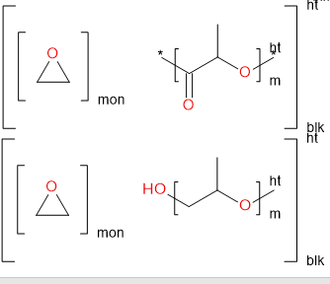
Polymers: extensions (and redesign)
On Fall 2018, a detailed feedback was received from the specialists involved in practical handling of polymer structures who extensively tested v. 1.05: Yulia Borodina, FDA Gerd Blanke, StructurePendium
Several important functionality extensions were developed according to their requests For example, support is added for copolymers represented as a combination of source-based and structure-based subunits

Slide 13
Polymers: extensions (and redesign)
updated
The most important change is
adding explicit “star” atoms (pseudo element atoms) to polymer InChI
“Experimental experimental” option
Preliminary testing is completed
Releasing and testing by users community is expected
Technicalities:
Use name “pseudo atoms” or “Zz-atoms”, as star symbol is already used in InChI strings for other purposes; Zz is fictional element, a placeholder
These atoms were nearly always used internally, but were carefully hidden from users, as a design feature...

Slide 14
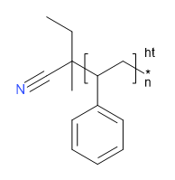
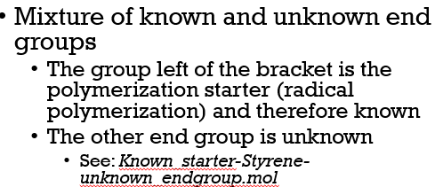
Zz-atom extension
PRO several serious reasons to have explicit Zz-atoms
Request from users who already use star atoms while “manually” post-processing InChI polymer strings (FDA)
These atoms provides more consistent description of various end group types
Opens possibilities hardly (if any) available with current “star-less” design. Example: supporting both undefined and defined end group surrounding CRU, the option requested by users. StructurePendium note:

Slide 15
Zz-atom extension
updated
CONTRA
Significant redesign of algorithm
Chiefly done (some final polishing in progress)
Changing many existing InChI polymer strings
may not be so important given still experimental “InChI=1B/” status of InChI for polymers
MISC
Upcoming v. 1.06 seems to be a good moment to introduce Zz-atoms
Zz-atoms may be used outside polymer context as general-purpose placeholders (e.g., to describe intermolecular connections; option exposed by non-default switch)

Slide 16
Miscellaneous other functionality extensions and fixes

Slide 17
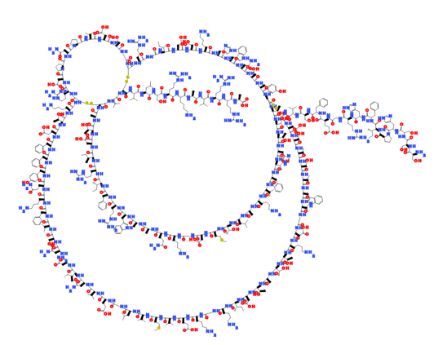
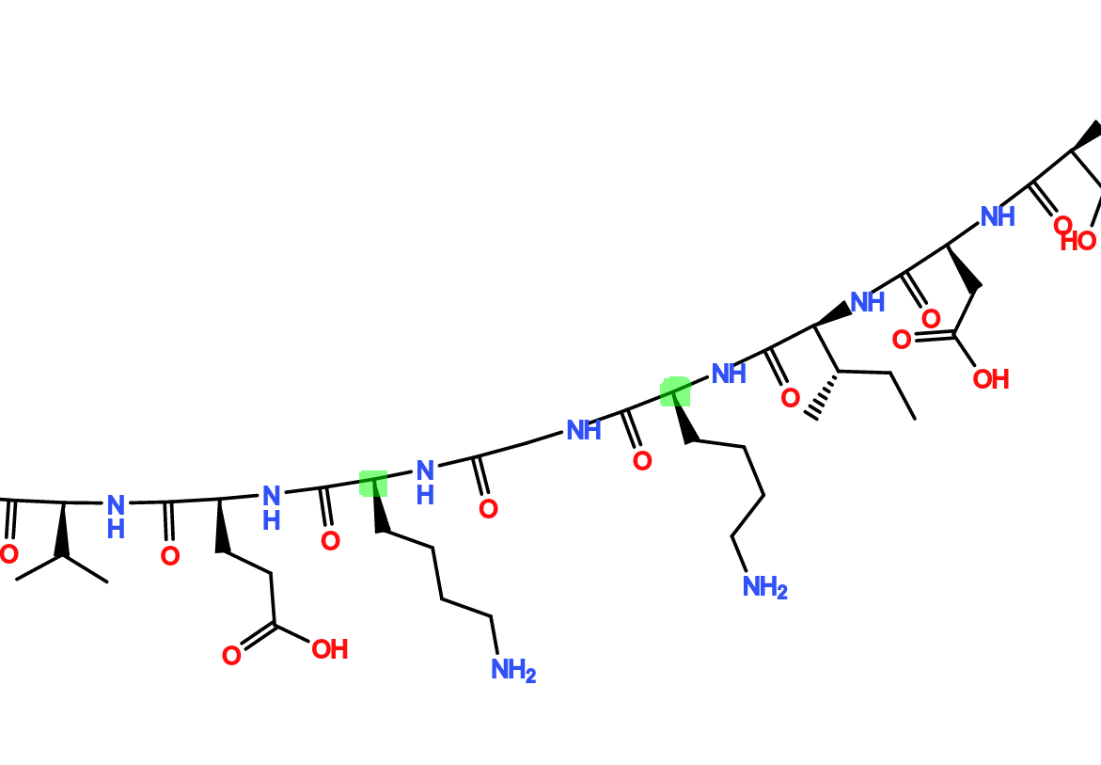
Example: LooseTSACheck
A new InChI structure-perception (i.e., available for generation of Std InChI) option LooseTSACheck relaxes the strictness of tetrahedral stereo ambiguity check, for in-ring atoms, thus getting stereo descriptor instead of undefined mark ‘?’
Accounts for now common case of large molecules/large cycles, drawn and then automatically 'cleaned' by chemoinformatics software.
Per request from FDA, see their example at right
If angle is too close to 180º, undef stereo ‘?’ appeared

Slide 18
Other minor extensions
Just some examples, much more in changelog
Added switch "NoFrameShift" (disables frame shift for all SRU's), works for both inchi-1 and API.
Added IXA_MOL_GetBondOtherAtom() exposed in the public API, as Paul Thiessen (NIH) suggested.
Added a simplistic example of using multi-threaded InChI generation into mol2inchi demo program (Linux pthreads/Windows threads are used).
Added switch "PERTHREAD:n" allowing one to process n SDF records in each of mol2inchi threads.
winchi-1: added Ctrl-Lt and Ctrl-Rt shortcuts for navigation through SDF records.
winchi-1: per Andrey Erin (ACD/Labs) request, changed disk output behavior to avoid unnecessary writing (by default, write to disk only in batch mode).
…

Slide 19
Google-Autofuzz issues
updated
What is Google-Autofuzz
Google runs a project called AutoFuzz which tries to improve security (in "computer security" sense) of open-source programs
The idea is to automatically search for various available open-source softwares and feed them with "invalid, unexpected, or random data as inputs" and then monitor for "crashes, or failing built-in code assertions or for finding potential memory leaks
By the very nature of fuzzing protocol, it uncovers problems which are relatively unlikely in regular-user practices.
Anyway, bugs found by (auto)fuzzers are still bugs

Slide 20
Google-Autofuzz issues
updated
November 2017 6 tickets (#20-26) on SourceForge & GoogleTracker…
December 2018 14 more tickets appeared on SourceForge
An example follows.

Slide 21
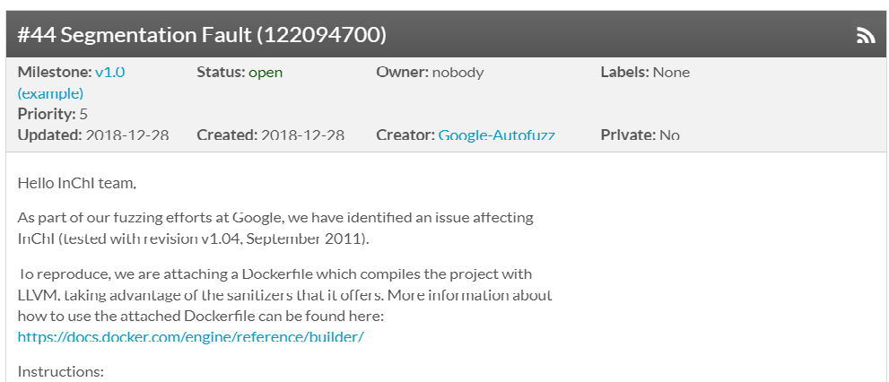
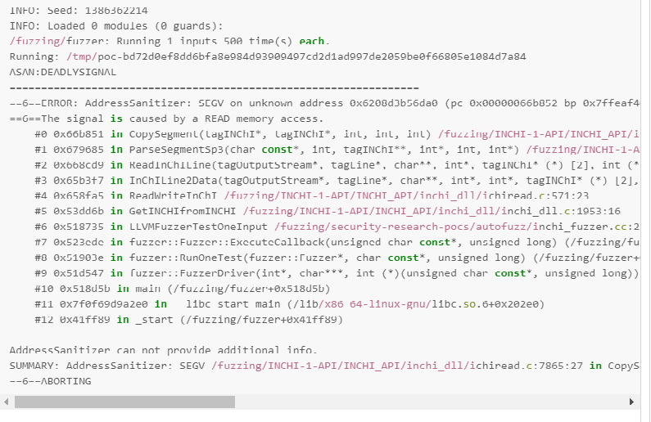
updated

Slide 22
Fixing Google-Autofuzz issues
updated
Total 20 issues/tickets
FIXED 20 out of 20 (Jan 2019)

Slide 23
A side note on SourceForge
updated
Do we still need in SourceForge hosting and bug tracker at all?
We do not develop on SourceForge and do not distribute software releases from there
We just use mailing list there (and it is far from perfect)
Seems that some people have a false feeling that SourceForge is InChI’s home.
Of course, the actual home is currently an InChI Trust site. Would it be wise to shutdown at SourceForge and migrate to inchi-trust.org, finally?

Slide 24
Some minor fixes
updated
Too many to list here. Just some examples, much more in changelog
Improved performance of IXA memory allocations by using expandable arrays (per request by Daniel Lowe; see #ifdef IXA_USES_SMART_ALLOCS).
Fixed bug which caused crash on read V3000 file alkane-c4000.mol.
Fixed bug in inchi2struct for polymers exhibiting when multipliers in brutto formula appear
Fixed erroneous behavior at display with "/D" option (required just changing one type cast:)
Fixed issue in polymer treatment: enabled SRU frame (phase) shift only for "head-to-tail" connection (was mistakenly set to general case).
Fixed critical race condition bug pointed out by Karl Nedwed, strutil.c.
Fixed bug reported by Andrew Dalke on inchi-discuss 2018-01-25 and re-issued by Burt Leland on 2018-07-13: impossible H isotope sometimes resulted in memory corruption.
Fixed return codes of GetInChIFrom...() functions in case of InChI read error
…

Slide 25
The difficult issues

Slide 26
Issues uncovered on testing with PubChem
Starting Dec 2017/Jan 2018, InChI software was extensively tested using a fresh Pubchem collections, 100+ M mols.
Some problems were detected
InChI generation errors
Renumbering issues
The tests were then many times repeated with updated software and other collections, finally with ~250M mols of PubChem Substance (December 2018 )

Slide 27
InChI generation errors
InChI generation errors: 5 for ~100M compounds
Two types
Issue #1 STEREOCOUNT_ERR 2 cases
Related to stereo analysis
Already fixed (with an invaluable help of Dmitrii)

Slide 28
InChI generation errors #2
Issue #2 BNS_VERT_EDGE_OVFL
Bug is there at least since InChI Software v. 1.01 in 2006. Sits somewhere in the normalization procedure, appeared for InChI generation with /FixedH option
Not resolved yet
May go to “Known Bugs” given a very limited impact: 3 cases per ~100M compounds

Slide 29
Renumbering issues
Tests of atom reordering performed in 2018 revealed 2000+ cases of broken identity per ~100M molecules (each entry has 100 random renumberings)
The good
Impact of bug is relatively low
The bad
By the very essence of unique Identifier, InChI must always be the same independent on atom numbering

Slide 30
Renumbering issues
updated
Not resolved yet despite significant effort
Suggest to list these issues in “Known Bugs” to avoid further delays with 1.06 release
Attempts to fix will be continued

Slide 31
Other matters

Slide 32
Custom allocators
Adding “custom allocator” routines replacing default C memory allocation functions may be necessary to reduce memory management performance overheads (locking issues, may arise in multi-threaded environment)
May be achieved either by changing InChI API calls, namely by providing custom allocator as additional parameter
necessary InChI API codebase changes available, were provided by BioRad
would require extensive code modification for all third-party software using InChI API
or by use of drop-in replacement allocators/libraries
no code change at all required
Continuing work, expected to be completed ASAP. Freely available/open source drop-in replacement allocators (e.g., Intel Threading Building Blocks, TBB ) are tested.

Slide 33
InChI FAQ
Many amendments/extensions were already made internally, work is continuing
Public update expected in early 2019 (preferably just after 1.06 release, to account for all the appearing changes)

Slide 34
Other matters
There was, as always, some “background” activity related to consulting users and InChI supporters/third-part developers through inchi-discuss mailing list and not so public correspondence

Slide 35
Current status
Expected v. 1.06 release:
early 2019 (March if have some luck)
Expected publication of updated InChI FAQ:
immediately after v. 1.06 release

Slide 36
Acknowledgements
In 2018, I had many valuable technical comments/issue reports/ advices from a number of people/organizations, to whom I am very grateful:
- Dmitrii Tchekhovskoi/NIST
- Burt Leland/OpenEyes
- Karl Nedwed/BioRad
- Yulia Borodina/FDA
- Gerd Blanke/StructurePendium
- Daniel Lowe/NextMove
- Andrei Yerin and Dmitry Redkin/ACD/Labs
- Paul Thiessen and Evan Bolton/NIH
- Andrew Dalke/Dalke Scientific Software
- inchi-discuss list members

